Slide 1
Hacking Kickstarter
Predicting Crowdfunding Project Success

Slide 2
What makes a successful Kickstarter project?
Kickstarter has hosted 473,134 projects since 2009
Only 37.49% have been successful. That’s almost twice as many failed projects as successful ones!
Can we figure out which factors lead to project success and which lead to project failure?

Slide 3
Who benefits?
Kickstarter users who want to maximize their chances of success.
Kickstarter the company, because more success means more people signing up.
Other crowdsourcing platforms and users, such as GoFundMe, IndieGoGo, Causes, Patreon, and LendingClub.
Start-ups in the investment phases of their growth.
Charity and non-profit fundraising campaigns.

Slide 4
Exploratory Analysis
Were different project types more successful than others?
Is it harder for more expensive projects to meet their goals?
How does the amount requested for a project correlate with the amount pledged?

Slide 5
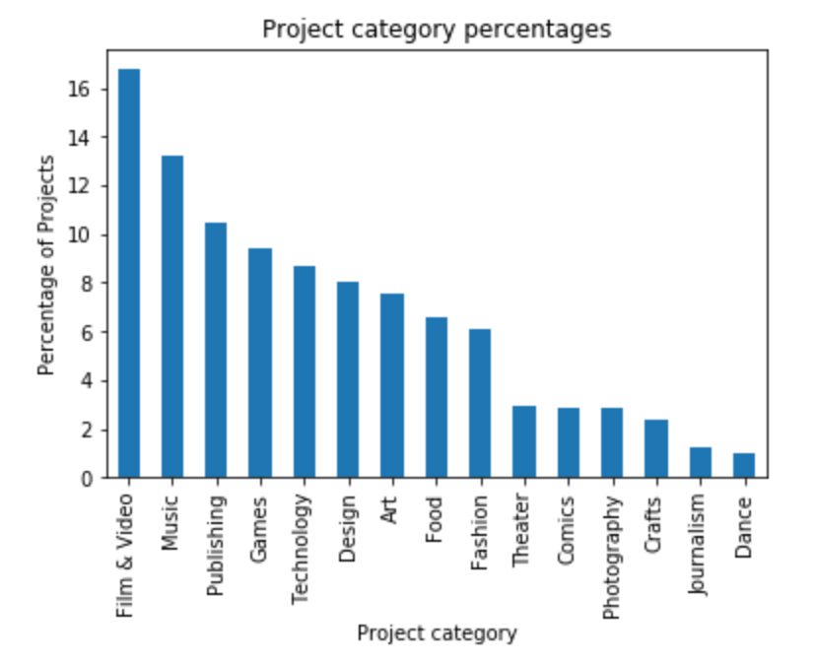
The distribution of project types overall

Slide 6
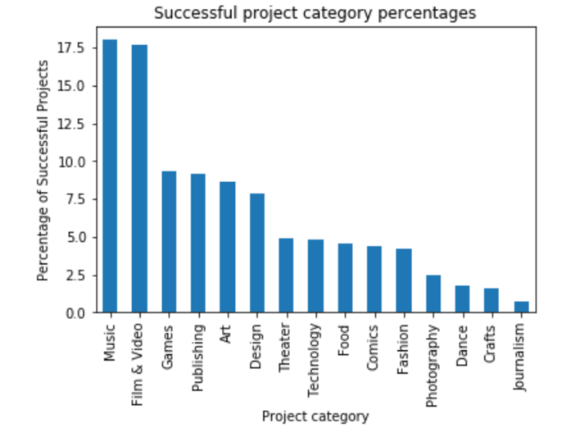
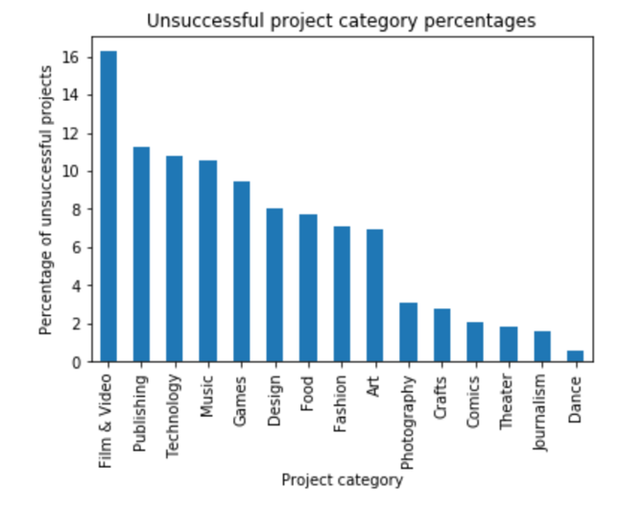
The distribution of project categories among successful and failed projects

Slide 7
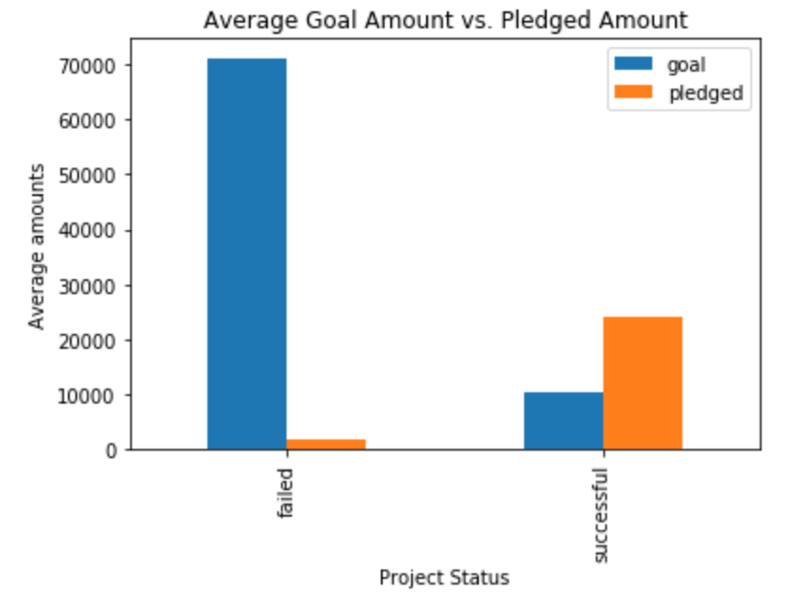
Average funding targets vs. average amounts pledged to the projects

Slide 8
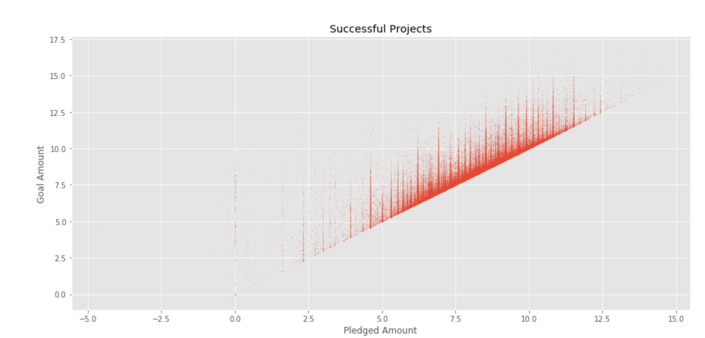
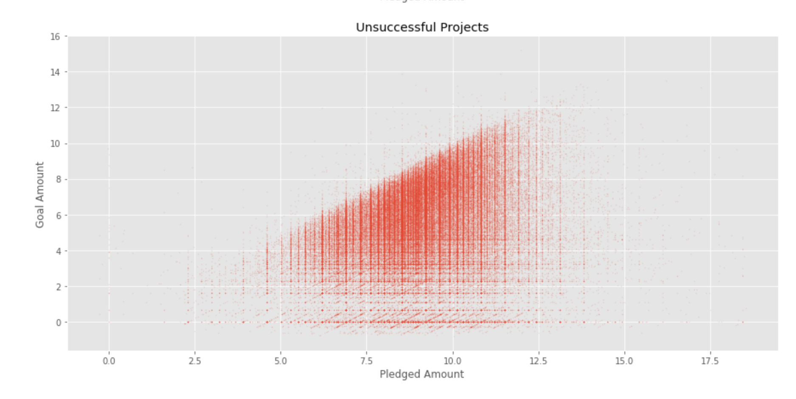
Pledged Amount Vs.
Goal Amount for
Successful Projects
Pledged Amount Vs.
Goal Amount for
Unsuccessful Projects

Slide 9
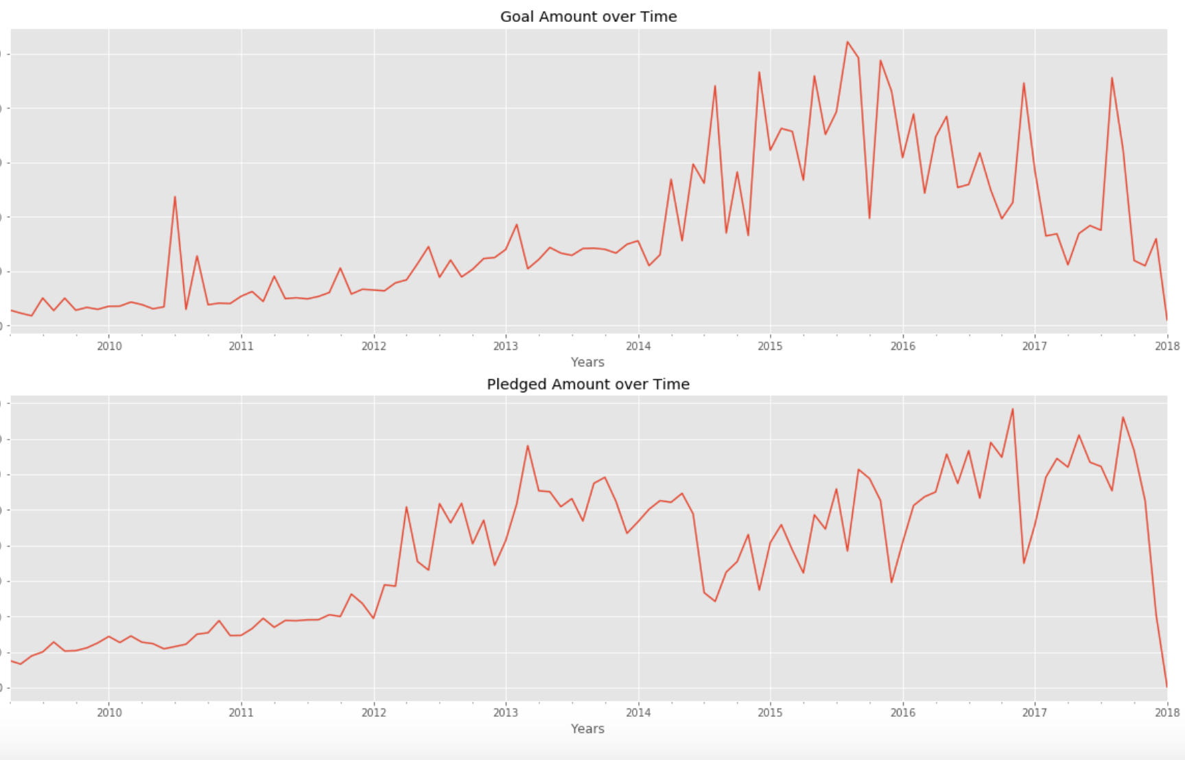
Goal Amount and Pledged Amount over Time from 2009-2018

Slide 10
Permutation tests for numerical data
For each column individually, success and failure were reassigned randomly to the data.
This was performed 1000 times and the difference of means between the reassigned successful and failed projects was taken in each instance.
The means were plotted, forming a normal distribution around 0.
This distribution was compared with the observed difference of means from the original data.

Slide 11
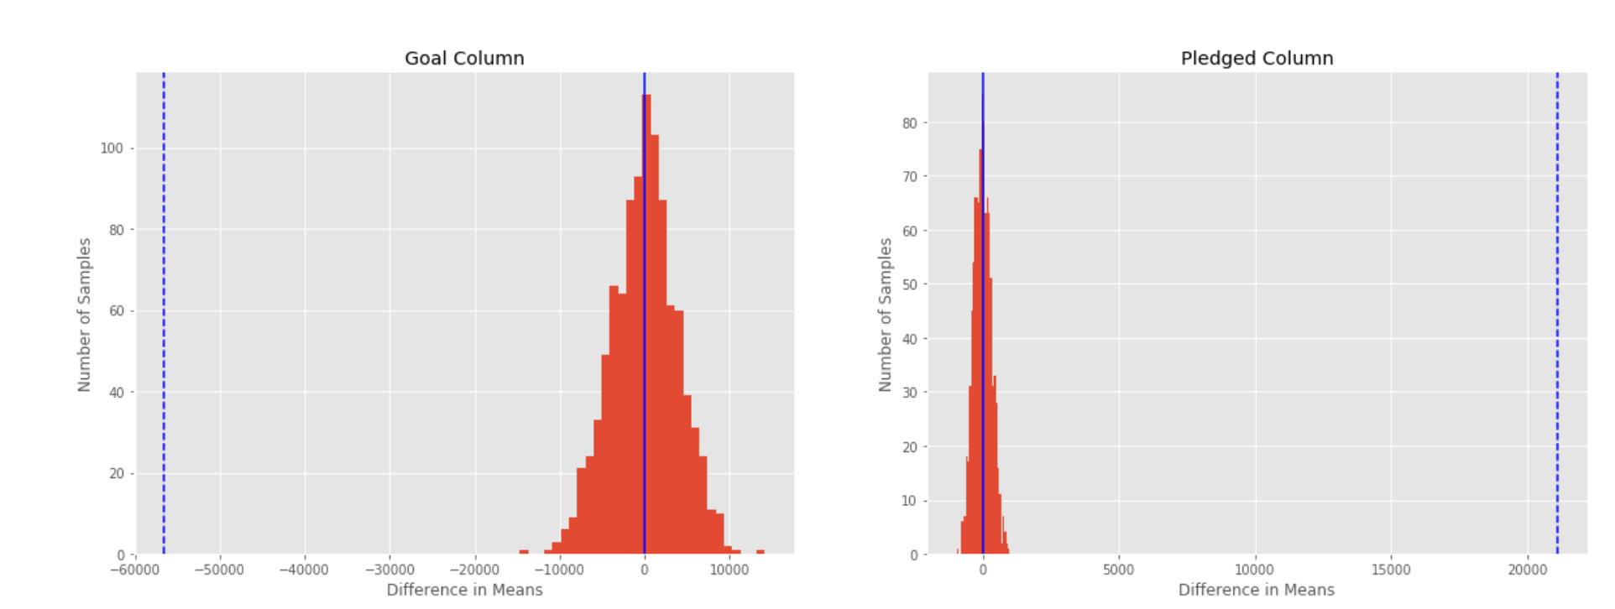
Difference of Means for Observed Data vs. Difference of Means for Permuted Replicates
Red Histogram: the distribution of differences of mean from the permuted samples
Dotted Blue Line: the observed difference of mean

Slide 12
Predicting Kickstarter Project Outcomes
Classification of Data with a Decision Tree Model
Tested model with default parameters
Tested model with tuned hyperparameters
Max_depth: controls how far the tree splits
min_samples_leaf: determines the minimum number of samples required in each leaf node
min_samples_split: controls the minimum number of samples required in a node for a split to occur.
Decision Tree Model | Train Data | Test Data
Default Parameters | 99.99% (overfit!) | 89.68%
Tuned Hyperparameters | 92.88% | 92.47%

Slide 13
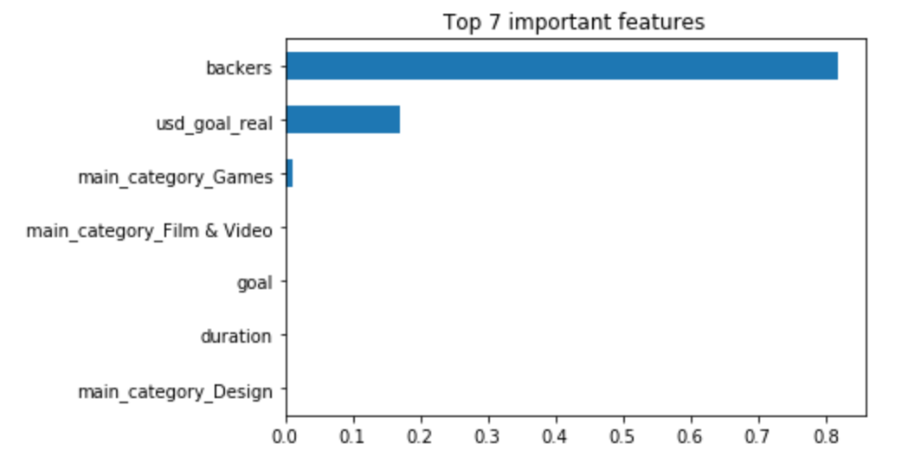
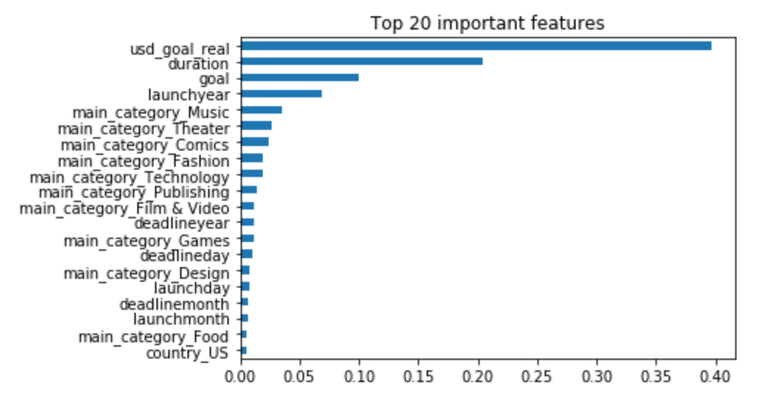
Top Feature Importances
Backers is by far the most important column
If backers is removed, predictive power suffers, but other features become more important when making splitting decisions

