Slide 1
PowerEnJoy RASD presentation
Riccardo Cattaneo 873647
Fabio Chiusano 874294

Slide 2
Roadmap
Text assumptions
Goals, Domain properties, Requirements
Proposed system
Actors and sequence diagram
Alloy
Future Development
Notes:
This is our roadmap.
We will give an overview of our Alloy model and show some possible future improvements of our system.

Slide 3
Roadmap
Text assumptions
Goals, Domain properties, Requirements
Proposed system
Actors and sequence diagram
Alloy
Future Development
Notes:
Let’s start with text assumptions. This is necessary because the specification document that the customers gave us can be ambiguous or incomplete and, since our document must be unambiguous and complete, some assumptions are necessary. In the reality, we would have called our customers in order to set a meeting to decide which assumption is ok or not, so there would have been an iterative process of redefinition of this document where the developers (or the people in charge) work together with the customers.

Slide 4
Text assumptions
It is only possible to reserve a car for the current time and the reservation expires after one hour if the user doesn’t pickup the car in time;
It is said that “The system stops charging the user as soon as the car is parked in a safe area and the user exits the car”. Since “the user exits the car” is ambiguous, we assumed that this is true when the user is not near the car anymore, namely when the distance between user and car is bigger than a certain amount:
The payment for a ride is carried out when the user exits the car;
If the user gets close to the car he rented and the car unlocks itself, then the car should be also able to lock itself if the user distances himself;
The discount for having at least two other passengers into the car is applied only if those passengers are in the car before the engine ignites.
Notes:
We found more assumptions then these but now we have the time to discuss just few of them.
READ FIRST ASSUMPTION. The fact that it’s only possible to reserve a car for the current time is not specified in the specification document. Consider the case where a user reserves a car for this evening at 8pm. One possible solution may be to mark the car as not available from now to this evening, but that would imply a big waste in terms of car availability. Since a company of electrical car-sharing has probably an intrinsic hate for waste of resources, we opted for another solution where the user can only reserve a car for the current time.
Next assumption. READ SECOND ASSUMPTION WITHOUT SUB_LIST. Since now we know what “the user exits the car” means in a not ambiguous way, we can say that READ SUB_LIST. In the second point, the car would have only unlocked itself without closing the reservation because the user haven’t ignited its engine.
Next assumption. READ THIRD ASSUMPTION, which doesn’t further explanation.

Slide 5
Roadmap
Text assumptions
Goals, Domain properties, Requirements
Proposed system
Actors and sequence diagram
Alloy
Future Development
Notes:
Now we analyze the domain of the application in order to extract some requirements that, together with the domain properties, fulfill the goals of our customers. In order to do a good job, we also need to make sure that the goals capture all the stakeholders needs and that domain properties are valid assumptions.

Slide 6
Goals
Users can see and select an available car close to them, or close to a specified address, and reserve it for up to one hour before they pick it up;
Users can get in a car only if they are near it and they have reserved it;
Users should pay proportionally to minutes they have used the car, and they should see in real time the amount of the bill;
Users can register to the system and have their personal area;
Virtuous behaviours by users should be incentivized.
Notes:
Here are the goals.
READ ALL GOALS.
This last goal comprehends all the discounts or extra charges applied to users that had particular behaviours.

Slide 7
Domain properties (1)
All the users have a device connected to the Internet, possibly with GPS built in;
All the electric cars have an on-board computer that allows execution of Java software;
All the electric cars have GPS, a sensor for every seat which detect the presence of a passenger, and Internet connection:
We assume that these devices always work;
Notes:
Those are some of the domain assumptions we made.
READ FIRST. GPS on the user device in our proposed system is optional. Therefore there will be a text input in which specify the location.
READ SECOND. Electric cars run software because they should tell the servers all the information that their sensors gathered, for example if the car is plugged in a power grid or the number of passengers.
READ THIRD.

Slide 8
Domain properties (2)
In a special parking area with power grid stations there is always space for a car to be plugged in;
Power grid maintenance is always ok.
Users behave politely and have no intention of cheating;
The company never reach the limit of requests per day for the external services.
Notes:
READ FIRST.
READ SECOND.
READ THIRD.

Slide 9
Requirements (1)
GOAL 1:
Users can see and select an available car close to him, or close to a specified address, and reserve it for up to one hour before they pick it up.
REQUIREMENTS:
The system has to detect if a car is parked in a Safe Area;
The system has to detect the battery level of each car;
The system has to detect car position and display it on a map;
The system has to be able to identify the location of a user or through his/her GPS, if he/she gives the consent, or through some input;
The system has to provide a list of available cars close to a given address;
The system has to give the possibility to reserve a car at most by one user at a time;
The system has to mark the reservation as expired for a car after one hour if the user has not picked it up;
The system has to apply a fee of 1€ if the reservation has expired;
Notes:
Let’s see now, for some goals, the requirements that we need.
READ GOAL
Requirements.
READ REQ 1, 2. This is because the system must know if the user has parked the car in an appropriate place and its battery level to know if some discounts or extra charges must be applied.
READ REQ 3. Because the user must be able to see where the car is in order to decide to reserve it or not.
READ REQ 4, 5, 6, 7, 8.

Slide 10
Requirements (2)
GOAL 2:
Users could get in a car only if they are near it and they reserved it.
REQUIREMENTS:
The system has to be able to identify the location of the user and of the car;
The system has to unlock the car if the distance between the position of the user and the position of the car is smaller than a certain amount;
Notes:
Let’s see another goal with its requirements.
READ GOAL.
READ REQ 1, 2.

Slide 11
Roadmap
Text assumptions
Goals, Domain properties, Requirements
Proposed system
Actors and sequence diagram
Alloy
Future Development
Notes:
Now we will give a not formal overview of a system that we think it can satisfy all the requirements that we found in the previous step. A formal view of such system will be in the Software Design Document.

Slide 12
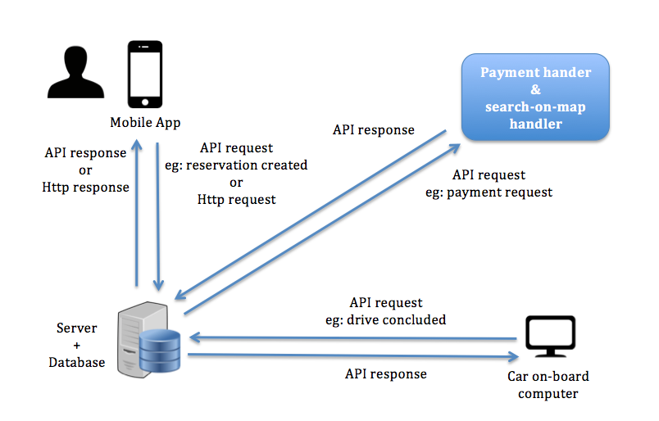
Proposed system
Notes:
We propose to make a web app that will give users a comfortable way to use our service. Since the user have to pick up the reserved car in only one hour since the moment of the reservation, we considered the PowerEnjoy service as an “on the fly” service and therefore we preferred the web app instead of the web site. However, we will take the necessary precautions to make it easy to build the web site in the future.
The web app will be available to all the major mobile operating systems and will be developed in a way to communicate with the PowerEnjoy servers through API and Http requests, consequently the front-end will lie on the server. This decision brings to a trade-off between the app performance and the overall flexibility of the system in terms of UI and functional requirements. At the beginning there will be only a server for everyone.
The database will stay on the same machine of the web server at the moment, but nothing will compromise the possibility to move it on another machine in the future.
Of course, the electric cars must be able to communicate with the server, so they must be provided with an Internet connection and an on-board computer that must be able to run Java software. However, the car is only an agent in our system and therefore all the business logic will lie on the server.

Slide 13
Roadmap
Text assumptions
Goals, Domain properties, Requirements
Proposed system
Actors and sequence diagram
Alloy
Future Development
Notes:
READ

Slide 14
Actors and sequence diagram: actors
User: a person that has already registered and so has provided his personal information and payment method.
Guest: a person that has not registered and can only perform basic functionalities such as looking for where safe areas are.
Payment handler: an external service that helps our system with all tasks related to the payments;
Search-on-map handler: an external service that helps our system with all tasks related to the use of maps;
Notes:
READ

Slide 15
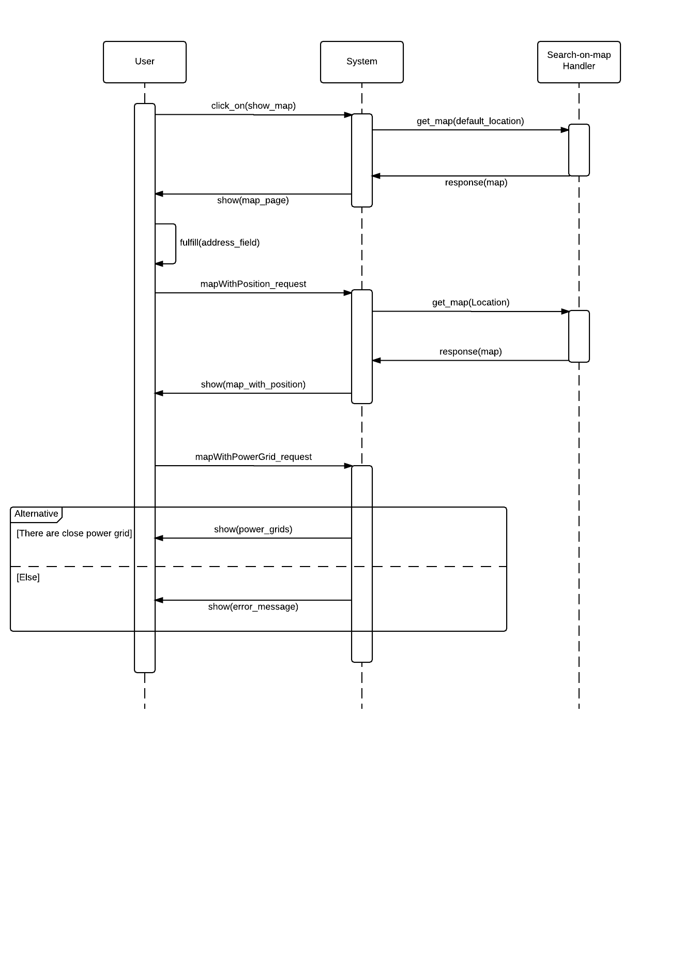
Actors and sequence diagram: Show Special Safe Areas (1)

Slide 16
Actors and sequence diagram: Show Special Safe Areas (2)

Slide 17
Roadmap
Text assumptions
Goals, Domain properties, Requirements
Proposed system
Actors and sequence diagram
Alloy
Future Development

Slide 18


Slide 19
Alloy: signatures (1)
sig User {
credential: Credential,
payment_info: Payment_Info,
location: Location
}
sig Credential {}
sig Payment_Info {}

Slide 20
Alloy: signatures (2)
sig Car {
id: Int,
available: Bool,
location: Location,
unlocked: Bool,
battery_level: Int
} {
id>0
battery_level >= 0
battery_level <= 10
}

Slide 21
Alloy: signatures (3)
sig Reservation {
user: User,
car: Car,
start_area: Safe_Area,
start_time: Time,
current_cost: Int,
final_discharged_cost: lone Int,
expired: Bool,
ride: lone Ride
} {
current_cost >= 0
final_discharged_cost >= 0
}

Slide 22
Alloy: signatures (4)
sig Ride {
reservation: Reservation,
passengers: Int,
pickup_time: Time,
release_time: lone Time,
release_battery_level: lone Int,
release_area: lone Safe_Area,
release_plugged: lone Bool
} {
passengers >= 1
passengers <= 4
release_battery_level >= 0
release_battery_level <= 10
not areEqual[pickup_time, release_time]
}

Slide 23
Alloy: signatures (5)
sig Time {
hour: Int,
minute: Int
} {
hour >= 0
hour =< 23
minute >= 0
minute =< 59
}
sig CurrentTime extends Time {}

Slide 24
Alloy: signatures (6)
sig Location {
latitude: Int,
longitude: Int
}
sig Area {
center: Location,
radius: Int
}
sig Safe_Area extends Area {}
sig Special_Safe_Area extends Safe_Area {}

Slide 25
Alloy: facts (1)
There can't be two reservations r1 and r2 for the same car overlapping.
fact carsCanBeReservedByOneUserAtOnce {
all c: Car | (
all r, r': Reservation | (
(r.car = c and r'.car = c and r != r’ and comesAfterOrEqual[r'.start_time, r.start_time])
implies (
(some r.ride and some r.ride.release_time and comesAfterOrEqual[r'.start_time, r.ride.release_time])
or
(r.expired = True and
not isLessThanOneHourAhead[r'.start_time, r.start_time])
)
)
)
}

Slide 26
Alloy: facts (2)
A car is available if it has no active reservations
fact carAvailableCondition {
all c: Car |
c.available = True
iff(
(no res: Reservation |
res.car = c and isActive[res])
)
}
pred isActive[r: Reservation] {
r.expired = False and (
no r.ride
or
no r.ride.release_time
)
}

Slide 27
Alloy: facts (3)
A car can be released plugged only if it is released in a Special Safe Area;
A reservation is expired if there is not a ride whose pickup_time is less than one hour after the reservation start_time;
The pickup time of a ride should be in one hour from its reservation start_time;
release_time is always after pickup_time ;

Slide 28
Alloy: facts (4)
There’s only a current time, that is after all the times in the model;
A car is unlocked if exists an active reservation for it whose user is near the car;
If a Reservation is expired without the user picked up the car, he/she has to pay a fee of 10;
The actual cost of a reservation not expired is proportional to minutes spent in the car;
The final discharged cost corresponds to the final current cost with a discount or an extra fee;
…

Slide 29
Alloy: assertions
If a car is available, then it’s locked;
If a car is unlocked, then it’s not available;
If a reservation is expired, then it has no ride;
If a reservation is active, then the car reserved is not available and there aren’t other active reservations for that car.

Slide 30
Alloy: worlds generated
At least:
one car locked;
one car unlocked.
At least:
one car available;
one car not available.
At least:
One expired reservation;
One active reservation;
One reservation both not active and not expired.

Slide 31
Roadmap
Text assumptions
Goals, Domain properties, Requirements
Proposed system
Actors and sequence diagram
Alloy
Future Development

Slide 32
Future development
Remove the assumption “In a special parking area with power grid stations there is always space for a car to be plugged in”;
Add a web site (create desktop front-end with the help of the mobile front-end);
Accident management;
Push notifications or SMS for reservation timer alerts;
Different type of cars and different fees for them;
Share car reservation info with friends by email, SMS or Whatsapp.

Slide 33
The end. Thanks for your attetion.

