Slide 1
PowerEnJoy RASD presentation
Riccardo Cattaneo 873647
Fabio Chiusano 874294

Slide 2
Roadmap
Text assumptions
Goals, Domain properties, Requirements
Proposed system
Actors and sequence diagram
Alloy
Future Development
Notes:
This is our roadmap, so we will discuss briefly about these points. We will show you just an overview of our RASD document because of the little time we have

Slide 3
Roadmap
Text assumptions
Goals, Domain properties, Requirements
Proposed system
Actors and sequence diagram
Alloy
Future Development
Notes:
Let’s start with text assumptions. This is necessary because the specification document that the customers gave us can be ambiguous or incomplete. In the reality, we would have created the document with an iterative process, involving customers in order to achieve a document approved by everyone, without text assumptions of course.

Slide 4
Text assumptions
It is only possible to reserve a car for the current time and the reservation expires after one hour if the user doesn’t pickup the car in time;
It is said that “The system stops charging the user as soon as the car is parked in a safe area and the user exits the car”. Since “the user exits the car” is ambiguous, we assumed that this is true when the user is not near the car anymore, namely when the distance between user and car is bigger than a certain amount:
The payment for a ride is carried out when the user exits the car;
If the user gets close to the car he rented and the car unlocks itself, then the car should be also able to lock itself if the user distances himself;
The discount for having at least two other passengers into the car is applied only if those passengers are in the car before the engine ignites.
Notes:
The first assumption we took is about when the reservation of a car starts. Consider the case where a user reserves a car for this evening at 8pm. The problem is that we don’t know when a user will leave the car. One possible solution may be to mark the car as not available from now to this evening, but that would imply a big waste in terms of car availability. Therefore we opted for another solution where the user can only reserve a car whose “pickup timer” starts immediately.
Another assumption we took is about when the system stops charging the user for a ride. It is said in the spec doc that that “The system stops charging the user as soon as the car is parked in a safe area and the user exits the car”. However, since “the user exits the car” is ambiguous, we assumed that it’s true when the user isn’t near the car anymore, that is when the distance between the user and the car is bigger than a certain amount. Since now we know what “the user exits the car” means in a not ambiguous way, we can also assume that, for example, READ SUB_LIST[0].
Another assumption is READ THIRD ASSUMPTION, which doesn’t need further explanation.

Slide 5
Roadmap
Text assumptions
Goals, Domain properties, Requirements
Proposed system
Actors and sequence diagram
Alloy
Future Development
Notes:
We did our best in order to extract some requirements that, together with the domain properties, fulfill the goals of our customers. In order to do a good job, we also need to make sure that the goals capture all the stakeholders needs and that domain properties are valid assumptions.

Slide 6
Goals
Users can see and select an available car close to them, or close to a specified address, and reserve it for up to one hour before they pick it up;
Users can get in a car only if they are near it and they have reserved it;
Users should pay proportionally to minutes they have used the car, and they should see in real time the amount of the bill;
Users can register to the system and have their personal area;
Virtuous behaviours by users should be incentivized.
Notes:
These are all our goals. We didn’t go into details and we wrote them remaining at a high level of abstraction.
Fro example, READ GOALS 1, 2.
The last one, READ LAST GOAL, comprehends all the discounts or extra charges applied to users that behave in particular ways.

Slide 7
Domain properties (1)
All the users have a device connected to the Internet, possibly with GPS built in;
All the electric cars have an on-board computer that allows execution of Java software;
All the electric cars have GPS, a sensor for every seat which detect the presence of a passenger, and Internet connection:
We assume that these devices always work;
Notes:
As examples of domain properties, we have some about devices. We assumed that all the users have a device connected to the internet, possibly – but not necessarily- with GPS built in. We also supposed that all the cars have a system able to run Java software, and have GPS, internet connection and other sensors (for example to detect the presence of passengers).

Slide 8
Domain properties (2)
Power grid maintenance is always ok.
Users behave politely and have no intention of cheating;
The company never reaches the limit of requests per day for the external services.
Notes:
READ FIRST.
READ SECOND.
READ THIRD.

Slide 9
Requirements (1)
GOAL 1:
Users can see and select an available car close to them, or close to a specified address, and reserve it for up to one hour before they pick it up.
REQUIREMENTS:
The system has to detect if a car is parked in a Safe Area and its battery level;
The system has to detect car position and display it on a map;
The system has to be able to identify the location of a user or through his/her GPS, if he/she gives the consent, or through some input;
The system has to provide a list of available cars close to a given address;
The system has to give the possibility to reserve a car at most by one user at a time;
The system has to mark the reservation as expired for a car after one hour if the user has not picked it up;
The system has to apply a fee of 1€ if the reservation has expired;
Notes:
Starting from high level goals, we have deduced detailed requirements. For example, starting from the first goal we mentioned before, that is …, the requirements are...
READ REQ 1, 2. We need those two because the user must be able to see where the car is in order to decide to reserve it or not.
READ REQ 3, 4, 5, 6, 7.

Slide 10
Requirements (2)
GOAL 2:
Users can get in a car only if they are near it and they reserved it.
REQUIREMENTS:
The system has to be able to identify the location of the user and of the car;
The system has to unlock the car if the distance between the position of the user and the position of the car is smaller than a certain amount;
Notes:
Let’s see another goal with its requirements.
READ GOAL.
READ REQ 1, 2.

Slide 11
Roadmap
Text assumptions
Goals, Domain properties, Requirements
Proposed system
Actors and sequence diagram
Alloy
Future Development
Notes:
Now we are going to see a not formal, high level view of a possible system that could satisfy those requirements we have seen before. A formal view of such system will be in the Software Design Document.

Slide 12
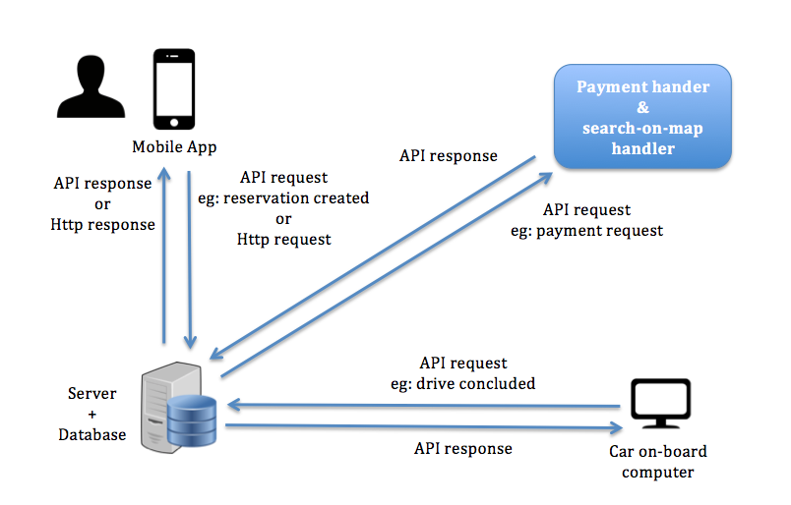
Proposed system
Notes:
We have decided that our system will be initially implemented only as a web-app. Since the user has to pick up the reserved car in only one hour since the moment of the reservation, we considered the PowerEnjoy service as an “on the fly” service and therefore we preferred the web app instead of the web site. However, we will take the necessary precautions to make it easy to build the web site in the future.
The web app, whose front-end will lie on the server, will be available to all the major mobile operating systems. This decision brings to a trade-off between the app performance and the overall flexibility of the system in terms of UI and functional requirements.
The database will stay on the same machine of the web server at the moment, but nothing will compromise the possibility to move it on another machine when we’ll need it.
Of course, the electric cars must be able to communicate with the server, so they must be provided with an Internet connection and an on-board computer. However, all the business logic will lie on the server, so there will be only some API calls.

Slide 13
Roadmap
Text assumptions
Goals, Domain properties, Requirements
Proposed system
Actors and sequence diagram
Alloy
Future Development
Notes:
READ

Slide 14
Actors and sequence diagram: actors
User: a person that has already registered and so has provided his personal information and payment method.
Guest: a person that has not registered and can only perform basic functionalities such as looking for where safe areas are.
Payment handler: an external service that helps our system with all tasks related to the payments;
Search-on-map handler: an external service that helps our system with all tasks related to the use of maps;
Notes:
READ

Slide 15
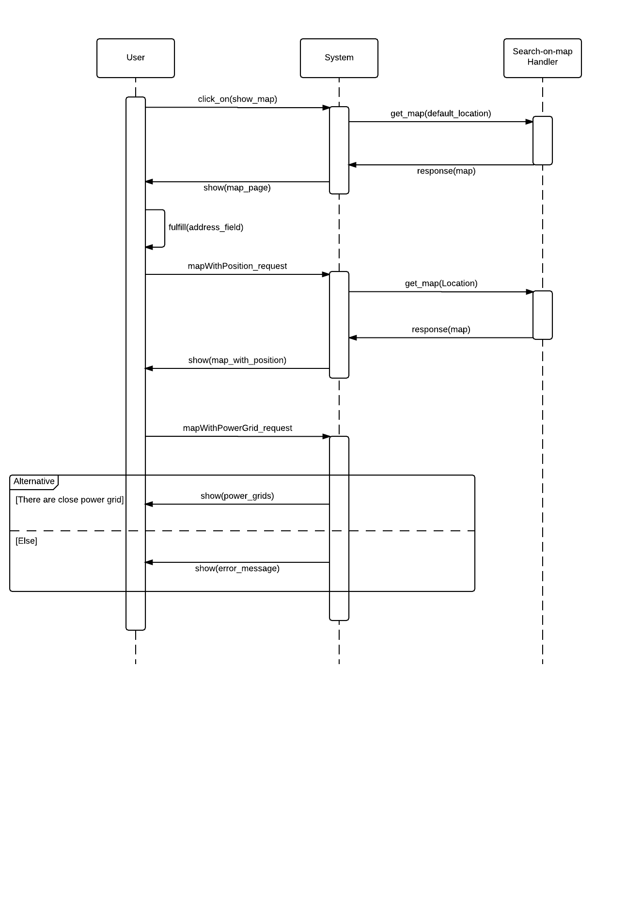
Actors and sequence diagram: Show Special Safe Areas (1)
Notes:
This is a sequence diagram that shows the steps with which the user can see the special safe areas.
The user send a request for the map to our server, which in turn asks an external actor, for example Google Maps, information about the map with a standard position (or its position if GPS is enabled).
Then the user asks the server for a specific map with a certain position, which replies again with the help of the external actor, and finally specify that he/she wants to know where the Special Safe Areas are.

Slide 16
Actors and sequence diagram: Show Special Safe Areas (2)
Notes:
This last step is done without the need of the external actor because information relative to the parking positions is known by our server only. Our app will manage this data and show the parking positions to the user accordingly.

Slide 17
Roadmap
Text assumptions
Goals, Domain properties, Requirements
Proposed system
Actors and sequence diagram
Alloy
Future Development

Slide 18


Slide 19
Alloy: signatures (1)
sig User {
credential: Credential,
payment_info: Payment_Info,
location: Location
}
sig Credential {}
sig Payment_Info {}
Notes:
We begin with signatures!
We have the User, which have credentials (by credentials we mean everything that someone needs in order to authenticate to the system).
There is the payment info and then its current Location, that we’ll see later. If GPS is enabled, than this location would be used to specify to the system if the user is near a car. If it’s not enabled, the user can send its position through some input.

Slide 20
Alloy: signatures (2)
sig Car {
id: Int,
available: Bool,
location: Location,
unlocked: Bool,
battery_level: Int
} {
id>0
battery_level >= 0
battery_level <= 10
}

Slide 21
Alloy: signatures (3)
sig Reservation {
user: User,
car: Car,
start_area: Safe_Area,
start_time: Time,
current_cost: Int,
final_discharged_cost: lone Int,
expired: Bool,
ride: lone Ride
} {
current_cost >= 0
final_discharged_cost >= 0
}

Slide 22
Alloy: signatures (4)
sig Ride {
reservation: Reservation,
passengers: Int,
pickup_time: Time,
release_time: lone Time,
release_battery_level: lone Int,
release_area: lone Safe_Area,
release_plugged: lone Bool
} {
passengers >= 1
passengers <= 4
release_battery_level >= 0
release_battery_level <= 10
not areEqual[pickup_time, release_time]
}

Slide 23
Alloy: signatures (5)
sig Time {
hour: Int,
minute: Int
} {
hour >= 0
hour =< 23
minute >= 0
minute =< 59
}
sig CurrentTime extends Time {}

Slide 24
Alloy: signatures (6)
sig Location {
latitude: Int,
longitude: Int
}
sig Area {
center: Location,
radius: Int
}
sig Safe_Area extends Area {}
sig Special_Safe_Area extends Safe_Area {}

Slide 25
Alloy: facts (1)
There can't be two reservations r and r’ for the same car overlapping.
fact carsCanBeReservedByOneUserAtOnce {
all c: Car | (
all r, r': Reservation | (
(r.car = c and r'.car = c and r != r’ and comesAfterOrEqual[r'.start_time, r.start_time])
implies (
(some r.ride and some r.ride.release_time and comesAfterOrEqual[r'.start_time, r.ride.release_time])
or
(r.expired = True and
not isLessThanOneHourAhead[r'.start_time, r.start_time])
)
)
)
}

Slide 26
Alloy: facts (2)
A car is available if it has no active reservations
fact carAvailableCondition {
all c: Car |
c.available = True
iff(
(no res: Reservation |
res.car = c and isActive[res])
)
}
pred isActive[r: Reservation] {
r.expired = False and (
no r.ride
or
no r.ride.release_time
)
}

Slide 27
Alloy: facts (3)
A car can be released plugged only if it is released in a Special Safe Area;
A reservation is expired if there is not a ride whose pickup_time is less than one hour after the reservation start_time;
The pickup time of a ride should be in one hour from its reservation start_time;
release_time is always after pickup_time ;

Slide 28
Alloy: facts (4)
There’s only a current time, that is after all the times in the model;
A car is unlocked if exists an active reservation for it whose user is near the car;
If a Reservation is expired without the user picked up the car, he/she has to pay a fee of 10;
The actual cost of a reservation not expired is proportional to minutes spent in the car;
The final discharged cost corresponds to the final current cost with a discount or an extra fee;
…

Slide 29
Alloy: assertions
If a car is available, then it’s locked;
If a car is unlocked, then it’s not available;
If a reservation is expired, then it has no ride;
If a reservation is active, then the car reserved is not available and there aren’t other active reservations for that car.

Slide 30
Alloy: worlds generated
At least:
one car locked;
one car unlocked.
At least:
one car available;
one car not available.
At least:
One expired reservation;
One active reservation;
One reservation both not active and not expired.

Slide 31
Roadmap
Text assumptions
Goals, Domain properties, Requirements
Proposed system
Actors and sequence diagram
Alloy
Future Development

Slide 32
Future development
Remove the assumption “In a special parking area with power grid stations there is always space for a car to be plugged in”;
Accident management;
Add a web site (create desktop front-end with the help of the mobile front-end);
Different type of cars and different fees for them;
Push notifications or SMS for reservation timer alerts;
Share car reservation info with friends by email, SMS or Whatsapp.

Slide 33
The end. Thanks for your attetion.

