Slide 1
PowerEnJoy RASD presentation
Riccardo Cattaneo 873647
Fabio Chiusano 874294

Slide 2
Roadmap
Text assumptions
Goals, Domain properties, Requirements
Proposed system
Actors and use case diagram
Alloy
Future Development

Slide 3
Roadmap
Text assumptions
Goals, Domain properties, Requirements
Proposed system
Actors and use case diagram
Alloy
Future Development

Slide 4
Text assumptions
It is only possible to reserve a car from the current time and the reservation expires after one hour if the user doesn’t pickup the car in time;
It is said that “The system stops charging the user as soon as the car is parked in a safe area and the user exits the car”. Since “the user exits the car” is ambiguous, we assumed that this is true when the user is not near the car anymore, namely when the distance between user and car is bigger than a certain amount:
The payment for a ride is carried out when the user exits the car;
If the user gets close to the car he rented and the car unlocks itself, then the car should be also able to lock itself if the user distances himself;
The discount for having at least two other passengers onto the car is applied only if those passengers are in the car before the engine ignites.

Slide 5
Roadmap
Text assumptions
Goals, Domain properties, Requirements
Proposed system
Actors and use case diagram
Alloy
Future Development

Slide 6
Goals
Users can see and select an available car close to them, or close to a specified address, and reserve it for up to one hour before they pick it up;
Users can get in a car only if they are near it and they have reserved it;
Users should pay proportionally to minutes they have used the car, and they should see in real time the amount of the bill;
Users could register to the system and have their personal area;
Virtuous behaviours by users should be incentivized.

Slide 7
Domain properties (1)
All the users have a device connected to the Internet, possibly with a GPS built in;
All the electric cars have an on-board computer that allows execution of Java software;
All the electric cars have a GPS, a sensor for every seat which detect the presence of a passenger, all the electric cars have Internet connection:
We assume that these devices always work;

Slide 8
Domain properties (2)
All the cars can carry a maximum of 4 passengers;
In a special parking area with power grid stations there is always space for a car to be plugged in;
Users behave politely and have no intention of cheating;
The company never reach the limit of requests per day for the external services.

Slide 9
Requirements (1)
GOAL 1:
Users could see and select an available car close to him, or close to a specified address, and reserve it for up to one hour before they pick it up.
REQUIREMENTS:
The system has to detect if a car is parked in a Safe Area and its battery level;
The system has to detect car position and display it on a map;
The system has to be able to identify the location of a user through his/her GPS, if he/she gives the consent;
The system has to provide a list of available cars close to a given address;
The system has to give the possibility to reserve a car at most by one user at a time;
The system has to mark the reservation as expired for a car after one hour if the user has not picked it up;
The system has to apply a fee of 1€ if the reservation has expired;

Slide 10
Requirements (2)
GOAL 2:
Users could get in a car only if they are near it and they reserved it.
REQUIREMENTS:
The system has to be able to identify the location of the user and of the car;
The system has to unlock the car if the position of the user is really close to the one of the car;

Slide 11
Requirements (3, …)
They are too many!
The show must go on!

Slide 12
Roadmap
Text assumptions
Goals, Domain properties, Requirements
Proposed system
Actors and use case diagram
Alloy
Future Development

Slide 13
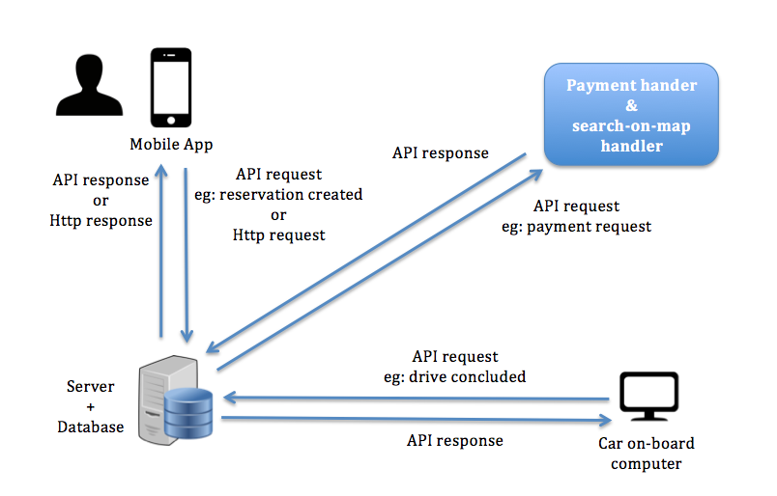
Proposed system

Slide 14
Roadmap
Text assumptions
Goals, Domain properties, Requirements
Proposed system
Actors and sequence diagram
Alloy
Future Development

Slide 15
Actors and use case diagram: actors
User: a person that has already registered and so has provided his personal information and payment method.
Guest: a person that has not registered and can only perform basic functionalities such as looking for where safe areas are.
Payment handler: an external service that helps our system with all tasks related to the payments;
Search-on-map handler: an external service that helps our system with all tasks related to the use of maps;

Slide 16
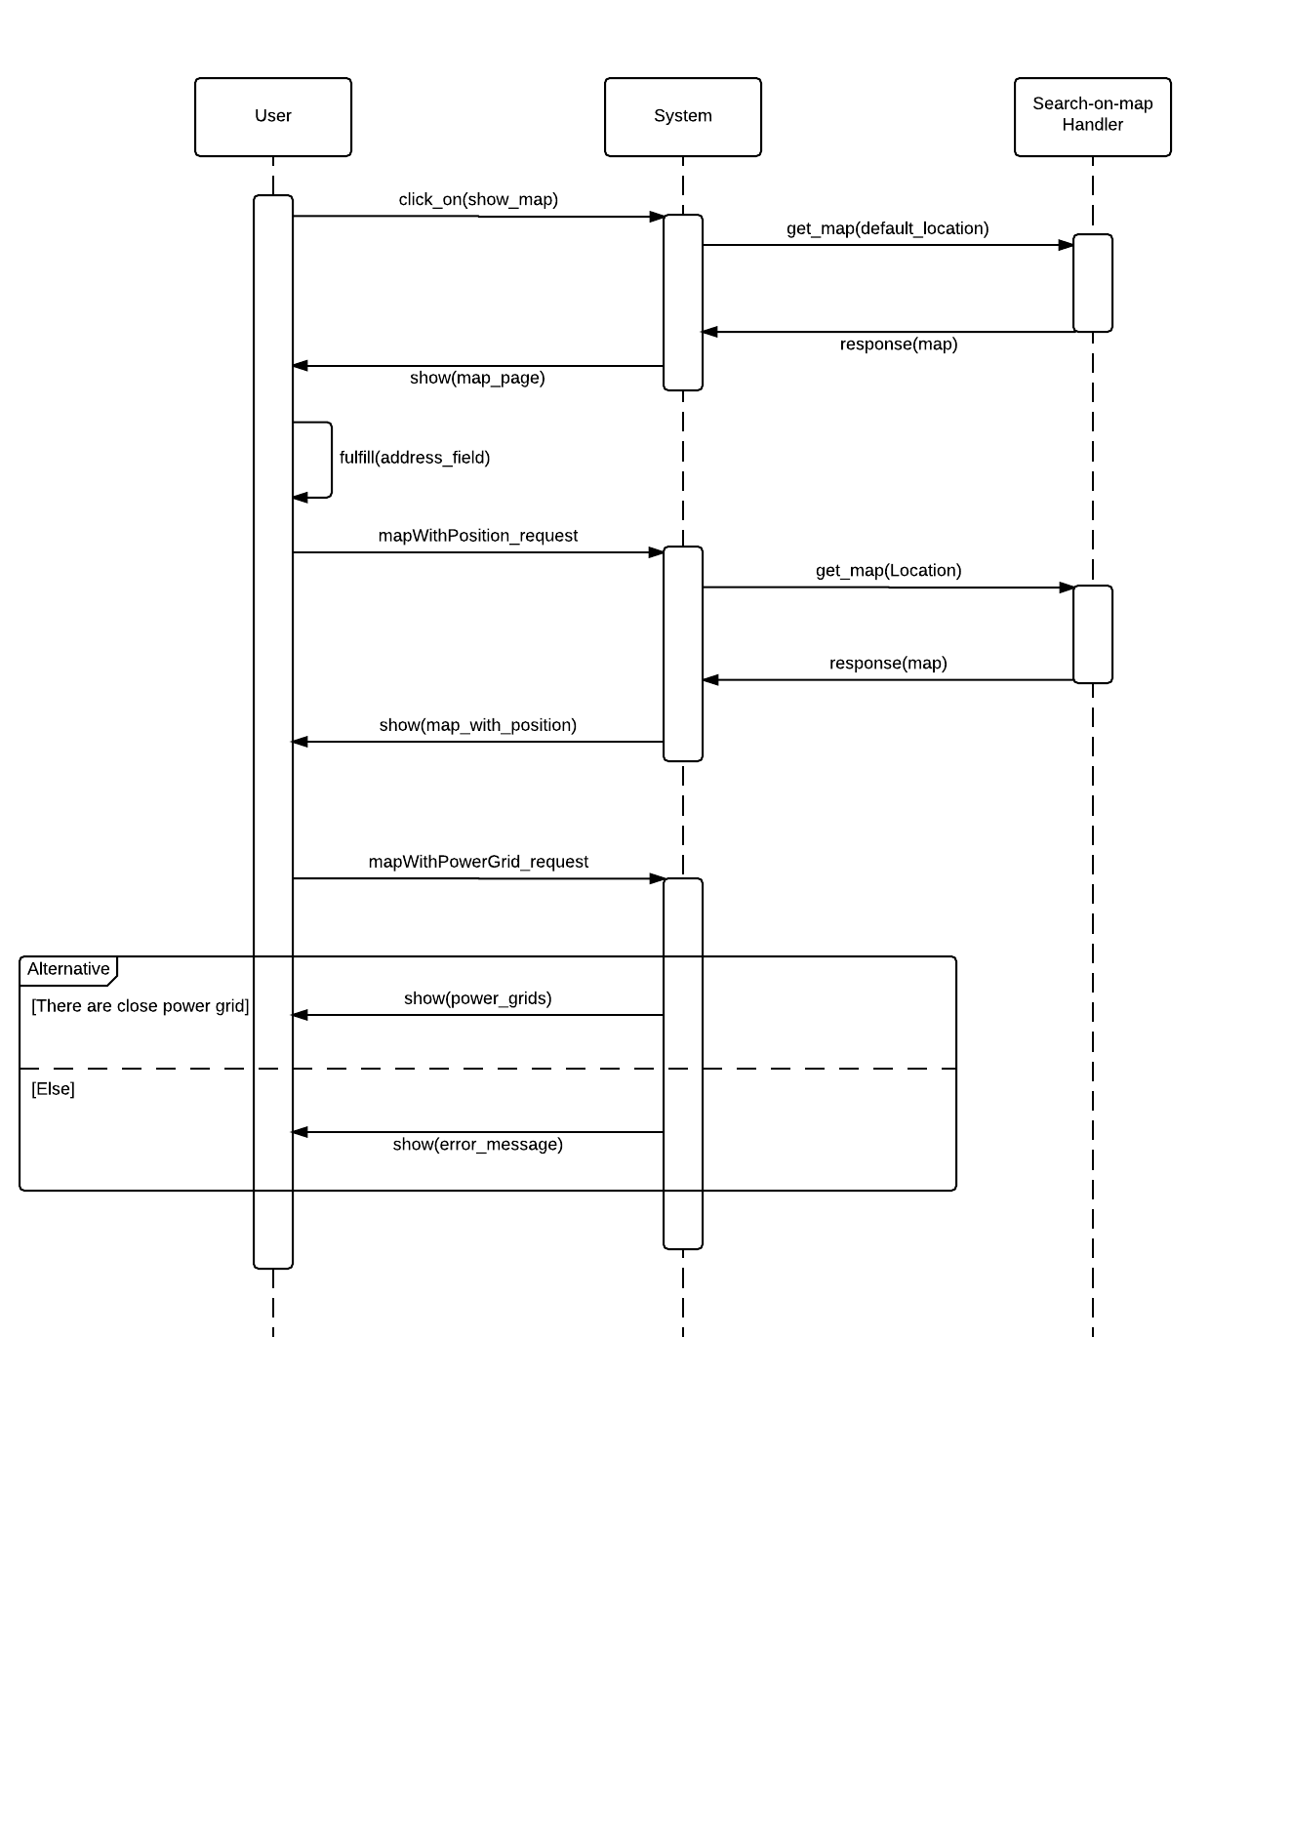
Actors and Sequence Diagram: Show Special Safe Areas(1)

Slide 17
Actors and Sequence Diagram: Show Special Safe Areas(2)

Slide 18
Roadmap
Text assumptions
Goals, Domain properties, Requirements
Proposed system
Actors and use case diagram
Alloy
Future Development

Slide 19


Slide 20


Slide 21
Alloy: signatures (1)
sig User {
credential: Credential,
payment_info: Payment_Info,
location: Location
}
sig Credential {}
sig Payment_Info {}

Slide 22
Alloy: signatures (2)
sig Car {
id: Int,
available: Bool,
location: Location,
unlocked: Bool,
battery_level: Int
} {
id>0
battery_level >= 0
battery_level <= 10
}

Slide 23
Alloy: signatures (3)
sig Reservation {
user: User,
car: Car,
start_area: Safe_Area,
start_time: Time,
current_cost: Int,
final_discharged_cost: lone Int,
expired: Bool,
ride: lone Ride
} {
current_cost >= 0
final_discharged_cost >= 0
}

Slide 24
Alloy: signatures (4)
sig Ride {
reservation: Reservation,
passengers: Int,
pickup_time: Time,
release_time: lone Time,
release_battery_level: lone Int,
release_area: lone Safe_Area,
release_plugged: lone Bool
} {
passengers >= 1
passengers <= 4
release_battery_level >= 0
release_battery_level <= 10
not areEqual[pickup_time, release_time]
}

Slide 25
Alloy: signatures (5)
sig Time {
hour: Int,
minute: Int
} {
hour >= 0
hour =< 23
minute >= 0
minute =< 59
}
sig CurrentTime extends Time {}

Slide 26
Alloy: signatures (6)
sig Location {
latitude: Int,
longitude: Int
}
sig Area {
center: Location,
radius: Int
}
sig Safe_Area extends Area {}
sig Special_Safe_Area extends Safe_Area {}

Slide 27
Alloy: facts (1)
There can't be two reservations r1 and r2 for the same car overlapping.
fact carsCanBeReservedByOneUserAtOnce {
all c: Car | (
all r, r': Reservation | (
(r.car = c and r'.car = c and r != r’ and comesAfterOrEqual[r'.start_time, r.start_time])
implies (
(some r.ride and some r.ride.release_time and comesAfterOrEqual[r'.start_time, r.ride.release_time])
or
(r.expired = True and
not isLessThanOneHourAhead[r'.start_time, r.start_time])
)
)
)
}

Slide 28
Alloy: facts (2)
A car is available if it has no reservations open and has enough battery
fact carAvailableCondition {
all c: Car |
c.available = True
iff(
(no res: Reservation |
res.car = c and isActive[res])
)
}
pred isActive[r: Reservation] {
r.expired = False and (
no r.ride
or
no r.ride.release_time
)
}

Slide 29
Alloy: facts (3)
A car can be released plugged only if it is released in a Special Safe Area;
A reservation is expired if there is not a ride whose pickup_time is less than one hour after the reservation start_time;
The pickup time of a ride should be in one hour from its reservation start_time;
release_time is always after pickup_time ;

Slide 30
Alloy: facts (4)
A car is unlocked if exists an active reservation for it whose user is near the car;
If a Reservation is expired without the user picked up the car, he/she has to pay a fee of 10;
The actual cost of a reservation not expired is proportional to minutes spent in the car;
The final discharged cost corresponds to the final current cost with a discount or an extra fee;
There’s only a current time, that is after all the times in the model;
…

Slide 31
Alloy: assertions
If a car is available, then it’s locked;
If a car is unlocked, then it’s not available;
If a reservation is expired, then it has no ride;
If a reservation is active, then the car reserved is not available and there aren’t other active reservations for that car.

Slide 32
Alloy: worlds generated
At least:
one car locked;
one car unlocked.
At least:
one car available;
one car not available.
At least:
One expired reservation;
One active reservation;
One reservation both not active and not expired.

Slide 33
Roadmap
Text assumptions
Goals, Domain properties, Requirements
Proposed system
Actors and use case diagram
Alloy
Future Development

Slide 34
Future development
Remove the assumption “In a special parking area with power grid stations there is always space for a car to be plugged in”;
Add a web site (create desktop front-end with the help of the mobile front-end);
Accident management;
Push notifications or SMS for reservation timer alerts;
Different type of cars and different fees for them;
Share car reservation info with friends through mail, SMS or Whatsapp.

Slide 35
The end. Thanks for your attetion.

