Slide 1
Single Cell Transcriptomics scRNAseq
Matthew L. Settles
Genome Center Bioinformatics Core
University of California, Davis
settles@ucdavis.edu; bioinformatics.core@ucdavis.edu

Slide 2
Purpose
The sequencing of the transcriptomes of single-cells, or single-cell RNA-sequencing, has now become the dominant technology for the identification of novel cell types and for the study of stochastic gene expression.
Single-cell transcriptomics determines what genes (and in what relative quantity) are being expressed in each cell.
Notes:
stochastic gene expression - Clonal populations of cells exhibit substantial phenotypic variation. Such heterogeneity can be essential for many biological processes and is conjectured to arise from stochasticity, or noise, in gene expression.
Bulk RNAseq – averages that expression

Slide 3
Major reasons to conduct single cell analysis
Bulk RNAseq, where you measure the ’average’ expression of all constituent cells, is sometimes insufficient for some experimental questions.
Gene dynamics - what changes in gene expression effect different cell characteristics, such as during differentiation
RNA splicing – cell to cell variation in alternative splicing
Cell typing - genes expressed in a cell are used to identify types of cells. The main goal in cell typing is to find a way to determine the identity of cells that don't have known genetic markers.
Spatial Transcriptomics – isolation of cells with known spatial location.

Slide 4
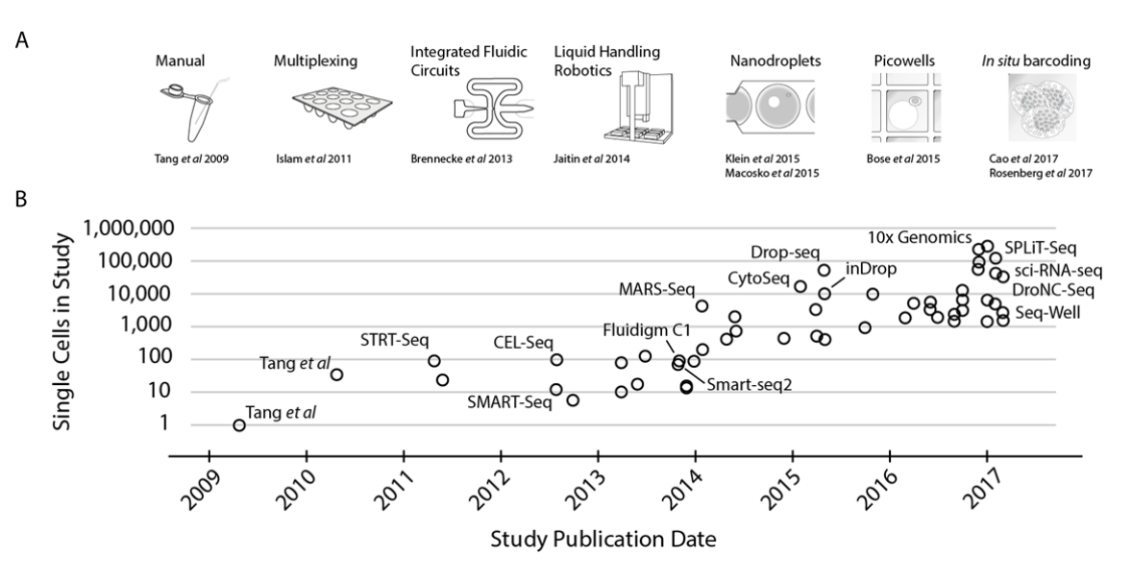
Exponential scaling of single-cell RNAseq in the last decade
https://arxiv.org/abs/1704.01379

Slide 5
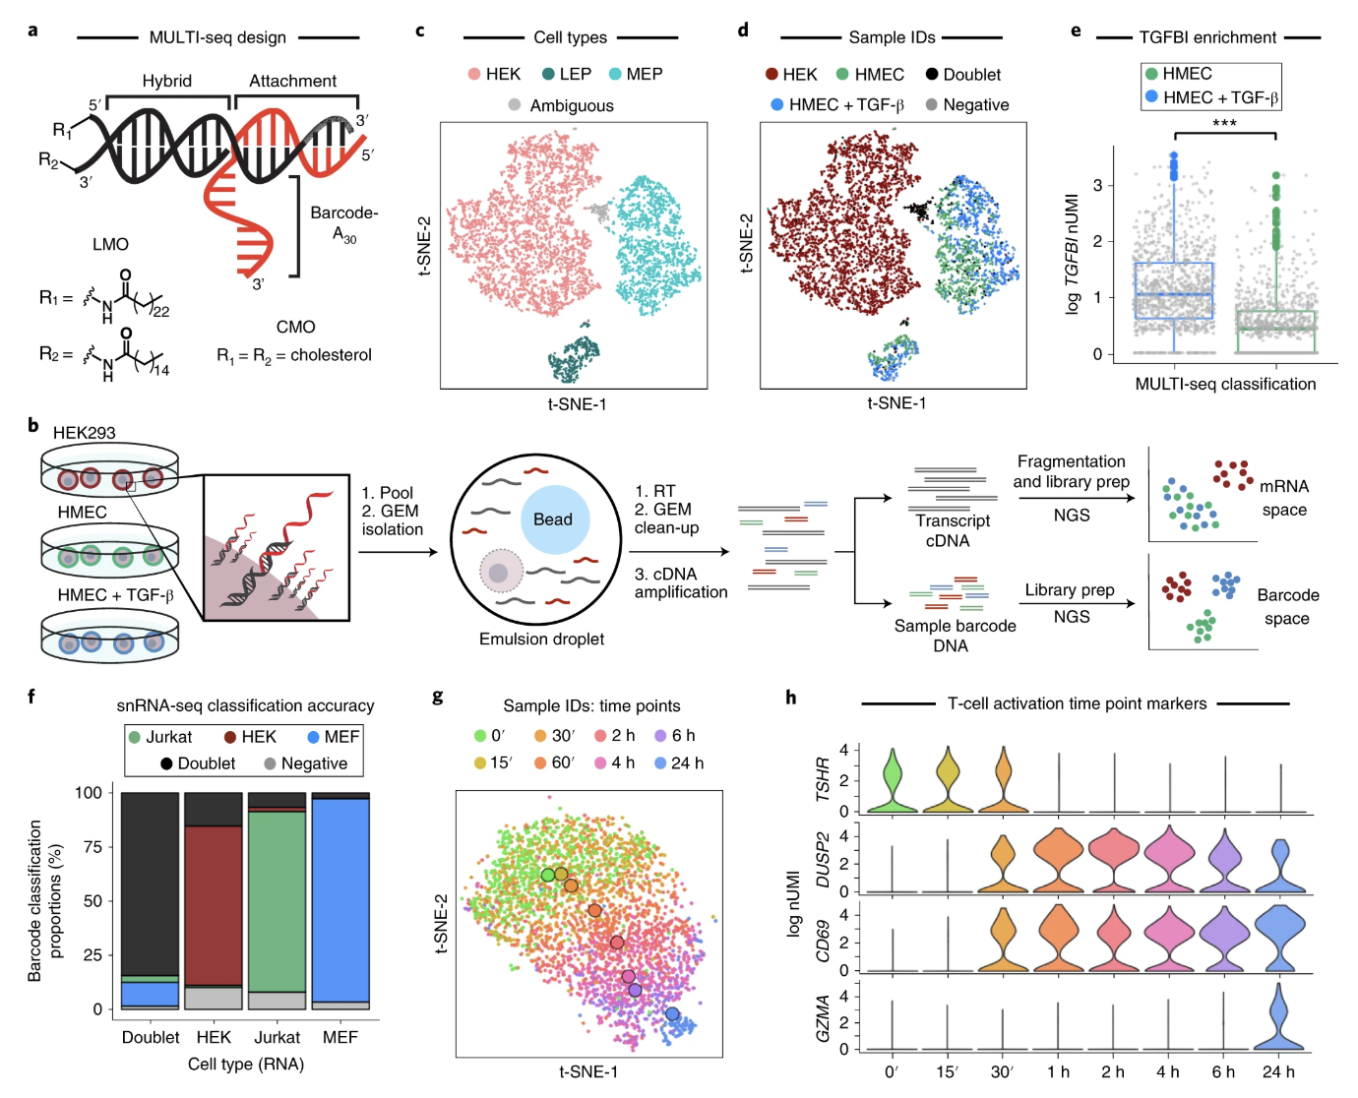
Multiplexing (MULTIseq)
https://www.nature.com/articles/s41592-019-0433-8

Slide 6
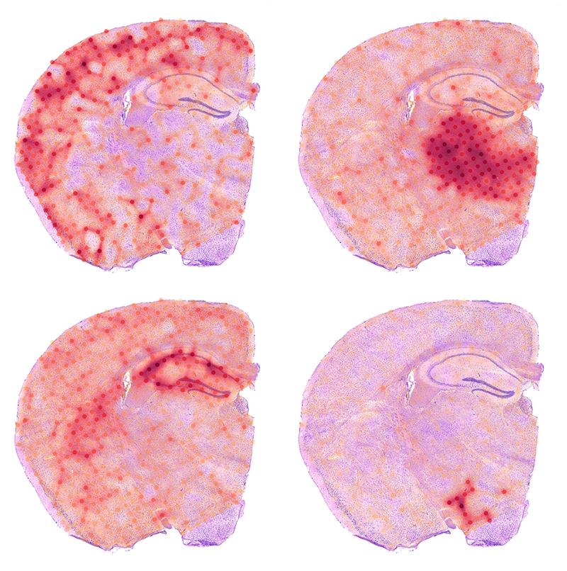
Spatial Transcriptomics (and single cell)

Slide 7
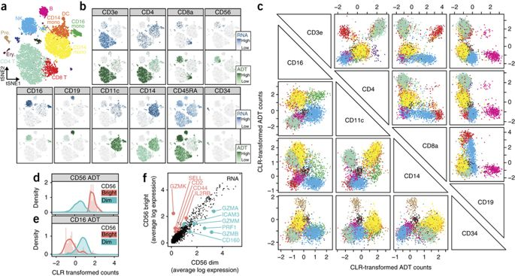
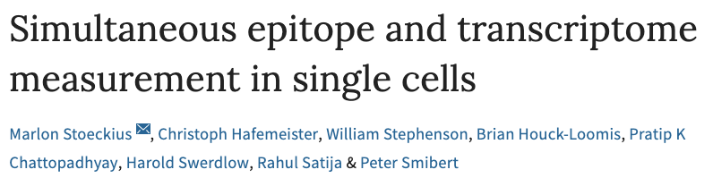
Cite-seq and Epitope/transcriptome integration

Slide 8
Designing Experiments
Beginning with the question of interest ( and working backwards )
The final step of a DE analysis is the application of a linear model to each gene in your dataset.
Traditional statistical considerations and basic principals of statistical design of experiments apply.
Control for effects of outside variables, avoid/consider possible biases, avoid confounding variables in sample preparation.
Randomization of samples, plots, etc.
Replication is essential (triplicates are THE minimum)
You should know your final (DE) model and comparison contrasts before beginning your experiment.

Slide 9
How many cells to target?
The number of cells to target can be estimated based on:
The expected heterogeneity of all cells in a sample
The minimum frequency expected of a particular cell type within the sample, and
The minimum number of cells of each type desired in the resulting data set.
With this information, a negative binomial distribution can be used to estimate the number of cells likely to capture at least a set number of cells from your rarest cell type.
For example, if we sequence a mixture of ∼10 cell types where the frequency of the rarest cell type is ∼0.03, then we would need to sequence ∼2200 cells to have a 90% chance of capturing at least 50 of those rare cells.
www.satijalab.org/howmanycells

Slide 10
General rules for preparing samples
Prepare more samples then you are going to need, i.e. expect some will be of poor quality, or fail
Preparation stages should occur across all samples at the same time (or as close as possible) and by the same person
Spend time practicing a new technique to produce the highest quality product you can, reliably
Quality should be established using Fragment analysis traces (pseudo-gel images, RNA RIN > 7.0)
DNA/RNA should not be degraded
260/280 ratios for RNA should be approximately 2.0 and 260/230 should be between 2.0 and 2.2. Values over 1.8 are acceptable
Quantity should be determined with a Fluorometer, such as a Qubit.

Slide 11
Comparison to RNA-seq libraries
Considerations
QA/QC of RNA samples Cells [Consistency across samples is most important.]
‘Cleanliness’ of cells and accurate cell counts
What is the RNA of interest [polyA extraction is pretty universal]
Library Preparation
Stranded Vs. Unstranded [Standard is pretty universal]
Size Selection/Cleanup [Target kit recommendations]
Final QA [Consistency across samples remains most important.]

Slide 12
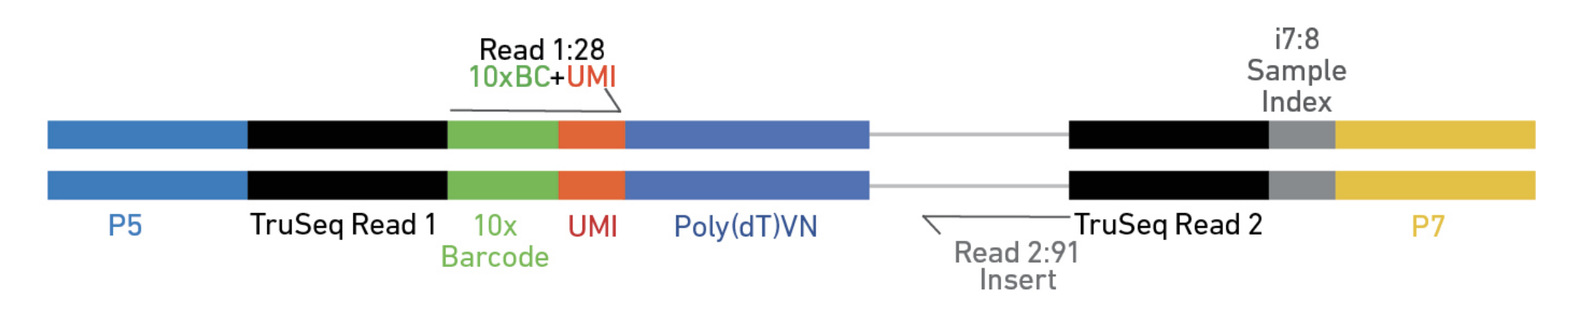
Elements of a Library
Library Barcode (Sample Index) - Used to pool multiple samples on one sequencing lane
Cell Barcode (10x Barcode) – Used to identify the cell the read came from
Unique Molecular Index (UMI) – Used to identify reads that arise during PCR replication
Sequencing Reads – Used to identify the gene a read came from

Slide 13
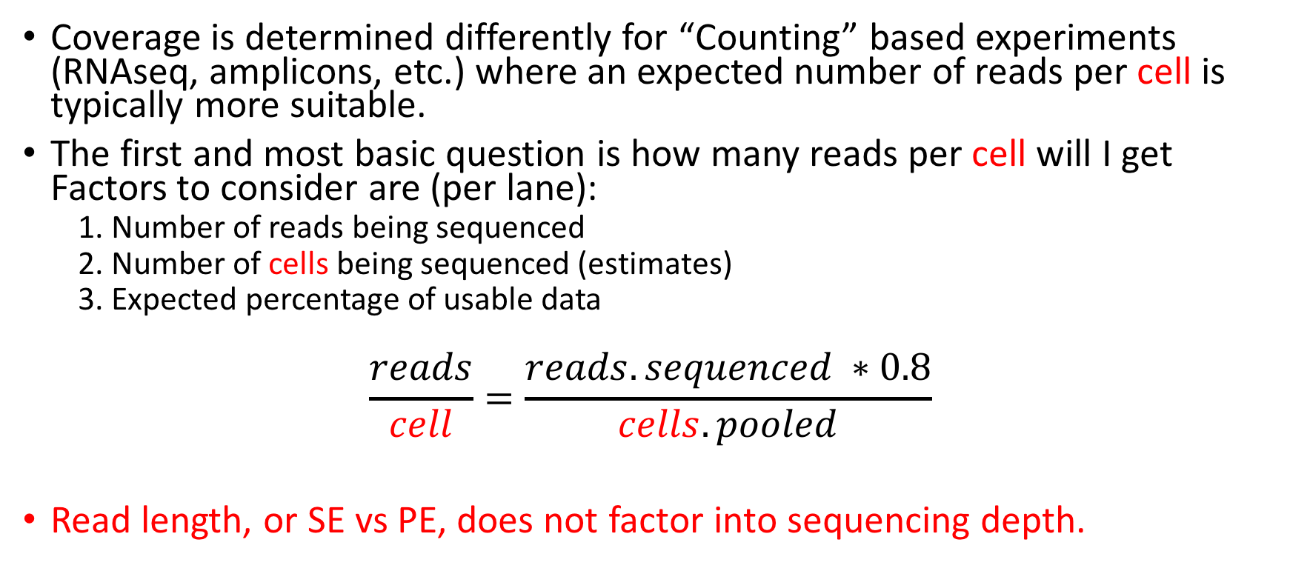
Sequencing Depth
Coverage is determined differently for “Counting” based experiments (RNAseq, amplicons, etc.) where an expected number of reads per cell is typically more suitable.
The first and most basic question is how many reads per cell will I get Factors to consider are (per lane):
1. Number of reads being sequenced
2. Number of cells being sequenced (estimates)
3. Expected percentage of usable data
$$\frac{reads}{cell}=\frac{reads.sequenced ∗0.8}{cells.pooled}$$
Read length, or SE vs PE, does not factor into sequencing depth.

Slide 14
Sequencing - Characterization of transcripts, or differential gene expression
Factors to consider are:
Read length needed depends on likelihood of mapping uniqueness, but generally longer is better and paired-end is better than single-end (except when its not) ( 75bp or greater is best ).
Complexity of sample, >> complexity -> the >> depth.
Interest in measuring genes expressed at low levels, << level -> the >> depth.
The fold change you want to be able to detect ( < fold change more replicates and more depth).
Detection of novel transcripts, or quantification of isoforms (full-length libraries) requires >> sequencing depth. [NON 3’ based methods]
The amount of sequencing needed for a given experiment is best determined by the goals of the experiment and the nature of the sample.

Slide 15
Sequencing, V3
Validated on
Novaseq
HiSeq 4000
HiSeq 2500 Rapid Run
NextSeq
MiSeq
Recommendation
20,000* raw reads per cell is the recommended sequencing depth for ‘typical’ samples.
Given variability in cell counting/loading, extra sequencing may be required if the cell count is higher than anticipated.
*Adjust sequencing depth for the required performance or application. The Sequencing Saturation metric and curve in the Cell Ranger run summary can be used to optimize sequencing depth for specific sample types.
sequencing run, with 3 reads, V3 kits
Sequence Read | Minimum Length | Read Description
Read 1 | 28bp (16bp bc, 12bp UMI) | barcode and UMI
I7 Index | 8bp | Sample Index Read
Read2 | 100bp | Transcript Tag
**Shorter transcript reads may lead to reduced transcriptome alignment rates. Cell barcode, UMI and Sample index reads must not be shorter than indicated. Any read can be longer than recommended.
@ full capacity 10,000 cells per sample and 20K reads per cell = 200M reads or ~0.5 lanes/sample

Slide 16
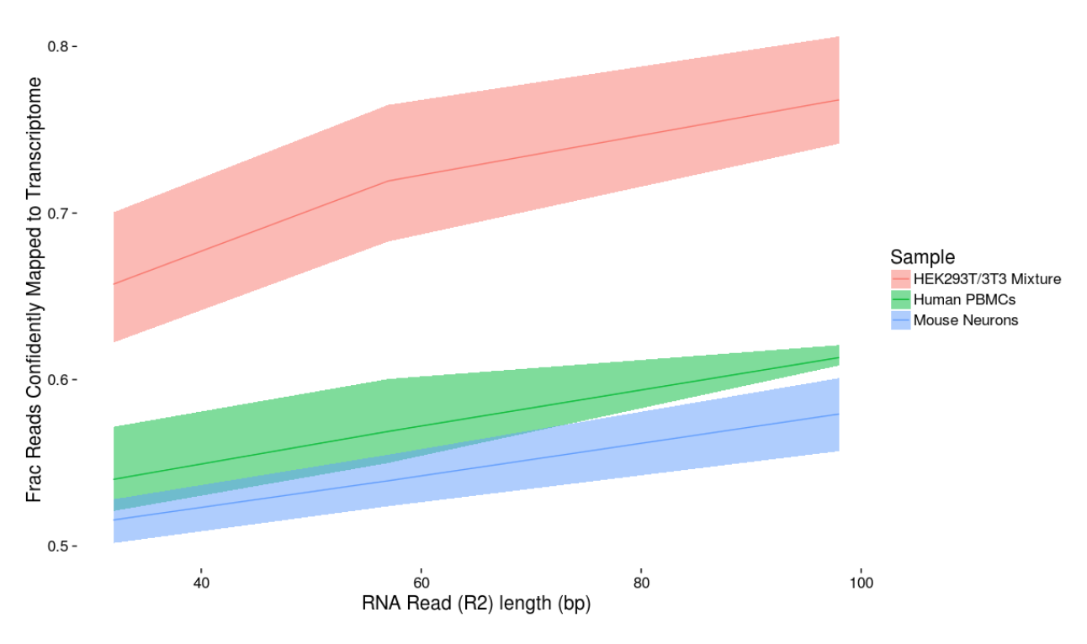
Read length matters (10x slide)

Slide 17
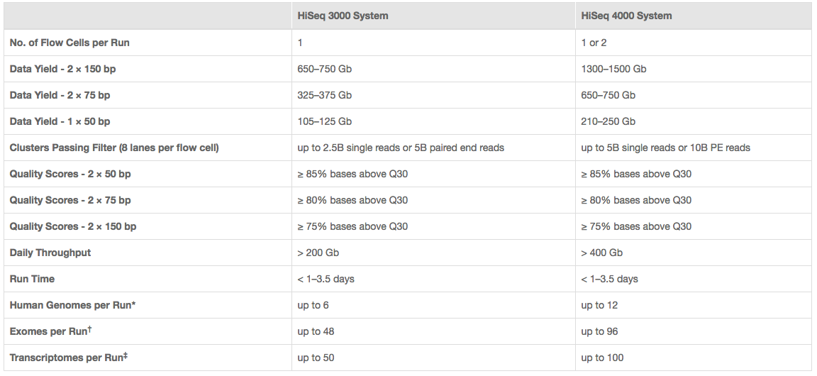
Illumina sequencing
http://www.illumina.com/systems/hiseq-3000-4000/specifications.html

Slide 18
Cost Estimation
Cell Isolation
Library preparation (Per sample/pool)
Sequencing (Number of lanes)
Bioinformatics
General rule is to estimate the same dollar amount as data generation, i.e. double your budget
http://dnatech.genomecenter.ucdavis.edu/prices/
http://bioinformatics.ucdavis.edu/services-2/

Slide 19
Multiplexing (MULTIseq)
https://www.nature.com/articles/s41592-019-0433-8

Slide 20
Be Consistent
BE CONSISTENT ACROSS ALL SAMPLES!!!

Slide 21
The Bottom Line: In Genomics
Spend the time (and money) planning and producing good quality, accurate and sufficient data.
Get to know to the data, develop and test expectations, explore and identify patterns.
Result, spend much less time (and less money) extracting biological significance and results with fewer failures and reproducible research.

