Slide 1
Planning Capital City of Andhra Pradesh
Capstone Project by Praneetha Boppa

Slide 2
Problem Statement
As a newly formed state in India, Andhra Pradesh wants to build its capital city.
Given that it has a chance to plan and build its city from scratch, Government wants to study big and established cities like Toronto, San Francisco, New York etc..
One of their cities of target was Toronto and wanted to study public places of interest planned for the city and outskirts.
They wanted to Especially study number of parks, railway stations, public community halls, libraries, per Borough and neighborhood etc..
They wanted to do study of several other similar cities and come up with the plan to build the prospective capital city

Slide 3
Problem Statement
Audience:
Government of Andhra Pradesh City planning department
Problem Attempted to Solve:
Here we help with study of city Toronto geographical plan for its public places

Slide 4
Data Description
Sources:
four square venue exploration api for looking at places of public interest like train stations, community halls, parks, indoor stadiums, Schools and Hospitals etc.
Wikipedia page for table listing hospitals https://en.wikipedia.org/wiki/List_of_hospitals_in_Toronto#:~:text=There%20are%20over%20forty%20hospitals,with%20the%20University%20of%20Toronto. https://www.tdsb.on.ca/About-Us#:~:text=Quick%20Facts,approximately%20247%2C000%20students%20each%20year.&text=There%20are%20over%20120%20languages%20spoken%20by%20TDSB%20students%20and%20their%20families.

Slide 5
Data Description
Sources:
Four Square trending venue api during morning and evening rush times with Toronto’s coordinates to get public transit information in addition to Public Transportation is pulled from https://en.wikipedia.org/wiki/Toronto_subway & https://en.wikipedia.org/wiki/GO_Transit
information from TDSB page for school information in addition to above to get to better conclusions.
We will get prospect city’s current population density and Toronto’s + GTA's population density to provide recommendations.
We will arrive at an optimum number of public service buildings for the population density of City that is in planning.

Slide 6
Methodology
import all the required libraries.
Work with the Wikipedia page https://en.wikipedia.org/wiki/List_of_postal_codes_of_Canada:_M which has Borough information and postal code for all neighborhoods.
scrape the data from this page and clean it.
add latitude and longitude information to that data set.
There is information for 10 unique Boroughs in total.
concentrate on Borough's end with Toronto and call them downtown Toronto
everything else becomes outskirts of downtown Toronto which is called GTA.
get near by venues and their categories for all the neighborhoods in downtown and GTA and store it in two different data frames.

Slide 7
Methodology
make a unique list of categories available in both these data frames
From this unique list, filter in categories that has words parks, playgrounds, railway stations, airports etc.
store them in filtered data frames., These data frames are then converted into dummy codes for each column.
count the occurrences of these in each neighborhood and Borough's and create a total row for filtered downtown data frame and GTA data frame.
From data for hospitals, scrape the first table from this page https://en.wikipedia.org/wiki/List_of_hospitals_in_Toronto#:~:text=There%20are%20over%20forty%20hospitals,with%20the%20University%20of%20Toronto and clean it.
make 2 subset data frames for downtown Toronto which consists of Old Toronto area and rest for GTA.
count the number of hospitals in each data frame as total number of hospitals for those areas

Slide 8
Methodology
For Schools, the data is directly available from TDBS website but there isn't a clear distinction on how many belong to downtown Toronto and how many for GTA
For public transit, RUN the trending Places api from foursquare using the latitude and longitude of downtown Toronto.
But since the api was always returning empty json, the information is pulled from this Wikipedia page https://en.wikipedia.org/wiki/Toronto_subway.
There are 75 subway stations in downtown Toronto, while GTA has 66 Go stations which is main transportation used by commuters in GTA, https://en.wikipedia.org/wiki/GO_Transit

Slide 9
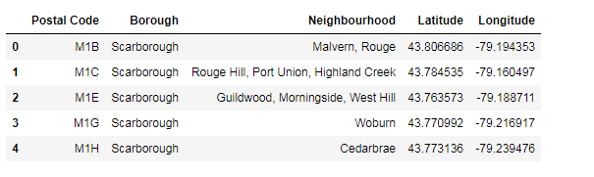
Results & discussion
After scraping the data for Borough's in Toronto from Wikipedia page and adding latitude & longitude details, the data looks like the table below.

Slide 10
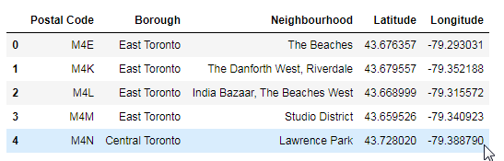
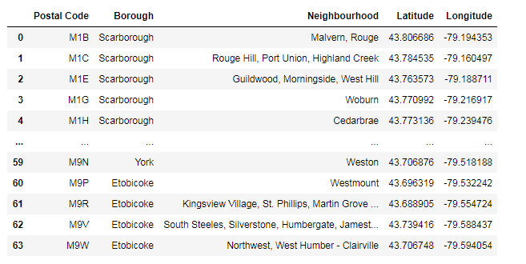
Results & discussion
The data is then split into 2 smaller data frames containing information for downtown Toronto and Greater Toronto Area(GTA) as shown below

Slide 11
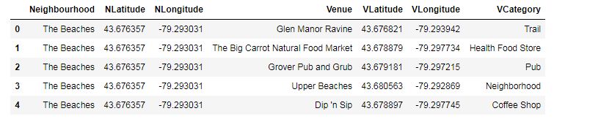
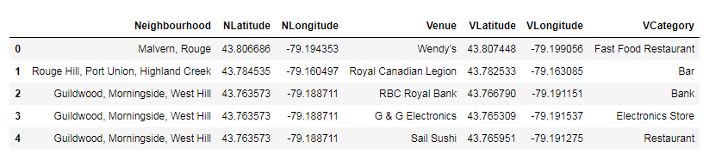
Results & discussion
The venues and venue categories for each neighborhoods in Toronto and GTA data frames form new data frames and they look like below

Slide 12
Results & discussion
From the unique list of the categories for the venues.
The ones we are interested in are
'Light Rail Station', 'Train Station', 'History Museum','Baseball Field','College Arts Building', 'Airport','Airport Terminal','Airport Gate','Bus Station','Medical Center','Metro Station', 'Athletics & Sports','Playground','Skate Park','Bus Line','Soccer Field','Skating Rink','Basketball Stadium','Music Venue','Performing Arts Venue', 'Monument / Landmark', 'Park', 'Dog Run', 'Hockey Arena','Historic Site','Fountain','Museum','Art Museum','Garden'

Slide 13
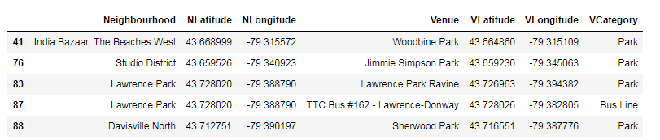
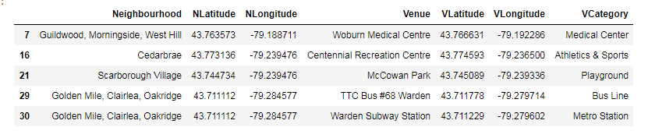
Results & discussion
Public places in Toronto & GTA form filtered data frames and they are

Slide 14
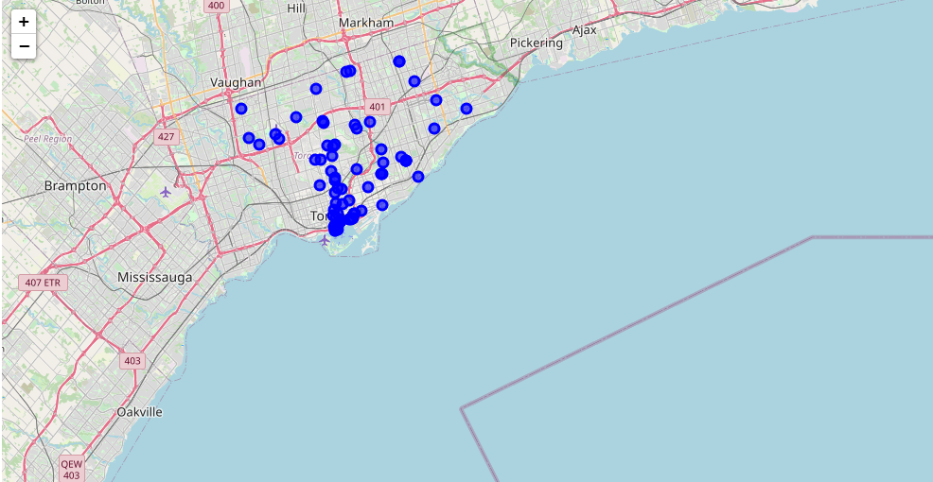
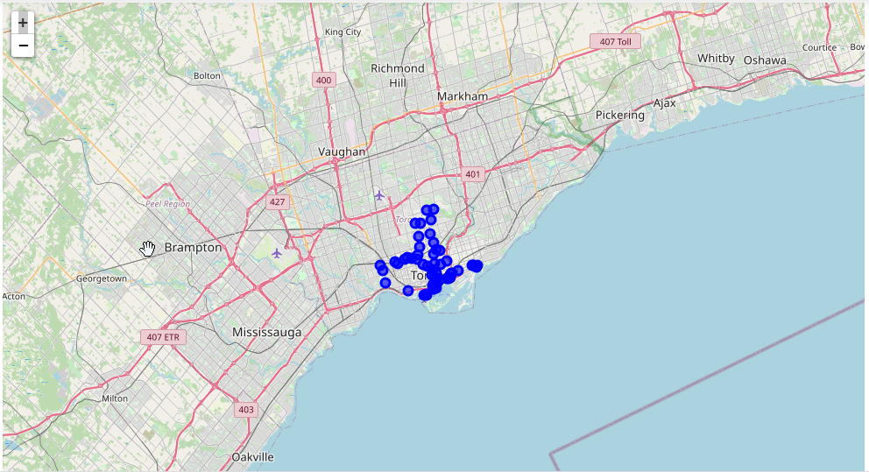
Results & discussion
Visualization of these venues on Map

Slide 15
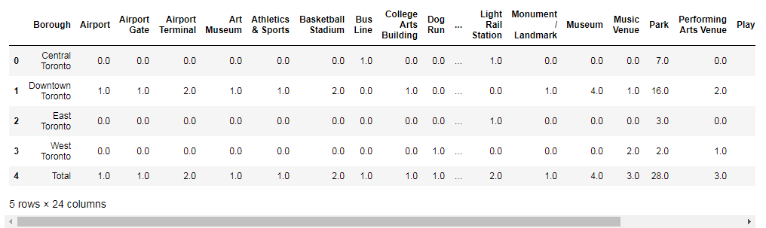
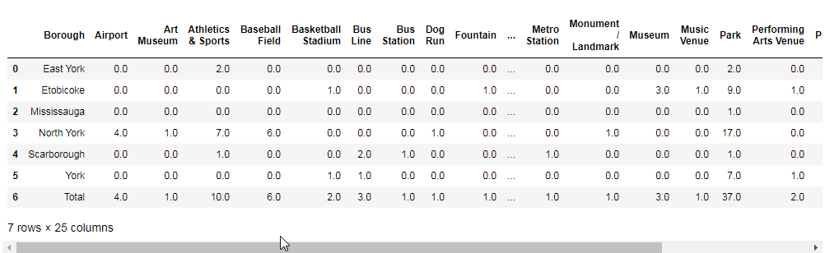
Results & discussion
Dummied data frames total per Borough for Toronto & GTA data frame

Slide 16
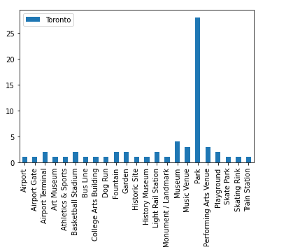
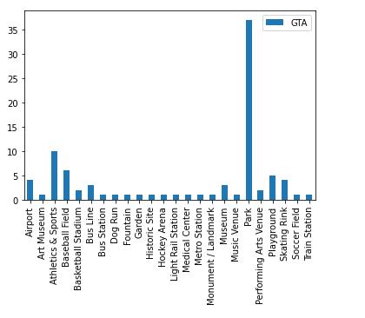
Results & discussion
Bar plots for the totals in Toronto & GTA

Slide 17
conclusion
Population density of GTA is 849 people per square kilometer.
There are 37 parks, 5 play grounds,1 Soccer Field, 2 Baseball fields and 1 major publicly maintained fountain.
Population density of downtown Toronto is 8,210 people per square kilometer.
There are 29 parks, 3 play grounds, 2 Basket Ball stadiums, 2 Skate parks, 1 major Train station(Union Station).
There are 75 subway stations in downtown and 66 train stations in GTA.
Total 35 hospitals, 16 of them are in downtown Toronto and 19 are in GTA. Based on population Density, this sounds reasonable
583 schools in total. 473 Elementary Schools and 110 Secondary Schools

Slide 18
Recommendations
Population density of capital city of Andhra Pradesh is 3800 people per square kilometer
This is almost half of the size of Toronto. So, my recommendation would be to size the public places accordingly for now and allocate for expansion in future.
For Downtown:
15 parks, 2 play grounds, 1 Basket Ball stadiums, 1 Skate parks, 8 hospitals, 40 Metro stations, 150 schools and 1 major publicly maintained fountain.
For Suburbs:
10 parks, 3 play grounds, 1 Soccer Feild, 1 Baseball feilds,30 Metro Stations, 100 schools, 10 hospitals
Note: In India, subways are called Metro's and they extend to Suburbs also.

