Slide 1

Introduction to Linux Administration Day 1
IT Professional Program

Slide 2
Agenda
Welcome to Linux Administration!
Course/Block Introduction
Ch.1 Introduction to Linux
Lab exercises/tasks

Slide 3
Course/Block Introduction
This block (Network and Linux Administration) is 16 weeks long:
4 weeks of IT Service and Project Management
4 weeks of Network Administration
6 weeks of Linux Administration (this course)
CompTIA Linux+ certification available
2 weeks of Security Fundamentals

Slide 4
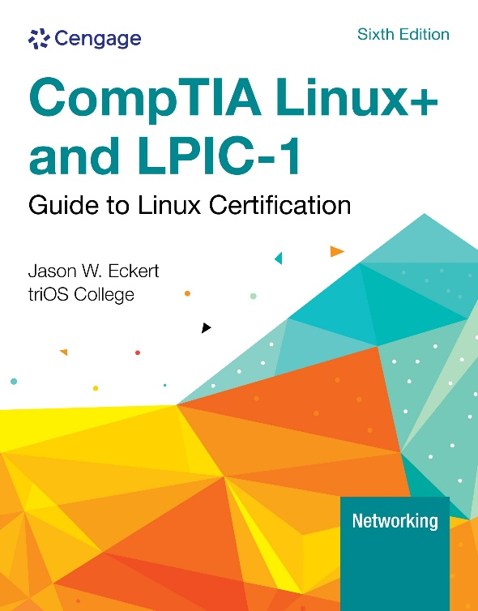
Course/Block Introduction
This course (Linux Administration):
Covers the usage and administration of the Linux operating system (including services and cloud)
CompTIA Linux+ certification available
Book is available in Brightspace:

Slide 5
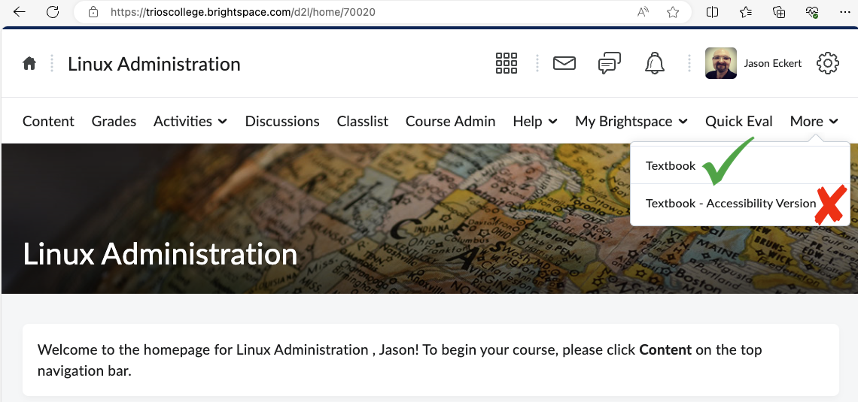
Course/Block Introduction

Slide 6
Course/Block Introduction
Attendance:
Like or reply to the Welcome post in Teams before 8:00a.m.
If you cannot make it to class, please message me beforehand if possible (email or Teams) and do the labs for that day (watch the video & read the PPT too).
Marks:
Assignment = 10%
Quizzes = 20% (5 quizzes in total, each Monday)
Final Exam = 60%
Professional Performance = 10%

Slide 7
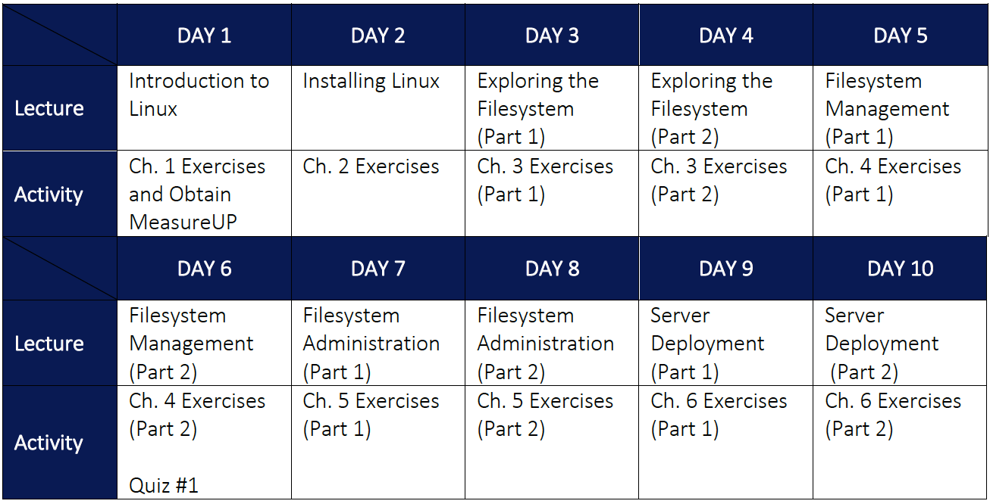

Slide 8
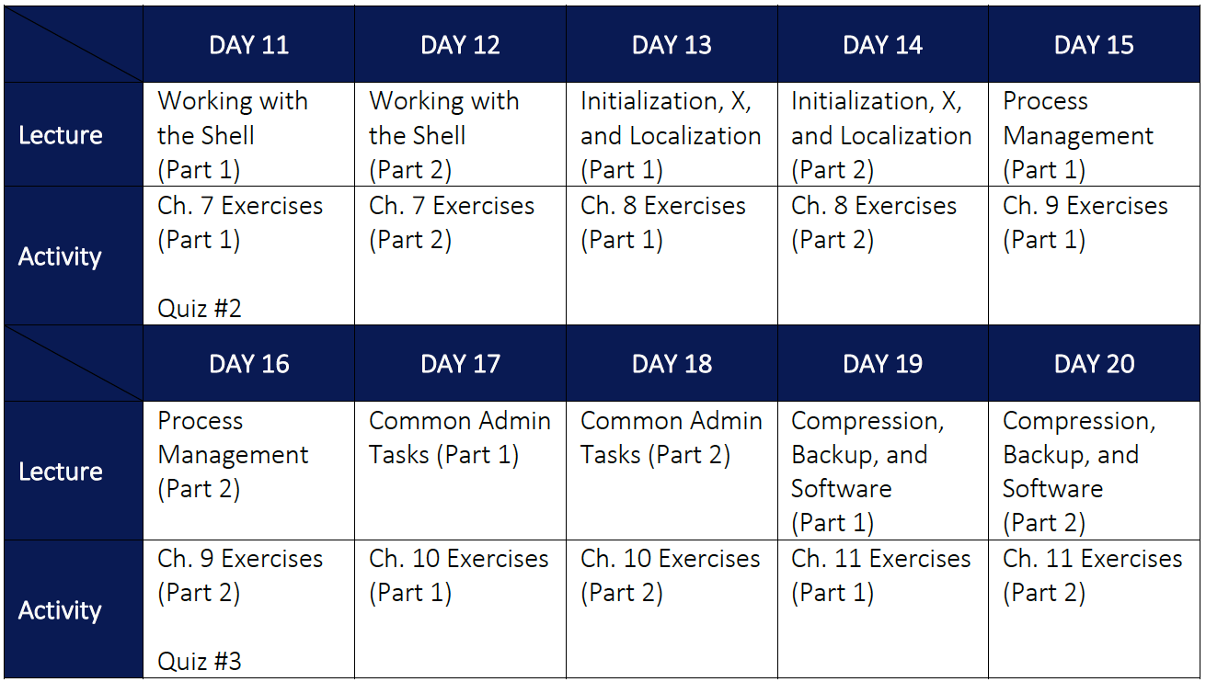

Slide 9
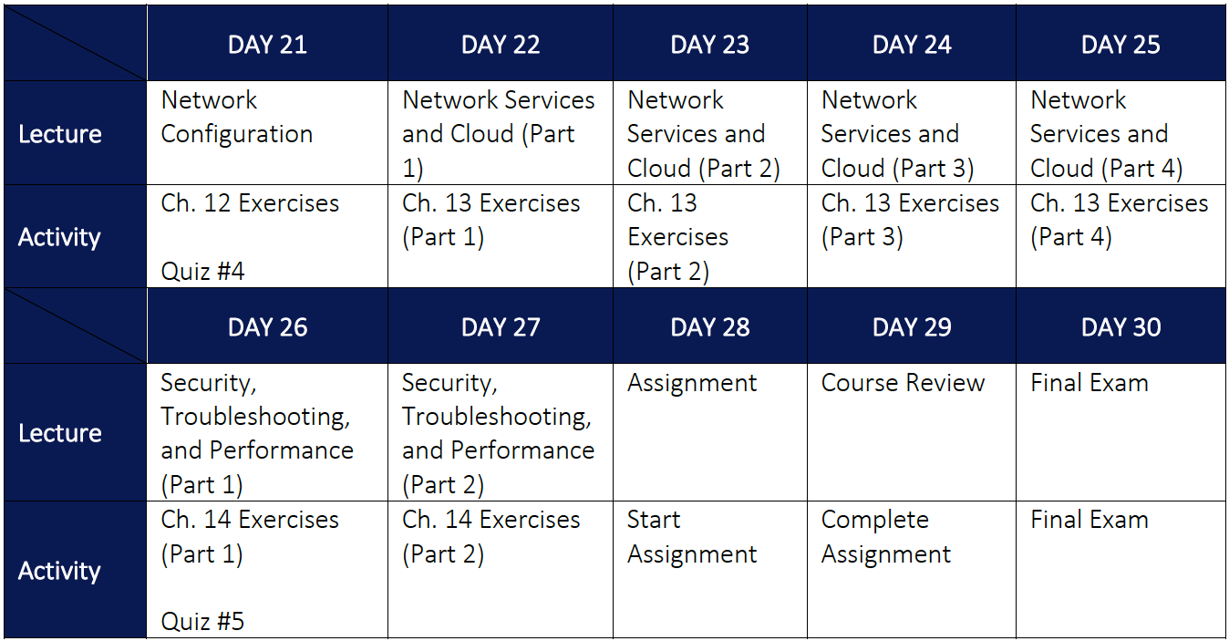

Slide 10
Ch.1 Introduction to Linux
An open source, UNIX-like OS created by Linus Torvalds in 1991 (most powerful today!)
Linus’ team develops the core Linux kernel, while other developers worldwide create the libraries and software that are packaged with it
Kernel versions have major.minor.revision format
e.g., the 6.3.18 kernel
Different packaged versions are called distributions (distros) – e.g., Fedora, Red Hat, Debian, Ubuntu, SuSE, etc.

Slide 11
Ch.1 Introduction to Linux
If you develop and release software under an open source license:
Others can access the original source code and make improvements
Bugs & security are fixed quickly
Supports any hardware platform
Software evolves quickly
This is not the case with closed source software (including freeware and shareware)

Slide 12
Ch.1 Introduction to Linux
Two major types of open source licenses:
Copyleft
Many restrictions on use
Includes the GPL that Linux uses!
Permissive
Most other open source software (e.g., programming libraries, applications, etc.)
Most common are the BSD and MIT licenses

Slide 13
Ch.1 Introduction to Linux
History (Figure 1-4 on pg 13)
1960s MULTICS (failed)
1969 AT&T Bell Labs UNIX – many vendors (flavors)
1980s Richard Stallman’s FSF > GNU > GPL
1991 GPL Linux = open source UNIX (distros)
1998: 750,000 Red Hat Linux installs
2000: Mainstream adoption (IBM commercial: https://www.youtube.com/watch?v=fJA9eiUktcA)
2008: 64 million Linux installs
Mobile, IoT, cloud, on-prem servers (https://www.youtube.com/watch?v=uxg17JlyFas)

Slide 14
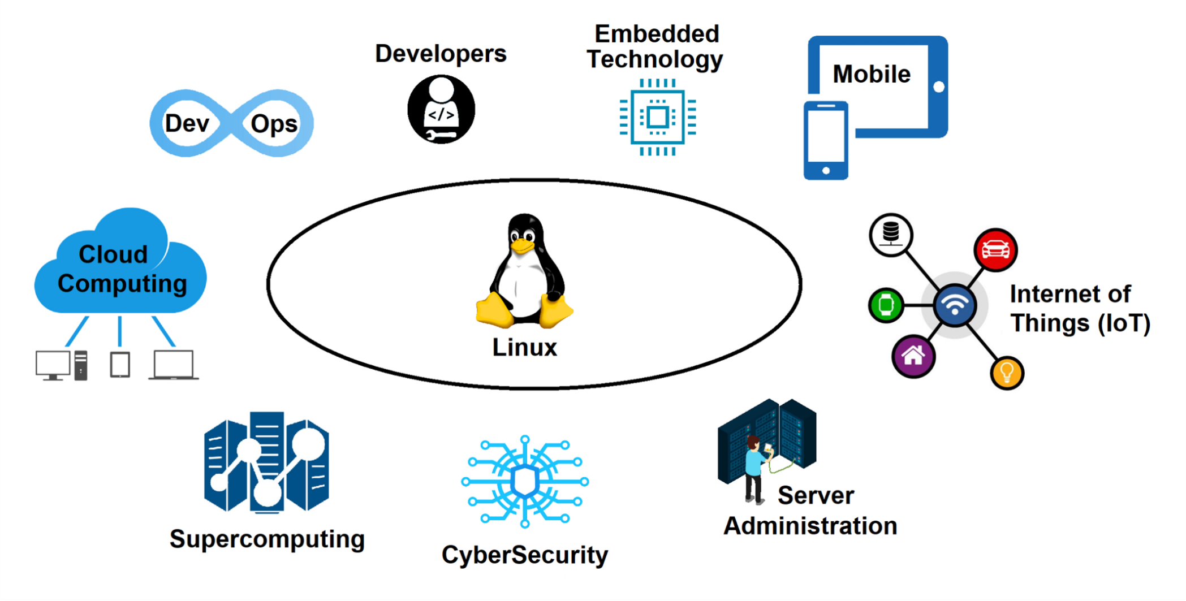
Ch.1 Introduction to Linux

Slide 15
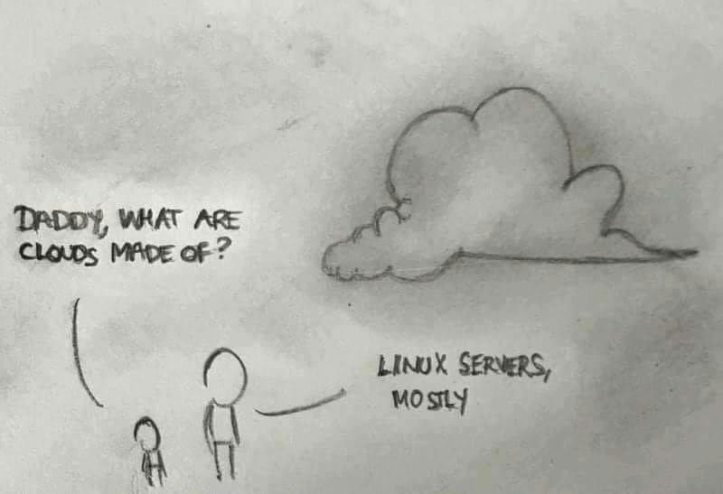
Ch.1 Introduction to Linux

Slide 16
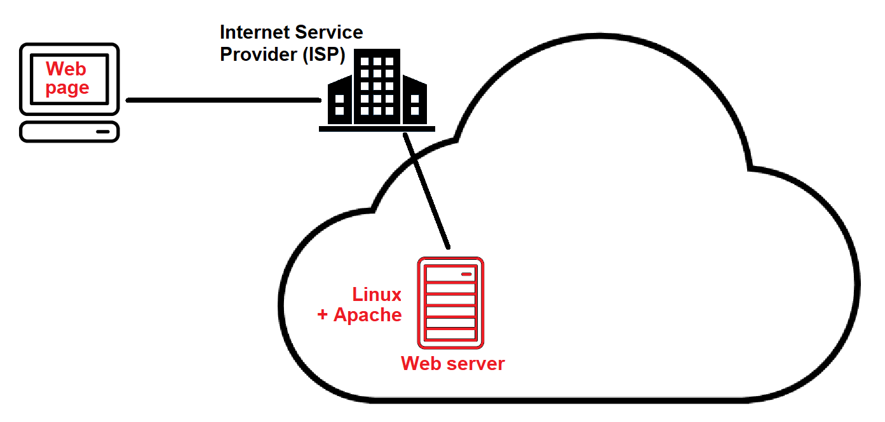
Ch.1 Introduction to Linux

Slide 17
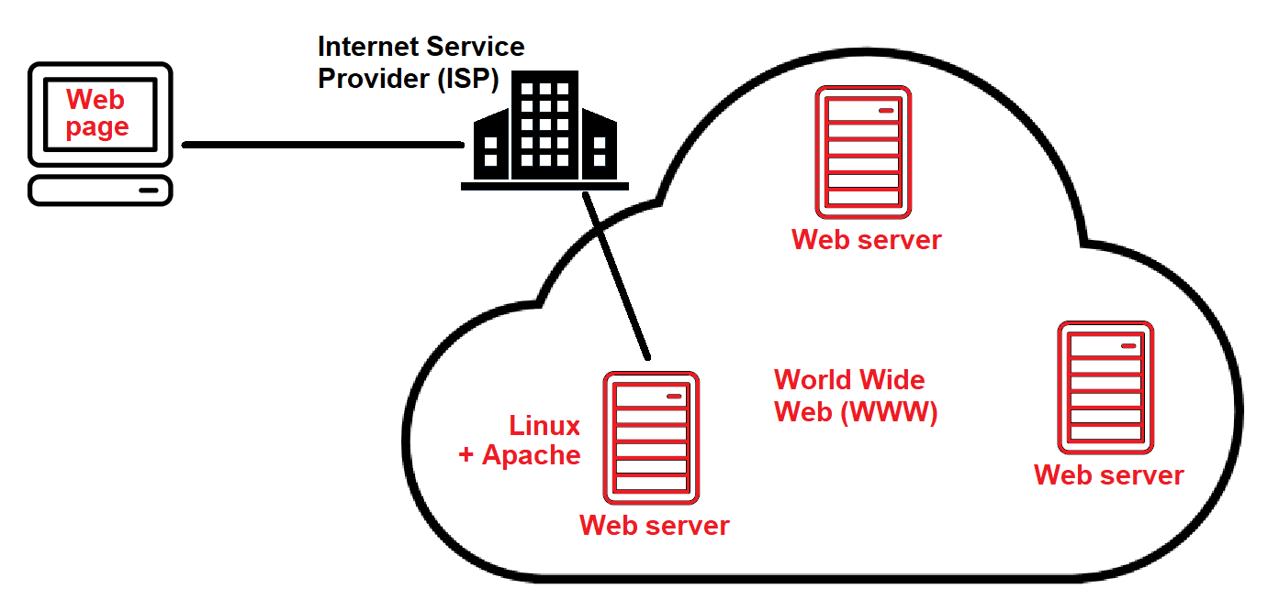
Ch.1 Introduction to Linux

Slide 18
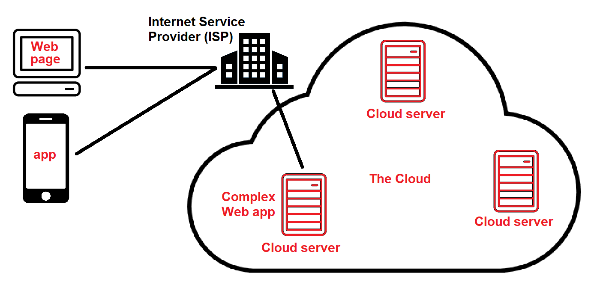
Ch.1 Introduction to Linux

Slide 19
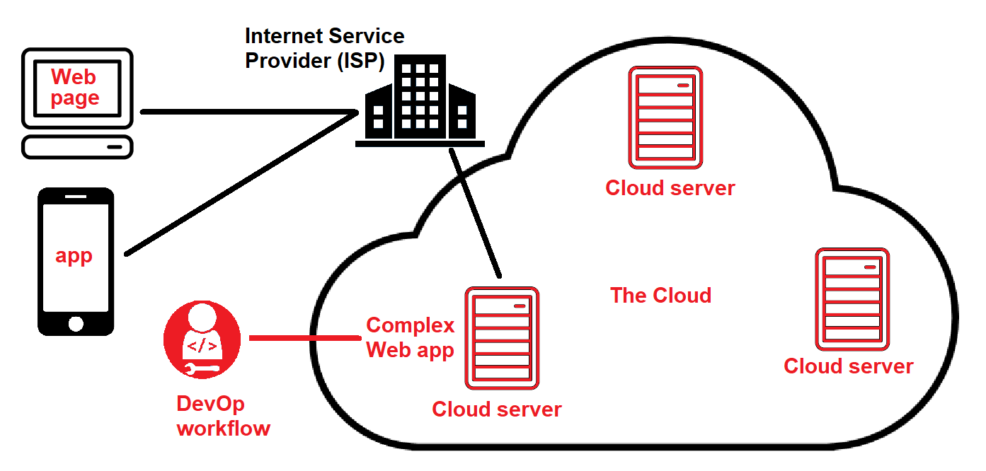
Ch.1 Introduction to Linux

Slide 20
Ch.1 Introduction to Linux
Gartner estimated that in 2020, over 90% of the world population is currently a Linux user in some way: 86% of embedded devices 100% of supercomputers 83% of smartphones/tablets/wearables (Android) 68% of servers (97% cloud, 29% on-premises) 96% of network appliances (routers, WAPs, NGFWs) 11% of desktops/laptops (includes Chromebooks and developer workstations) =67% of all devices worldwide!

Slide 21
Ch.1 Introduction to Linux
Common Linux distributions/distros
Table 1-4 on pg 19
We’ll use Fedora Workstation & Ubuntu Server
Different distros often:
Have different pre-packaged desktop environments (GNOME & KDE are the most common)
Desktop environments run on top of the X Windows GUI (either X.org/X11 or the new Wayland)

Slide 22
Ch.1 Introduction to Linux
Support different package managers
Red Hat Package Manager (RPM) ~ Fedora
Debian Package Manager (DPM) ~ Ubuntu
Support different sandboxed (all-in-one) apps
Snap (Ubuntu)
Flatpak (Fedora)
AppImage (both)
You can also distribute software and source code in tarball format for any distro
In this case, you run the compiled software, or compile the source code yourself to generate the program

Slide 23
Ch.1 Introduction to Linux
More on Linux in the cloud
Cloud delivery models (IaaS, PaaS, SaaS) – pg 29
Cloud workflows (=Devops workflow)
Continuous integration (CI) of code to GitHub
Continuous deployment (CD) from GitHub to orchestrator and build automation in cloud (testing → production)

Slide 24
Ch.1 Introduction to Linux
You know Linux? You also know UNIX!
macOS/iOS, Cisco IOS, BSD, etc.
CompTIA Linux+ certification
Very desirable for many jobs (cloud, cybersecurity, etc.)
Everything on exam is in your book (plus more!)
No substitute for practice in a virtual machine!
Lots of Internet resources:
www.explainshell.com, www.ss64.com/bash
@Fedora, @AskUbuntu, @LinuxQuestions
KW-LUG

Slide 25
Ch.1 Introduction to Linux
Linux installation types:
Bare metal (write ISO to DVD/USB flash drive)
WSLv2 (Linux running next to Windows – devs)
Virtual machine (full Linux distro)
Type 1 (Hyper-V), Type 2 (Oracle VM Virtualbox)
Container (mini VM without a Linux kernel/libraries)
Run on existing Linux system + container runtime (docker)

Slide 26
Lab exercises/tasks
Ensure you have Hyper-V installed
Create C:\SOURCE to store everything
Download Fedora Workstation 39 Linux ISO to this folder before tomorrow!
Read Ch.1 of the textbook and do the questions at the end
Optionally perform some of the Discovery Exercises at the end of Ch.1

