Slide 1

Introduction to Linux Administration Day 2
IT Professional Program

Slide 2
Agenda
Review
Ch.2 Installing Linux
Lab exercises/tasks

Slide 3
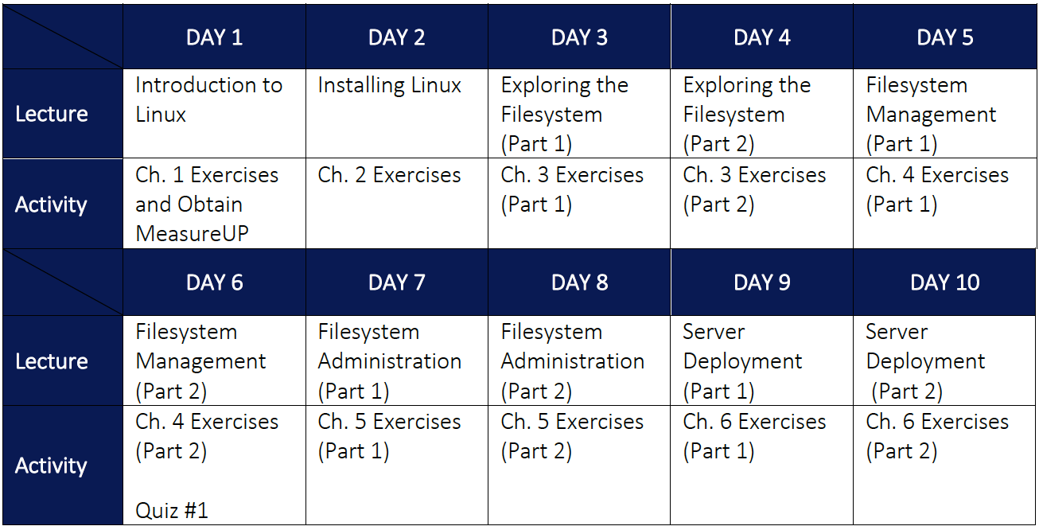

Slide 4
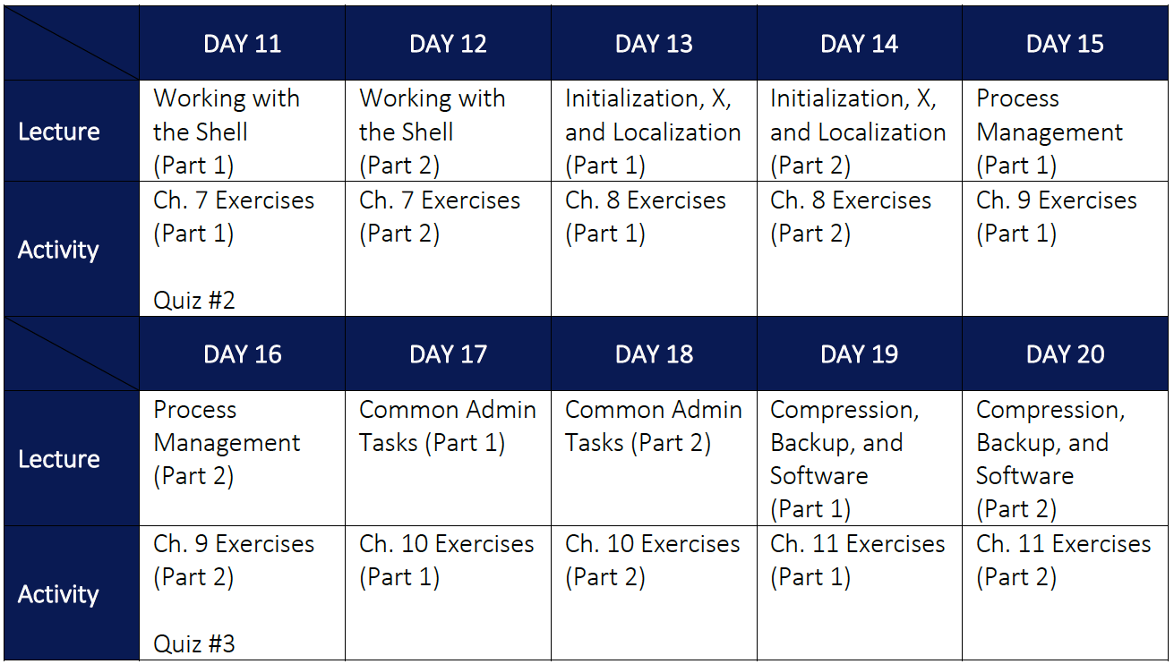

Slide 5
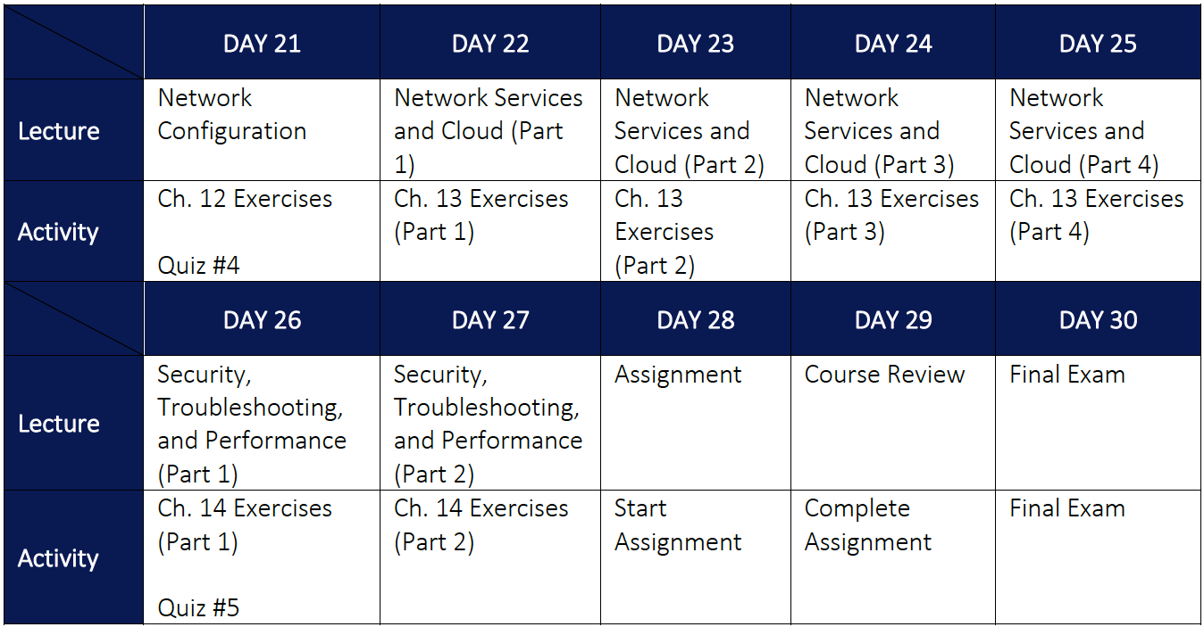

Slide 6
Review
What is Linux?
Most powerful and common OS in the world
Based on UNIX (=open source UNIX)
What is open source?
Allows others to modify the source code (=code used to create the program, that is later compiled into a functional program)
“Copyleft” (GPL) vs “Permissive” (MIT, BSD)
Where is Linux used?
Everywhere (IoT to biggest servers)

Slide 7
Review
Who started Linux?
Linus Torvalds
What is the difference between a UNIX flavor and a Linux distribution (distro)?
UNIX flavors differ in all areas (kernel/libraries/etc.)
Linux distros all have the same kernel/libraries, but are distributed with different software on top
Why is knowing Linux important for UNIX jobs?
95%+ of all Linux/UNIX commands and concepts are identical (Linux=UNIX)

Slide 8
Ch.2 Installing Linux
Course setup:
Download lastest ISO of Fedora Workstation
Create a VM (Hyper-V) & install Fedora
Create user1/LINUXrocks!
sudo passwd root (set root password)
su – (switch to root)

Slide 9
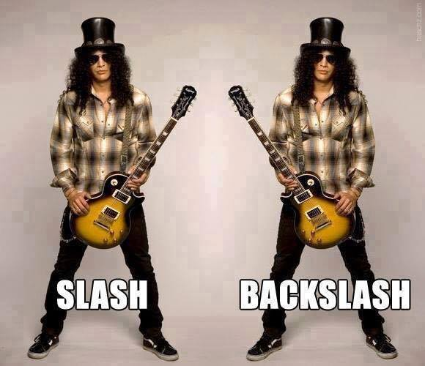
Ch.2 Installing Linux
When typing commands in this course:
Ctrl+c cancels a command
There is a difference between slash and backslash

Slide 10
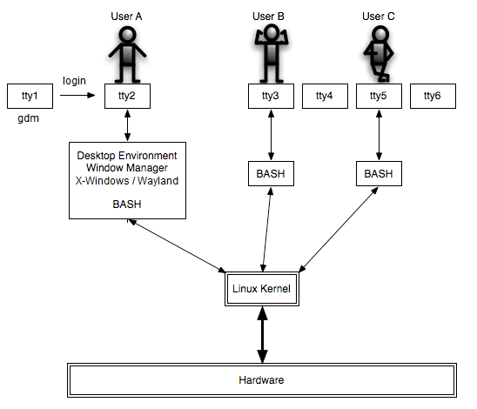
Ch.2 Installing Linux
Logging into Linux:

Slide 11
Ch.2 Installing Linux
Logging into Linux:
Local terminal (tty1-6), pseudoterminal (pty) ~ ssh
GUI
X-Windows (X.org/Wayland)
Desktop Environment = GNOME (macOS), KDE (Windows)
BASH shell
Regular user = $ prompt
Root user = # prompt
su – root
su –c "some command" root

Slide 12
Ch.2 Installing Linux
command options arguments date Date (case sensitive) date –u date --universal (POSIX)
options may not be dashed, or use other symbols
date +%s

Slide 13
Ch.2 Installing Linux
More commands finger username (dnf install finger first) whoami id echo arguments passwd clear uname -a

Slide 14
Ch.2 Installing Linux
[Shift]+[PageUp] and [Shift]+[PageDown]
Shell metacharacters: command | more date;id;who echo We use the $SHELL shell echo Today is `date`

Slide 15
Ch.2 Installing Linux
Protecting shell metacharacters: echo "You owe me $4.50" (protects most, not $) echo 'You owe me $4.50' (protects all) echo You owe me \$4.50 (protect next char only)
Forgot a quote? Ctrl-c (cancels current command)
Reset terminal? clear, reset, Ctrl-j stty sane Ctrl-j

Slide 16
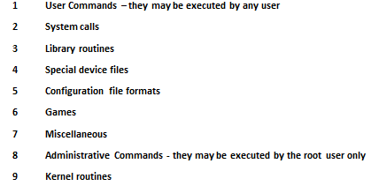
Ch.2 Installing Linux
Getting help: man who man –k cpu apropos cpu man crontab man 6 crontab info who help echo help

Slide 17
Ch.2 Installing Linux
Powering down:
wall “The system will be rebooted in 5 min!” shutdown –r +5 minutes shutdown -c shutdown –h now or halt shutdown –P now or poweroff shutdown –r now or reboot

Slide 18
Ch.2 Installing Linux
Multiple Terminal windows?
Desktop Environment or screen/tmux (BASH)
screen Ctrl-a → c (create), n (next), p (previous)
tmux Ctrl-b → % (split horizontal), “ (split vertical)

Slide 19
Lab exercises/tasks
Do Hands-On Projects 2-1 to 2-7
Optionally perform some of the Discovery Exercises at the end of Ch.2

