Slide 1
CN Mid Term Assignment
Johanna Catharina Smit
(12220070)

Slide 2
Content
Assignment overview
Tools
Approach
Result
Demo

Slide 3
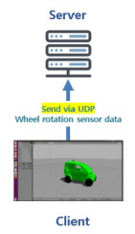
Assignment overview
Write a client ping program in Python using UDP. The client should send wheel rotation sensor data, extracted from a json file, to targeted server.
Main goal: understand socket programming.

Slide 4


Tools

Slide 5
Approach
According to given requirements:
Simple ping-pong
Round Trip Time (RTT)
Read sensor data from json file
Send sensor data to server
Timeout

Slide 6


Simple ping-pong
Creating the sockets and making communication possible

Slide 7
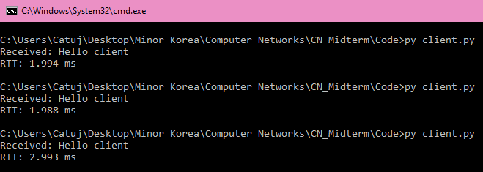
RTT
Delay between when the client sent the ping message and received the pong message

Slide 8
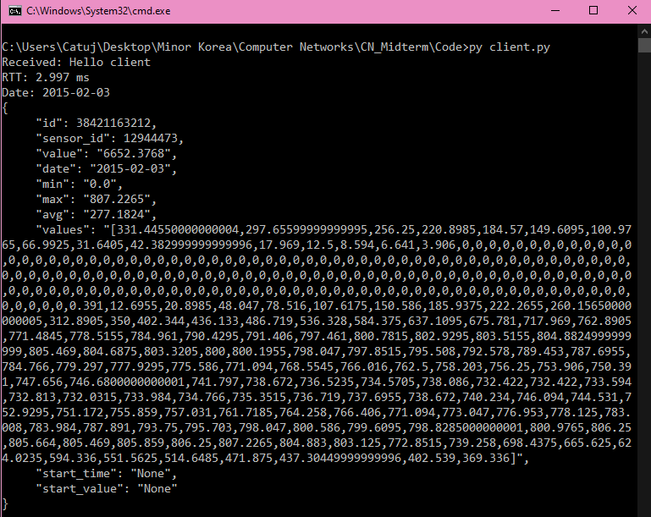
Read sensor data from json file
> Taking user input
Reading json file and printing the time series data for a specific day

Slide 9
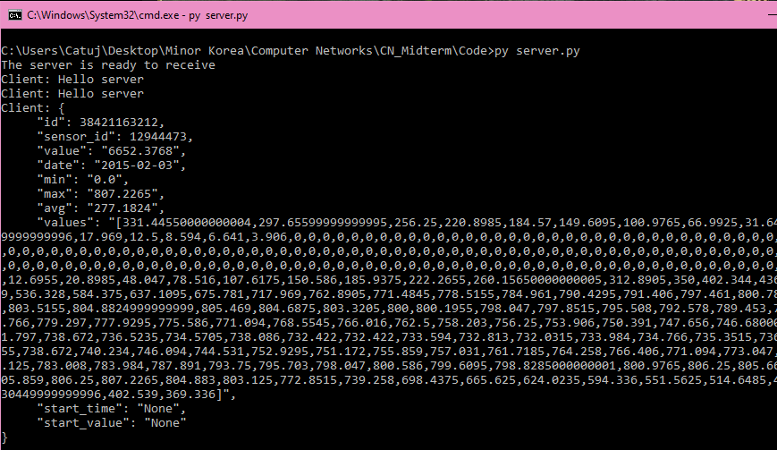
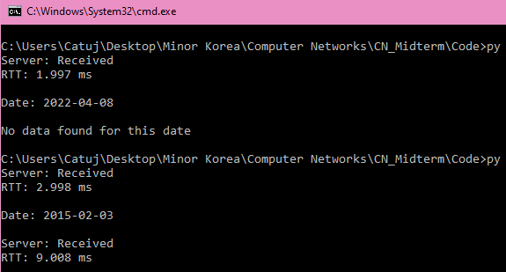
Send sensor data to server
Entire data snippet for a specific day sent to server over UDP

Slide 10
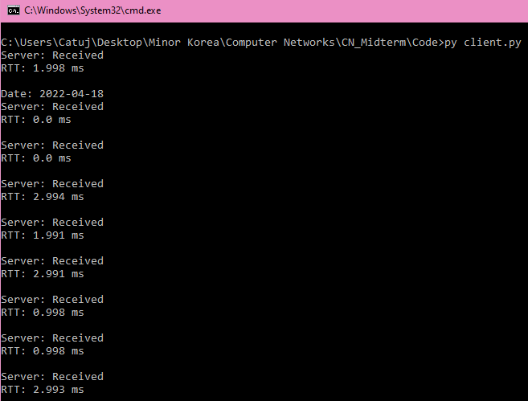
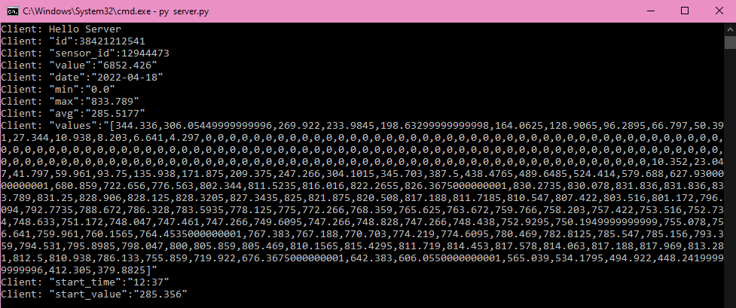
Send sensor data to server
Sensor data separately sent to server over UDP
Key + pair value

Slide 11

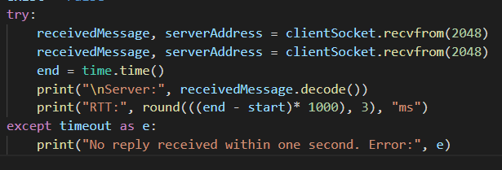

Timeout

Slide 12
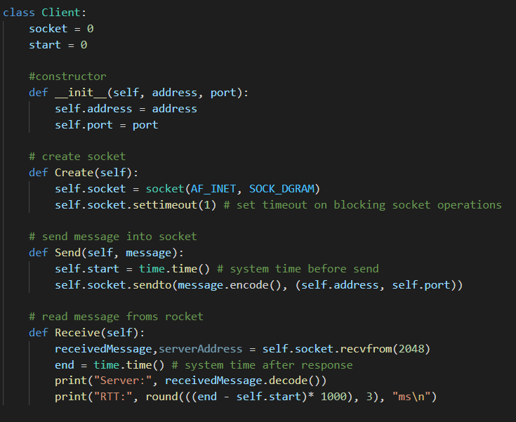
Creating class

Slide 13
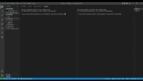
Demo

