Slide 1
NLP Milestones | Description | Models & Algorithms | Applications
2001 - Neural Language Models | The task of predicting the next word in a text given the previous words. | n-grams feed-forward neural network RNNs & LSTM | Intelligent keyboards and email response suggestion
2008- Multi-task Learning | Sharing parameters between models that are trained on multiple tasks. | general purpose lower-level representations | Automated speech recognition Multilingual language task
2013 - Word Embedding | Learn sparse vector representations of text large-scale training over different corpus | Word2Vec (CBOW and skip-gram ) matrix factorization (SDV and LSA) GloVe LexVec | Music/Video Recommendation System Text analytics metrics
2014 - Sequence to Sequence Models | A general framework for mapping one sequence to another one using a neural network | encoder - decoder neural network | Machine translation
2015 - Memory based Networks & Attention | New mechanism that enable training parallelization and less dependencies | NMT (Neural Turing Machines) | Machine Comprehension, Question and Answer
2018 Pretrained Language Models | Pretrained model act as initialize and can be fine-tuned on task specific data | BERT XLnET ELMo OpenAI’s GPT-2 | Reading comprehension, Classification text stigmatization language generation

Slide 2
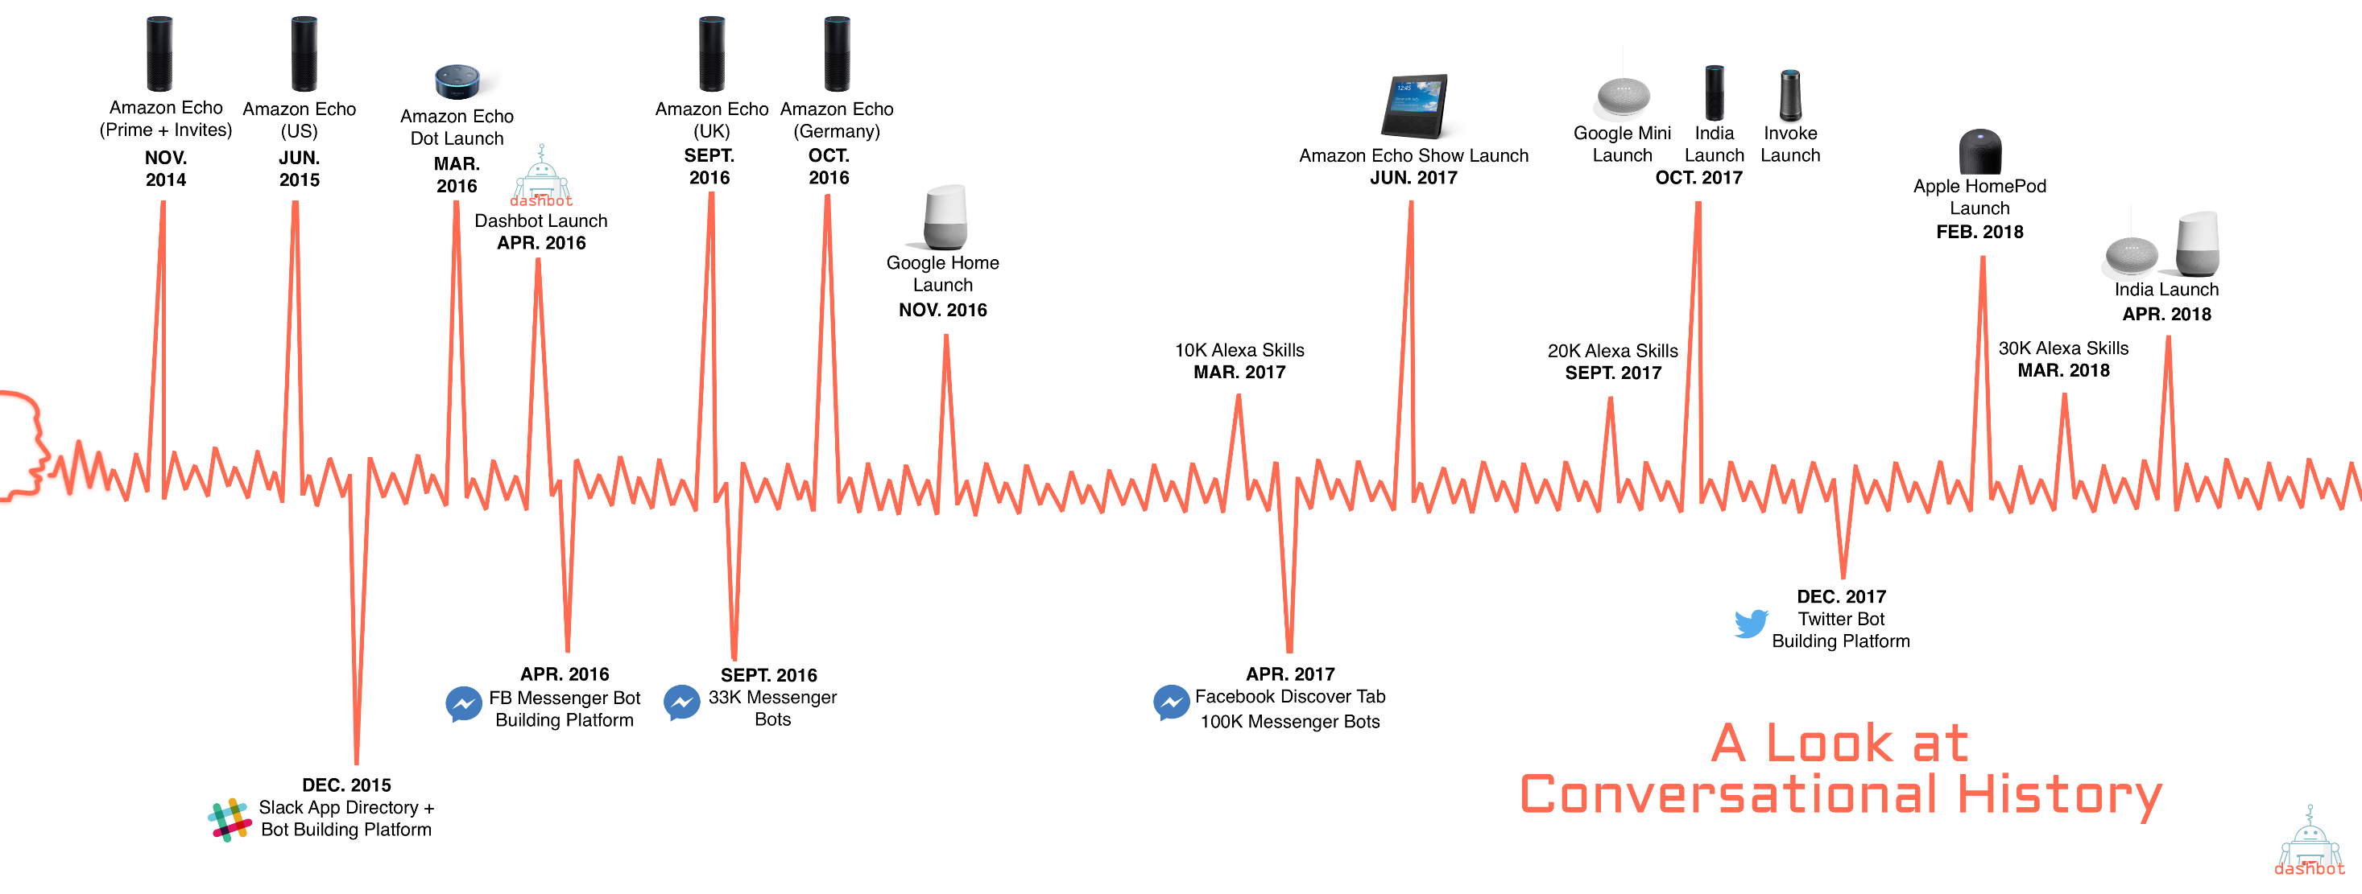

Slide 3
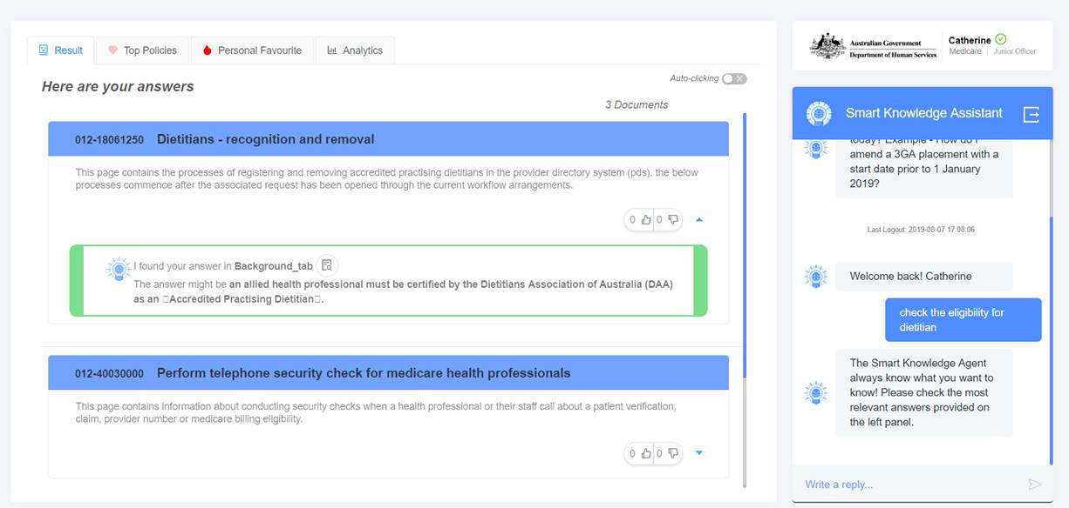
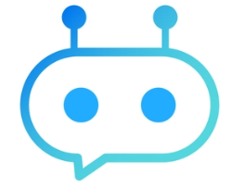
Key features & challenges addressed
 | Cognitive search capability (speed and accuracy) |  | Top policies (speed and innovation)
 | 48 hours of conversation (speed) |  | Personal Favourite (confidence, speed and innovation)
 | Answer at a glance (speed) |  | Personalisation (confidence, speed and innovation)
 | Detailed drill down to policy (confidence) |  | Analytics (innovation)
1
5
2
6
3
7
4
8
5
6
8
7
021-22033 Document Title 1
This page is about Customer service Collaboration research. Customer service is traditionally considered a cost centre, so many organizations have focused their customer improvement efforts on reducing costs.
2
7
7
4
3
The answer might be virtual agent systems has demonstrated two fundamental — and counterintuitive — facts about customer service and automation.
1
What is the fundamental for customer service bot?
021-22343 Document Title 2
Business Insider experts predict that by 2020, 80% of enterprises will use Chatbots. According to Lauren Foye, by 2022, banks can automate up to 90% of their customer interaction using Chatbots

