Slide 1
Artificial Intelligent Deep Learning

Slide 2
Introduction
What, why
Milestone
CNN for image recognition / classification
RNNs for sequence data pattern recognition (audio, language, stock price)

Slide 3
How we got here

Slide 4
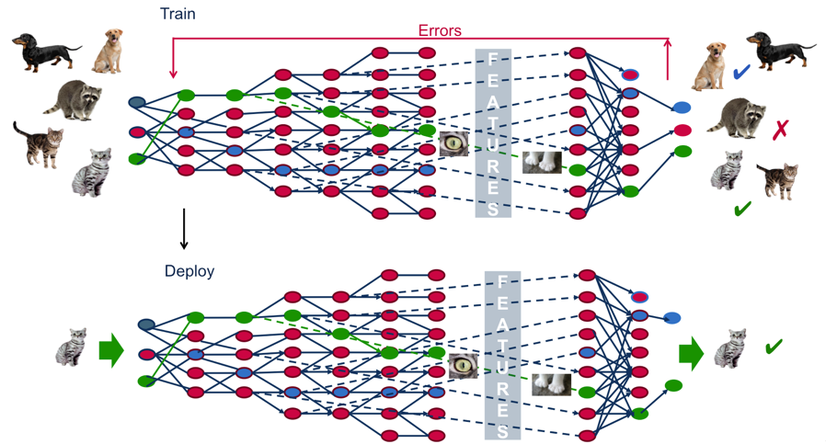
What is Deep Learning
A way of solving complicated problem ( especially for vast amount of unstructured data)
Trainable feature hierarchy (no need to ask domain experts to hand crafted feature extractor)
Short Answer
1. ‘Deep Learning’ means using a neural network
with several layers of nodes between input and output
2. the series of layers between input & output do
feature identification and processing in a series of stages,
just as our brains seem to.
1.Deep learning is about representing high-dimensional data
Notes:
Deep is a technical terms It refers to the number of layers in a neural network. A shallow network has one so-called hidden layer, and a deep network has more than one. Multiple hidden layers allow deep neural networks to learn features of the data in a so-called feature hierarchy, because simple features (e.g. two pixels) recombine from one layer to the next, to form more complex features (e.g. a line). Nets with many layers pass input data (features) through more mathematical operations than nets with few layers, and are therefore more computationally intensive to train. Computational intensivity is one of the hallmarks of deep learning, and it is one reason why GPUs are in demand to train deep-learning models.

Slide 5
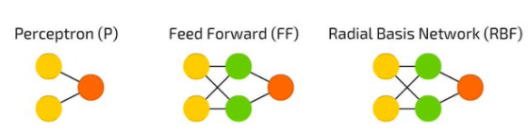
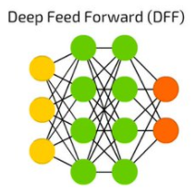
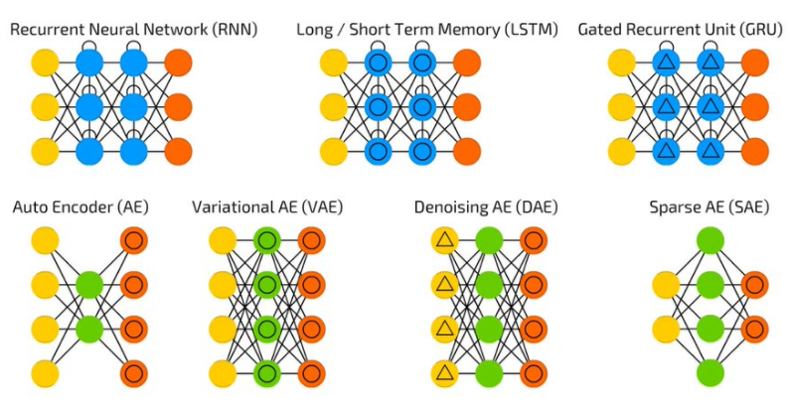
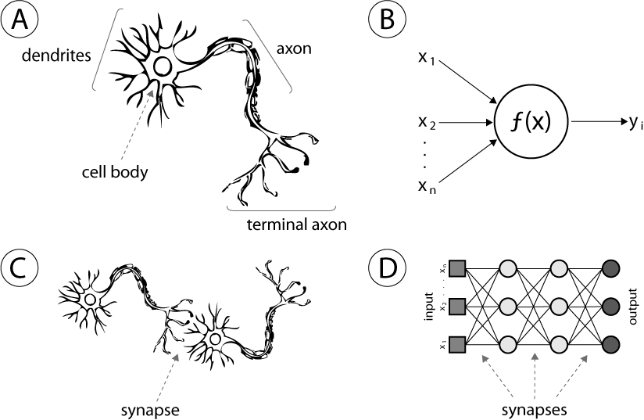
Neural Network
Most perception (input processing) in the brain may be due to one learning algorithm. Then build learning algorithms that mimic the brain.

Slide 6
Which models are deep

Slide 7
Why deep learning
Challenge
Large amount of data
Unstructured data (audio, video, text, )
Traditional model of pattern recognition
- Fixed/ engineered features + trainable classifier (feature extractors + template matching + linear classifier)
End to end learning / deep learning
Trainable features + trainable classifier
learning hierarchical representations
trainable feature hierarchy
Non-linear feature + non-linear classifier
Required considerable Experts effort

Slide 8
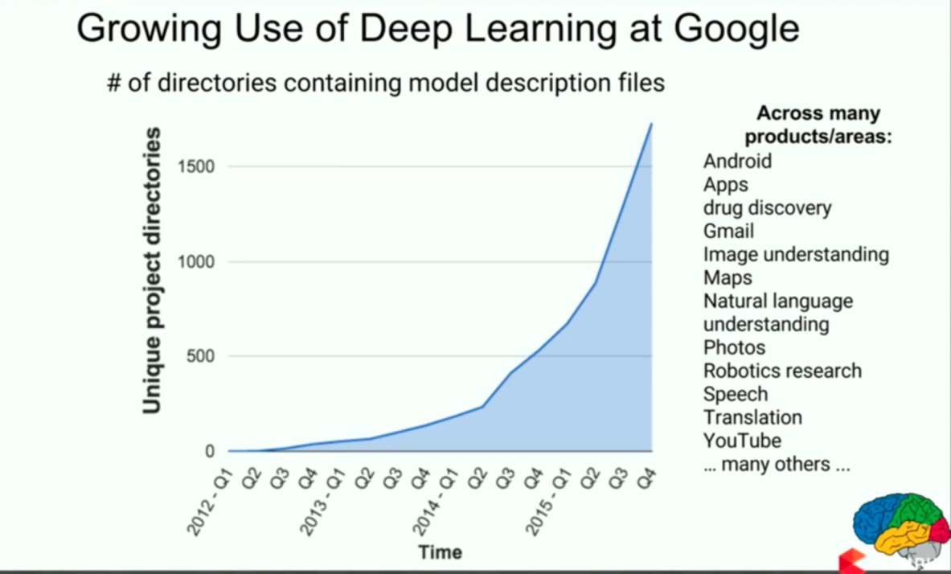
Why Deep Learning
Best algorithm for image classification
Best algorithm for speech recognition
Very good at NLP tasks
Feature learning (vs. feature engineering)
Unstructured data (vs. structured data)
Variable length inputs/outputs
(vs. fixed length)
Deep learning is being used more and more
Google, Facebook, Microsoft, Amazon…
Image, speech, text, Q&A, self-driving cars…

Slide 9
History of Artificial Intelligent

Slide 10
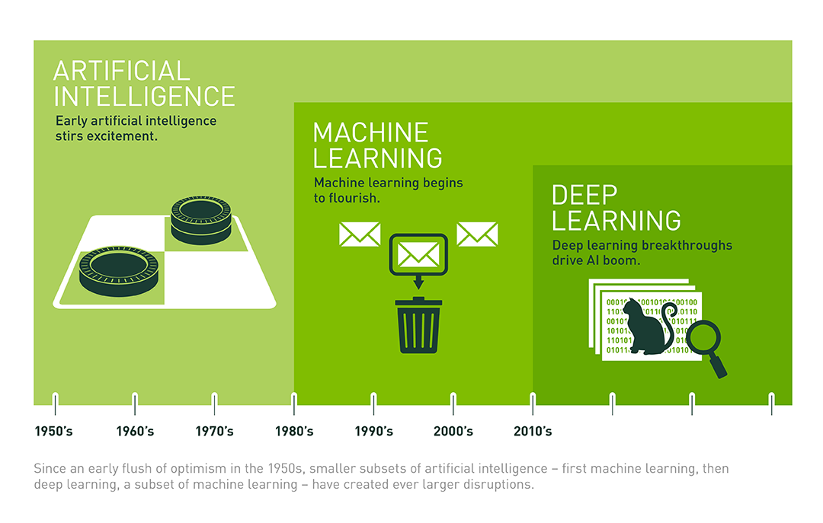
Relationship btw AI, ML and DL
Notes:
The easiest way to think of the relationship is to visualize them as Concentric circles with AI, the idea of artificial intelligent came first (around 1842, by who??), then machine learning -which blossomed later, and finally deep learning which is driving today's AI explosion.
AI can be a pile of if-then statements (rule engine), or a complex statistical model
Machine learning is a subset of AI. That is, all machine learning counts as AI, but not all AI counts as machine learning. For example, symbolic logic – rules engines, expert systems and knowledge graphs – could all be described as AI, and none of them are machine learning.

Slide 11
History of Deep Learning
Speech recognition I (late 1080s)
Handwriting recognition and OCR (late 1980s to mid 1990s)
Face & People Detection (early 1990s to mid 2000s)
Object recognition I (2000s)
Low-Res Object Recognition (2010s):
Speech recognition II (2011)
Object recognition III, semantic labeling (2012)
Notes:
New way to learn the weights for networks with more hidden layers (partial derivatives and backpropagation)
unsupervised feature learning (intermediate features)
Feature detectors

Slide 12
Milestone of Deep Learning
Development
Technology advancement
Big data
Academic research
GPU
Current status
Notes:
New way to learn the weights for networks with more hidden layers (partial derivatives and backpropagation)
unsupervised feature learning (intermediate features)
Feature detectors

Slide 13
People in deep learning

Slide 14
Deep Learning Application
Image – label image
Audio – speech recognition
Text – web search
Computer vision
Robotics

Slide 15
Deep Learning KPMG use cases
Policy simplification – NLP
financial services – responsible lending / policy simplification
Retails – digital assistance
Image recognition – toll road , plate recognition
Video preprocessing – crime
Government client – crime prevention, public monitor

Slide 16
Foundation of Deep Learning
els

Slide 17
CNN
els

Slide 18
RNN
LSTM
GRUs
Dynamic Memory Networks
Attention Model
NLP
Reasoning bot
Image / video captioning
Word2vec, seq2seq. TF-IDF

Slide 19
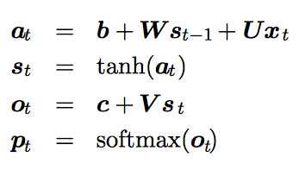
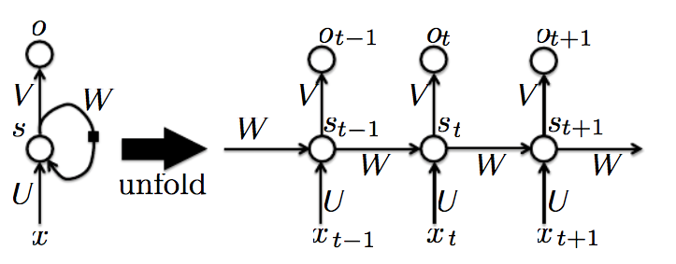
RNN: Recurrent Neural Network
Designed to process sequential input: speech, text, video, etc.
Can handle sequences both as input and as output
Weights (U, V, W) are shared across time steps, but inputs and outputs vary
Can model fixed-length as well as varying-length sequences
Longer sequences lead to vanishing gradients, poor performance (LSTMs help fix this)
Output o
Parameters U, V, W
Learning
Prediction
State s
Input x
Time

Slide 20
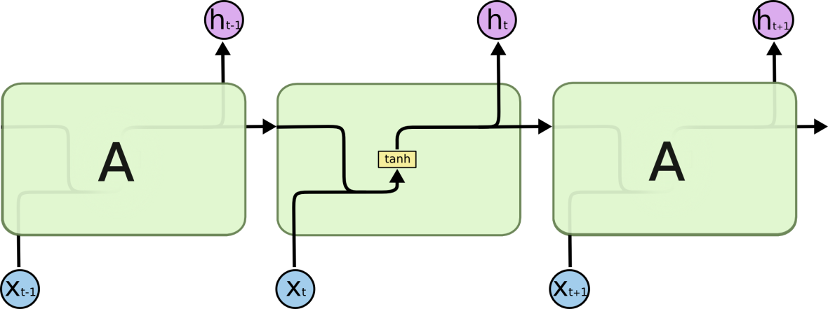

LSTM: Long Short-Term Memory Network
RNN: each state gets the previous state as input
LSTM: each state gets the previous state as input, PLUS
a “memory” state that can preserve state over long times

Slide 21
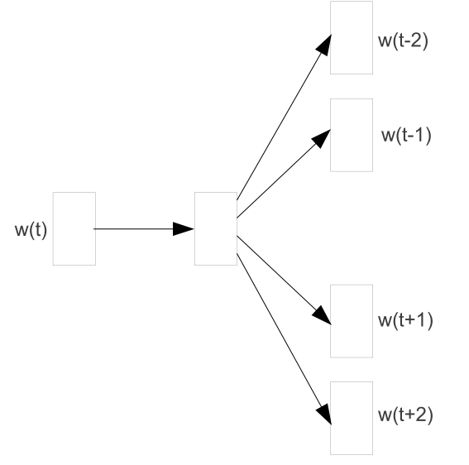
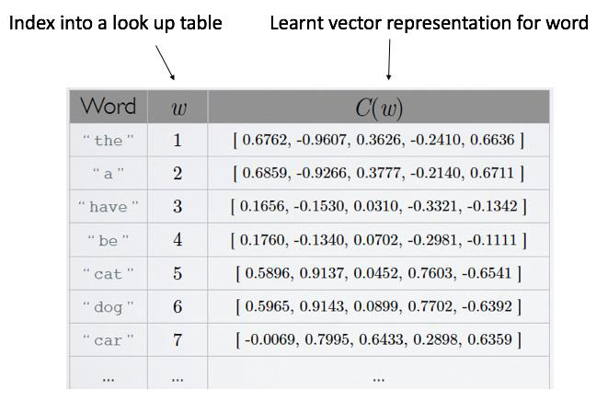
Language Modeling
I
Word2Vec Model
play
soccer
on
All inputs, parameters, and outputs in a Deep Learning model are matrices of real numbers
Naïve approach to text is to have a one-hot encoding for each word
Embeddings use fewer dimensions and contain more information
Can use pre-trained embeddings or random embeddings which get trained with the model.
Input data is a 3-D matrix (length of sentence, length of embedding, number of sentences)
Saturday

Slide 22
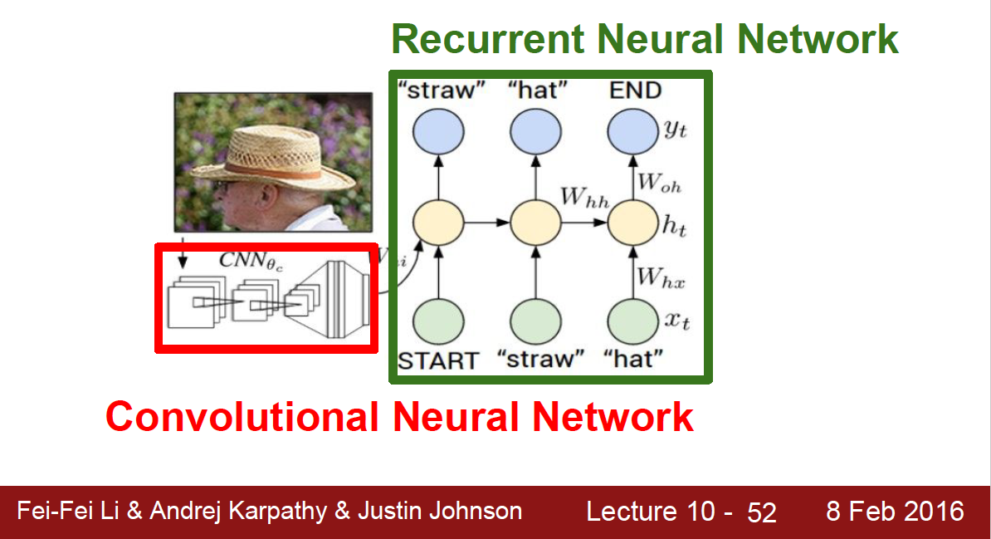
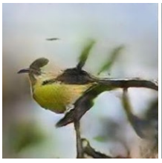
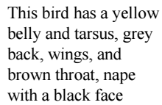
NLP Deep Learning use cases
Fake Wikipedia text, letter-by-letter
Many governments recognize the military housing of the [[Civil Liberalization and Infantry Resolution 265 National Party in Hungary]], that is sympathetic to be to the [[Punjab Resolution]] (PJS)[http://www.humah.yahoo.com/guardian. cfm/7754800786d17551963s89.htm Official economics Adjoint for the Nazism, Montgomery was swear to advance to the resources for those Socialism's rule, was starting to signing a major tripad of aid exile.]]
Question answering with memory networks
John dropped the milk.
John took the milk there.
Sandra went to the bathroom.
John moved to the hallway.
Mary went to the bedroom.
Where is the milk ? Hallway

Slide 23
What’s more
Kubeflow
Probabilistic graphical model
Monte Carlo Simulation
Generic Algorithms
Reinforcement learning
Sequence learning w/ weak feedback from a distant goal
Learn to play video games
Generative adversarial network
Generator learns to produce fake data that looks real
Discriminator learns to distinguish real from fake data
Capsule Networks

Slide 24
Summary

Slide 25
Afternoon Training Session
Tensorflow & JupterNote Book
Computational graph
Vectorization, partial derivatation
Activation function
Backpropagation / forward propagation
Dropout regularization
Optimization algorithms
Mini-batch
Exponentially weighted average
Gradient descent with momentum
RMSprop
Adam
model optimization
Normalizing input
Vanishing / exploding gradient
Weight initialization
Batch norm
Softmax regression

