Slide 1
iSelect Product Ranking Analysis
Internship insight presentation
By Catherine wang

Slide 2
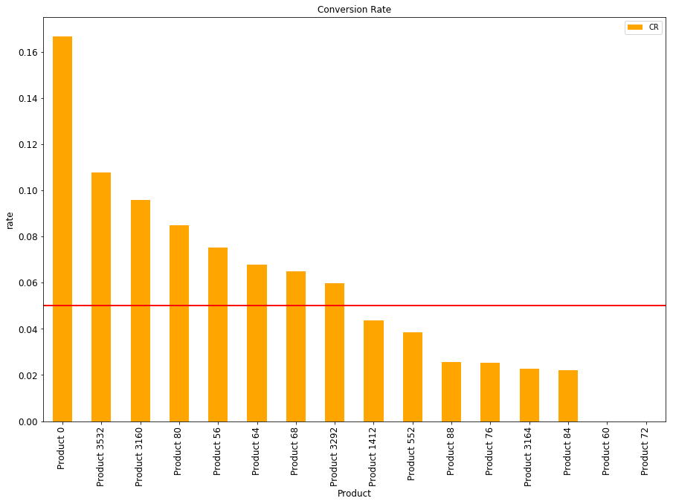
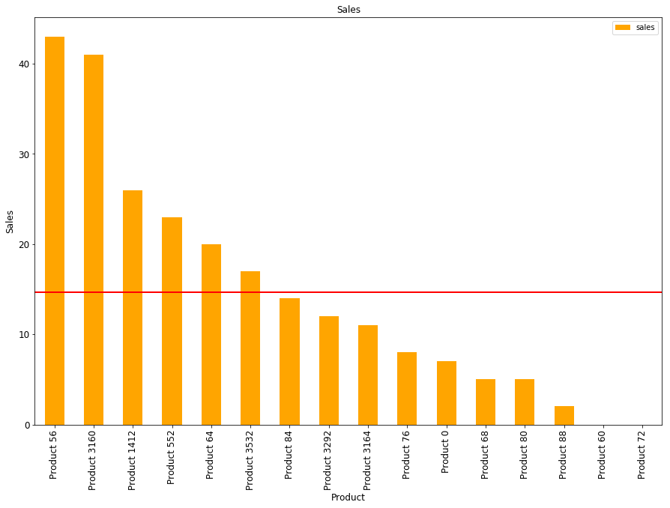
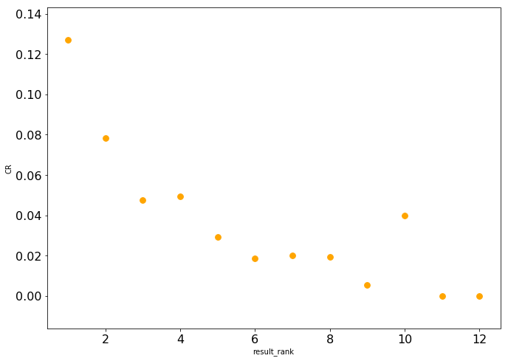
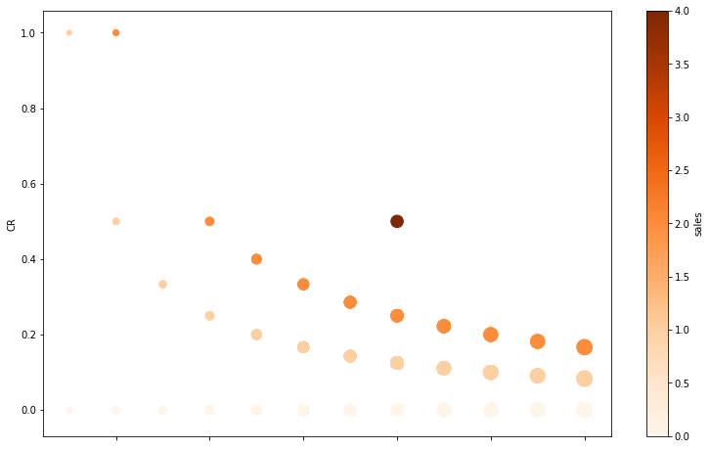
Effectiveness of iSelect Ranking System
Conversion rate by Product
Sales by Product
Using conversion rate to measure the performance of Ranking system
8 out of 16 products’ CR was above average line ( ≈ 0.05)
Only 6 out of 16 product has higher sales than average (14.6)
Conversion rate and products rank is positive correlated
Conversion rate and number of products recommend are negatively correlated
Conversion rate by Ranking
Conversion rate by # of product on page

Slide 3
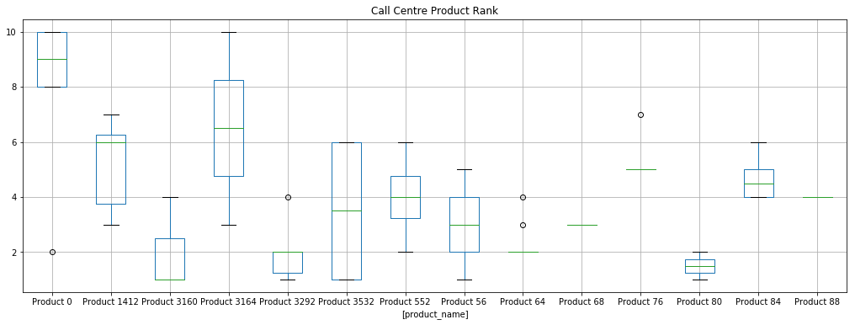
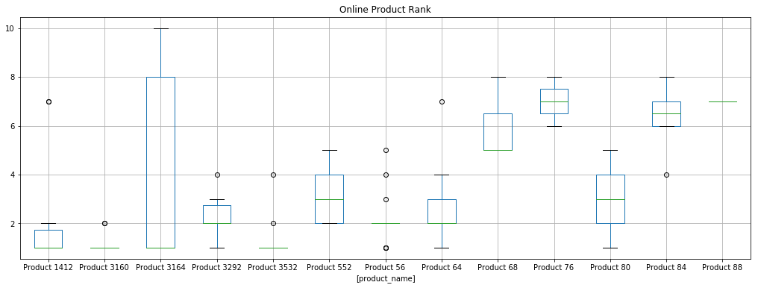
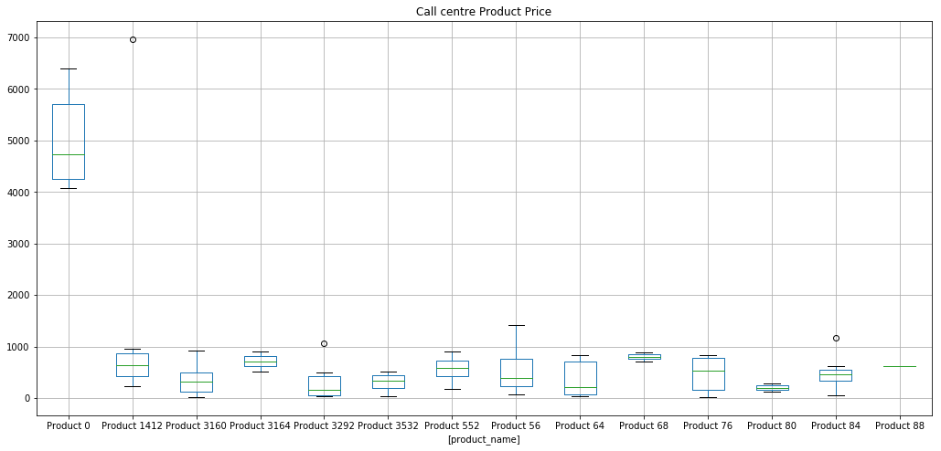
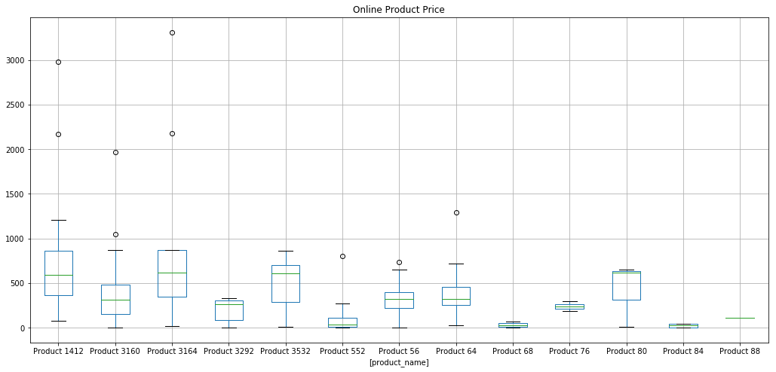
Call Centre Vs. Online
Weighted Average Price for Call Centre ≈ $816.89
Weighted Average Ranking for Call Centre ≈ 3. 88
Call Centre contribute 0.48 percent sales
Average Product customer brought through Call Centre is 1.15
Weighted Average Price for Online ≈ $452.87
Weighted Average Ranking for Online ≈ 2.68
Online contribute 0.52 percent sales
Average Product customer brought through Call Centre is 1.07

Slide 4
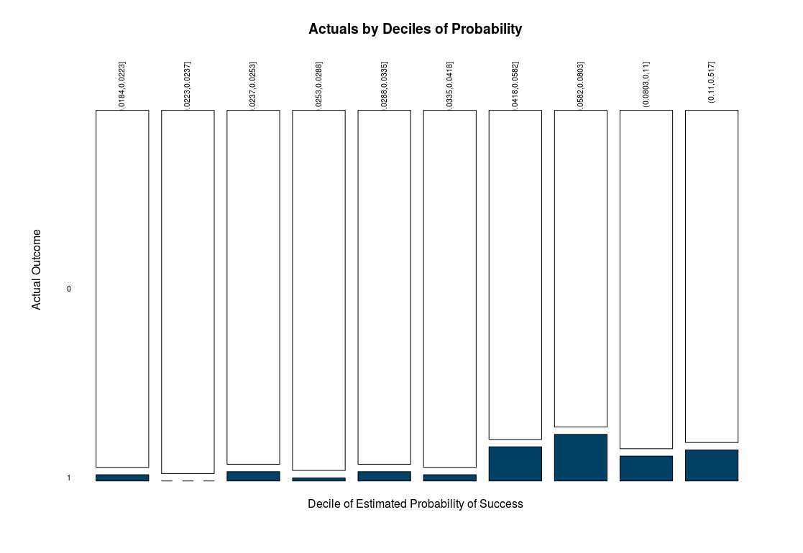
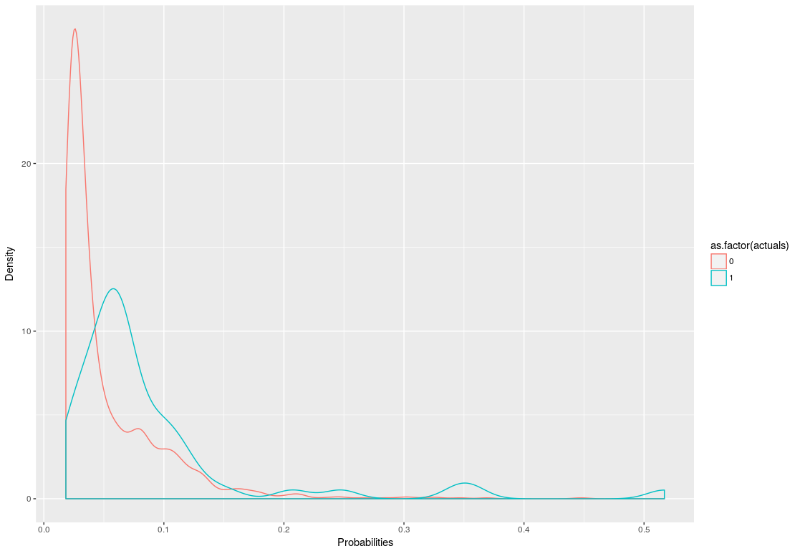
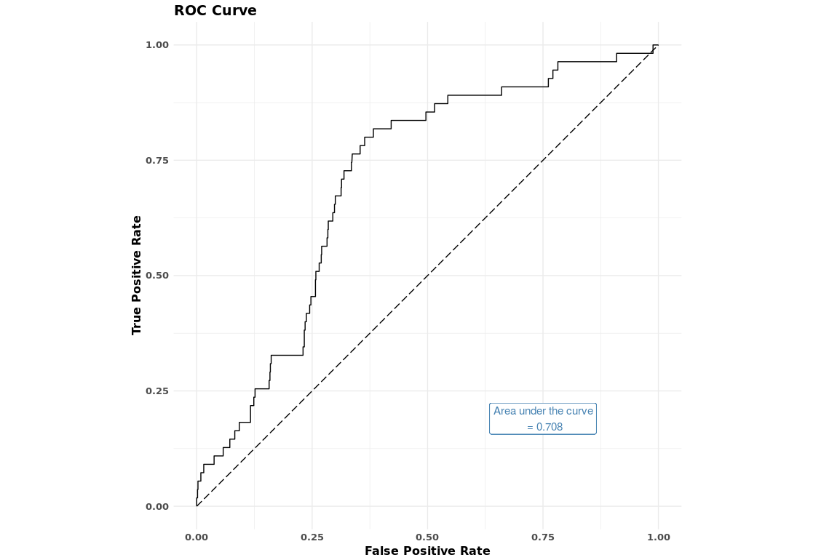
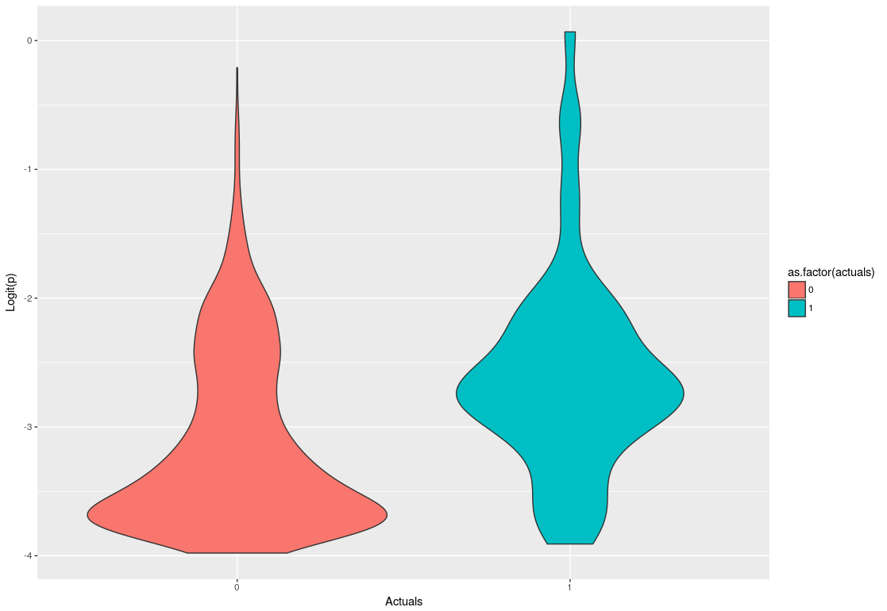
Gradient Boosting Predictive Model
Feature
TotalProd
Percentile of Ranking
Provider
AvgPrice
PriceIndex
PercProvider
Data Split
Stratified Sampling
50% training : 25% testing : 25% validation
Result
Low Specificity (0.51)
Unbalanced target variable
Small dataset
Accuracy: 0.532

Slide 5
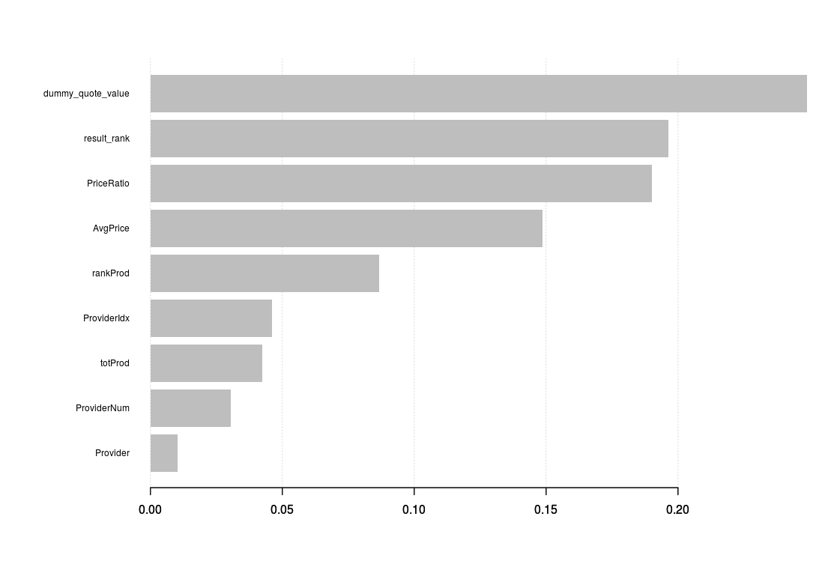
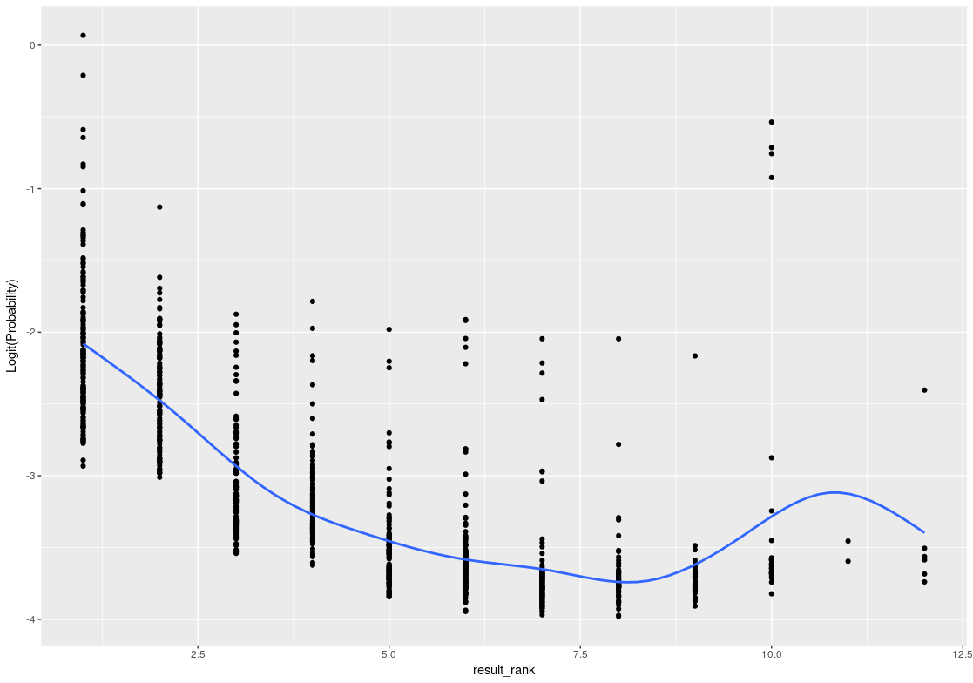
Metrics for Comparing Providers and Produts
Feature Relevance
Feature Analysis based on GBT
result_rank , dummy_quote_value and PriceRatio are top 3 most important features
Used them as Metrics when comparing Providers and Products
linear correlations between result_rank and predicted possibilities
Improvement
More Features (Product hierarchy, Customer behavior/ personal information, Product / Bundle / Promotion details)
CTR (Purchase predictions can be fed into next layer of models)
Optimize the rankings of product recommendations on the page
A/B Testing
Probability by Ranking

