Slide 1
Weekly Report 8.30.2013
n
Yao Heng
Rlibs Zhejiang University

Slide 2
Introduction
We did these based on an Assumption :
We assume that the strengths of the functional interactions between the genes that en- code physically interacting proteins were approximately at the same level.
Feature
Statistics
Protein Pairs
Data
The Assumption
Physical Interaction
Fonctional Interaction

Slide 3
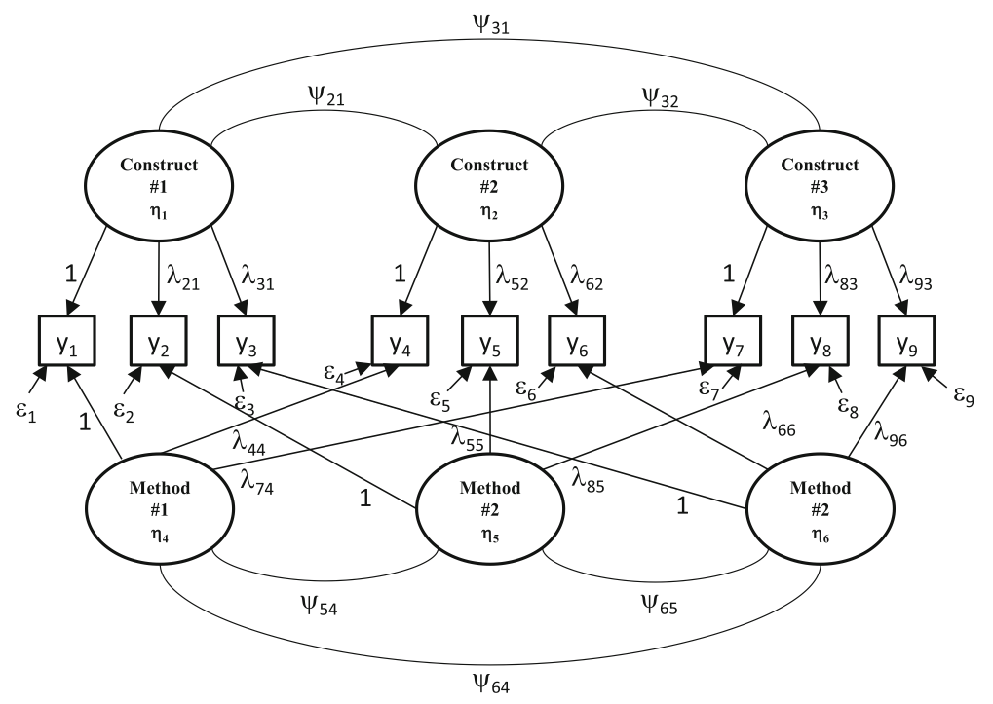
Introduction
What we do：
我们通过Factor Analysis得以找出生物学概念和数据之间的Latent Factors
通过SEM的方法，选取合适的统计学方法，我们能到并检验这些Latent Factors之间的数学关系
Conception
Fonctional Interaction
Why We do this：
未经抽象的数据对于作为生物学概念Fonctional Interaction的统计学效力并不相同(The strengths were not at the same level)而Fonctional Interaction并不是一个统计学构造因此没有精确的数学度量
Latent Factor是从数据中提取出的经过初步抽象的统计学构造，它们是经过初步抽象的Features。通过SEM确定，检验，并修正这些Features和原生数据间的关系而获得一批具有可度量统计学效力的Latent Factors。
Latent
Factor
Statistics
Data
Physical Interaction

Slide 4
Introduction
Data Collection
ComPASS & the data-source in the paper
Feature Selection
Analysis Software
Calculative effciency
Data format
Theory Learning
Paper Reading

Slide 5
Q&A

Slide 6
Tnank You

