Slide 1
Weekly Report 02.28.2014
5
Yao Heng
Rlibs Zhejiang University

Slide 2
Weekly Summary
GO DATA
Go_Association
1. association
2. gene_product
3. evidence
Go_Graph
1. term
2. term2Term
Go_Optimisation
*1. gene_product_count
*2. grapg_path

Slide 3


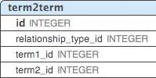



Weekly Summary

Slide 4
Tnank You

