Slide 1
Weekly Report
Introduction writing

Slide 2
Main Topics
Protein-protein interactions are important.
Review the experimental resource.
Old PAIR introduction
New Features of the update of PAIR
Application of PAIR

Slide 3
Protein-protein interactions are important.
Fundamental essential to explain cellular process.
Promote a better understanding towards protein functions and a deeper cognition of regulation biological process
Lead to an insight into the high-level causality between molecular mechanisms and certain phenotypes.
Find bibliography report the application of PPI to support.

Slide 4
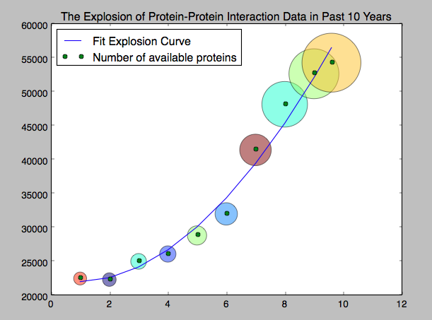
Review the experimental resource (Part.I)
Intact, BIND, BioGrid, TAIR ...
Still grows explosively.

Slide 5
Review the experimental resource (Part.II)
However, experimental data is a drop in the ocean compared to truly existing interactions.
And still, the quality of the data can’t be guaranteed:
1) Single Evidence
2) High Throughput
3) Thus the FP rate is high
Find bibliography to support the FP rate.

Slide 6
Old PAIR introduction
Old PAIR is designed based on the concept of ‘Functional Network’
However, PAIR is the best predicted resource of interactome when applied as an ‘Interaction Network’. (Bibliography support)
1) The basic concept, methods and features of PAIR
2) The limitation of traditional PPIN (Bibliography support) compared to PAIR.

Slide 7
New Features of the update of PAIR
New Methods and Resource
Highly modularized pipeline.
More statistical operators with qualification tools.
Strictly filtered experimental interaction data set.
Newly expanded annotations and profiling data.
New results (waiting for the svm result

Slide 8
Application of PAIR
A general review of the RLIBS works.
Other application citing PAIR/HIR
Bibliography support

