Slide 1
Predicting Action Matrix Movement Based on Power Output
Caty Nolan
Fall 2020

Slide 2
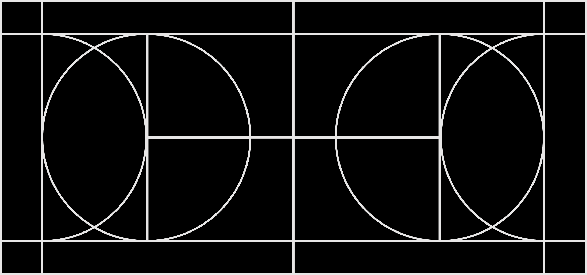
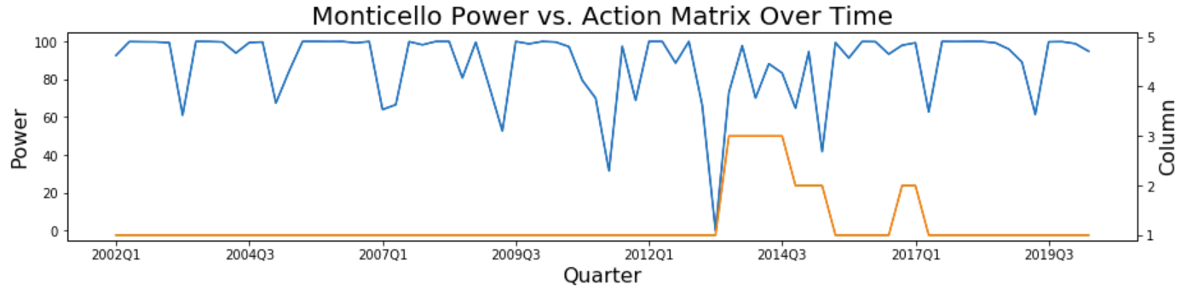
Predictions

