Slide 1
Predicting Action Matrix Movement Based on Power Output
Caty Nolan
Fall 2020

Slide 2
Problem
Predict action matrix column movement
Reactor power level
Number of event notifications
Challenges
Event notification data
Size of data

Slide 3
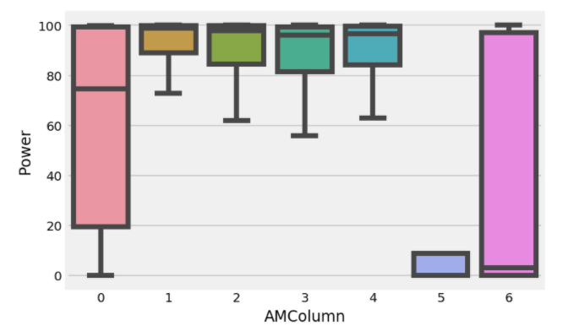
Results

Slide 4

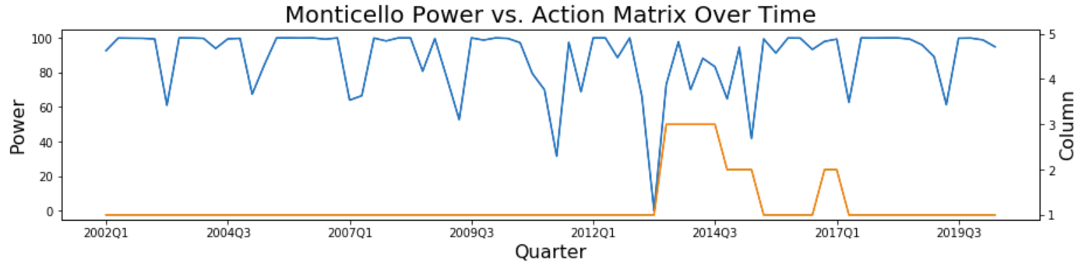
Predictions

Slide 5
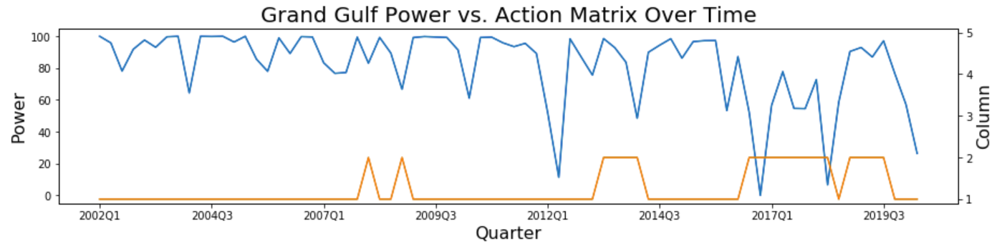
Predictions

Slide 6
Uses
Budget planning
Inspectors
Inspections
Future
Additional features
More methods

