Slide 1
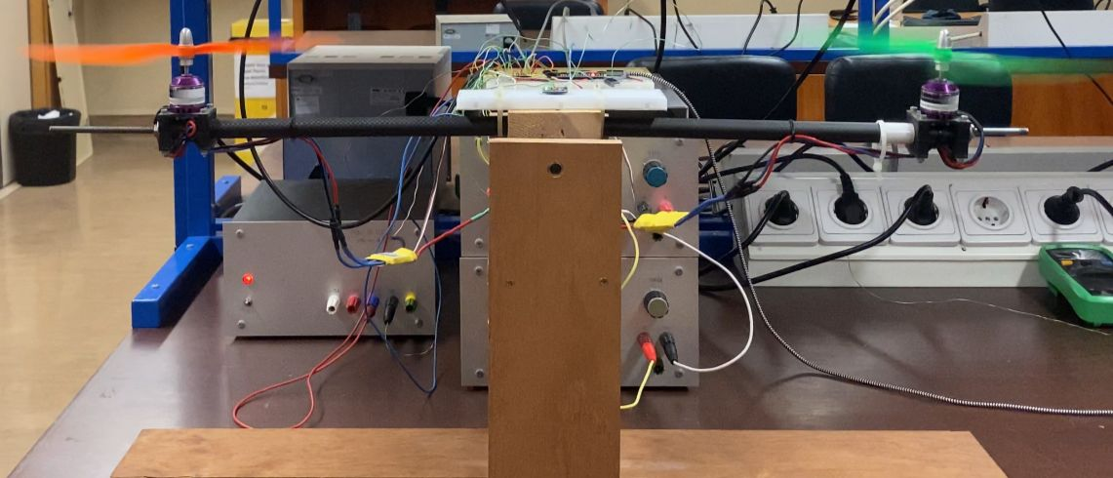

Controlo PID drone 1-dimensão
Cauã Veiga & Felipe Coutinho

Slide 2
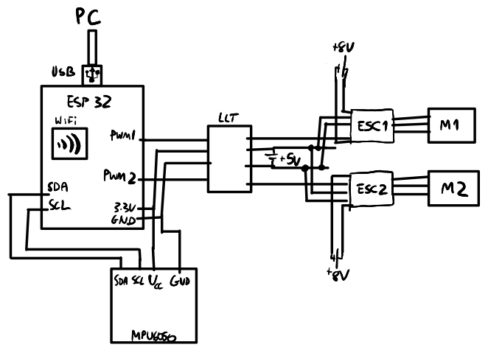
Diagrama Circuito Final

Slide 3
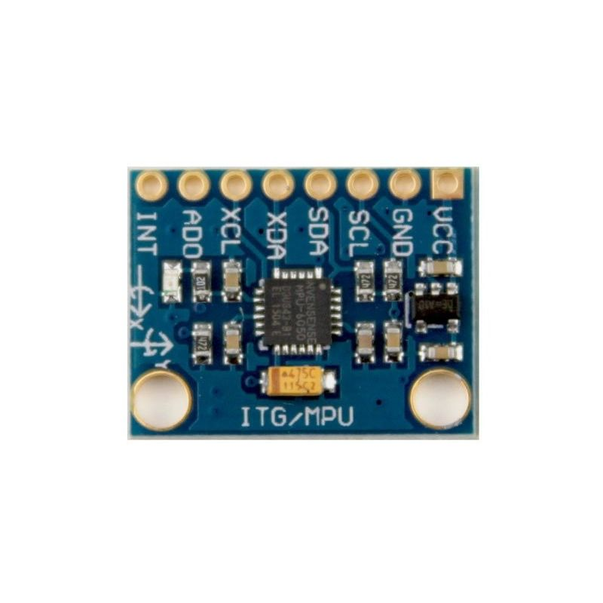
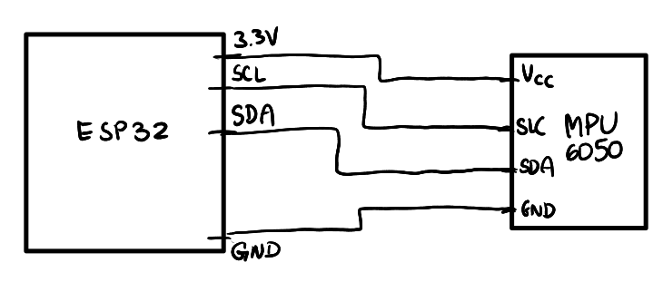
Sensor MPU-6050
http://wiki.sunfounder.cc/index.php?title=MPU6050_Module

Slide 4
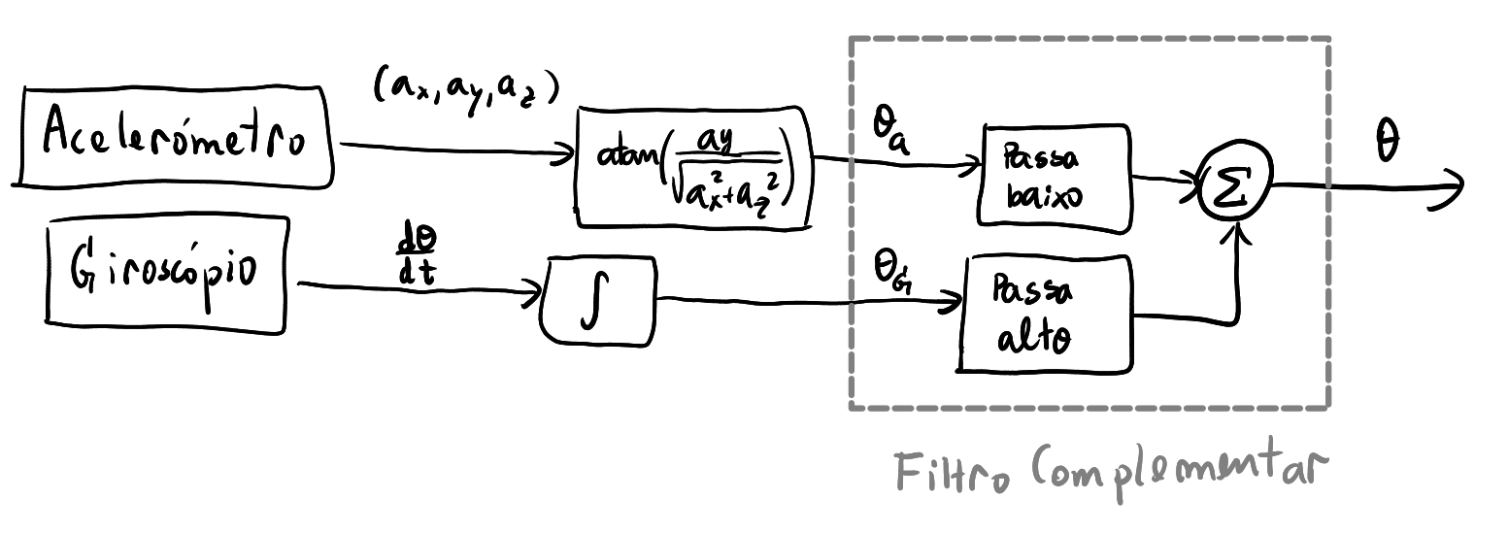
Sensor MPU-6050

Slide 5
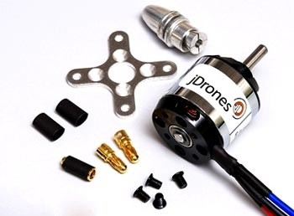
Motor Sem Escovas
Fonte: 8V
Corrente: 1A
https://www.buildyourowndrone.co.uk/850kv-motor-ac2830-358

Slide 6
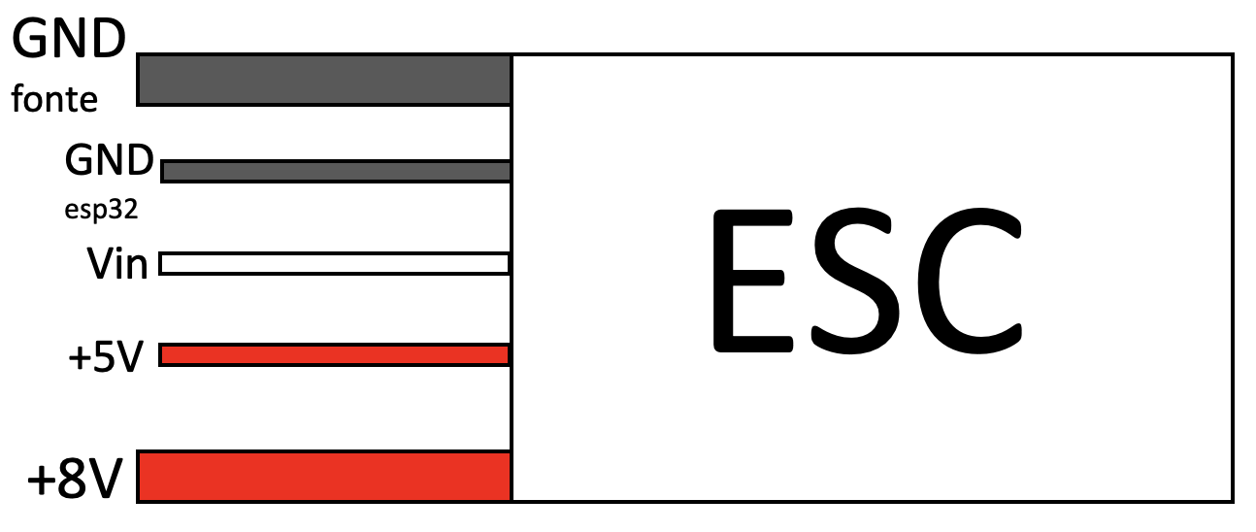
Electronic Speed Control

Slide 7
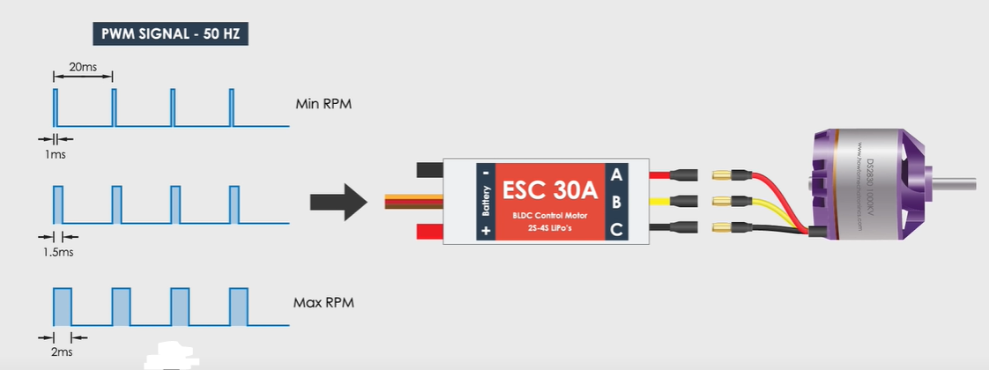
Pulse Width Modulation
“How Brushless Motor and ESC Work and How To Control them using Arduino” https://www.youtube.com/watch?v=uOQk8SJso6Q

Slide 8
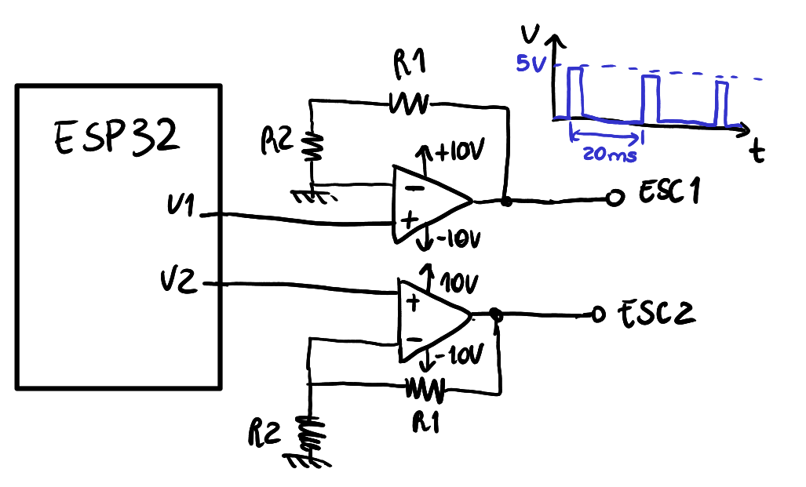
Conversão 3.3V -> 5V

Slide 9
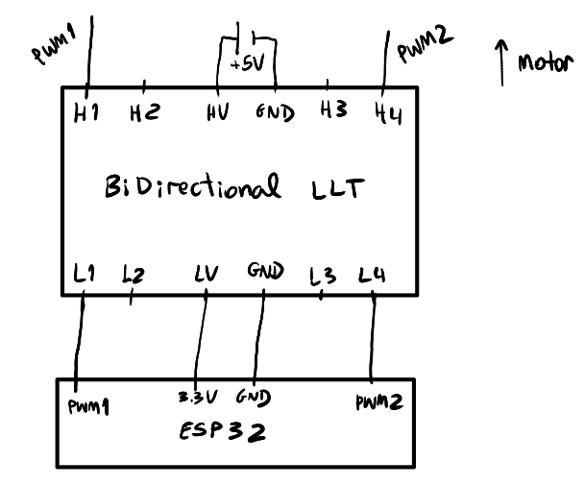
Bidirecional 3.3V⬄5V

Slide 10
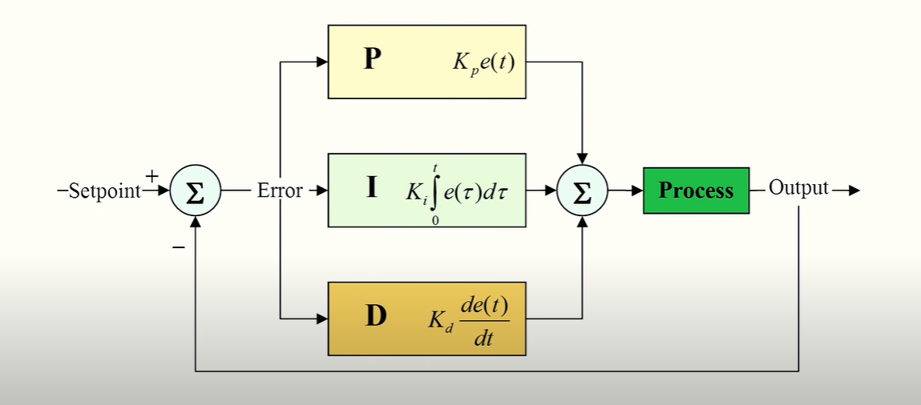
Controlador PID
https://blog.kakaocdn.net/dn/Nk0zF/btqCWdW5LfQ/AUKAtpamO2Ky9Bko9YrWg1/img.png

Slide 11
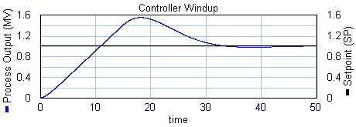
Controlador PID
https://www.20sim.com/webhelp/library_signal_control_pid_control_antiwindup.php

Slide 12
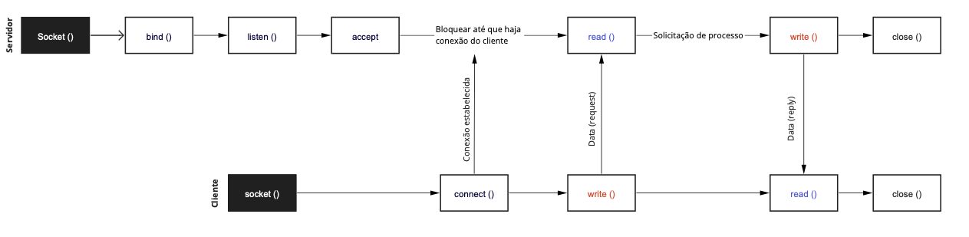
Comunicação WiFi

Slide 13
Comunicação WiFi

Slide 14
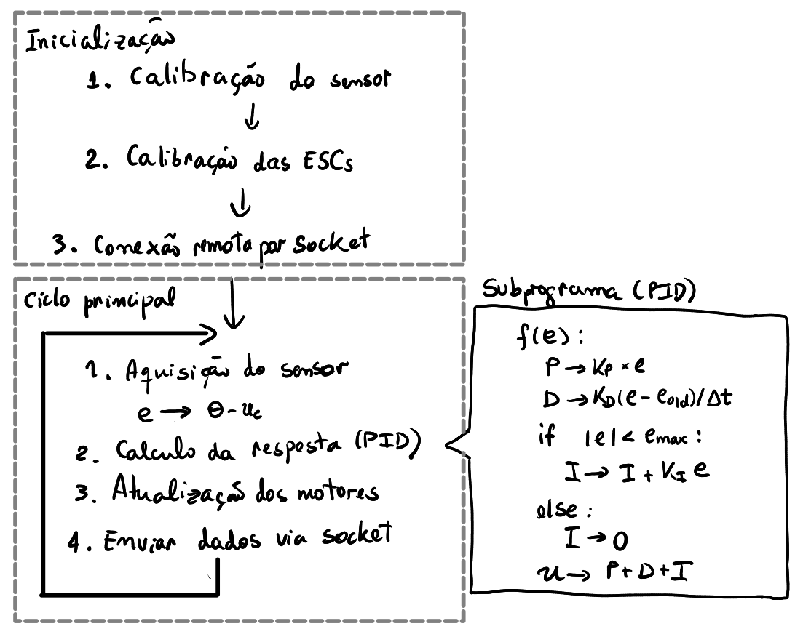
Sistema Final

Slide 15
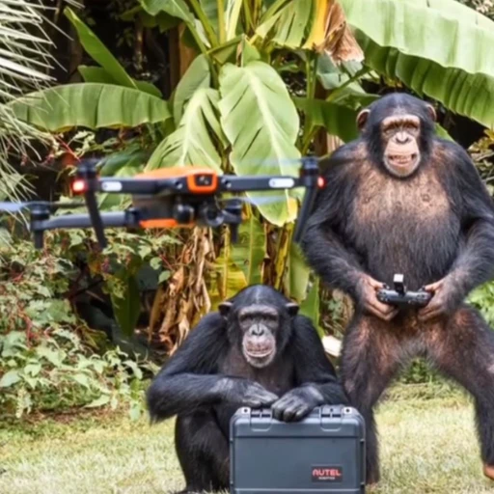
Demonstração

