Slide 1
Customer Premise Equipment Management API Proposal

Slide 2


High-Level Overview
Customer Premises Equipment (CPE), refers to telecommunications and information technology equipment located at the customer's site, specifically associated with their account and address:
Wi-Fi routers
Modems
Set top boxes
The CPE Management APIs enhance functionality for value added resellers and vendors in the short-term rental sector, offering features such as:
Manage SSID
Reboot equipment

Slide 3
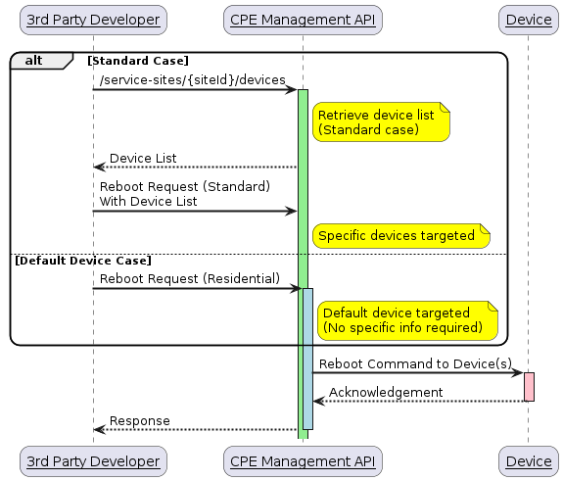
Example Flow
Standard CASE/DEFAULT DEVICE CASE - REBOOT DEVICE
Service Site
A distinct service owner location, as interpreted by the network operator, with one or more devices. A service site typically has a one-to-one relationship with the mailing address of the location.
Device
A network operator supplied network access device that supports isolated networks.

Slide 4
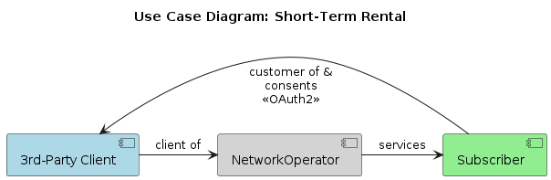
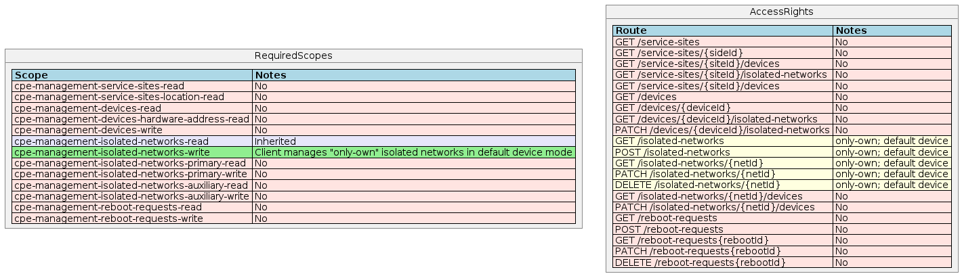
Use Case (B2B2C) – Short Term Rental
Example short term rental use case for managing a guest network for a host that is the subscriber with a single device.

Slide 5
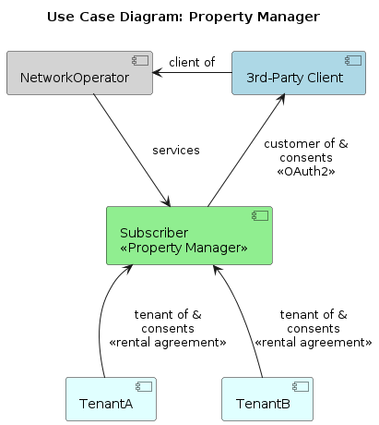
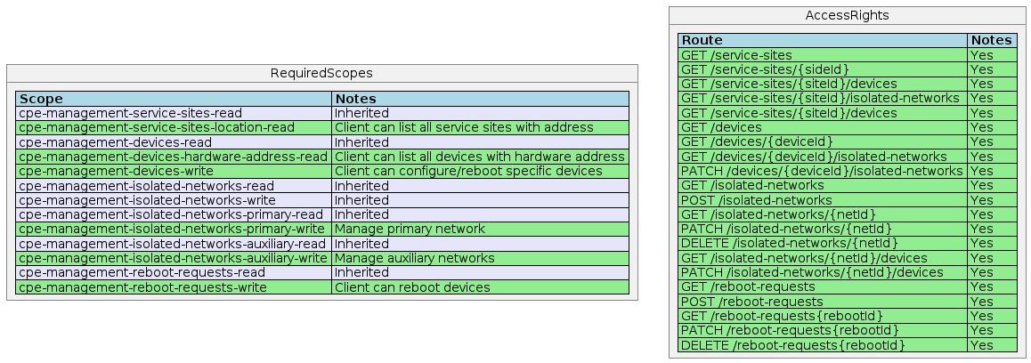
Use Case (B2B2B2C) – Property Manager
Example hospitality use case where the property manager is the subscriber of services providing internet as an amenity through a 3rd-party reseller with a tenant portal. Property manager may have tens of thousands of units in their portfolio making it prohibitive to target a specific tenant without an equipment to unit mapping supplied by the network operator.

Slide 6
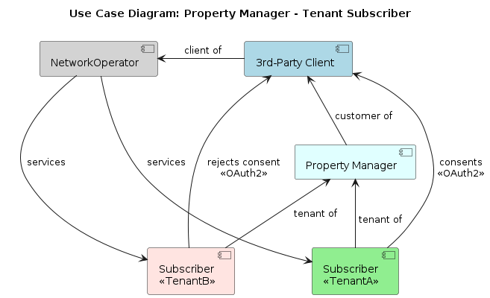
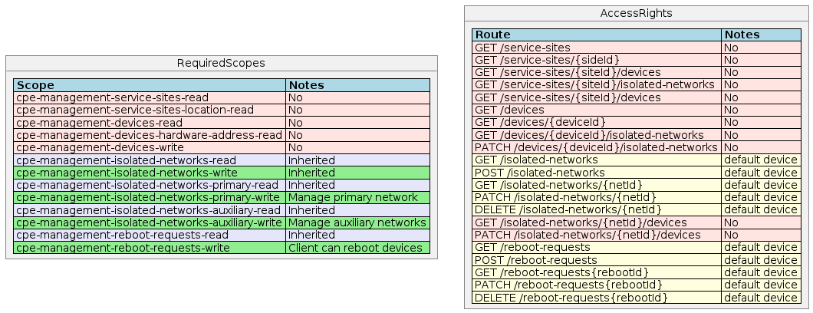
Use Case (B2B2B2C) – Property Manager – Tenant Subscriber
Example hospitality use case where the property manager offers network management through a tenant portal provided by a 3rd-Party as an amenity. The tenant is the subscriber and must individually consent.

Slide 7
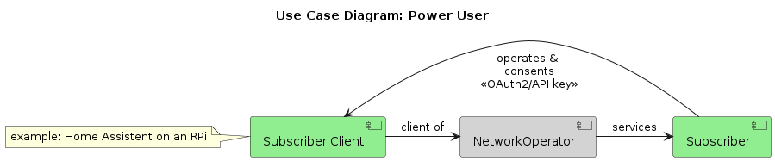
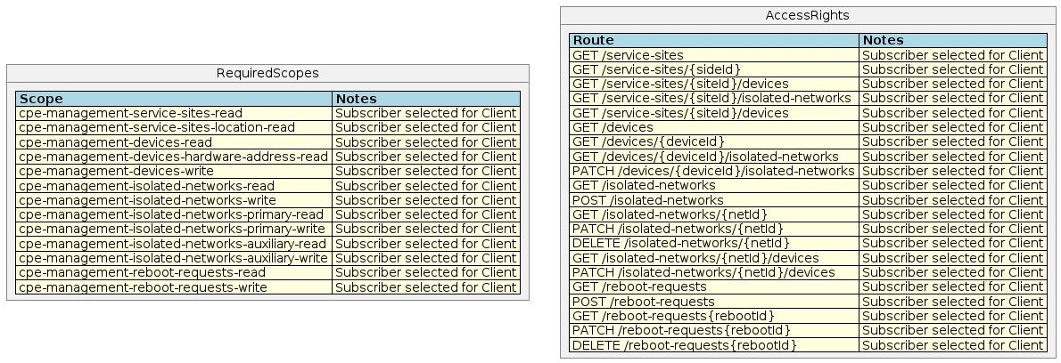
Use Case (B2C) – Power User
Example power user use case where they consent a self-hosted application to manage the network.

