Slide 1
Ethnicity Detection
Using Neural Networks
Christopher Audretsch

Slide 2

Goal
-> “Asian”

Slide 3
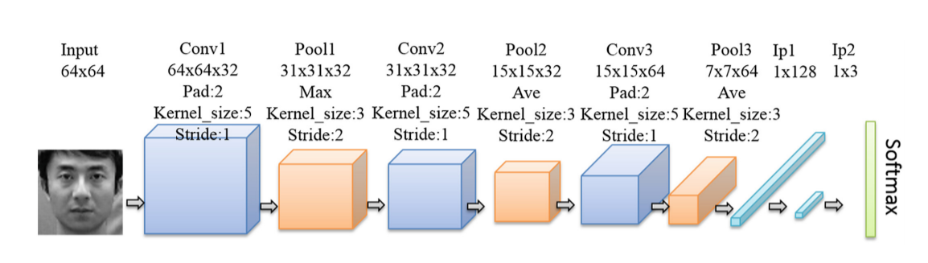
Paper
Wang, W., He, F., & Zhao, Q. (2016). Facial Ethnicity Classification with Deep Convolutional Neural Networks. Lecture Notes in Computer Science, 176–185. doi:10.1007/978-3-319-46654-5_20

Slide 4
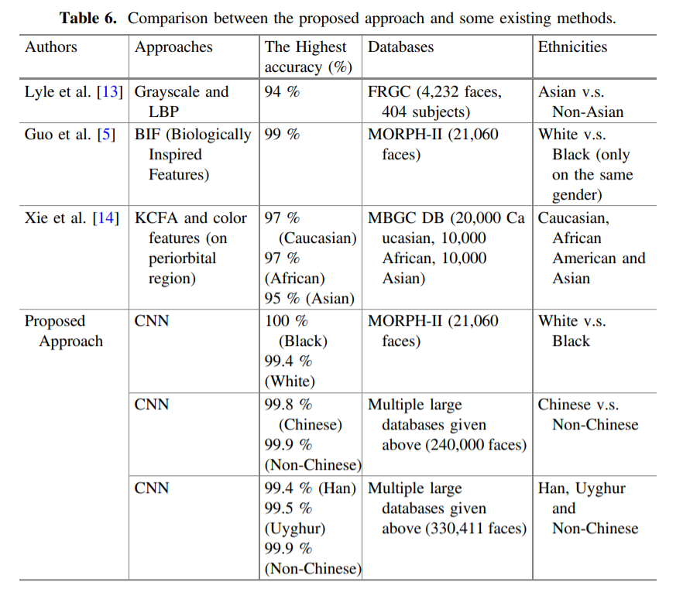

Slide 5



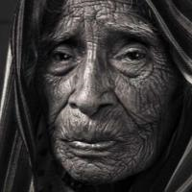
Dataset
“UTKFaces”
~20,000 images of faces
White, Black, Asian, Indian, Other
42%/19%/14%/17%/7%
Various ages, lighting, etc.
Aligned and cropped

Slide 6
Algorithm Overview
Preprocess data How?
Initialize neural net What architecture?
Train
Test
Repeat
Using Pytorch in Python

Slide 7
Data Processing
Images initially are 200x200x3 matrices, with values 0-255
Convert to grayscale
Resize to 64x64
Convert to tensor
Normalize
Average of image pixel values should be 0 with values from -1 to 1

Slide 8
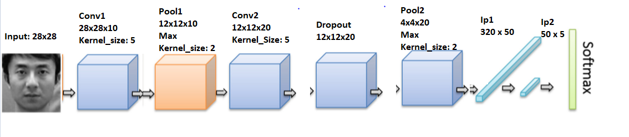
Architecture 1

Slide 9


Architecture 2
Notes:
Ip means “fully connected”

Slide 10
Training, Specifications
10,000 images in training set
2,000 images in testing set
~12,000 images left for final testing
Relu activation
Negative Log Likelihood loss
Stochastic Gradient Descent optimization

Slide 11
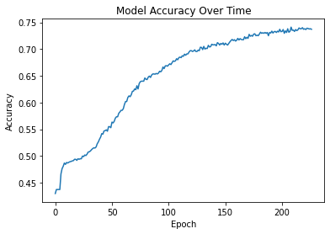
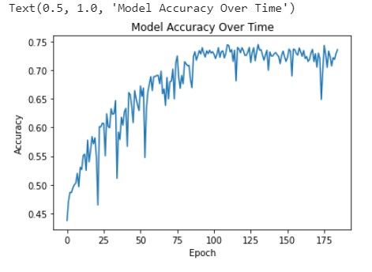
Architecture 1 (generic) Architecture 2 (from paper)
Notes:
With 800 epochs, Model 1 reached 77% around Epoch 500 and stalled there. But I lost my data on that.

Slide 12
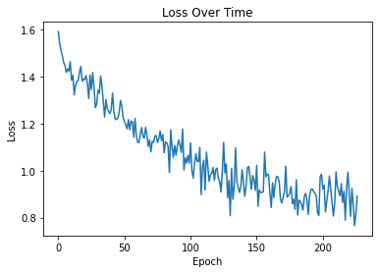
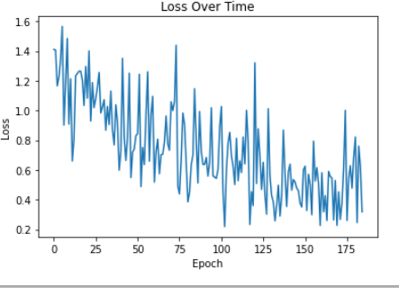
Architecture 1 (generic) Architecture 2 (from paper)

Slide 13




0 = White, 1 = Black, 2 = Asian, 3 = Indian, 4 = Other
Notes:
0 = White, 1 = Black, 2 = Asian, 3 = Indian, 4 = Other

Slide 14
Why are my results so much worse?
Less training
Worse dataset
Harder dataset
Model is missing something
Preprocessing

