Slide 1
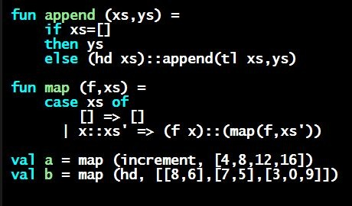
Programming Languages Dan Grossman
Pattern-Matching for Each-Of Types: The Truth About Function Arguments

Slide 2
An exciting segment
Learn some deep truths about “what is really going on”
Using much more syntactic sugar than we realized
Every val-binding and function-binding uses pattern-matching
Every function in ML takes exactly one argument
First need to extend our definition of pattern-matching…

Slide 3
Each-of types
So far have used pattern-matching for one of types because we needed a way to access the values
Pattern matching also works for records and tuples:
The pattern (x1,…,xn)
matches the tuple value (v1,…,vn)
The pattern {f1=x1, …, fn=xn}
matches the record value {f1=v1, …, fn=vn}
(and fields can be reordered)

Slide 4
Example
This is poor style, but based on what I told you so far, the only way to use patterns
Works but poor style to have one-branch cases
fun sum_triple triple =
case triple of
(x, y, z) => x + y + z
fun full_name r =
case r of
{first=x, middle=y, last=z} =>
x ^ " " ^ y ^ " " ^ z

Slide 5
Val-binding patterns
New feature: A val-binding can use a pattern, not just a variable
(Turns out variables are just one kind of pattern, so we just told you a half-truth in lecture 1)
Great for getting (all) pieces out of an each-of type
Can also get only parts out (not shown here)
Usually poor style to put a constructor pattern in a val-binding
Tests for the one variant and raises an exception if a different one is there (like hd, tl, and valOf)
val p = e

Slide 6
Better example
This is okay style
Though we will improve it again next
Semantically identical to one-branch case expressions
fun sum_triple triple =
let val (x, y, z) = triple
in
x + y + z
end
fun full_name r =
let val {first=x, middle=y, last=z} = r
in
x ^ " " ^ y ^ " " ^ z
end

Slide 7
Function-argument patterns
A function argument can also be a pattern
Match against the argument in a function call
Examples (great style!):
fun f p = e
fun sum_triple (x, y, z) =
x + y + z
fun full_name {first=x, middle=y, last=z} =
x ^ " " ^ y ^ " " ^ z

Slide 8
A new way to go
For Homework 2:
Do not use the # character
Do not need to write down any explicit types

Slide 9
Hmm
A function that takes one triple of type int*int*int and returns an int that is their sum:
fun sum_triple (x, y, z) =
x + y + z
A function that takes three int arguments and returns an int that is their sum
fun sum_triple (x, y, z) =
x + y + z
See the difference? (Me neither.) ☺

Slide 10
The truth about functions
In ML, every function takes exactly one argument (*)
What we call multi-argument functions are just functions taking one tuple argument, implemented with a tuple pattern in the function binding
Elegant and flexible language design
Enables cute and useful things you cannot do in Java, e.g.,
* “Zero arguments” is the unit pattern () matching the unit value ()
fun rotate_left (x, y, z) = (y, z, x)
fun rotate_right t = rotate_left(rotate_left t)

