Slide 1
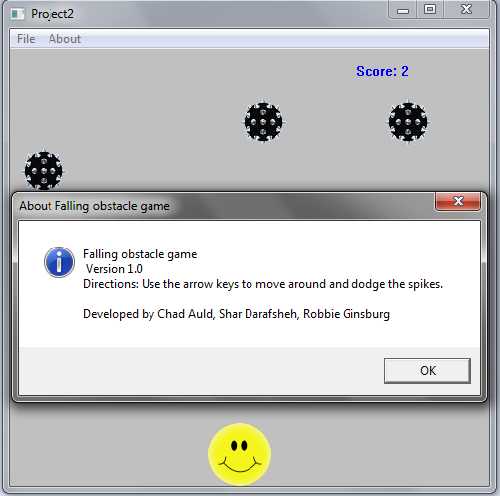
CMSC331 – Ruby Game Project
Chad Auld
Shar Darafsheh
Robbie Ginsburg

Slide 2
Program Demonstration
Link to video demonstration:
http://www.screencast.com/t/WnZQvQmYhc

Slide 3
What We Didn’t Get To…
Power-ups
High score table
Soundtrack

Slide 4
Challenges
Different operating systems
Problems installing/running ruby programs
Some code didn’t run on other computers
Developing in an unfamiliar language
Conflicting schedules

Slide 5
Improvement Suggestions
Collision detection (circles instead of squares)
Better movement (smoother, not simply incrementing the coordinates by set amount)
Images more suited to the game

Slide 6
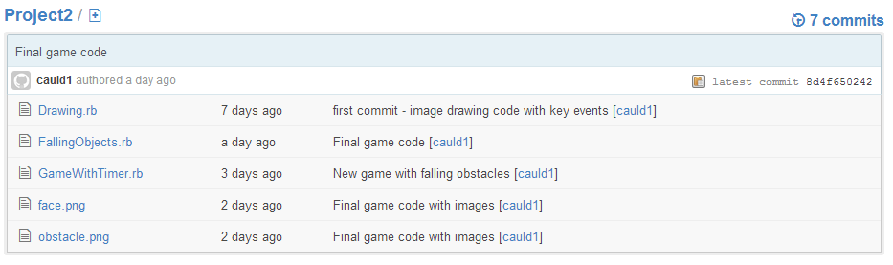
Concurrent Version System (CVS)
Used Github
Everyone accessed one central repository

Slide 7

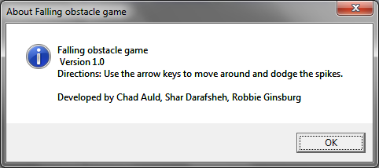
Who Did What: Robbie
Menubar + functionality

Slide 8
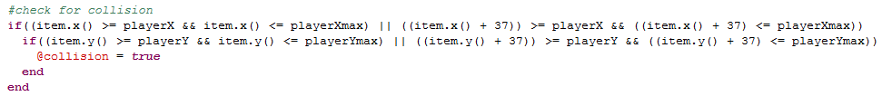
Who Did What: Shar
Algorithm for collision detection
Frame design + attributes

Slide 9
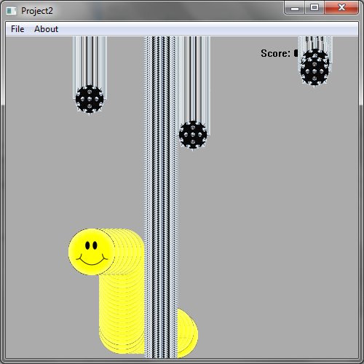
Who Did What: Chad
Object motion
Game logic/timer

