Slide 1
AASC2018
WIFI Password
Join Millenium Conference

Slide 2
Scaling R to the Cloud with doAzureParallel
Chris Auld
Principal Engineering Manager, Microsoft
@cauld

Slide 3
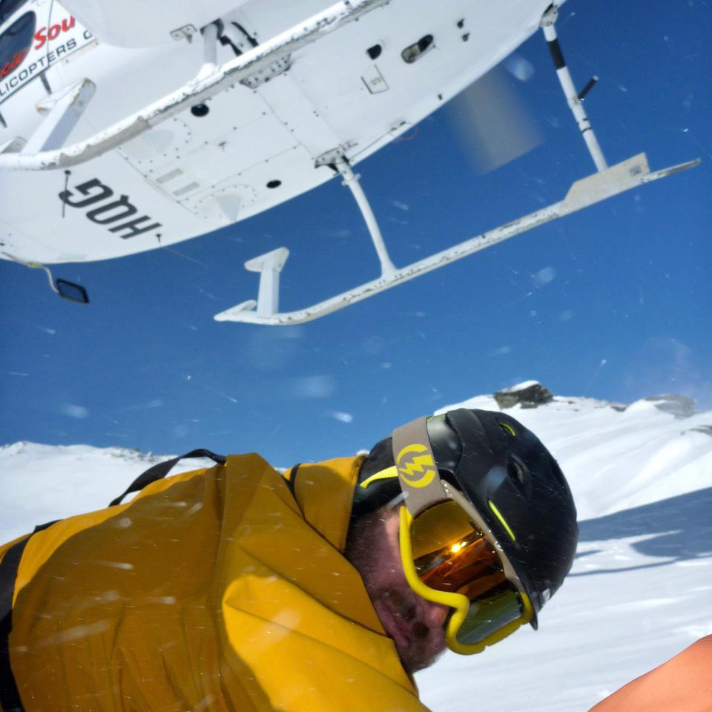



Slide 4

Speeding up your R code
Vectorize
Moar megahertz!
Moar RAM!
Moar cores!
Moar computers!
Moar cloud!
Vectorize

Slide 5
Embarrassingly Parallel Problems
Easy to speed things up when:
Calculating similar things many times
Iterations in a loop, chunks of data, …
Calculations are independent of each other
Each calculation takes a decent amount of time
Just run multiple calculations at the same time

Slide 6
Is this Embarrassing?
Embarrassingly Parallel
Not Embarrassingly Parallel
Group-by Analyses
Reporting
Simulations
Resampling / Bootstrapping
Optimization / Search (somewhat)
Random Forests
Prediction (scoring)
Cross-Validation
Backtesting
SQL operations (many)
Matrix inverse
Linear regression (training)
Logistic Regression (training)
Building Trees
Boosting
Neural Networks (training)
Time Series (most things)
Train tracks

Slide 7
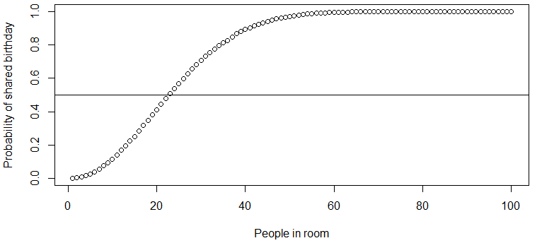
The Birthday Paradox
What is the likelihood that there are two people in this room who share the same birthday?

Slide 8
Birthday Problem Simulator
pbirthdaysim <- function(n) {
ntests <- 100000
pop <- 1:365
anydup <- function(i)
any(duplicated(
sample(pop, n, replace=TRUE)))
sum(sapply(seq(ntests), anydup)) / ntests
}
bdayp <- sapply(1:100, pbirthdaysim)
 About 5 minutes (on this laptop)

Slide 9
HANDS ON GIT CLONE https://tinyurl.com/aasc2018
Running the Birthday Simulation on your Local Machine

Slide 10
library(foreach)
x <- foreach (n=1:100) %dopar% pbirthdaysim(n)
Looping with the foreach package on CRAN
x is a list of results
each entry calculated from RHS of %dopar%
Learn more about foreach: cda.ms/6Q

Slide 11
Parallel processing with foreach
Change how processing is done by registering a backend
registerDoSEQ() sequential processing (default)
registerdoParallel() local cluster via library(parallel)
registerAzureParallel() remote cluster in Azure
Whatever you use, call to foreach does not change
Also: no need to worry about data, packages etc. (mostly)
library(doParallel)
cl <- makeCluster(2) # local cluster, 2 workers
registerDoParallel(cl)
bdayp <- foreach(n=1:100) %dopar% pbirthdaysim(n)

Slide 12
HANDS ON
Running the Birthday Simulation on your Local Machine with foreach

Slide 13
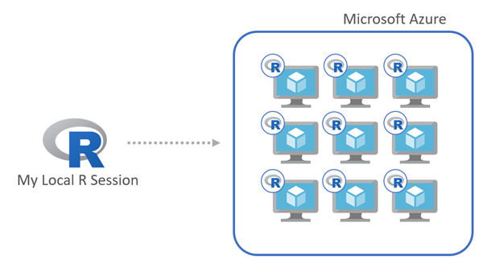
foreach + doAzureParallel
doAzureParallel: A simple R package that uses the Azure Batch cluster service as a parallel-backend for foreach
github.com/Azure/doAzureParallel

Slide 14
Birthday simulation
8-node cluster (compute-optimized D8v3 8-core instances)
Total of 64 cores and 256gb RAM
Cost of 62 cents per hour via Low Priority VMs
specify VM class in cluster.json
specify credentials for Azure Batch and Azure Storage in credentials.json
library(doAzureParallel)
setCredentials("credentials.json")
cluster <- makeCluster("cluster.json")
registerDoAzureParallel(cluster)
bdayp <- foreach(n=1:100) %dopar% pbirthdaysim(n)
bdayp <- unlist(bdayp)
cluster.json (excerpt):
"name": "davidsmi8caret",
"vmSize": "Standard_D2_v2",
"maxTasksPerNode": 8,
"poolSize": {
"dedicatedNodes": {
"min": 8,
"max": 8
}

Slide 15
DEMO – Configuring Batch Cluster

Slide 16
HANDS ON 4 Cores Each (2 x Standard_D2_v3)
Running the Birthday Simulation on the Cloud with doAzureParallel

Slide 17
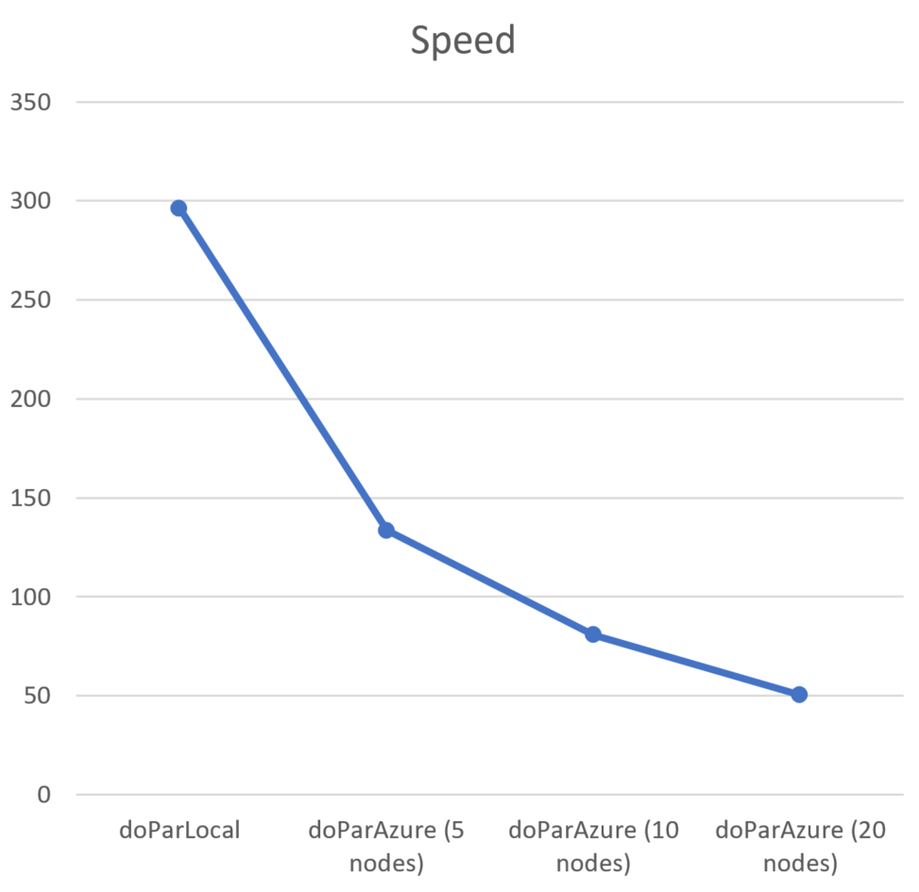
Scale
From 1 to 10,000 VMs for a cluster
From 1 to millions of tasks
Your selection of hardware:
General compute VMs (A-Series / D-Series)
Memory / storage optimized (G-Series)
Compute Optimized (F-Series)
GPU enabled (N-Series)
Results from computing the mandelbrot set when scaling up:
seconds
Local machine
5 parallel workers
10 parallel workers
20 parallel workers

Slide 18
Tuning Your Loops
Ensuring that all Cores are used requires some thought
MaxTasksPerNode in cluster configuration
Nested foreach on the nodes; doParallel will fork processes on Linux
registerDoAzureParallel(pool)
results <- foreach(i = 1:number_of_outer_iterations, .packages='doParallel') %dopar% {
cl <- makeCluster(detectCores())
registerDoParallel(cl)
inner_results <- foreach(j = 1:number_of_inner_iterations) %dopar% {
runAlgorithm()
}
}
Chunky not Chatty
Latency to submit jobs has an impact on performance. Need ‘largish’ chunks of work
opt <- list(chunkSize = 3)
results <- foreach(i = 1:number_of_iterations, .options.azure = opt) %dopar% { ... }

Slide 19
Cross-validation with caret
Most predictive modeling algorithms have “tuning parameters”
Example: Boosted Trees
Boosting iterations
Max Tree Depth
Shrinkage
Parameters affect model performance
Try ‘em out: cross-validate
grid <-
data.frame(
nrounds = …,
max_depth = …,
gamma = …,
colsample_bytree = …,
min_child_weight = …,
subsample = …)
)

Slide 20
Cross-validation in parallel
Caret’s train function will automatically use the registered foreach backend
Just register your cluster first:
registerDoAzureParallel(cluster)
Handles sending objects, data, packages to nodes
mod <- train(
Class ~ .,
data = dat,
method = "xgbTree",
trControl = ctrl,
tuneGrid = grid,
nthread = 1
)

Slide 21
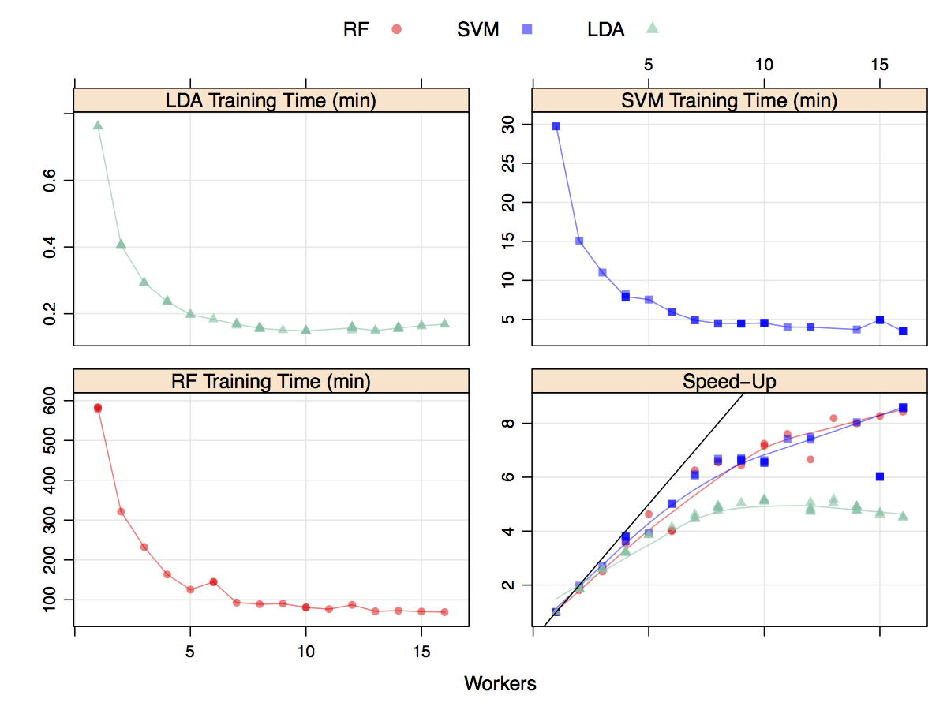
caret speed-ups
Max Kuhn benchmarked various hardware and OS for local parallel
cda.ms/6V
Let’s see how it works with doAzureParallel
Source: cda.ms/6V

Slide 22
Packages and Containers
{
"name": "davidsmi8caret",
"vmSize": "Standard_D2_v2",
"maxTasksPerNode": 8,
"poolSize": {
"dedicatedNodes": {
"min": 0,
"max": 0
},
"lowPriorityNodes": {
"min": 4,
"max": 4
},
"autoscaleFormula": "QUEUE"
},
"containerImage": "jrowen/dcaret:latest",
"rPackages": {
"cran": ["xgboost","e1071"],
"github": [],
"bioconductor": []
},
"commandLine": []
}
Docker images used to spawn nodes
Default: rocker/tidyverse:latest
Caret: jrowen/dcaret:latest
Lots of R packages pre-installed
See how we can also install:
xgboost, e1071
add to cluster.json

Slide 23
HANDS ON – Work in Pairs or groups 8 cores per group
Re-work the provided script to find an optimized set of XGBoost Hyperparameters using doAzureParallel

Slide 24
How much does it cost?
Pay by the minute only for VMs used in cluster
No additional cost for the Azure Batch cluster service
Using D8v3 Virtual Machines
Ubuntu 16, 8Mb RAM, 8-core “compute optimized”
17 minutes × 8 VMs @ $0.38 / hour
about 23 cents (not counting startup)
… but why pay full price?

Slide 25

Low Priority Nodes
Low-Priority = (very) Low Costs VMs from surplus capacity
up to 80% discount
Clusters can mix dedicated VMs and low-priority VMs
D8_v3 LowPri @ $0.077/hr
"poolSize": {
"dedicatedNodes": {
"min": 3,
"max": 3
},
"lowPriorityNodes": {
"min": 9,
"max": 9
},
Azure Batch
Dedicated VMs
Low Priority VMs
at up to 80% discount
My Local R Session

Slide 26
Cost Effective: More about Low Priority
When should I use it?
Long running work that can be broken into smaller pieces and work that doesn't have a strict time limit to complete
Experimentation, testing, evaluating models
What you need to know when using it:
Possibility that Azure
will not allocate your VMs OR
that it will take some or all of the low-priority capacity back
If a node is pre-empted
Azure Batch will replace your node for you
Azure Batch will reschedule your work so that you job can successfully complete

Slide 27
Managing Data
Foreach will transparently pass data into the batch tasks …not always ideal
Manual chunking
chunks <- split(<data_set>, 10) results <- foreach(chunk = iter(chunks)) %dopar% { runAlgorithm(chunk) }
Pre-loading resource files Use ‘Shared Access Signatures’ for security
rAzureBatch::createResourceFile( url=‘http://foo’)) cluster <- makeCluster("cluster.json", resourceFiles = resource_files) listFiles <- foreach(i = 2010:2011, .combine='c') %dopar% {
fileDirectory <- paste0(Sys.getenv("AZ_BATCH_NODE_STARTUP_DIR"), "/wd")
return(list.files(fileDirectory))
}

Slide 28
HANDS ON 2 cores EACH
Re-work the provided script to find an optimized set of XGBoost Hyperparameters using doAzureParallel

Slide 29
TL;DR: Embarrassingly Parallel
Install the foreach and doAzureParallel packages
Get Azure Batch and Azure Storage accounts
Need an account? http://azure.com/free
Set up Azure keys in credentials.json
Define your cluster size/type in cluster.json
Use registerAzureParallel to set up your job
Use foreach / %dopar% to loop in parallel

Slide 30
Distributed data processing with sparklyr
For when it’s not embarrassingly parallel:

Slide 31

What is Spark?
Distributed data processing engine
Store and analyze massive volumes in a robust, scalable cluster
Successor to Hadoop
in-memory engine 100x faster than map-reduce
Highly extensible, with machine-learning capabilities
Supports Scala, Java, Python, R …
Managed cloud services available
Azure Databricks & HDInsight, AWS EMR, GCP Dataproc
Largest open-source data project
Apache project with 1000+ contributors
Notes:
R is #8 in January 2018 Tiobe language rankings. #6 in IEEE Spectrum 2017 top programming languages.

Slide 32

R and Spark: Sparklyr
sparklyr: R interface to Spark
open-source R package from RStudio
Move data between R and Spark
“References” to Spark Data Frames
Familiar R operations, including dplyr syntax
Computations offloaded to Spark cluster, and deferred until needed
CPU/RAM/Disk consumed in cluster, not by R
Interfaces to Spark ML algorithms
spark.rstudio.com

Slide 33
Provisioning clusters for Sparklyr with aztk
aztk: Command-line interface to provision Spark-ready (and Sparklyr-ready) clusters in Batch
www.github.com/azure/aztk
Pip install aztk
Provision a Spark cluster in about 5 minutes
Choice of VM instance types
Use provided Docker instances (or your own)
Pay only for VM usage, by the minute
Optionally, use low-priority nodes to save costs
Tools to manage persistent storage
Easily connect to RStudio Server and Spark UIs from desktop

Slide 34
AZTK - Basic Architecture
AZTK runs Spark on Standalone Mode (on the master) in Azure Batch
All processes run within the Docker container that comes ready with each node
Each node in the cluster is a Spark worker node, one of which is elected as the Spark master (we can also choose to the put the Spark master on its own node)
Additional software/custom-scripts can run on the Spark master node (such as Jupyter, R Studio Server, etc)
Additional software/custom-scripts can run across the Spark worker nodes (such as installing specific jars, propietary libraries, etc)

Slide 35
Launch and connect
Provision a Spark cluster:
aztk spark cluster create --id chauldspark4 --size 4
Connect to the Spark cluster and map ports:
aztk spark cluster ssh --id chauldspark4
Launch RStudio
library(sparklyr)
cluster_url <- paste0("spark://",”localhost”, ":7077")
sc <- spark_connect(master = cluster_url)

Slide 36
dplyr with Sparklyr
Connect to the Spark cluster:
library(sparklyr)
cluster_url <- paste0("spark://", system("hostname -i", intern = TRUE), ":7077")
sc <- spark_connect(master = cluster_url)
Load in some data:
library(dplyr)
flights_tbl <- copy_to(sc, nycflights13::flights, "flights")
Munge with dplyr:
delay <- flights_tbl %>%
group_by(tailnum) %>%
summarise(count = n(), dist = mean(distance), delay = mean(arr_delay)) %>%
filter(count > 20, dist < 2000, !is.na(delay)) %>%
collect

Slide 37
Things to note
All of the computation take place in the Spark cluster
Computations are delayed until you need results
Behind the scenes, Spark SQL statements are being written for you
None of the data comes back to R
Until you call collect, when it becomes a tbl
It’s only at this point you have to worry about data size
Be conscious if you are transferring over the internet
Consider interacting on a ‘remote’ VM
This is all ordinary dplyr syntax

Slide 38
Machine Learning with SparklyR
SparklyR provides R interfaces to Spark’s distributed machine learning algorithms (MLlib)
Computations happing in the Spark cluster, not in R
> m <- ml_linear_regression(delay ~ dist, data=delay_near)
* No rows dropped by 'na.omit' call
> summary(m)
Call: ml_linear_regression(delay ~ dist, data = delay_near)
Deviance Residuals::
Min 1Q Median 3Q Max
-19.9499 -5.8752 -0.7035 5.1867 40.8973
Coefficients:
Estimate Std. Error t value Pr(>|t|)
(Intercept) 0.6904319 1.0199146 0.677 0.4986
dist 0.0195910 0.0019252 10.176 <2e-16 ***
---
Signif. codes: 0 ‘***’ 0.001 ‘**’ 0.01 ‘*’ 0.05 ‘.’ 0.1 ‘ ’ 1
R-Squared: 0.09619
Root Mean Squared Error: 8.075
>

Slide 39
HANDS ON – Work in Pairs or groups 8 cores per group
Train a RandomForest model to predict flight delays in the nycflights13 dataset

Slide 40
In summary
Embarrassingly parallel (small): foreach + local backend
Embarrassingly parallel (big): foreach + cluster backend
Create & use clusters in Azure with doAzureParallel
Low priority can be extremely well priced!
Big, distributed data: sparklyr
Create Spark clusters with sparklyr in Azure with azkt
chauld@microsoft.com

