Slide 1
Modelling COVID-19 Symptoms
Objectives:
To predict result of COVID-19 test by asking a few basic questions about symptoms like cough, head ache, sore throat, etc.
To prioritize testing of patients in case of surge by predicting their likeliness of having the virus by asking some basic questions

Slide 2
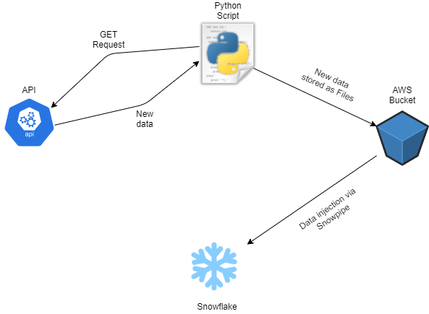
Data Ingestion
Batch Streaming:
Scheduled 24 hours
Israel Health Ministry’s API
AWS Bucket
Data Pipeline through Snowpipe

Slide 3
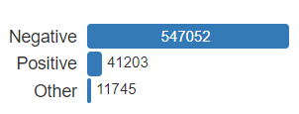
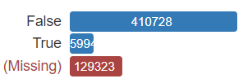
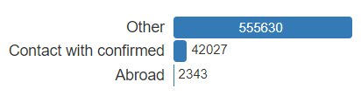
Raw Data Profile
Structure of Data:
  6 Columns of self-reported information – cough, fever, sore throat, shortness of breath, head ache and contact with confirmed
  3 Columns of general information – age 60 and above, gender and test date
  Gender and COVID Result fields are in Hebrew
Around 98% duplicate feature vectors present for each TEST_DATE but with both positive & negative COVID result
AGE_60_AND_ABOVE field has 21% rows missing while GENDER has 8% missing
CORONA_RESULT field AGE_60_AND_ABOVE field TEST_INDICATION field

Slide 4
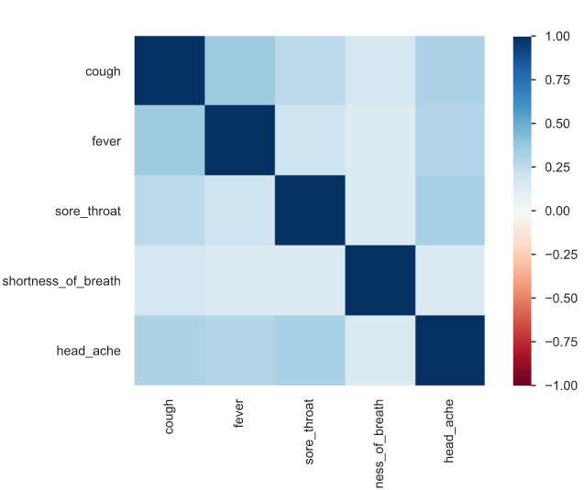
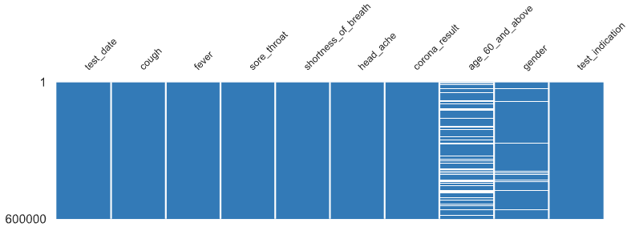
Raw Data Profile
Correlation Matrix of Symptoms
  Features like COUGH, FEVER,
  SORE_THROAT and HEAD_ACHE
  have strong correlation
Plot showing missing values in
various features

Slide 5
Data Quality
High Bias due to Missing Values
Symptoms like lack of smell and taste aren’t present in the Data
Self-Reported Symptoms resulting in higher bias
Fields like TEST_INDICATION didn’t have accurate data about contact with confirmed
Duplicates in features are present but they are important better ML model training since same set of features give different COVID_RESULT values
Overall quality of data isn’t adequate enough for reliable ML Model training

Slide 6
Cleansing of Data & Target Data Profile
Hebrew translated to binary form (0, 1)
All data types (boolean, strings) changed to Integer with binary values (0, 1)
Missing values in AGE_60_AND_ABOVE and GENDER were replaced with 0
TEST_DATE column transformed from datetime format to UNIX timestamp (Integer)
Rows with values “Others” in CORONA_RESULT field were discarded (1-2% of the data)
Values of Abroad (0.5%) and Contact with confirmed (6-7%) were merged in the column TEST_INDICATION

Slide 7
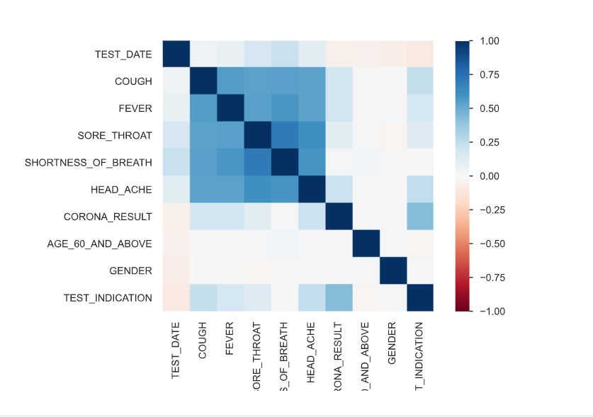
Target Data Profile
Correlation of Features

Slide 8
Machine Learning Model
Gradient Boosting Machine using the python library LightGBM
Trained for 500 rounds with learning rate = 0.05 and early stopping
Previously tried Neural Network using Tensorflow
Accuracy on Test Data-set : 94%
Precision = 54%
Recall = 59%

Slide 9
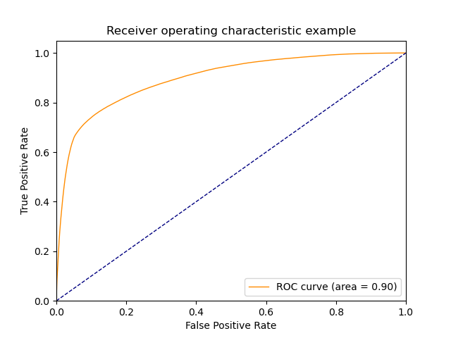
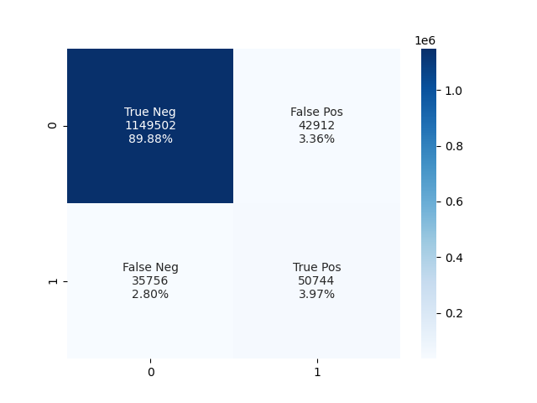
Machine Learning Model
ROC Curve: Confusion Matrix (on Test Data):

Slide 10
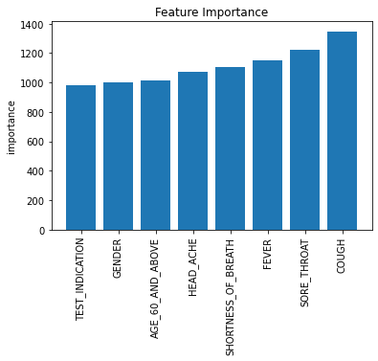
Machine Learning Model - Inferences
Feature Importance
X axis – Feature labels
Y axis – Importance Value
(Higher values mean more important
in CORONA_RESULT prediction)
COUGH sports highest importance value
among all features implying that it was a
major symptom observed in COVID positive
patients

Slide 11
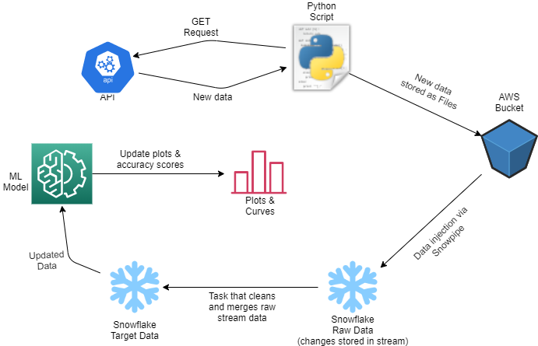
Automation
Scheduled every 24 Hours

Slide 12
Acknowledgment
I would like to express my gratitude to my manager Mr. Kishore Kaushal and my mentor Mrs. Ritu Tomar for guiding me through this project and giving their valued feedback to help improve the overall quality of the same

Slide 13
References
Data has been taken from Israel’s Ministry of Health’s public databases available online
Machine Learning Model inspired from this article : https://www.nature.com/articles/s41746-020-00372-6

