Slide 1
SciViz
Team members: Chris Dean, David Jones, Yangyang Li

Slide 2
Problem

Slide 3

Growing number of academic journals require graphical abstracts
Visual summary of research findings
The first thing a reader sees
Image courtesy of Mathieu et al., 2021
Notes:
Image from https://www.cell.com/cell/fulltext/S0092-8674(21)00241-5#secsectitle0015

Slide 4
Why is the problem hard?

Slide 5

Many scientists do not have experience creating these illustrations
Time consuming
Difficult to develop
Costly to outsource
Notes:
Image from https://www.militaryhire.com/blog/how-to-spin-lack-of-experience-to-your-advantage/

Slide 6
Solution
Notes:
Platform that allows for the creation of robust, user generated visualizations that can span multiple disciplines

Slide 7
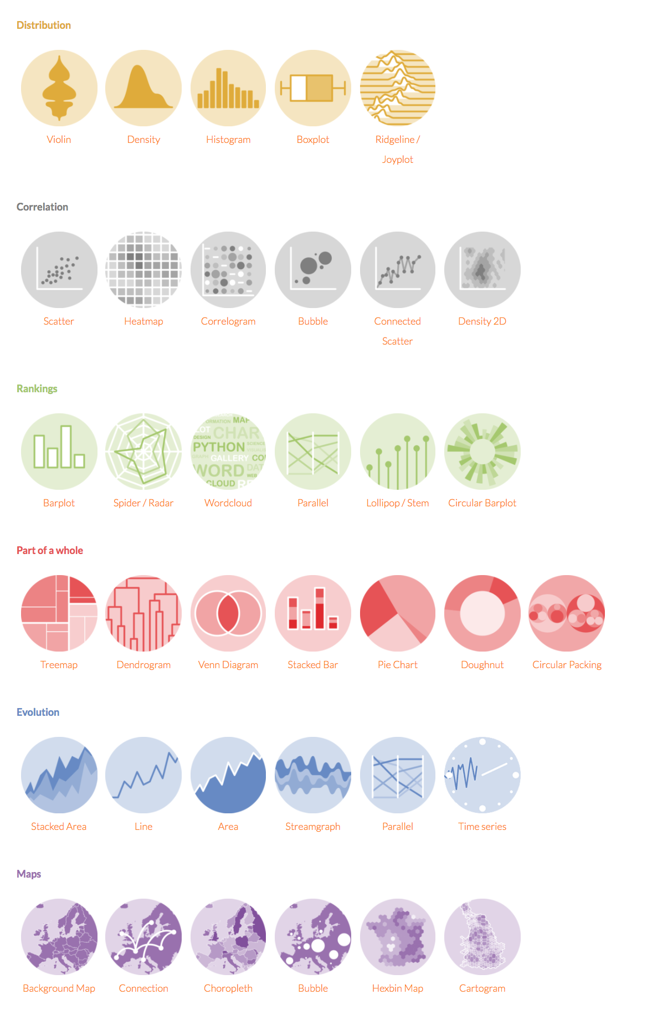
Construct a graph gallery for people to use

Slide 8
Blue Ocean Framework

Slide 10
How Will We Promote our Business?
Notes:
To promote our business, I think platforms like Twitter and academic listservs would be a good start.

Slide 11
Create very friendly useful tool for beginner
Design simple interaction to add more features by using mouse
Great free degree to construct beautiful and sophisticated figure
The tool is base on cloud and local device in order to allow people to use it everywhere
Data can be stored in privacy space in case the data is lost.

Slide 12
Challenges
Different people have different needs
Individuals have a variety of experiences to use computer
People may not trust our platfom in order to protect their data.
Maintenance and development is relatively hard.
Notes:
The main challenges are ensuring the platform is accessible and usable.

Slide 13


Usability and accessibility
Ease of use
Accessible

