Slide 1
Instrumental Variables
Discussion 9

Slide 2
Reminders and Announcements
Problem Set 4 due tomorrow at 5pm
Office hours (as usual!)
Questions about course/final project logistics?

Slide 3
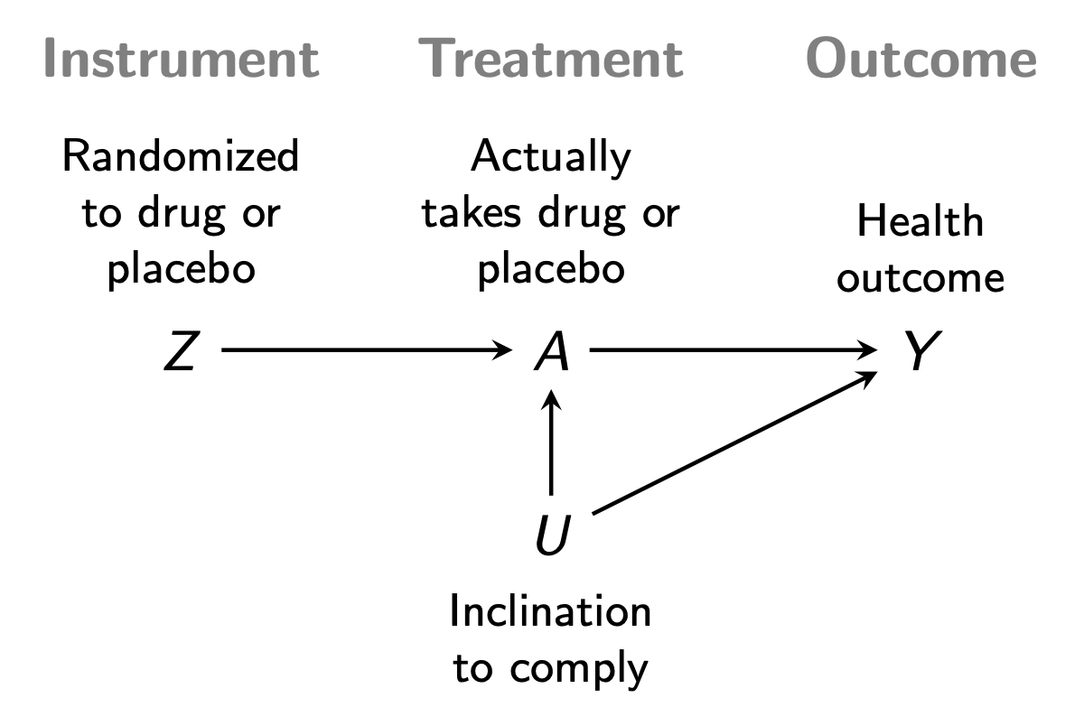
Ice-Breaker
Greet/meet 3-4 people next to you!
In your groups discuss (using the example from class):
What is the key assumption of IV?
What is the intent to treat effect?
What is the local average treatment effect?

Slide 4
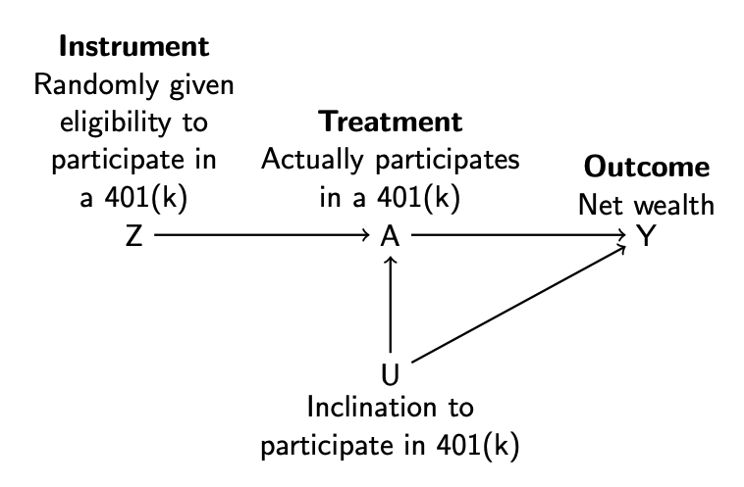
401(k) Example
Does participating in a 401(k) increase an individual’s wealth?
Participating in a 401(k) is not a random thing!
However, being eligible for a 401(k) is arguably random.
401(k) eligibility affects net wealth only through participation.

Slide 5
401(k) Example
In your groups discuss:
Describe what the intent to treat effect effect is?
Describe who are the always-takers? Never-takers? Compliers?
What would it look like in this context if someone was a defier?
Why does it matter that our instrument (Z) is assigned randomly? (In other words, what assumption becomes credible because (Z) is random?)

Slide 6
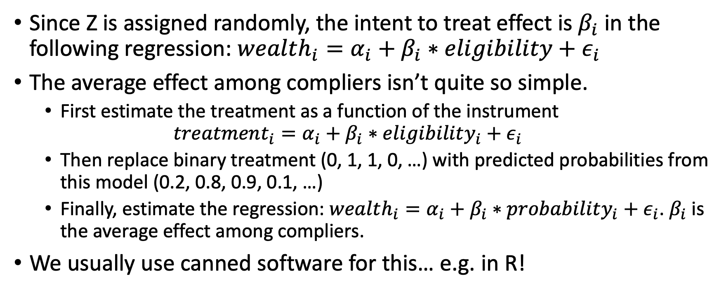
Estimation (Two-stage least squares)
Since Z is assigned randomly, the intent to treat effect is $β_{i}$ in the following regression: $wealth_{i}=α_{i}+β_{i}∗eligibility+ε_{i}$
The average effect among compliers isn’t quite so simple.
First estimate the treatment as a function of the instrument
$$treatment_{i}=α_{i}+β_{i}∗eligibility_{i}+ε_{i}$$
Then replace binary treatment (0, 1, 1, 0, …) with predicted probabilities from this model (0.2, 0.8, 0.9, 0.1, …)
Finally, estimate the regression: $wealth_{i}=α_{i}+β_{i}∗probability_{i}+ε_{i}$. $β_{i}$ is the average effect among compliers.
We usually use canned software for this… e.g. in R!

Slide 7
Let’s do it ourselves!
There is a short coding exercise on the website…

