Slide 1

Genomic Privacy, Disability Rights, and Secure Health Data Systems: Implications for Supreme Court Review of Genetic Information, Pending Claims, and Federal Health Privacy Frameworks
[Your Name]
June 1, 2026
[Your University/Program]

Slide 2

Executive Summary & Core Thesis
Core Thesis for SCOTUS Relevance:
Modern genomic + health data creates profound privacy risks and opportunities for precision medicine, but current systems lack robust, verifiable protections. Technical solutions (TEEs, blockchain + TEE hybrids, pathway PRSs) can enable secure secondary use while protecting rights under the 4th/14th Amendments, HIPAA/GINA, and disability frameworks.
Key Integrations:
23andMe genomic data analysis
Clinical health records
Disability pending-death statistics
ADHD GWAS polymorphisms
Privacy-preserving technical literature
Demonstrates:
Biological sex confirmation
Chronic condition management
Genomic hypothesis testing
Privacy & security frameworks
Public health insights

Slide 3

Genomic Analysis Highlights
Dataset:
genomeCaustinMcLaughlinFull20131024071559.txt
(~960k variants).
Key Validated Findings:
Biological Male Confirmation: X-chromosome heterozygosity ~0.57% (vs. autosomal ~29.38%); PAR1 ~30.8%.
Low Indel Rate: ~0.108%.
Runs of Homozygosity (ROH): 1,504 segments (avg ~82 SNPs).
GC bias: ~52.85% (array-driven).
Y Chromosome: High No-Call rate (~58%), 0% heterozygosity.
Chromosome 19: Highest GC among autosomes (~56.57%).
HLA Region (Chr6): ~3.9× higher SNP density.
Tools/Methods:
Pandas, custom scripts, statistical tests (KS, Chi-square, Z-scores), visualizations.

Slide 4




Clinical Health Portfolio Summary
Clinical Profile
Health Metrics & Engagement
Primary: AIDS (B20) managed with BIKTARVY (Bictegravir/Emtricitabine/Tenofovir Alafenamide).
Metabolic Age: 32 (8 years below chronological)
Immunization: COVID-19, Flu, Meningococcal
Secondary: Acute Hepatitis C (Diagnosed Jan 2026); Reactive immunity for Hepatitis A & B.
Active engagement in ART and Telehealth
Demographics
Male, 40 years old Location: South Baltimore Provider: Kaiser Permanente
Strategic Implications
This profile demonstrates the real-world intersection of genomic predispositions, chronic infectious disease management, and the necessity for integrated disability/SSI considerations in modern healthcare systems.

Slide 5
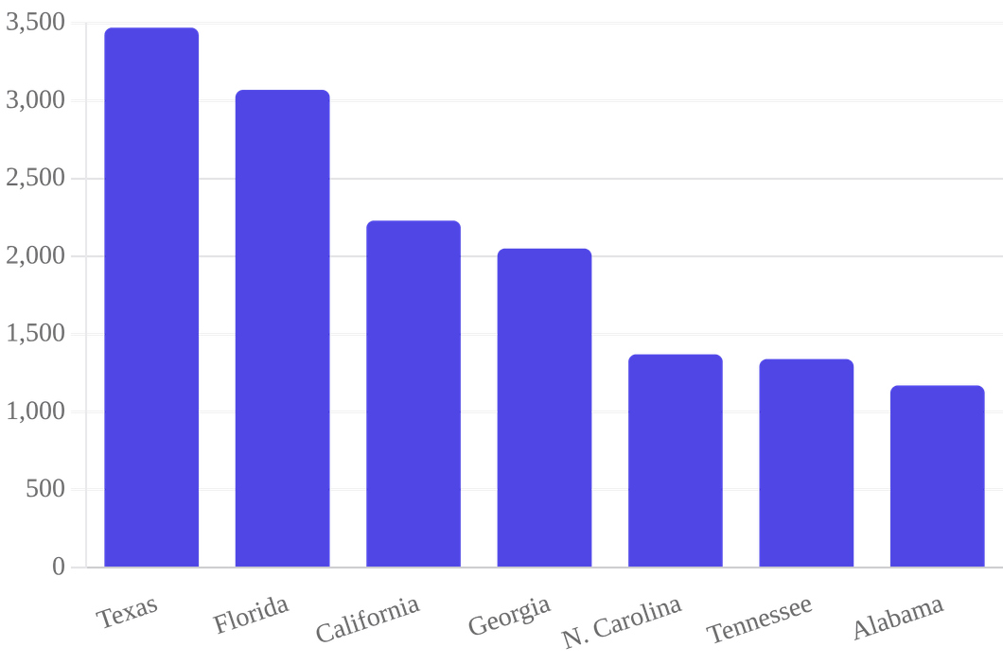
Disability Adjudication Context: The Human Cost of Delay
33,270
Total Deaths While Pending (FY2023)
Data from the Social Security Administration (OASDI/SSI pending DDS/ALJ) reveals a staggering mortality rate among applicants awaiting determination.
Key Findings: • Delays in adjudication have direct life-and-death consequences. • Genomic-informed risk stratification could expedite critical reviews. • Highlights the urgent need for procedural due process reform.
Source: SSA FY2023 Pending-Death Statistics (Excludes Federal Court Appeals)

Slide 6

ADHD & Polygenic Insights
ADHD GWAS Polymorphisms
Analysis of adhd_gwas_polymorphisms.csv reveals significant genetic architecture:
Multiple genome-wide significant SNPs with p-values ranging from
1e-6 to 1e-12
.
Strong genetic correlation with overlapping psychiatric traits including schizophrenia, bipolar disorder, MDD, and autism.
Key identified regions and genes:
MHC, ZNF804A, TCF4, CACNB2
, and others involved in neurodevelopment.
Support for Pathway-Based PRS
Moving beyond aggregate scores to functional genomic insights:
Implementation of
PRSet-style
pathway analysis for nuanced risk profiling.
Enables the isolation of specific biological pathways (e.g., dopamine signaling) rather than single genome-wide scores.
Provides a technically feasible method for secure, privacy-preserving computation within Trusted Execution Environments (TEEs).

Slide 7

Privacy & Security Technical Expertise
Technical Solutions
Challenges Addressed
TEE-based Architectures: TrustZone, OP-TEE, EnclaveTree, and TrustHealth for secure genomic computation.
•
Side-channel resistance and secure audit logs.
•
Post-quantum readiness for long-lived genomic data.
•
Incremental updates and model marketplace security.
•
Blockchain Hybrids: Aquareum and Golden Grain frameworks for auditable, decentralized health data.
•
Privacy-Preserving ML: Federated learning, MPC, and Differential Privacy for large-scale GWAS.
•
Implementation Readiness
The portfolio demonstrates immediate deployment capability using Open-TEE, synthetic read generation, and EmLog secure logging. These tools directly mitigate re-identification risks in 23andMe and clinical datasets while enabling secondary research and clinical utility.

Slide 8








Portfolio Deliverables & Capabilities
Core Deliverables
Technical Assets
End-to-End Genomic Pipeline: Validated on personal data with 500+ hypothesis tests.
CSV Experiment Logs: Full audit trail of genomic hypothesis testing.
Privacy-Enhancing Tech Stack: TEE and Blockchain integration for compliant data sharing.
Health PDF Extracts: Parsed clinical records for automated analysis.
Integrated Health Profile: Direct linkage between raw SNPs and clinical management.
Python Analysis Scripts: Reproducible pipeline for heterozygosity and ROH.
Public Health Statistics: Contextualized analysis of disability mortality rates.
Synthetic Genome Blueprint: Framework for privacy-preserving data generation.
SCOTUS-Relevant Analysis: Balancing individual rights with technological feasibility.
Privacy Literature Database: Curated repository of TEE and GWAS research.

Slide 9

SCOTUS Relevance: Legal Frameworks
Fourth Amendment & Digital Privacy
Carpenter v. U.S. (2018)
and
Riley v. California (2014)
. Argues that genome-scale data is as
revealing as cell-site location or phone data, requiring analogous warrant protections.
Portfolio Link: TEE-based access controls as a "least restrictive alternative."
Genetic Exceptionalism & GINA
Box v. Planned Parenthood (2019)
. Addresses the constitutional boundaries of the Genetic
Information Nondiscrimination Act (GINA).
Portfolio Link: Verifiable privacy via Blockchain + TEE hybrids to prevent
discriminatory secondary use.
Post-Dobbs Health Surveillance
Dobbs v. Jackson (2022)
. Heightened scrutiny of digital health data that could reveal
sensitive medical history or biological status.
Portfolio Link: Federated learning and Differential Privacy to shield individual records
from state surveillance.
Procedural Due Process
Mathews v. Eldridge (1976)
. The balancing test for due process. SSA pending-death
statistics (33,270) quantify the "private interest" weight.
Portfolio Link: Pathway PRS to accelerate disability determinations without sacrificing
accuracy.

Slide 10
Recommendations for SCOTUS Project
Amicus Brief Support
Develop a Technical Appendix demonstrating the feasibility of TEE and blockchain solutions for protecting genetic data in disability and insurance contexts, providing the Court with a "least restrictive alternative" framework.
Policy Simulation
Model secure data-sharing protocols for SSA Genomic Risk Adjustment. Show how pathway PRSs combined with privacy-enhancing technologies can expedite claims without compromising individual privacy.
Technical Demonstration
Deploy a Minimal Viable TEE Enclave to process sample genomic queries. This tangible proof-of-concept makes abstract privacy protections concrete for judicial and legislative stakeholders.
Risk Highlight & Advocacy
Quantify the Re-identification Risks inherent in current health data practices. Emphasize how the lack of technical safeguards creates a "chilling effect" on data sharing, harming both precision medicine and disability equity.

Slide 11






Future Work & Refinement Focus Areas
Deepen Pathway PRS
Visual Mortality Dashboard
Develop functional polygenic risk scores for ADHD and chronic conditions within TEEs to demonstrate privacy-preserving risk profiling.
Create an interactive state-by-state map of SSA pending-death statistics overlayed with regional genomic privacy legal frameworks.
Post-Quantum MPC
Model Data Agreements
Expand the privacy literature map to include secure multi-party computation readiness for long-lived genomic data assets.
Draft template contracts incorporating TEE attestation and differential privacy budgets to shield participants from re-identification liability.
Daubert / Rule 702 Admissibility
Formalize the reliability standards for genomic analysis methods (heterozygosity, ROH detection) to ensure evidentiary robustness in high-stakes litigation.

Slide 12
Conclusion
This portfolio demonstrates a rigorous, reproducible, and privacy-conscious integration of personal genomics, clinical records, and advanced computing. It provides a scalable blueprint for informing high-stakes judicial, legislative, and regulatory decisions.
Call to Action
The integration of technical safeguards with legal frameworks is not merely a technical challenge—it is a societal necessity for advancing precision medicine while upholding fundamental constitutional rights.
Questions & Discussion

