Slide 1
HACKELITE

Slide 2
PROBLEM STATEMENT TITLE
Help me with my Mood- With Social-media Health Analysis and Display Engine (SHADE).
ROLES:
Cauvery A : Removal of Stop words
App Creation
Databases
Greeshma Panchakshary: APIs
Playlist Creation
Databases
Akshitha Y V: Sentiment Analysis
Databases

Slide 3
Tools/platform/APIs used in the solution
APIs used:
Twitter4j
Removed stop words
Java Swings
Platform Used
Java

Slide 4
Process
Get tweets from twitter
Remove the stop words in those tweets
Analyse the tweets
App creation
Change mood options
Output

Slide 5
Output Screenshots

Slide 6
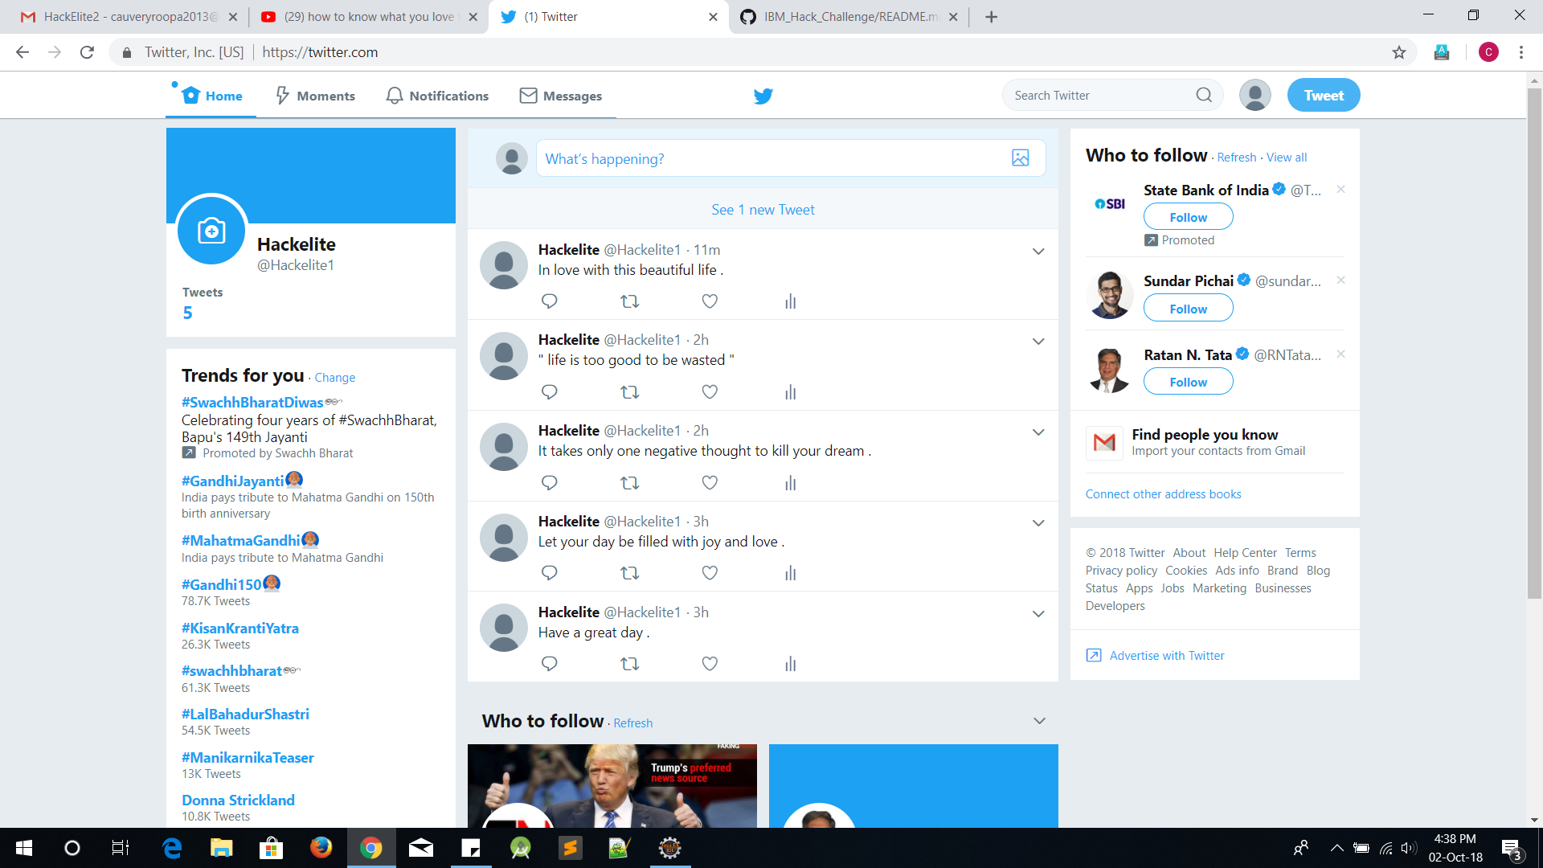

Slide 7
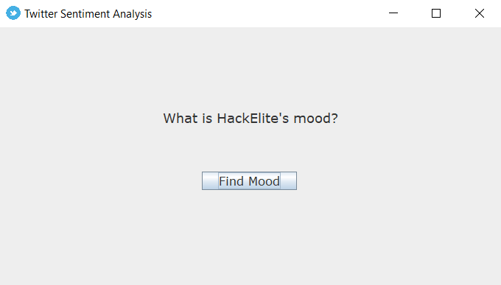

Slide 8


Slide 9
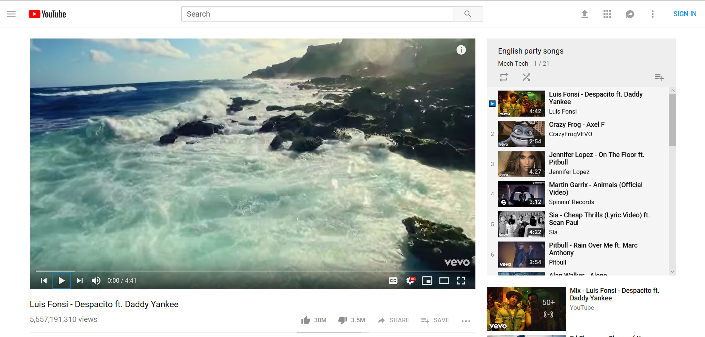
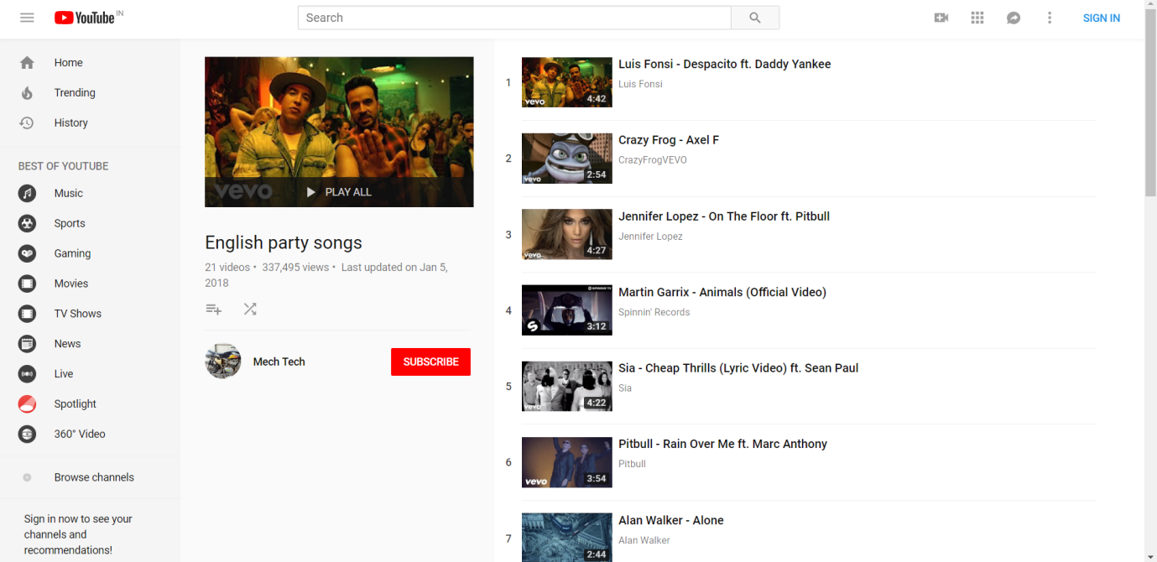

Slide 10
Functional requirement developed
This app checks the tweets of a twitter account and analyses that persons mood based on their tweets.
It shows both happiness and sad percentage on the whole and displays the output according to it.
According to that output if the person wants to change/enhance his mood we have the playlist for them and we provide them that.

Slide 11
Java Swings
Swing is a GUI widget toolkit for Java.
This is the light weighted UI and is extensible and is easy to use.
We have used frames, labels, buttons, etc. for this application of ours.

Slide 12
THANK YOU

