Slide 1

Prepared by Javad Ibrahimli

Slide 2

PROBABILITY and STATISTICS
Using and understanding probability and statistics theories have become required skills in every profession and academic discipline. Probability:
- The chance that a given event will occur.
- A branch of mathematics concerned with developing models to define the likelihood of an
event.
Statistics:
Statistics is based on the collection, analysis, interpretation, and presentation of numerical facts (data).
A branch of mathematics dealing with fitting the available data to probability models and thus estimating the properties of the variable.

Slide 3
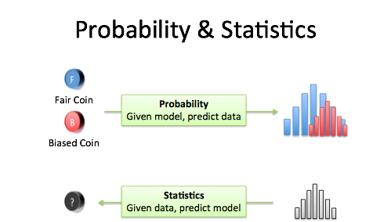
PROBABILITY vs. STATISTICS
Probability theory is devoted to the study of uncertainty and variability.
Statistics can be described as the study of how to make decisions in the face of uncertainty and variability.

Slide 4

How to approach a problem:
Deterministic Approach
• Deterministic approach assumes certainty in all aspects.
• A deterministic situation is the one in which the system parameters can be determined
exactly. This is also called a situation of certainty.
• In engineering systems in reality, such a system rarely exists. There is usually some
uncertainty associated.
Some Examples:
Predicting the amount of money in a bank account.
If you know the initial deposit, the amount of interest and the amount you spent, then: You can determine the amount left in the account.
Finding the acceleration (a) of a body of known mass (m) when a certain force (F) is exerted.
Using the Newton’s second law, you can calculate the acceleration (F=ma) and always obtain the same output from the provided input.

Slide 5

How to approach a problem:
Probabilistic Approach
• Probabilistic situation is called a situation of uncertainty.
• You know the likelihood that something will happen, but you don’t know if or when it is going to happen
Some Examples:
Predicting what number will come up when you roll a die.
(Dice are commonly used to give examples in probability. Dice is plural , die is singular )
Predicting when number 6 will come up when rolling dice. (You know that in each roll, each number will come up with the probability of 1/6, but you cannot exactly predict what will come up and when.)

Slide 6
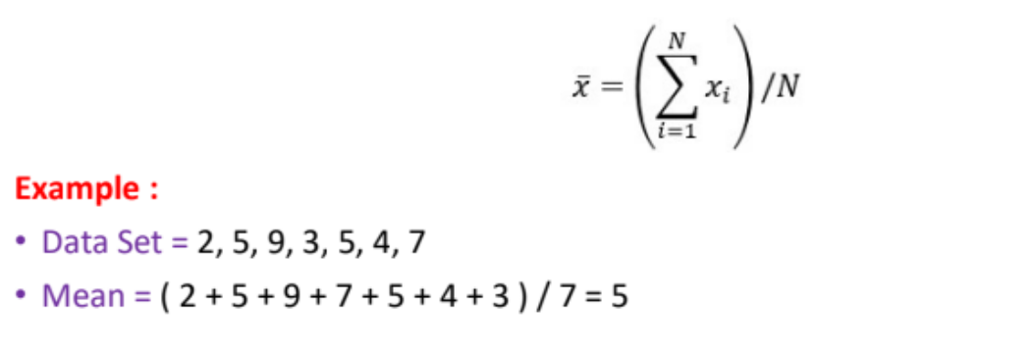
Some statistical terms:
Mean:
In statistics, "mean" usually refers to the arithmetic mean, which is a measure of the central tendency of a group of numbers. It is found by adding all of the numbers in the group together and then dividing the sum by the total number of items in the group. The mean is often used as a measure of the average value in a dataset, and it is also known as the average.

Slide 7
Some statistical terms:
Mode:
In statistics, the mode is the most common value in a set of data. For example, if you have the numbers 1, 2, 2, 3, 3, 3, 4, 5, 5, the mode would be 3, because it is the number that appears most frequently in the data set. The mode can be useful for identifying trends or patterns in data, and it is often used in conjunction with other measures of central tendency, such as the mean and median.
For example, if you have the numbers 4, 5, 6, and 7, the median would be the middle value, which is 6. If you have the numbers 4, 5, 6, 7, and 8, the median would be the average of the two middle values, which is (6 + 7) / 2 = 6.5.

Slide 8
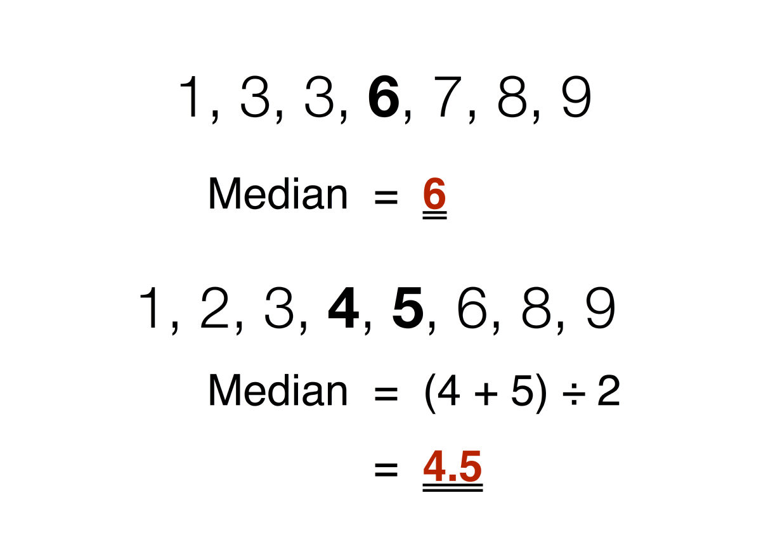
Some statistical terms:
Median:
In statistics, the median is the middle value of a set of data. To find the median, you first need to order the data from smallest to largest (or vice versa), and then select the middle value. If there is an even number of data points, the median is usually defined as the average of the two middle values.

Slide 9
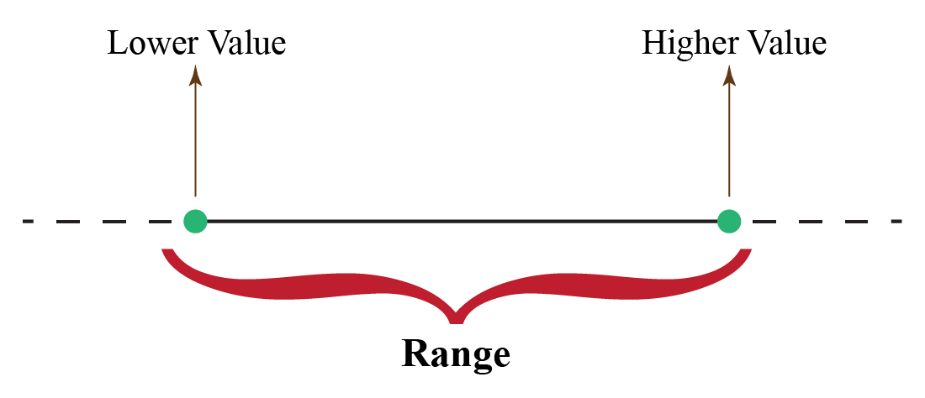
Some statistical terms:
Range:
In statistics, the range of a set of data is the difference between the largest and smallest values in the set. It is a measure of the spread or variability of the data.
For example, if a set of data has values that range from 1 to 10, the range would be 10 - 1 = 9. The range can be a useful tool for identifying outliers, which are values that are significantly higher or lower than the other values in the set. It can also be used to compare the variability of different data sets. For example, if one data set has a range of 10 and another has a range of 5, the second data set is less variable or more consistent than the first.

Slide 10
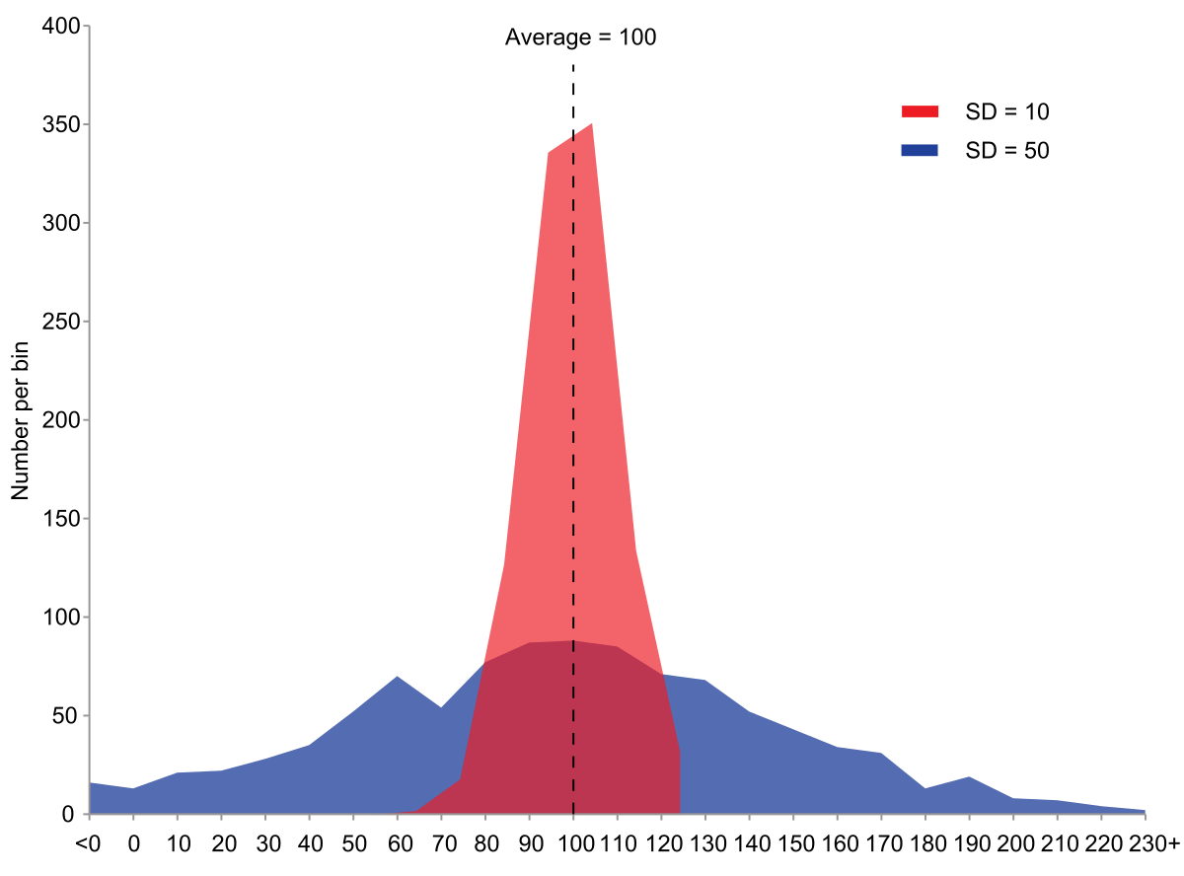
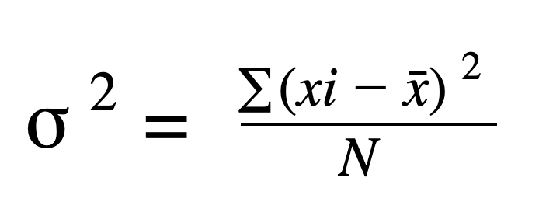
Some statistical terms:
Variance:
In statistics, variance is a measure of how much a set of numbers varies from the average or mean of the set. It is calculated by taking the average of the squared differences from the mean of the set.
Variance is a useful measure because it allows you to compare the spread of data in different sets. For example, if you had two sets of numbers with the same mean but different variances, you would know that the set with the higher variance has more spread out or diverse values.

Slide 11
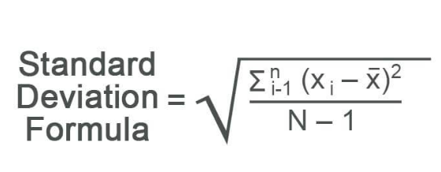
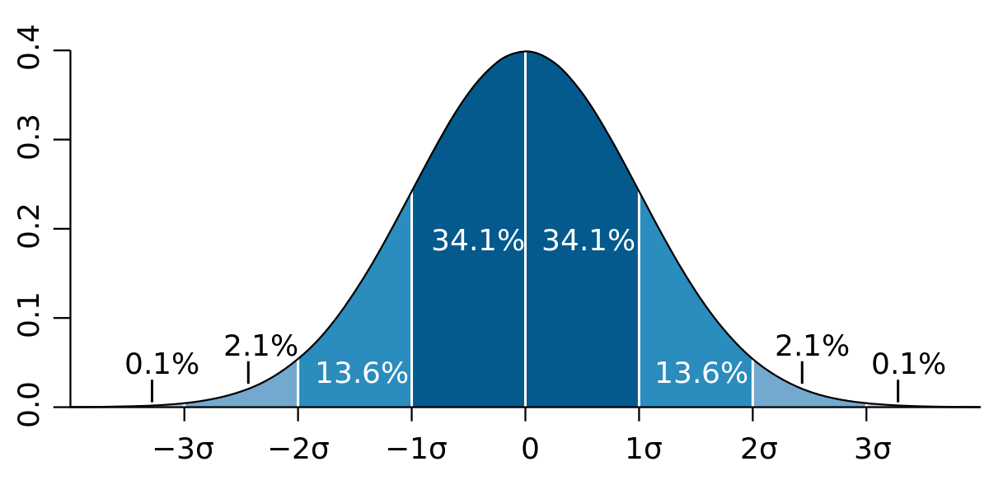
Some statistical terms:
Standart deviation:
Standard deviation is a measure of how spread out a group of numbers is. In other words, it tells you how much the individual numbers in a dataset differ from the mean of the dataset.

Slide 12
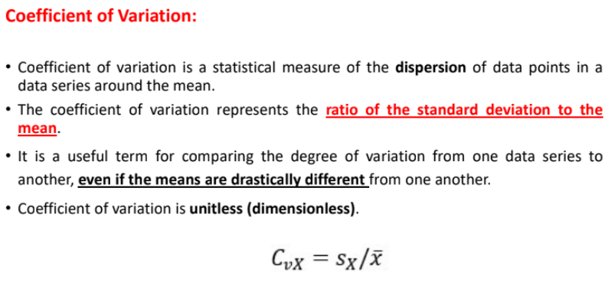
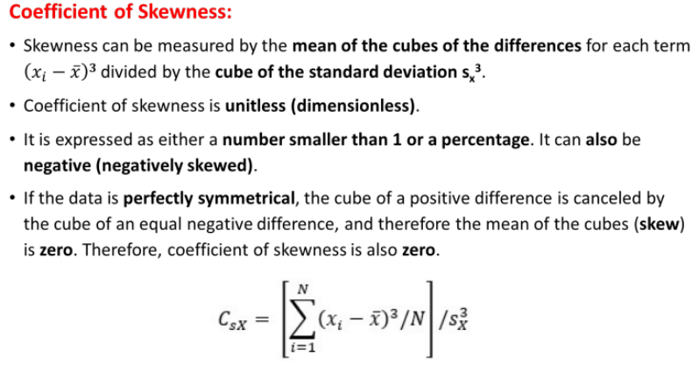
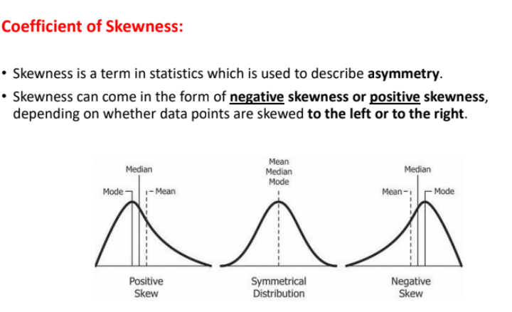
Some statistical terms:

Slide 13
Github

