Slide 1
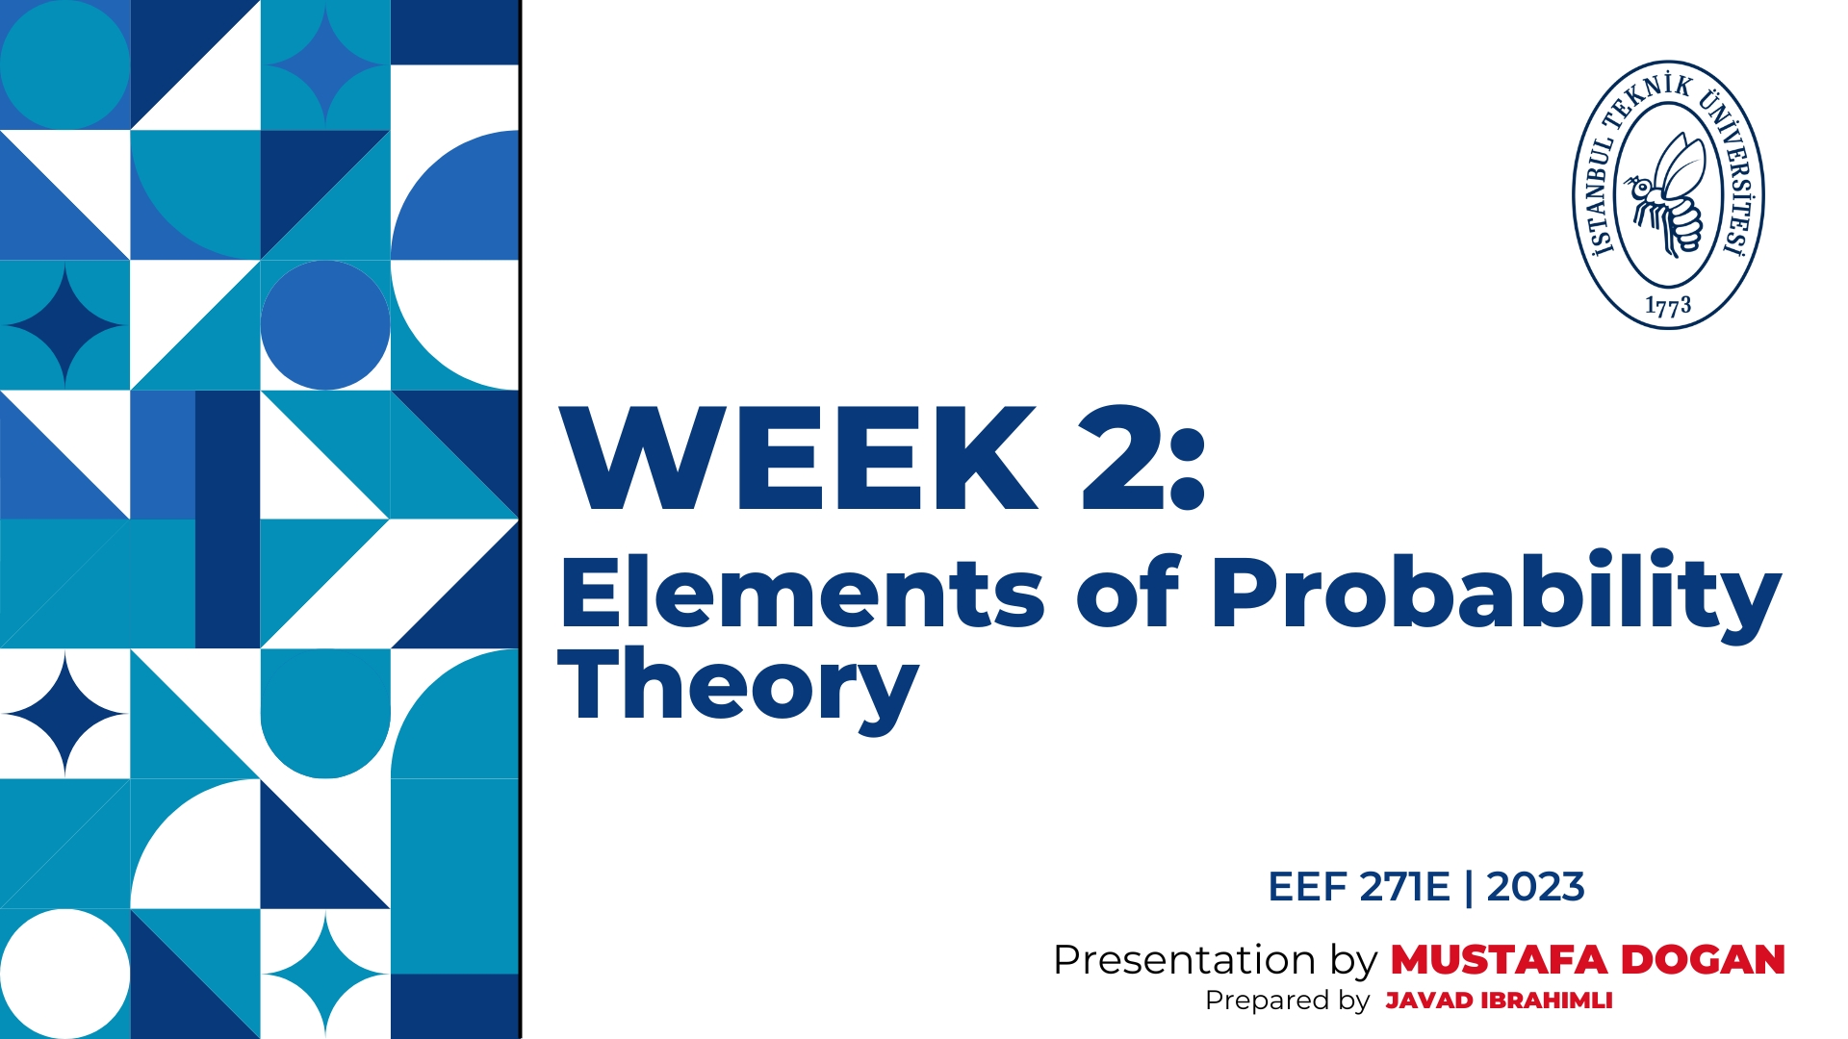
Prepared by Javad Ibrahimli

Slide 2


ELEMENTS OF PROBABILITY THEORY
Random Variable:
Probability theory studies variables that have uncertain behavior. Such variables, whose values cannot be predicted with certainty, are called random variables. Uncertainties of random variables is due to the effects of a large number of unknown properties involved. Therefore: Random variables cannot be studied by a deterministic approach. A Probabilistic approach is needed. ( Slide #1) Random Event:
A random event is defined as: the occurrence of a particular value for a random variable in an observation. It is possible to only estimate the chance of an event to take place.
Example:
- When you flip a coin. There are 2 random events with equal chances: heads or tails - When you roll a die. There are 6 random events (integers 1-6) with equal chances.

Slide 3
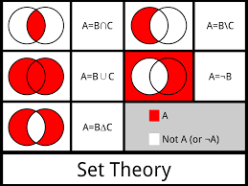

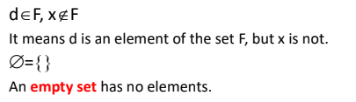
ELEMENTS OF SET THEORY
Probability theory uses the concepts of set theory. In this theory, a set consists of exactly defined elements. Name of the set is expressed with capital letters. If its element is a letter, it should be a small letter.
Order of elements is not significant. If we write:

Slide 4

ELEMENTS OF SET THEORY
Elements of a subset are also the elements of the set
For example: D={1,2,3,4,5,6}
Set E, which consists of even numbers (when you throw a die), is a subset of D.
If for example, set X is not a subset of D it is expressed as: X∉D
If E⊂D, this means that the region corresponding to E is also a part of the region corresponding to D.
If two sets have no common elements, their intersection is the empty set. The set of even numbers E (when throwing a die) and the set of odd numbers O are disjoint sets (they do not intersect).
The set consisting of elements of two sets is their union.
For example: when throwing a die, the union of E and O is set D (E ∪ O=D)

Slide 5

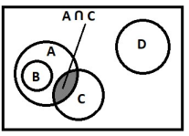
ELEMENTS OF PROBABILITY THEORY
Venn diagram:
A Venn diagram shows the relations between the sets and subsets. In a Venn diagram, each set is represented by the region inside a closed shape. - From the Venn diagram above, we can write:
Random Event:
The set consisting of common elements of two sets is their intersection. The shaded region (intersection of A and C) is expressed as: A ∩ C or AC

Slide 6
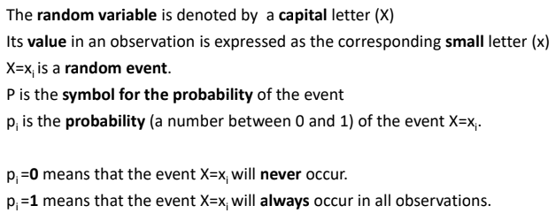

ELEMENTS OF PROBABILITY THEORY
Probability Concept :
In probability theory, the chance of the occurrence of a random event is defined as its probability.
Each random event has a certain probability that varies in the range of 0 to 1.

Slide 7
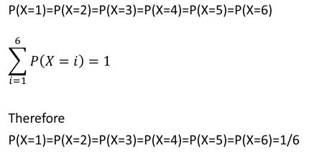
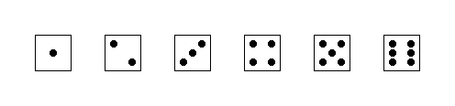
ELEMENTS OF PROBABILITY THEORY
How we can estimate the probabilities of random events? In case of simple variables, the probabilities can be determined by logic. Let’s look at this example: There are six random events in the throw of die with equal probabilities;.

Slide 8
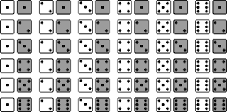
ELEMENTS OF PROBABILITY THEORY
Example:
If two dice are rolled, what is the probability that the sum of the two will be equal to 7. 6*6=36 possible outcomes.
Sum of two dice=7
(1,6), (2,5), (3,4), (4,3), (5,2), (6,1) P(sum of two dice=7)=6/36=1/6

Slide 9
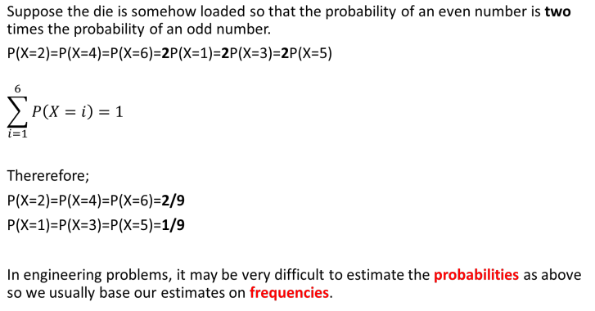
ELEMENTS OF PROBABILITY THEORY

Slide 10

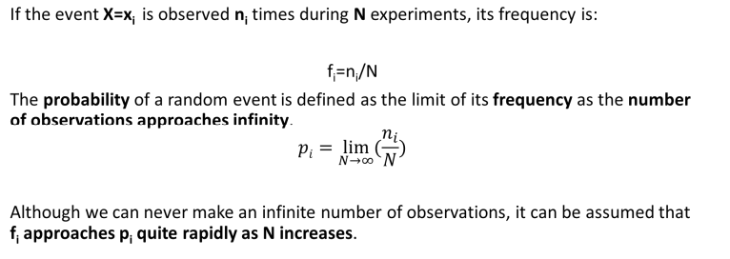
How to approach a problem:
Frequency:
Frequency of a random event is the ratio of the number of time it occurs to the total number of observations.

Slide 11
How to approach a problem:
Frequency:
For example, if no precipitation has been observed for ni=900 days along a period of
N=1500 days, then the probability of no precipitation can be estimated to be:
P(X=0)=900/1500=0.60
As the observation period increases, the estimated frequency will be a better estimate
of the true probability.

Slide 12
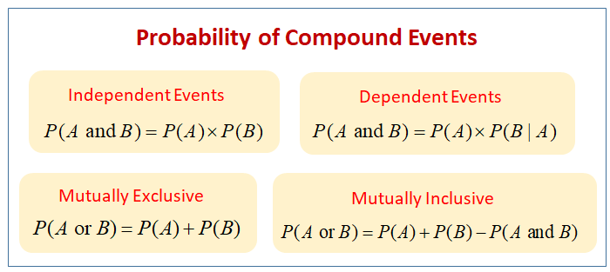
How to approach a problem:
Probabilities of Simple and Compound Random Events
Sample space of a random variable consists of all the values that it can take.
Each point (element) of this space is a sample point that corresponds to a random
Compound random event is the union of a number of (simple or compound) random events.

Slide 13
How to approach a problem:
Probabilities of Simple and Compound Random Events
Each compound random event is subset of the sample space.
A certain point in the probability space corresponds to each point or region in the sample space.
P = 0 corresponds to the empty set that has no points in the sample space p = 1 corresponds to the set that consisting all points in the sample space
Complementary events are those two events which are the only possible events. Since P(A) + P(B) = 1, A and B are possible events. Hence, A and B are mutually exclusive, exhaustive and complementary events.

Slide 14
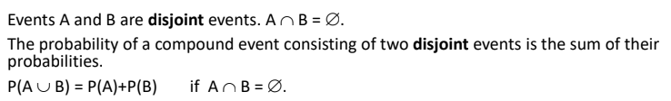
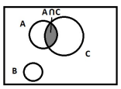
Probabilities of Simple and Compound Random Events
If two events have no common points, they are called disjoint events. Their intersection
is an empty set.

Slide 15
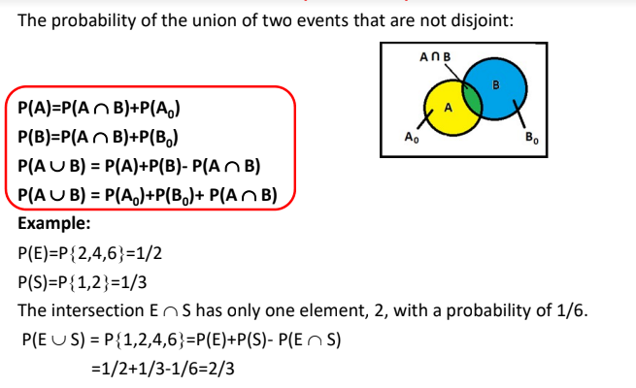
Probabilities of Simple and Compound Random Events

Slide 16

Example (M. Bayazıt, B. Oğuz, Example 2.1, pg 15):
The number of vehicles waiting for a left turn at a cross-section is observed to vary
between 0 and 6, with the following probabilities:
P(X=0)=4/60, P(X=1)=16/60, P(X=2)=20/60 , P(X=3)=14/60, P(X=4)=3/60, P(X=5)=2/60,
P(X=6)=1/60
- What is the probability (of the event) that more than 3 vehicles are waiting for a left
turn?
- What is the probability that less than or equal to 3 vehicles are waiting for a left turn?
There are 7 simple events in the sample space of the random variable X (the number of vehicles waiting for a left turn). The sum of their probabilities is 1. The probability that more than 3 vehicles are waiting is calculated taking three simple disjoint events.
P(X>3)=P(X=4)+P(X=5)+P(X=6)=3/60+2/60+1/60=6/60=1/10
The event less than or equal to 3 vehicles waiting is the complementary of the above event.
P(X<=3)=1 - P(X>3)=1-1/10=9/10

Slide 17
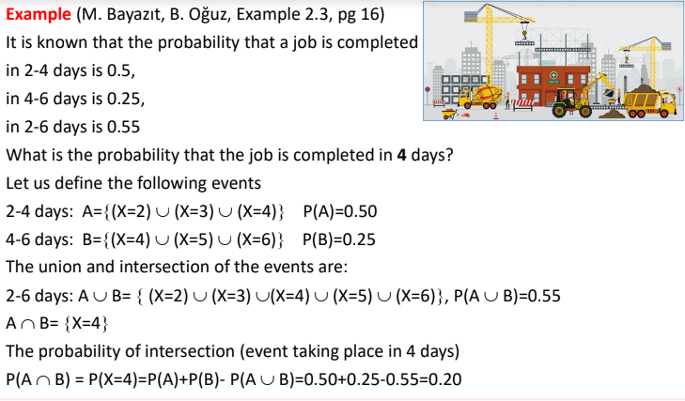

Slide 18
Some statistical terms:
Factorial:
A factorial is represented by the sign (!).
n factorial => n!
Factorial is the product of all the whole numbers between 1 and n, where n must always
be positive. For example:
1! = 1 = 1 3! = 1 x 2 x 3 = 6 0! = 1 (special case)

Slide 19
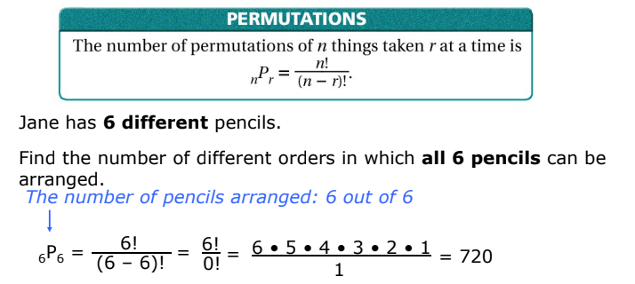
Permutation:
A permutation is an arrangement of things in a certain order.

Slide 20
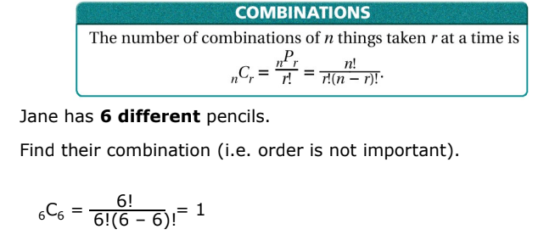
Combination :
A combination is a selection of things in any order.

Slide 21
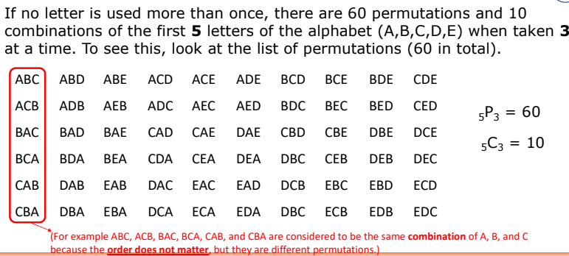
Combination and Permutation:

Slide 22
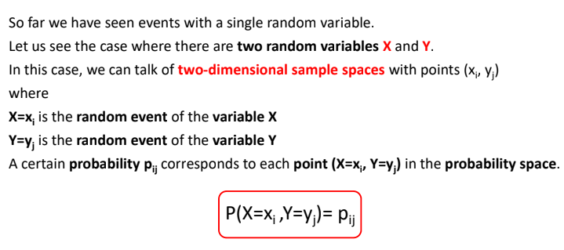
Two-Dimensional and Conditional Sampling Spaces

Slide 23
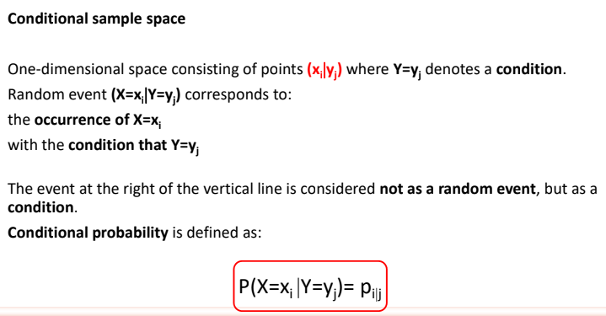
Two-Dimensional and Conditional Sampling Spaces

Slide 24
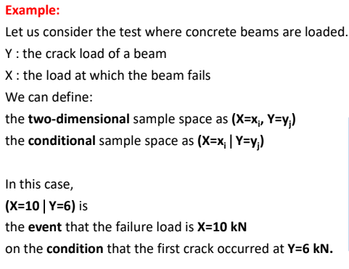

Two-Dimensional and Conditional Sampling Spaces

Slide 25
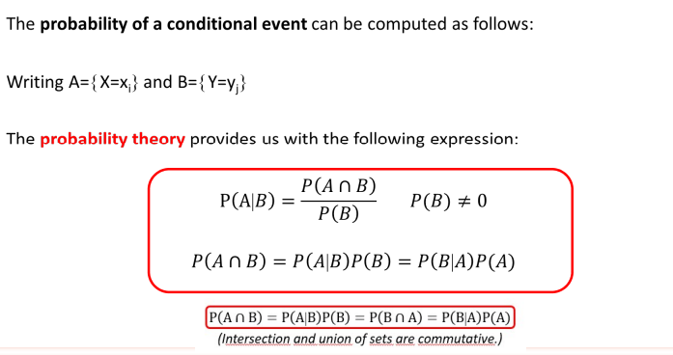
Two-Dimensional and Conditional Sampling Spaces

Slide 26
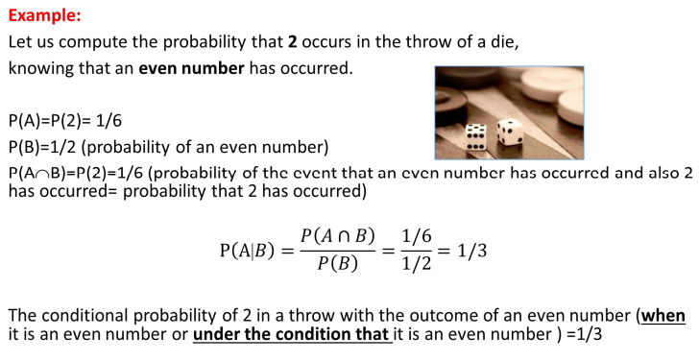
Two-Dimensional and Conditional Sampling Spaces

Slide 27
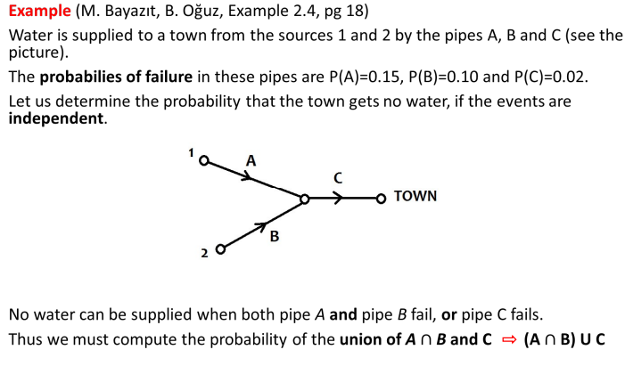

Slide 28
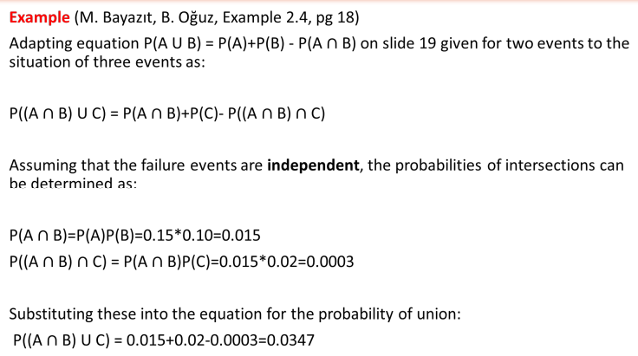

Slide 29
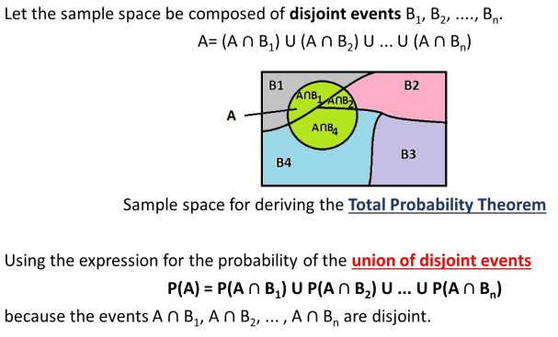
Total Probability and Bayes Theorem

Slide 30
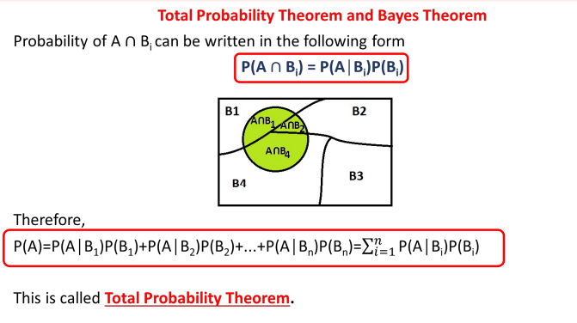
Total Probability and Bayes Theorem

Slide 31
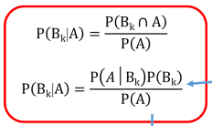
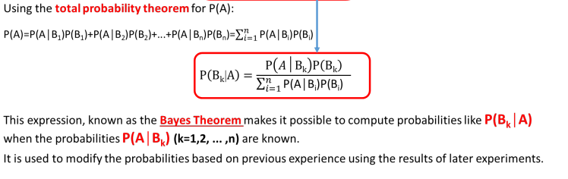
Total Probability and Bayes Theorem
For any k ( k= 1, 2, .. N) the conditional probability of P can be expressed as:

Slide 32
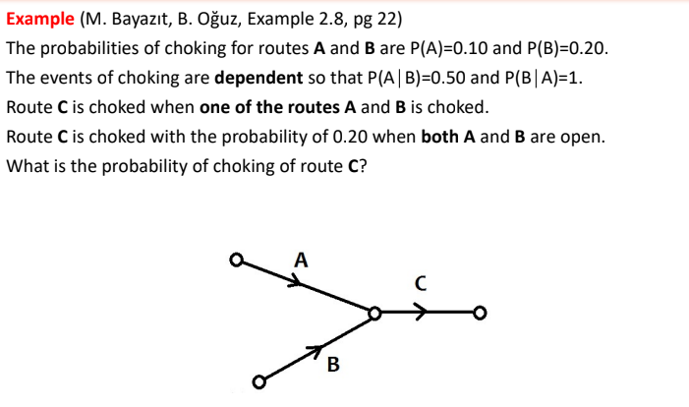
Total Probability and Bayes Theorem

Slide 33
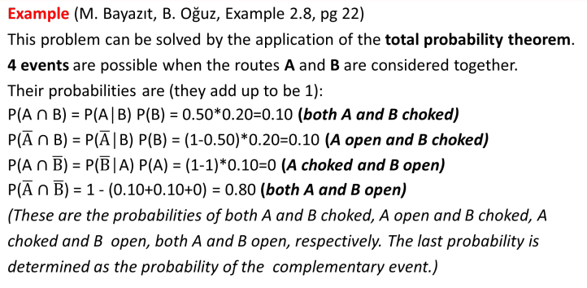
Total Probability and Bayes Theorem

Slide 34
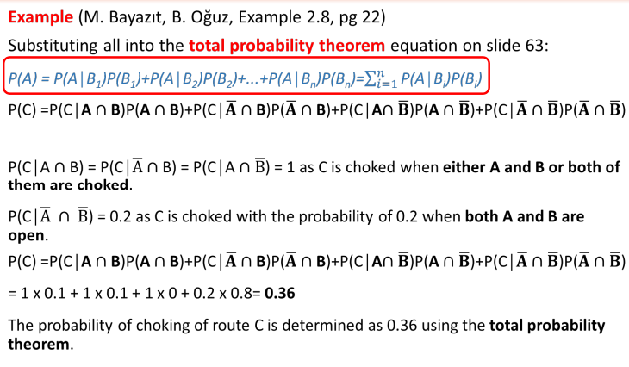
Total Probability and Bayes Theorem

Slide 35
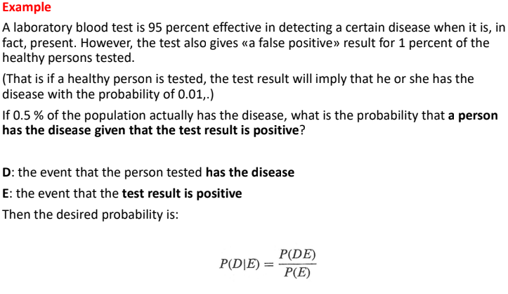
Total Probability and Bayes Theorem

Slide 36
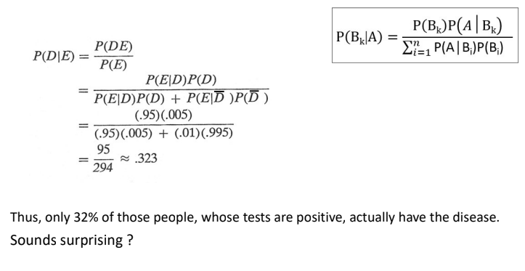
Total Probability and Bayes Theorem

Slide 37
Githubdffffdf

