Slide 1


Welcome to
STARTUP WEEKEND
Notes:
What to Edit:
Add the city name / edition. Add some flair! The more its customized, the more personal and intimate the event will feel.What to Do during the presentation:
Get people excited and energized.
Example Facilitator Introduction:
Welcome to Startup Weekend!
Who has been to Startup Weekend before?
How many: designer? Developers? Women?
Who here has an idea they want to pitch?

Slide 2
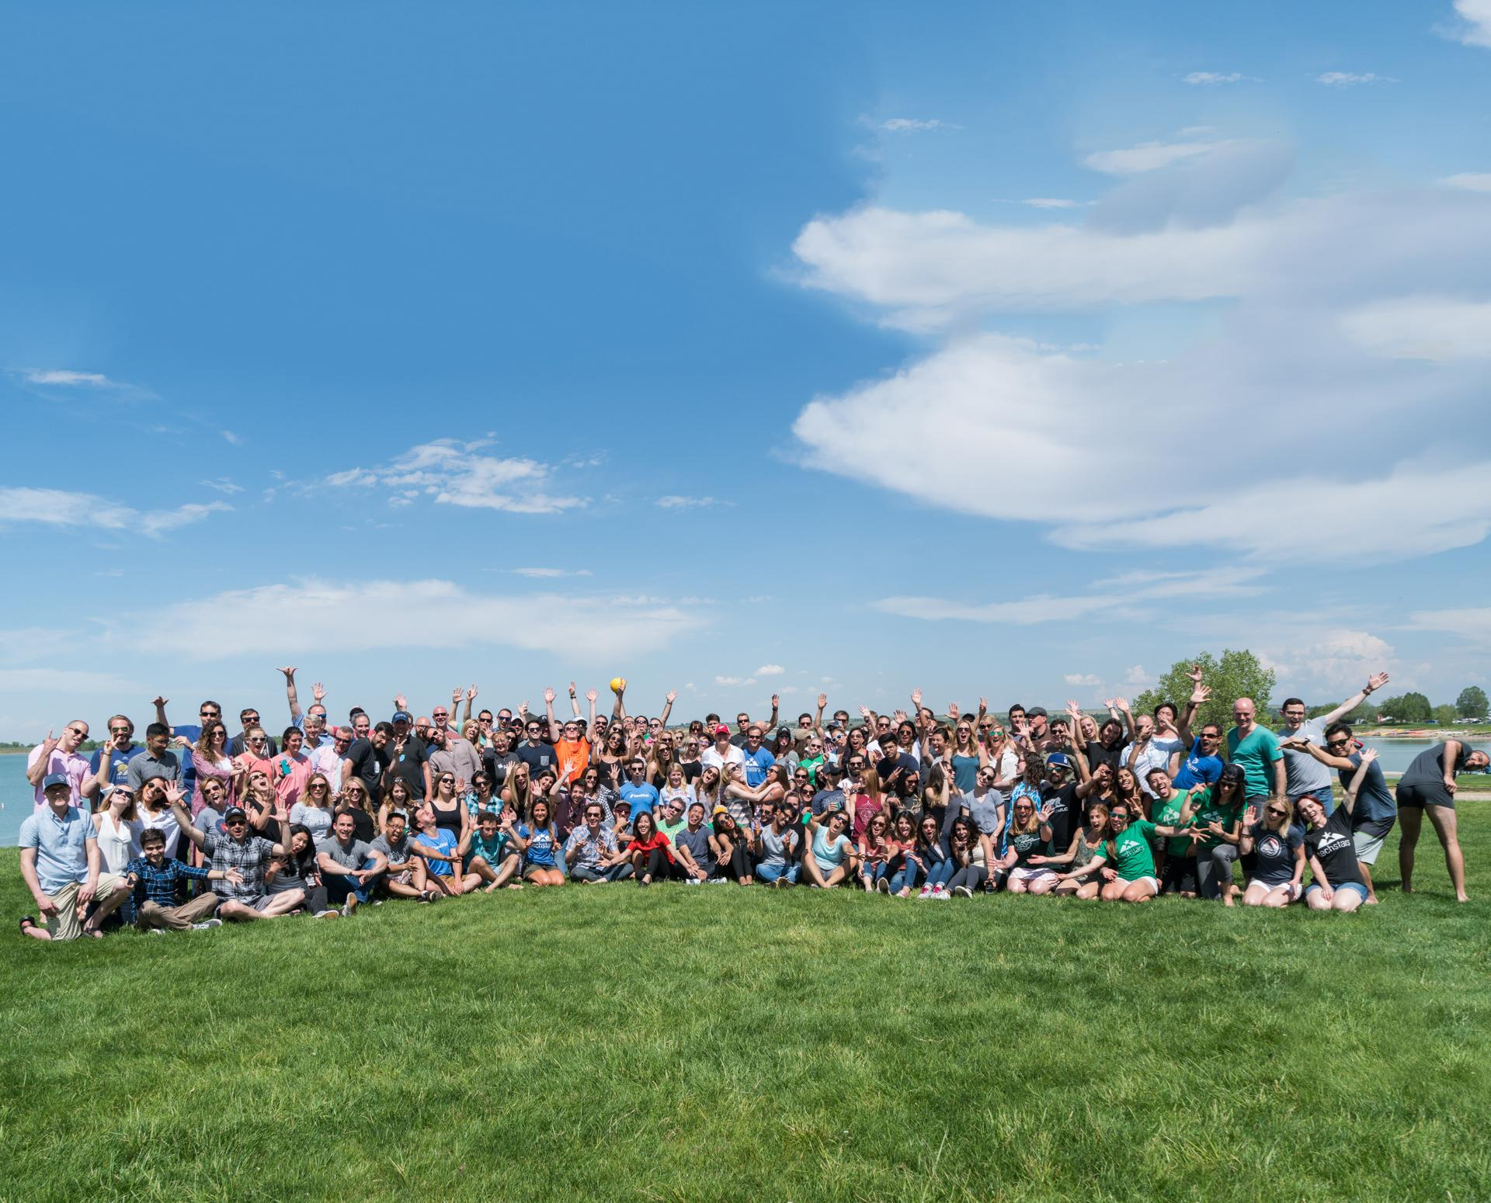

Our mission is to inspire change in the lives of entrepreneurs like you.
Image options
Photo Credit: www.brettwhysel.com
Notes:
What to Do:
Startup Weekends are meant to be a safe place to bring people together to learn, build, and grow. Give a quick overview of Startup Weekend and the scale of our events.
Example Talking points
So what is Startup Weekend all about? Startup Weekend is one of the leading catalysts for startup creation and entrepreneurial education around the world. Our mission is to educate and inspire entrepreneurs and give them the motivation and networking opportunities they need to take the next step in creating a successful startup company. Founded in 2007, we’re focused on expanding our model to become a global, hyper-local grassroots movement.
Some quick facts:- [Updated June 2017]
Startup Weekend has helped educate & inspire over 350,000 entrepreneurs - We’ve had over 4500 events in over 150+ countries to date.
Over 10,000 organizers and volunteers that are the driving force in Startup Weekend’s success- Over 7000 ventures have been launched at Startup Weekend’s around the globe.

Slide 3
What will you do this weekend?
Notes:
Now’s the time to challenge Participants: What are their goals for the weekend?
Challenge attendees to challenge themselves. The more they put into the weekend, the better the experience.
Example talking points:
Why are you here?
What is your end goal for the weekend?
What you can expect to get out of the weekend:
Education
Build your network
Co-Founder Dating
Learn a new Skill
Launch a Business!
Mentorship
Have fun!

Slide 4
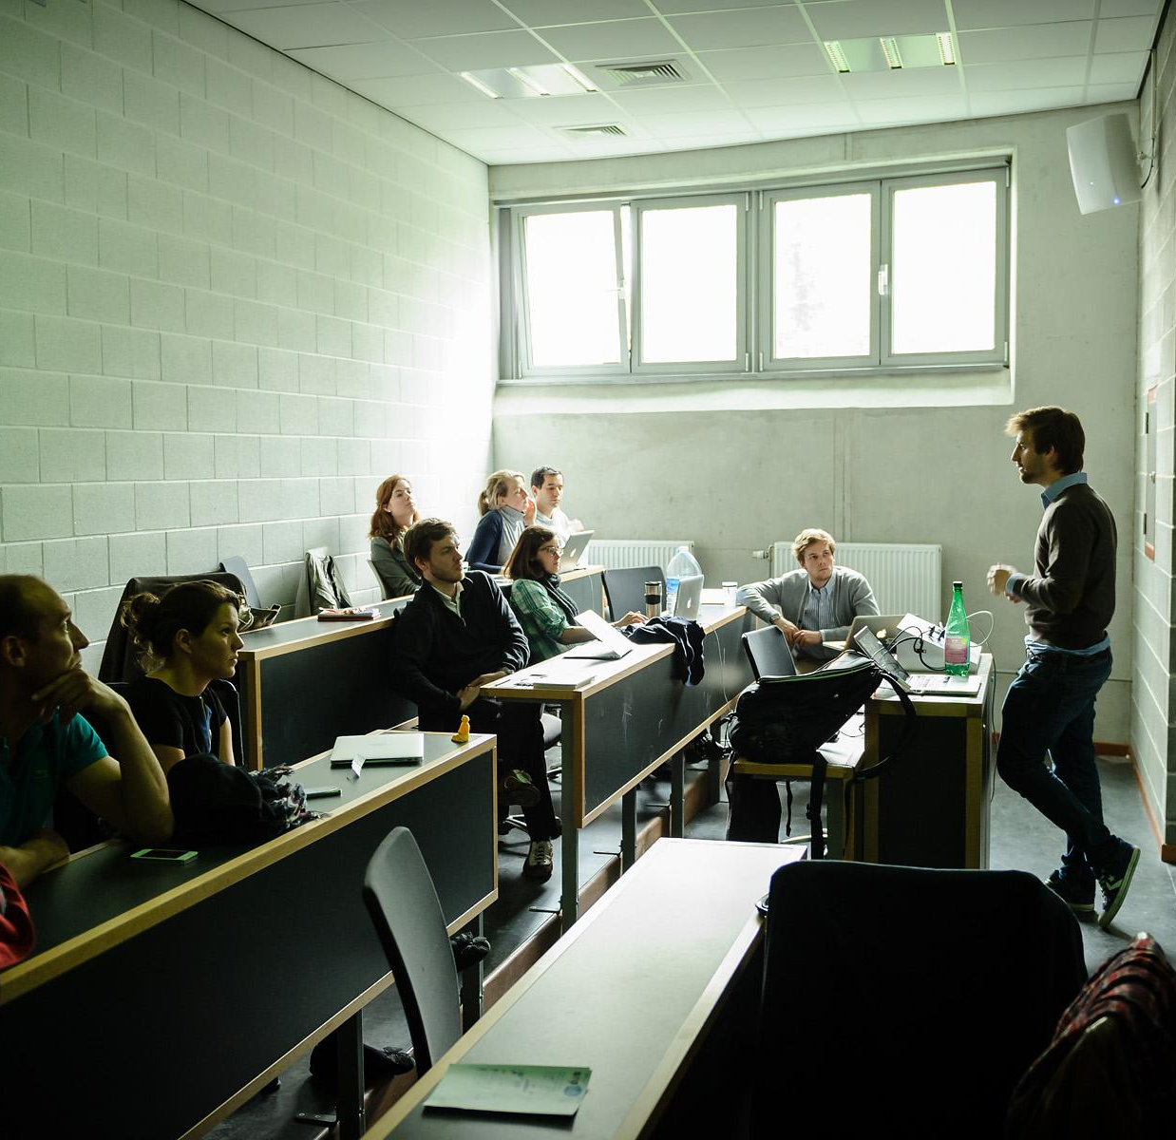
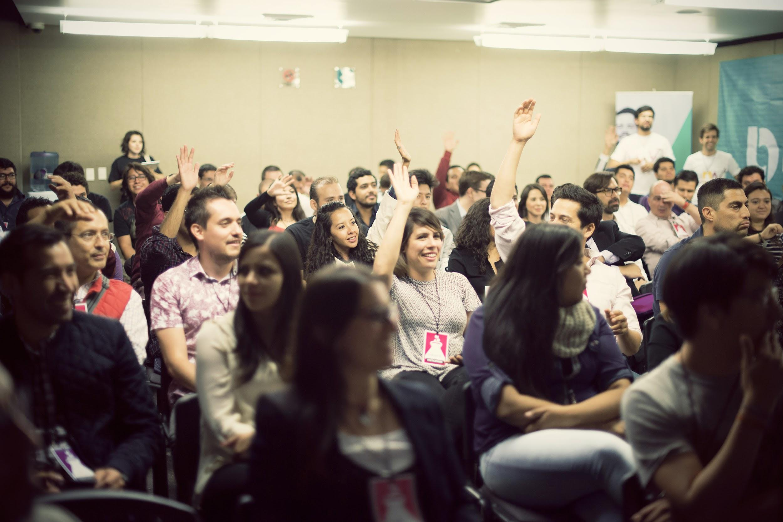
validate an
idea
learn a
new skill
meet a
cofounder
and build
a team
Image options
Notes:
Now’s the time to challenge Participants: What are their goals for the weekend?
Challenge attendees to challenge themselves. The more they put into the weekend, the better the experience.
Example talking points:
Why are you here?
What is your end goal for the weekend?
What you can expect to get out of the weekend:
Education
Build your network
Co-Founder Dating
Learn a new Skill
Launch a Business!
Mentorship
Have fun!

Slide 5

Weekend Schedule

Slide 6
Weekend Roadmap
Tonight
60 sec Pitches
Exchange Contact info
Vote
Brain Dump
Form teams
Weekend Deliverables
Notes:
The Friday Schedule:
---- Longer version
We are going to pitch ideas, vote, form teams then get on your way.
When you get into teams, everyone on your team is going to braindump every feature they can think of, just get it all out. Then you'll spend a few minutes cutting them all away as you prioritize and refine until you hone on your weekend MVP - minimum viable product. What you can actually deliver this weekend.
If your team starts to argue, and they will, work out a voting process (thumb up / thumb down, majority wins). Don't spend more than a few moments getting perspectives and MOVE ON. For the love of God, do not spend more than 10 minutes figuring out a name. It's ok if it changes later.
The goal is to build enough to be able to tell your story.
To goal of tonight is to get on the same page. Prioritize which work is most important, and which assumptions your team will need to test. This will make work easier for tomorrow morning.
Make sure to exchange contact info before you leave!

Slide 7
Weekend Roadmap
Tomorrow
Market Research
Customer Validation
Define MVP
Iterate
Start Building
Keep Building
Notes:
The Saturday Schedule:
Saturday is all about getting work done and validating your idea! When you come in you should be thinking about who on your team is going to interview potential customers. Remember to get out of the building! Set a time for to regroup for those people to come back and share the feedback collected. Coaches will be coming in throughout the day to give feedback as well (remember to check the schedule).

Slide 8
Weekend Roadmap
Sunday
Team Registration
Build Presentation
Got Customers?
Pitch Practice
Rollout Strategy
Tech Check
Business Model
Final Presentations!
Notes:
The Sunday Schedule:
---- Longer version
Sunday morning your team will come in and continue to work and collect feedback from customers. By mid morning we’ll check back in to prepare you for the final presentations with presentation coaching and a tech check.

Slide 9
Saturday
9 am | Show up
10 am | Define problem
11 am | Get out and talk to customer
12pm | Lunch
2 pm | Mentor hours
6 pm | Dinner and check-in
11 pm | Venue closes
Sunday
9 am | Show up
10 am | Last pivots & mentor hours
12 pm | Lunch and check-ins
2 pm | Tech check
3:30 pm | Pitches
5:30 pm | It’s over!
Notes:
Don’t forget! Some people are completely new to Startup Weekend and may not have a clear idea what’s happening. Help them plan their weekend.
Tomorrow doors open at X am for breakfast, and at X am will go through getting the most out of Saturday. There is some great information here, do not miss it.
Same goes for Sunday, we will meet together at 10am and go over how to best deliver your presentation.
Let's get to pitching!

Slide 10
Judging Criteria

Slide 11
Did your team get out
and talk to customers?
Validation
Are you actually
solving a problem?
Have you identified a
specific target market?

Slide 12
Execution
and Design
Do you have
an mvp or prototype?
How functional is
your technical demo?
Design matters!
Is your product easy to use?

Slide 13
How do you plan on making
this a successful business?
Are you solving a problem?
(value proposition)
Is your idea unique?
Business Model

Slide 14
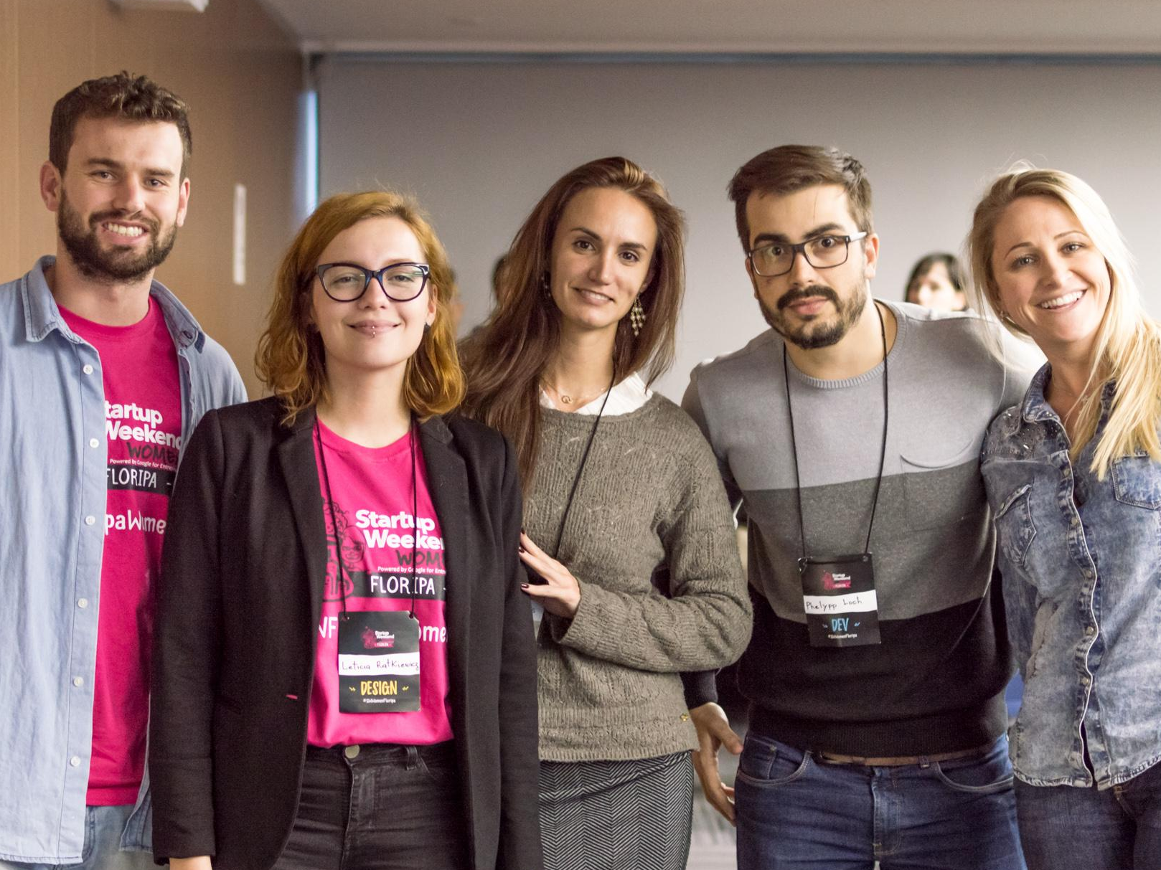
Building the Team
65% of all startup failure is due to team issues
have diverse skill sets and perspectives
no one is CEO! everyone wears as many hats
Notes:
Talking Points:
Find ideas and people that resonated, spend no more than a couple mins per person, talk to EVERYONE. Come back to people you click with, find complimentary skill sets (business, creative, technical)Start with the ideas and people that resonated with you and find out more. Most importantly, see who you mesh well with, and try to have a well balanced team with complementary skills. A balanced team includes people that can build product, people that can think through the user's experience, who can help put together a kick ass presentation and story, people who can validate the product and business, and people who have a great understanding of the technical aspects of the project.

Slide 15

picking a work area for the weekend
defining a scope
brainstorm
top 3 priorities
assign roles
Don’t Leave Without
making a sign with
team name
members
problem
Notes:
What to do:
Give your participants some guidance for the first night. Help them get started. #1 & #2 will help you keep track of teams and facilitate Mentor/Coaches.

Slide 16
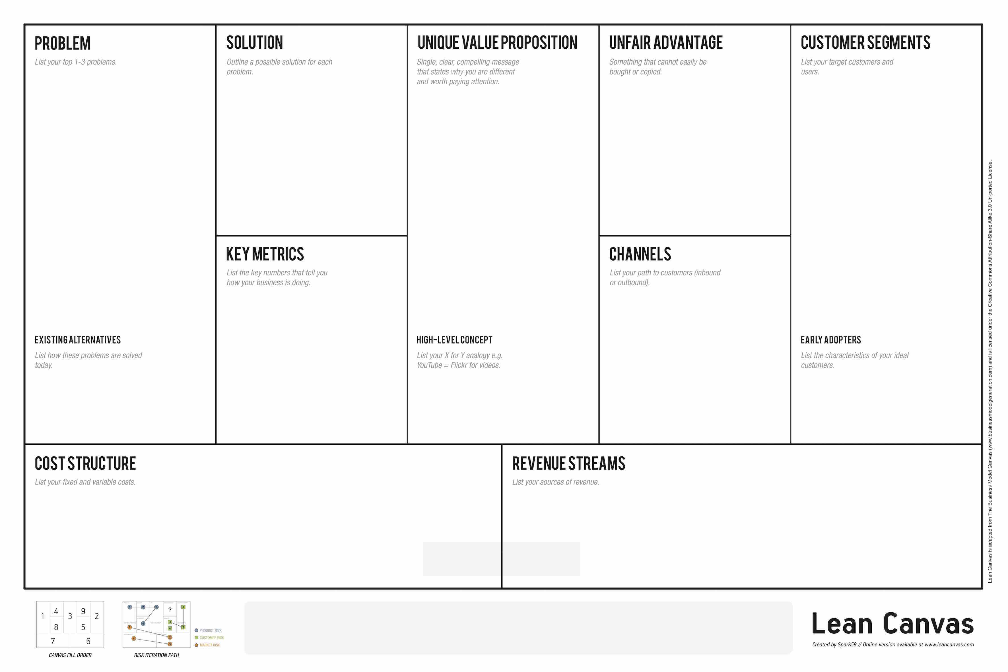
Lean Canvas
Notes:
What to do:
Let ‘em loose! Time for the attendees to form teams.

