Slide 1

Be a “Scrapy” Scraper: Extracting Data from a Protected Website
BRAIN Conference 2023
Dr. James Davis

Slide 2

About.me
BS in Mathematics
MS in Computer Science
PhD in Information Systems
Tech Entrepreneur
Principal @ Human Trafficking Research Group
Teach data science, machine learning, agile methods, & app development
jamesdavis@lsu.edu
linkedin.com/in/jdavisphd/
github.com/cavalryjim/scrapy_whisky

Slide 3

Web Scraping Defined
Extracting data from websites
fetch data
extraction of useful information
Prerequisite Knowledge Needed
HTML
CSS
HTTP
en.wikipedia.org/wiki/Web_scraping

Slide 4

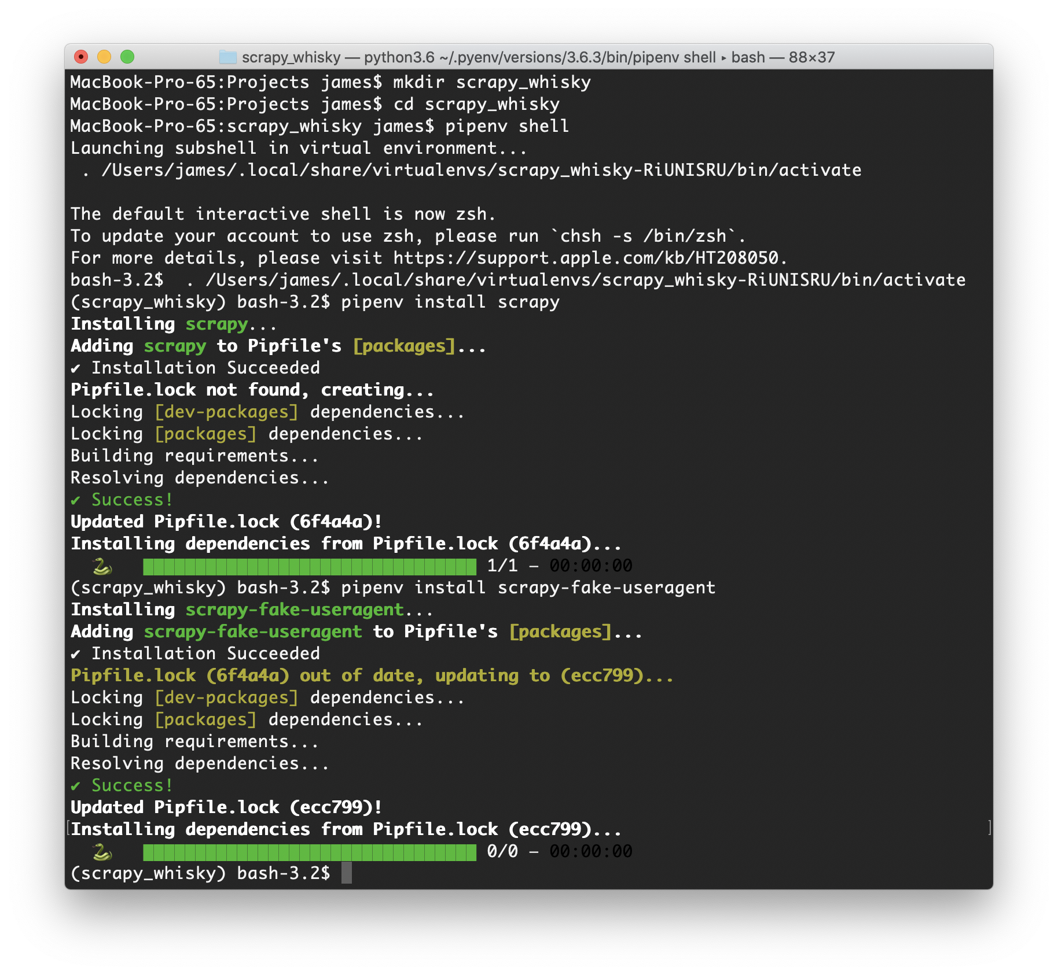
Get Ready!
$ mkdir scrapy_whisky
$ cd scrapy_whisky
$ pipenv shell
$ pipenv install scrapy
$ pipenv install scrapy-fake-useragent

