Slide 1
S.M.A.R.T
More midwife less paper

Slide 2

Time Errors Metrics

Slide 3
Time
Increased workload with no supporting tools
Two hours per day paper to paper transfer
43 fields 5 actually change

Slide 4
Clinical Errors
Missing Data
Missing Clients

Slide 5
Poor Metrics
What you can measure you can manage
% Missed visits
% Clinic usage
Clinical time versus Admin time
….

Slide 6
Impact
????? See poor metrics
My 19 midwives
60+ community midwives
Public Health Nurses
NI, UK, World…

Slide 7
Solution
What We Built
Database schema
Rest API Interface
Cross platform HTML5 front end
Select User
Something else

Slide 8
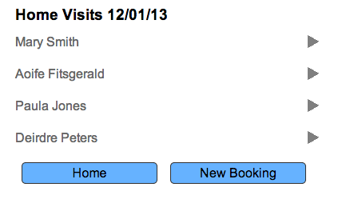
Schedule

Slide 9
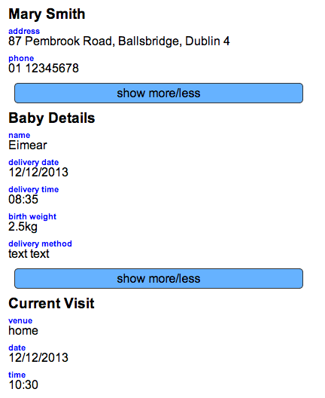
Individual Clients

Slide 10
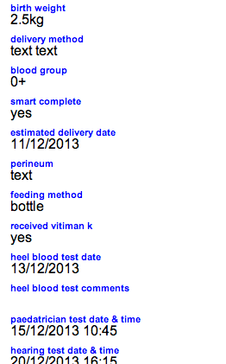
Extra Information

Slide 11
Solution
What we will build
The Team
Medical Expert
Teresa McReery
IT Team
Dr Derry O’Sullivan
Niall Reilly
Dr John Craddock
Business
David Curran
Call to action
No Brainer

