Slide 1

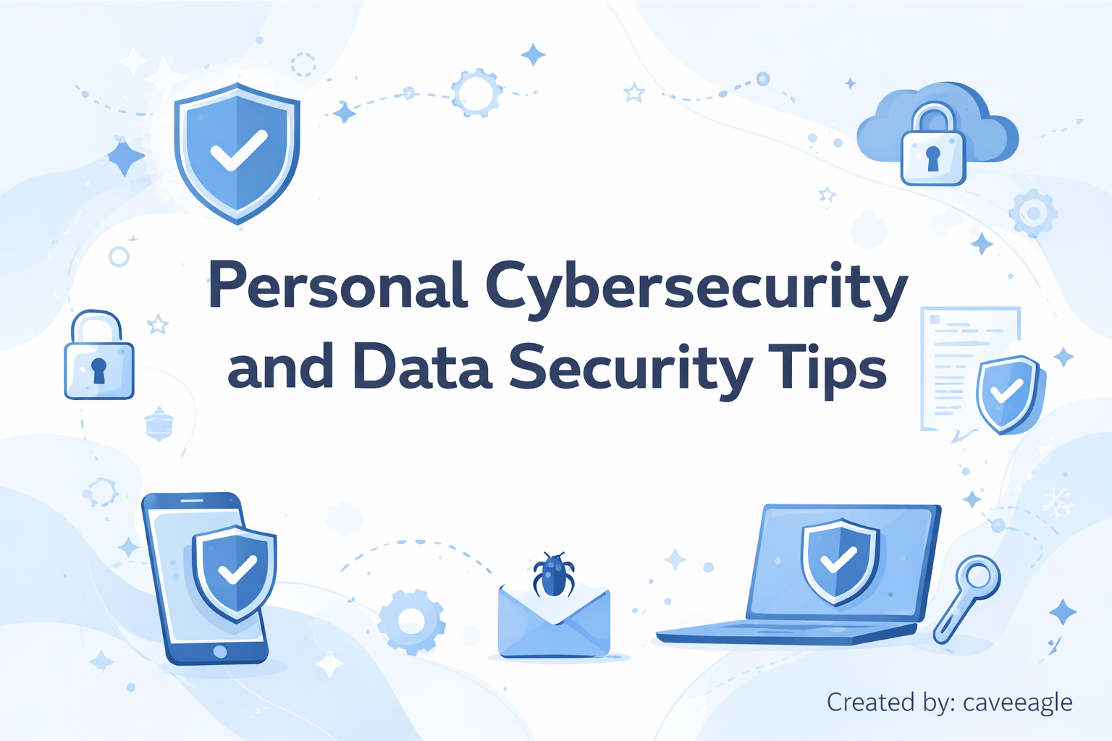

Slide 2
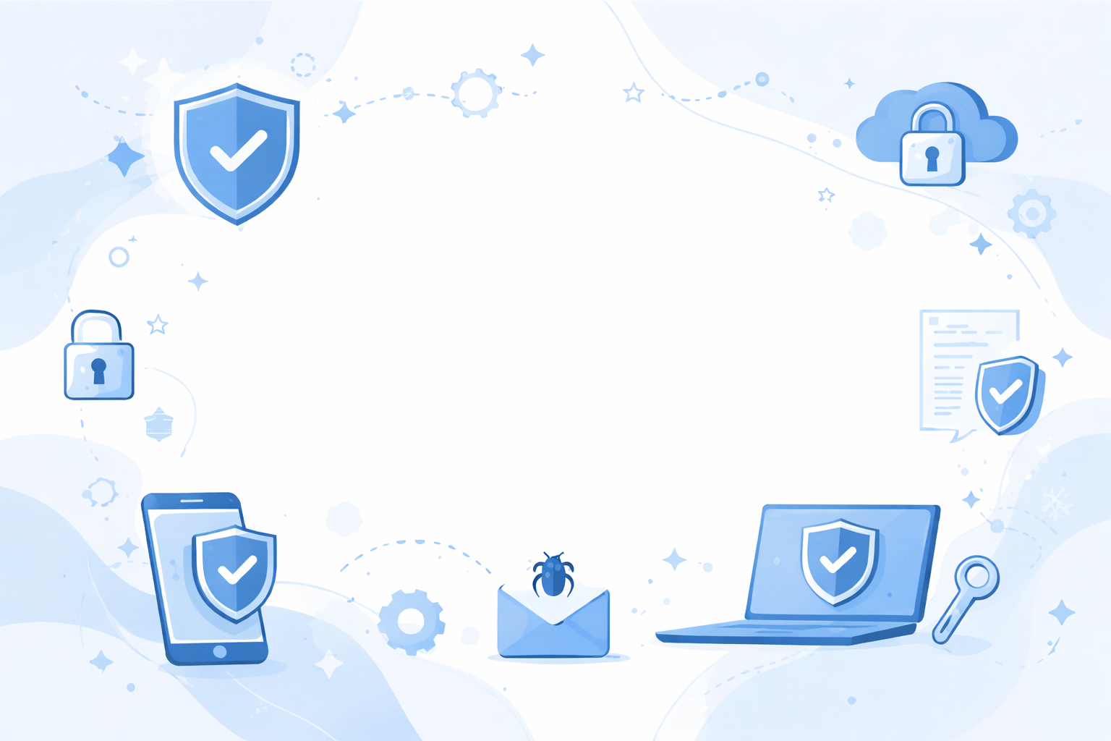
Login: caveeagle
Password: **********
I have published several articles
on cybersecurity

Slide 3
Login: caveeagle
Password: beCodeCave2020
I have published several articles
on cybersecurity

Slide 4

Personal Cybersecurity and Data Security Tips

Slide 5
Personal Cybersecurity and Data Security Tips
Part 1: Personal Security
Part 2: Password Data Leaks
Part 3: Data Security

Slide 6
Personal security
1. Don’t concern yourself with privacy. concern yourself with security!

Slide 7
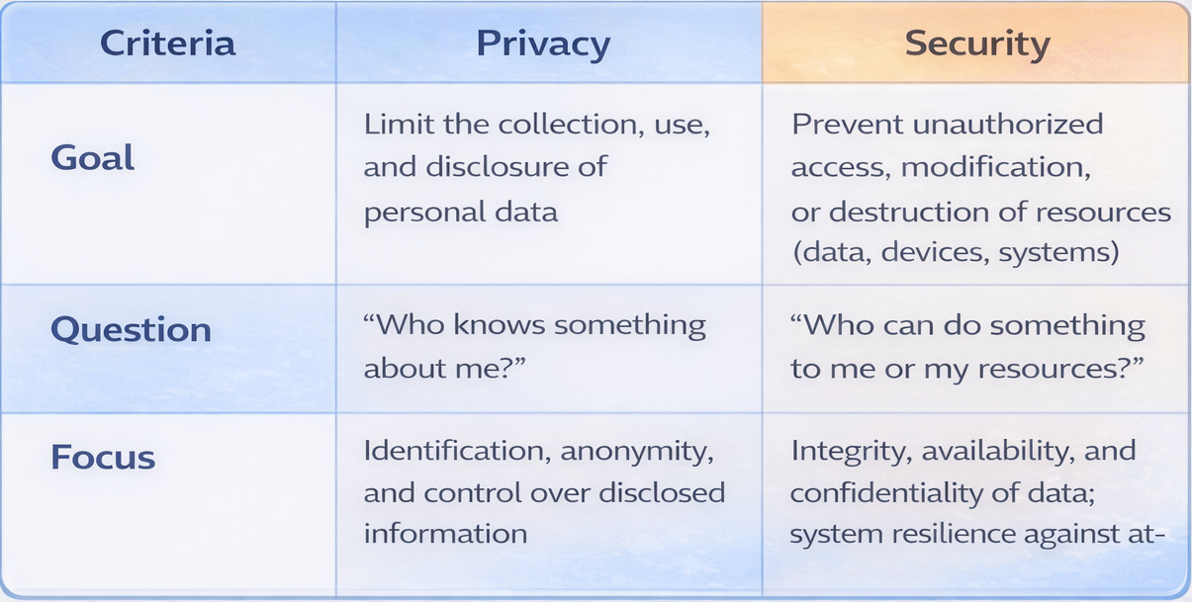
Personal security
1. Don’t concern yourself with privacy. concern yourself with security!

Slide 8
2. Divide your environment and identity

Slide 9
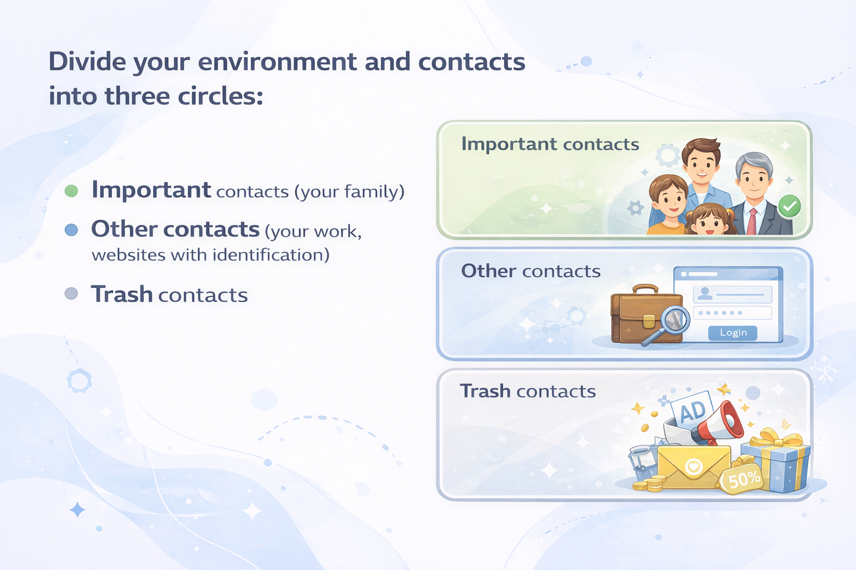

Slide 10
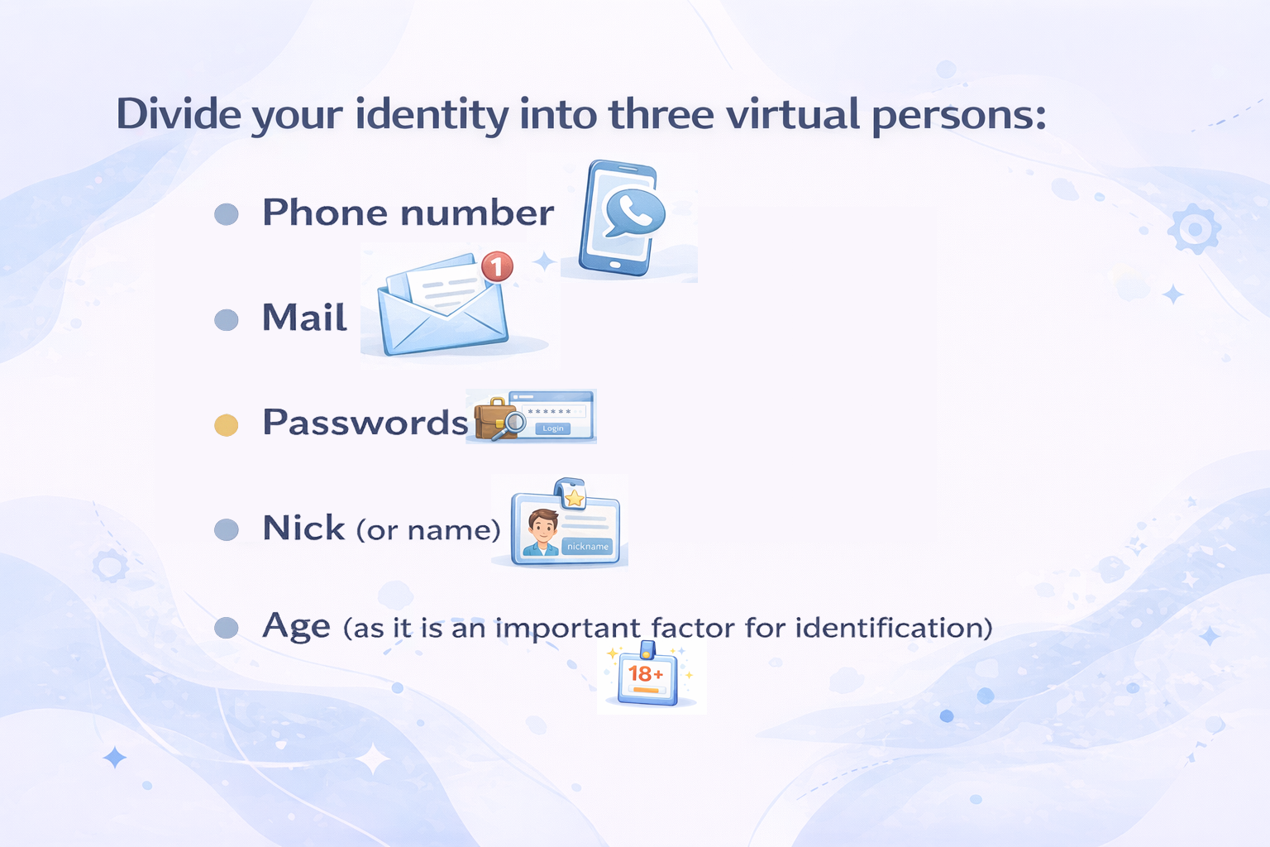

Slide 11
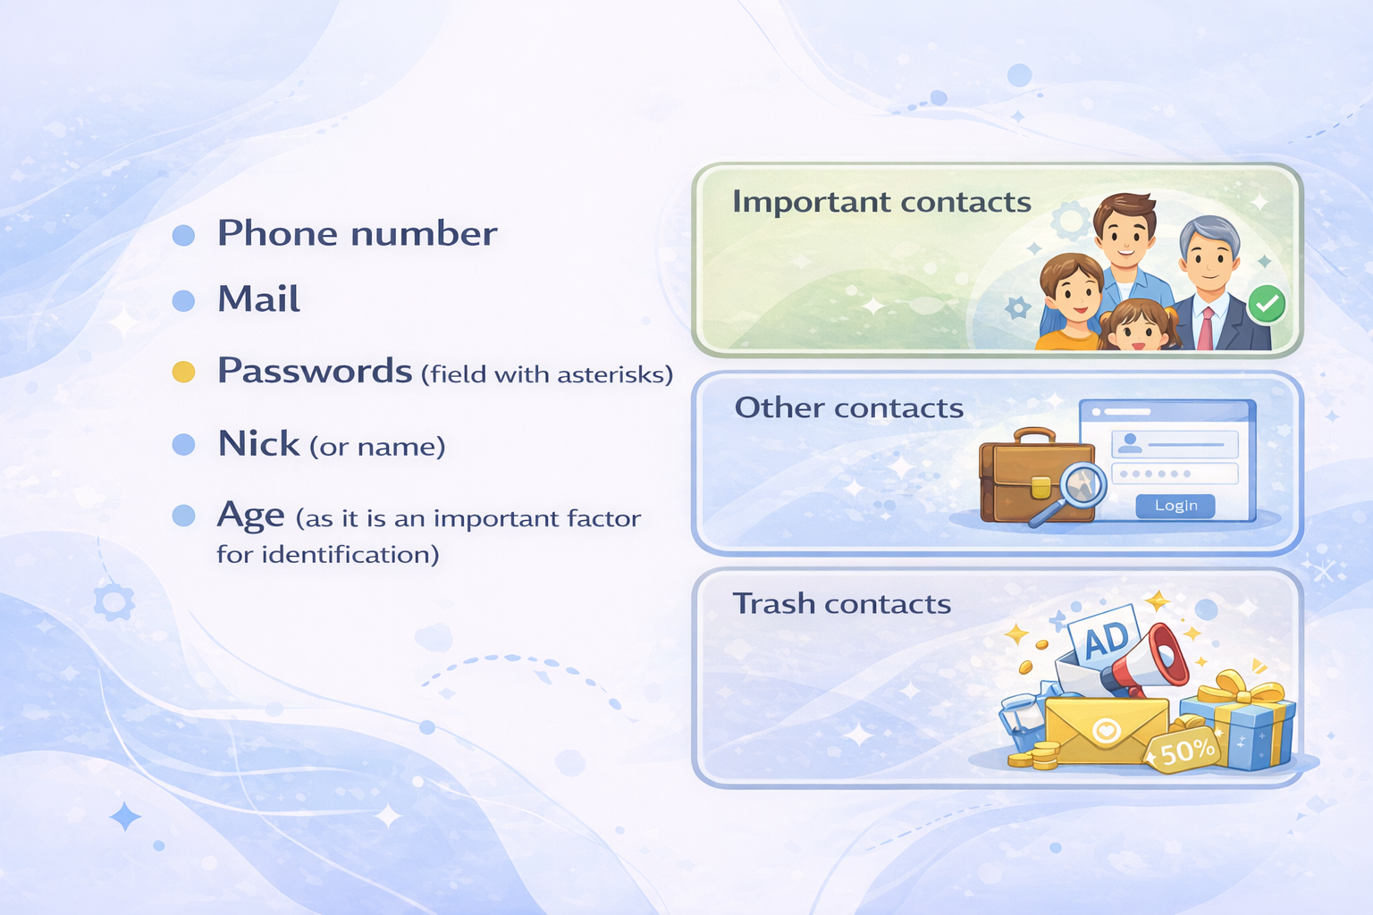

Slide 12
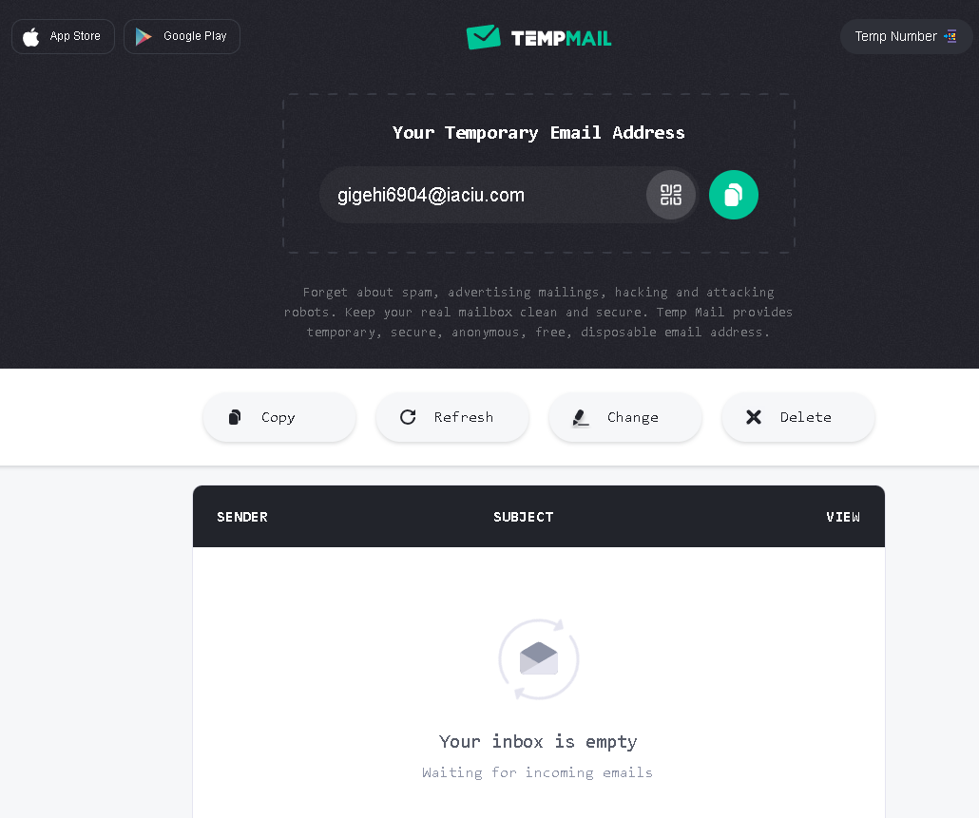

Slide 13
3. Create good passwords and keep them in a secure place.

Slide 14
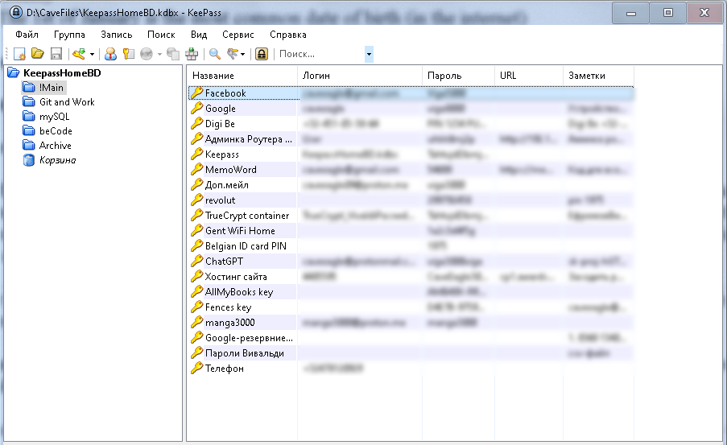
Good Passwords
Two strategies:
3 passwords for 2 scenarios
Important sites with two-factors auth
Other sites
Master-pass to keep them
KeepAss

Slide 15
Good Passwords
Two strategies:
3 passwords for 2 scenarios
Important sites with two-factors auth
Other sites
Master-pass to keep them
KeePass

Slide 16
Good Passwords
Two strategies:
Implement domain name into password
google.com – caveeagle_google_secret
manga.jp – caveeagle_manga_secret
chatgpt.com – caveeagle_chatgpt_secret

Slide 17
Good Passwords
Use phrases from your native language
typed with the English keyboard layout
(assuming English is not your native language)
СорокТысячОбезъянВЖопуСунулиБанан
An untranslatable phrase in Russian, but extremely strong password:
CjhjrNsczxJ,t]zyD:jgeCeyekb<fyfy

Slide 18
KeePass

Slide 19

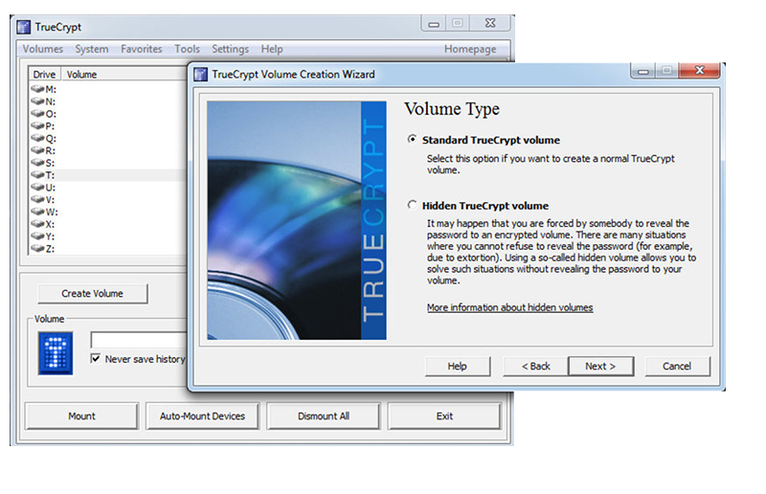
TrueCrypt
TrueCrypt is a software for creating encrypted containers for Windows, Linux, and macOS. It can create virtual encrypted disks in the form of file containers.
The last version: 7.1 (2012)

Slide 20
Personal Cybersecurity and Data Security Tips
Part 2: Password Data Leaks

Slide 21
Dark Web

Slide 22

Dark Web
lawful intercept equipment

Slide 23

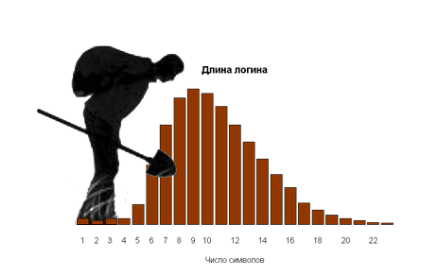
Black archaeology of data mining

Slide 24
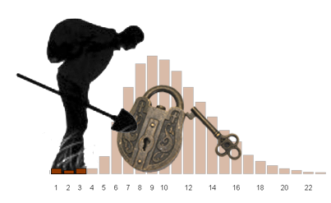
Black Archaeology of Data Mining:
What Could Be More Effective Than a Dictionary Attack?

Slide 25
Black Archaeology of Data Mining:
What Could Be More Effective Than a Dictionary Attack?
The «login equals password» attack
https://caveeagle.github.io/articles-data-mining/

Slide 26
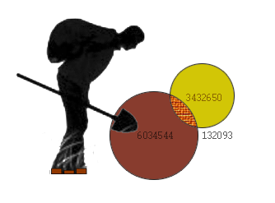
Black Archaeology of Data Mining:
How Dangerous Are Large Data Leaks?
intersection of sets

Slide 27
Some key insights
A dictionary attack is highly effective; many of your passwords have already leaked to the dark web. Therefore, never use the same passwords on critical sites and on the rest one.
The most frequently used password is the user’s own login. The second most common choice is the login followed by one or two digits.
Some sites keep passwords in plain text, and those passwords reach the darknet the very next day. For example, this included Twitter (in 2019) and certain government organisations.
Remember: even the most secret password on any site can leak.

Slide 28
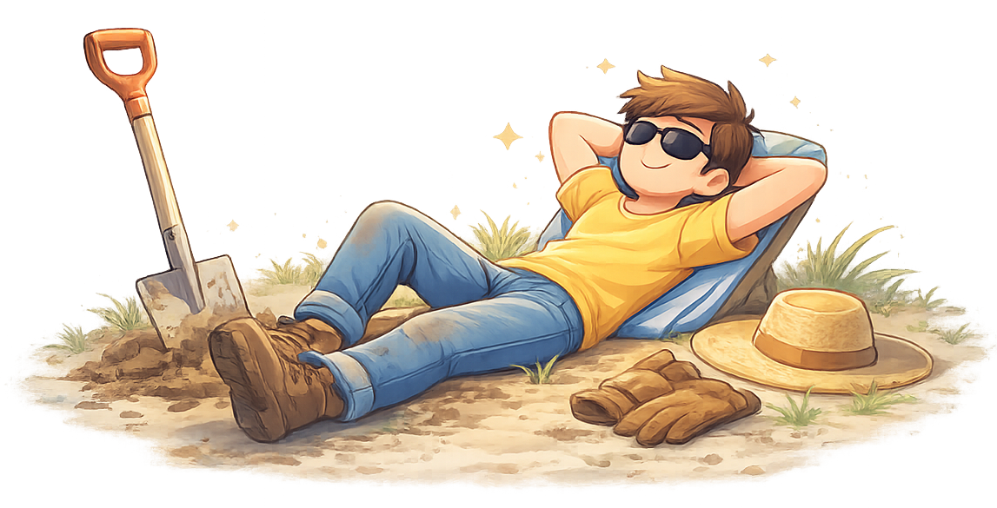
End of the second part
Let’s take a break

Slide 29
Data Security Tips
Part 3: Data Security

Slide 30
The main rule is: never trust data
that comes from web users!

Slide 31
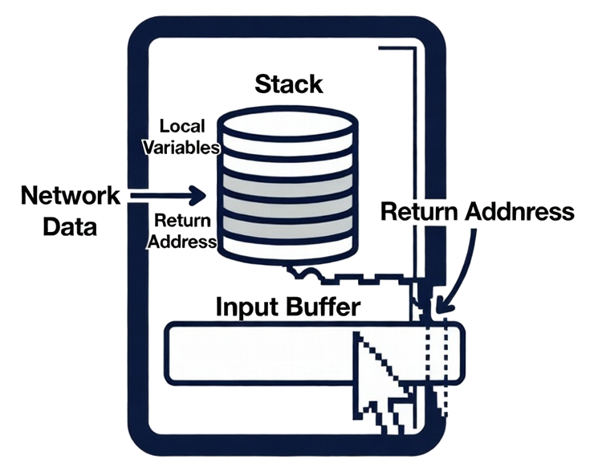
Never trust data that comes from web users!
Buffer Overflow Attack

Slide 32
Never trust data that comes from web users!
user_input = "admin' OR '1'='1" # entered by the user
query = f"SELECT * FROM users WHERE username = {user_input} AND password = 123"
# After substitution the query becomes:
SELECT * FROM users WHERE username = 'admin' OR '1'='1' AND password = '123'
SQL Injection

Slide 33
How to prevent
Good practice:
cursor.execute(
'''
INSERT INTO embeddings (chunk_id, chunk_hash, embedding)
VALUES (?, ?, ?)
''',
(chunk_id, chunk_hash, vec.tobytes())
)
Bad practice:
cursor.execute(f"INSERT ... VALUES ('{chunk_id}', ...")
cursor.execute("SELECT * FROM ? ORDER BY ? DESC", (table_name, column))

Slide 34
2. Do not store secrets in the repository.
And remember:
Git never truly deletes data
git filter-repo

Slide 35

2. Do not store secrets in the repository.
And remember:
Git never truly deletes data

Slide 36
3. Never store user passwords
(and user secrets) in plain text

Slide 37
3. Never store user passwords in plain text
Facebook and Instagram – from 2012 to 2019 year
NetEase (like Chinese gmail) – in 2015
Twitter – from 2018 to … (I checked in 2020)
Sony (PSN и Sony Online Entertainment, 2011)
GitHub – in 2018 (fixed)
LinkedIn (2012)

Slide 38
3. Never store user passwords in plain text
Facebook and Instagram – from 2012 to 2019 year
NetEase (like Chinese gmail) – in 2015
Twitter – from 2018 to … (I checked in 2020)
Sony (PSN и Sony Online Entertainment, 2011)
GitHub – in 2018 (fixed)
LinkedIn (2012)
Passwords into DB must be hashed and salted

Slide 39
3. Never store user passwords in plain text
Passwords into DB must be hashed and salted

Slide 40
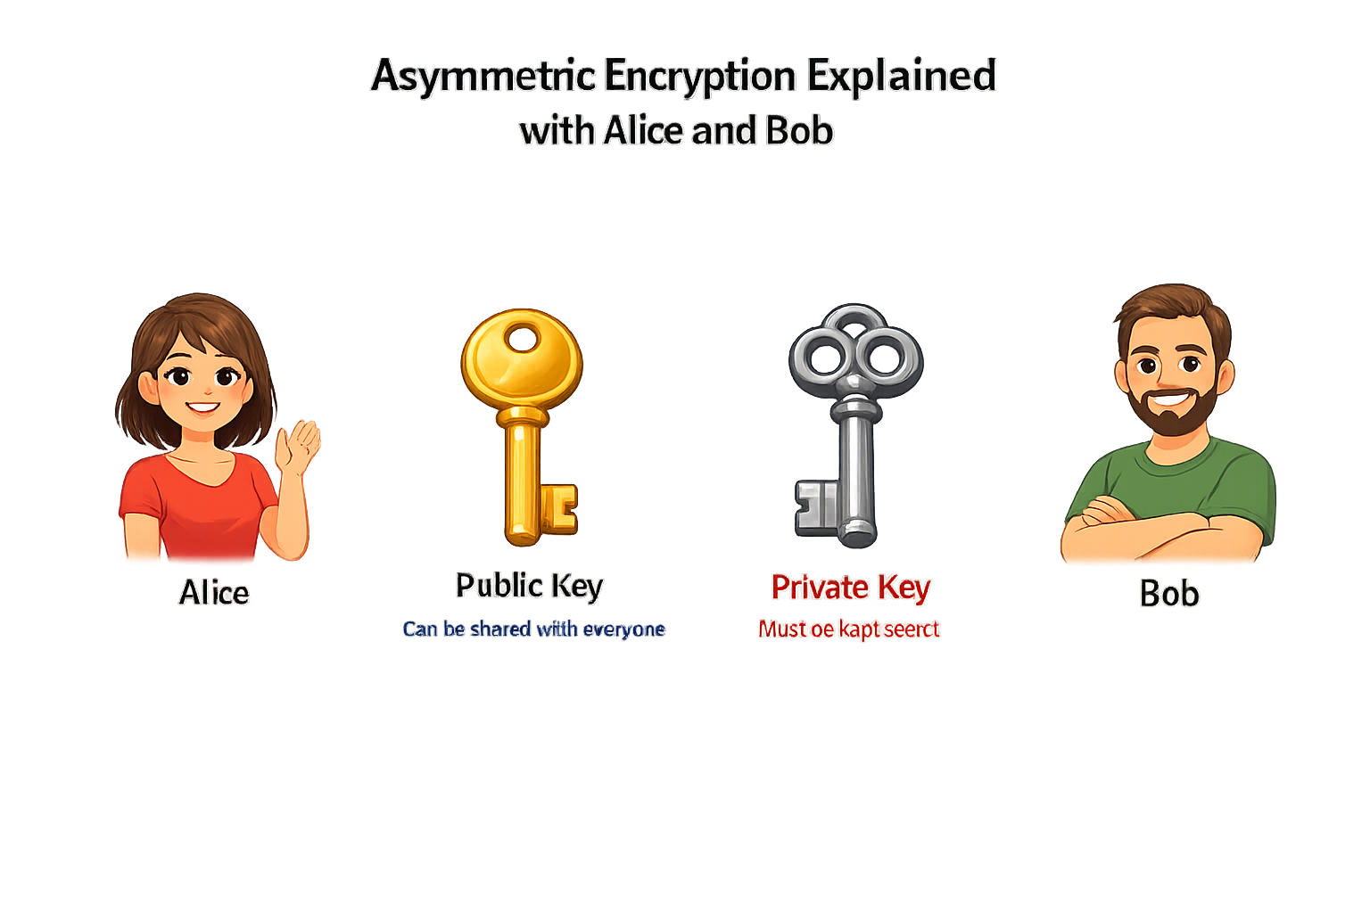
Asymmetric Encryption

Slide 41
Thank you for your attention

