Slide 1
CAVIAR Guide for Developers
Morad Biagooi
2020-07-17

Slide 2
Prerequisite knowledge for CAVIAR developers
- C++ programming (Polymorphism, Preprocessors)
- CMake
- Molecular Dynamics basic algorithms

Slide 3
Part I: a C++ review for CAVIAR

Slide 4
CAVIAR source code looks complicated, why is it developed like that?
We had the following goals while developing CAVIAR:
- Creation of the most flexible design
- Automation the code as much as possible to reduce typos, errors and mental workload for developers
- An input script with a functionality that make the user independent of changing C++ source code.
The above items resulted in:
- Creation of an MD library (such as Espresso) instead of an MD software (like LAMMPS (LAMMPS also can be used as a c++ library))
- Developing almost everything as C++ classes with polymorphism
- Creation of CASL language and interpreter

Slide 5
What do we mean by “library”?
- We instantiate objects of the library by using the constructor functions defined in the class descriptions of the libraries:
class Lj {
public:
Lj (type1 arg1, type2 arg2) {...}
...
};
Lj my_force(arg1, arg2); // class instantiation

Slide 6
What do we mean by “library”?
- The instantiated objects does not know each other unless we tell them.
Objects instantiation:
Lj my_force(arg1, arg2);
Verlet_list my_nbl(arg3, arg4);
Setting Variables:
my_force.neighborlist = &my_nbl; // C++
my_force.set_neighborlist (my_nbl); // C++
my_force set_neighborlist my_nbl #CASL Script
my_force.set_neighborlist(my_nbl) #Python Script
my_force.neighborlist=my_nbl #Python Script

Slide 7
Polymorphism in CAVIAR
class Force_field : public Pointers {
...
void calculate_acceleration() = 0; // Force_field becomes an abstract class by setting to zero.
Atom_data *atom_data;
...
};
class Lj : public Force_field {
...
void calculate_acceleration() {...}
...
};
class Electrostatic : public Force_field {
...
void calculate_acceleration() {...}
...
};

Slide 8
Why polymorphism?
Class Md_simulator : public Pointers{
...
std::vector<Force_field *> force_fields;
...
};
int main () {
...
md_simulator::Basic my_simulator (arg1);
force_field::Lj my_force_1 (arg2);
force_field::Electrostatic_ewald my_force_2 (arg3);
my_simulator.force_fields.push_back(&my_force_1); // Possible with polymorphism
my_simulator.force_fields.push_back(&my_force_2); // Possible with polymorphism
...
}

Slide 9
Why polymorphism?
class Force_field : public Pointers {
...
void calculate_acceleration() = 0;
...
};
Class Md_simulator : public Pointers{
...
std::vector<Force_field *> force_fields;
void time_step () {
...
For (auto f : force_fields) {
f → calculate_acceleration(); // Possible only with polymorphism
  }
  ...
}
...
};

Slide 10
A Base Class Example:
Class declarations
#ifndef CAVIAR_OBJECTS_FORCEFIELD_H
#define CAVIAR_OBJECTS_FORCEFIELD_H
#include "caviar/utility/objects_common_headers.h"
namespace caviar {
namespace objects {
class Atom_data; // Class Declaration (I): Instead of #include “Atom_data.h” → less compile time
class Domain; // Class Declaration (II): Instead of #include “Domain.h” → less compile time
class Neighborlist; // Class Declaration (III): Instead of #include “Neighborlist.h” → less compile time
class Force_field : public Pointers {
public:
Force_field (class CAVIAR *);
virtual bool read (class caviar::interpreter::Parser *) = 0;
virtual void calculate_acceleration () = 0;
virtual double potential (const Vector<double> &);
virtual Vector<double> field (const Vector<double> &);
...
class objects::Atom_data *atom_data; // It can be defined because of the declaration (I)
class objects::Domain *domain; // It can be defined because of the declaration (II)
class objects::Neighborlist *neighborlist; // It can be defined because of the declaration (III)
...
};
} //objects
} // namespace caviar
#endif

Slide 11
Class declarations. Reason
If a header is changed, all of the files that has included it are need to be recompiled.
For example If you change ‘Pointer.h’ or ‘CAVIAR.h’ in the package, almost all of the project source files needs to be recompiled.
CAVIAR have more than 500 source files and re-compiling all of them takes a long time.
Using declarations instead of include is possible when we are working with pointers.
Less include -> less dependency

Slide 12
CAVIAR Major Namespace
namespace caviar {
namespace objects {
… // (containing the classes that have different
algorithms for CAVIAR MD simulations)
}
namespace interpreter {
… // (containing the input/output classes that are
used to create and call objects classes)
}
}

Slide 13
CAVIAR Major Namespace
namespace caviar {
namespace objects {
  class Atom_data;
  namespace atom_data {
    class Basic;
  }
  class Force_field;
  namespace force_field {
  class Lj;
  class Electrostatic;
  class Plt_dealii;
  ...
  }
  ...
}
}

Slide 14
Part II: CAVIAR MD Pipeline

Slide 15
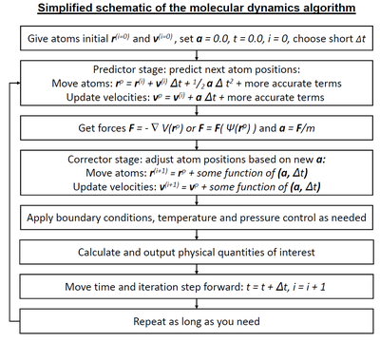
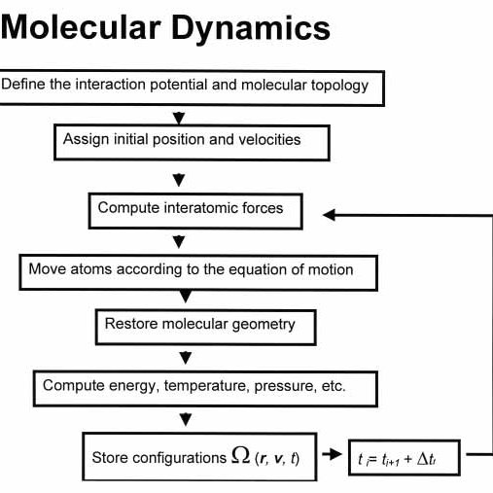
Molecular Dynamics Flowcharts

Slide 16
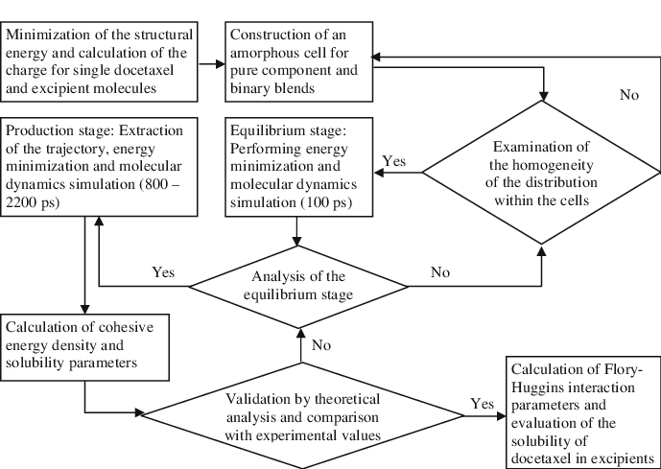
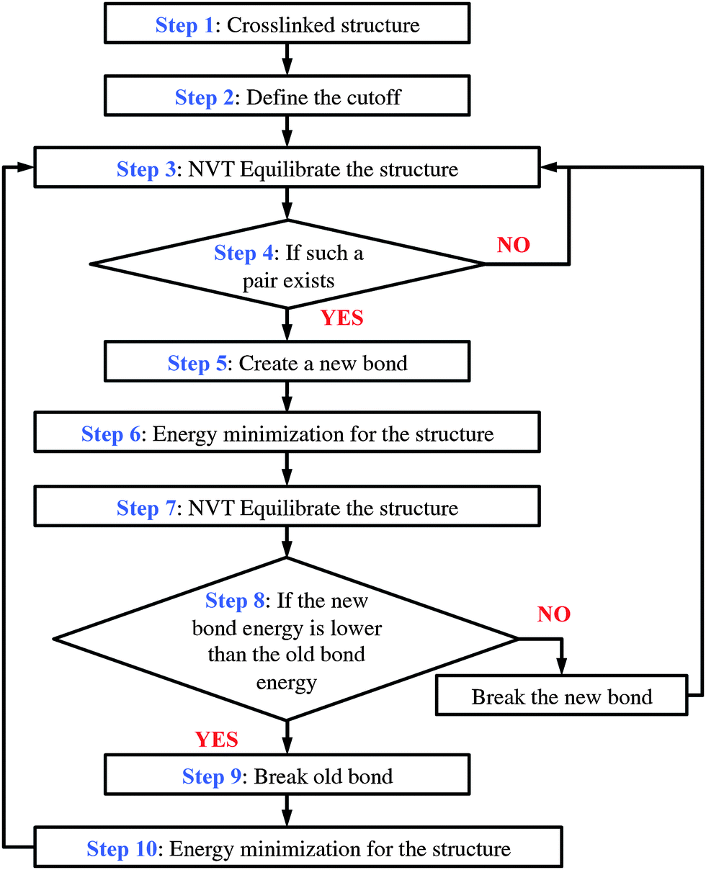
Molecular Dynamics Flowcharts

Slide 17
Molecular Dynamics Flowcharts
There are different MD algorithms and we have one Package.
So its software design must support different Algorithms

Slide 18
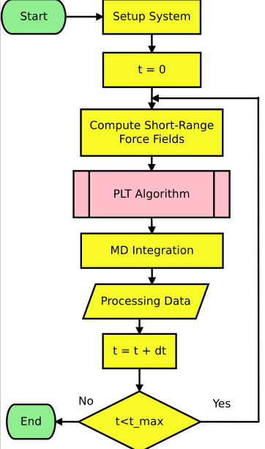
CAVIAR MD Flowchart

Slide 19
CAVIAR MD Flowchart
Where is the main MD time loop in CAVIAR package?

Slide 20
CAVIAR MD Flowchart
Where is the main MD time loop in CAVIAR package?
There’s no main loop.
One can instantiate an Md_simulator class to have such functionality.
Also one can develop his or hers own custom MD loop.

Slide 21
CAVIAR 1.0 (without python)
Pipeline
start
At the program starting point, the main function instantiate a CAVIAR object.
CAVIAR object creates the
IO classes that are in the interpreter namespace.
Then the Input instance starts reading the input stream.
int main ()
CAVIAR
Object_creator
Input
Output
Communicator
Object_container
Read and execute
input CASL script
until it reaches
the end of file.
Error
Object_handler

Slide 22
CAVIAR 1.0 (without python)
Pipeline
There are three different type of commands:
I) Object Creation
force_field Lj my_force
Input
Object_creator
Create an object and put its pointer into the correct container in Object_container.
Also store its name, type and storage index in a dictionary for later calls. Then return to input.
Object_container

Slide 23
CAVIAR 1.0 (without python)
Pipeline
There are three different type of commands:
I) Object Creation
II) Object Calling (For setting, getting or calling a routine in that object)
my_force cutoff 0.5
Input
Looks for an object with the called name.
If it exists, find its pointer and by using it, pass the script parser to its read() function.
The read function interprets the given command such as setting or calling another internal function.
Wait for the return from the function. Then return to input to get the next line.
Object_handler
Object_container
my_force -> read(parser)

Slide 24
CAVIAR 1.0 (without python)
Pipeline
There are three different type of commands:
I) Object Creation
II) Object Calling (For setting, getting or calling a routine in that object)
- CASL commands (If Condition, Loop,...)
Input
The input class handles the CASL commands by calling its internal functions.

Slide 25
CAVIAR 1.0 objects interface:
Pointers.h
Inheritance
Force_field
Inheritance
Lj
Pointer class has :
pointer to Error
pointer to Output
pointer to Input
pointer to Communicator
pointer to Obj. Container

