Slide 1
CAVIAR with Boost Python
II

Slide 2
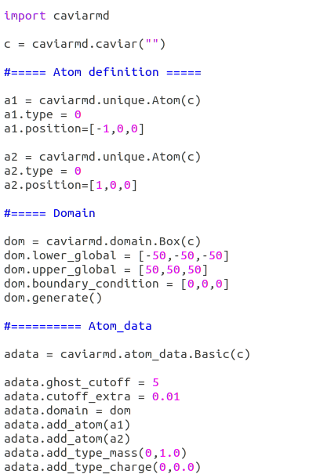
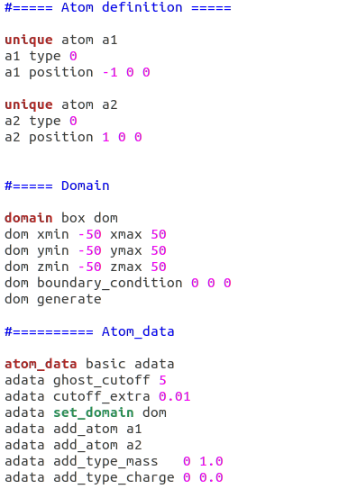

Slide 3
Classes inside interpreter namespace
CAVIAR class
Force_field Class
Error
Pointer to Error
Pointer to Error
Pointer to CAVIAR
Output
Pointer to Output
Input
Pointer to Input
Communicator
Pointer to Communi.
Container
Pointer to Container
...
...
MPI_Comm mp;

Slide 4
Atom_data
Force_field class
MD_Simulator
Pointer to Force_field
Position
Pointer to Error
Pointer to Atom_data
Pointer to Integrator
Velocity
Pointer to Neighborlist
Member functions...
Mass
Pointer to Domain
...
...
Member functions...

Slide 5
include/caviar/objects/force_field/lj.h
src/caviar/CAVIAR.cpp
src/caviar/objects/force_field/lj.cpp
include/caviar/utility/python_utils_dec.h
include/caviar/utility/python_utils_def.h

Slide 6
void f()
void f(double)
void f(double, int)
double f ()
void g()
void f_wr1() { f();}
void f_wr2(){ f(1.2);}
void f_wr3(){ f(1.2, 3); }
Boost : def(“f”, &f)
Boost : def(“g”, &g)
Boost : def(“f” ,&f_wr1)
Boost : def(“f” ,&f_wr2)

Slide 7
bool, int, double, ...
std::shared_ptr<Force_field>
std::vector<int>
std::vector<std::vector<int>>
...
Boost : def_readwrite(...)
Setter and getter for
shared_ptr<>
Setter and getter for
each type
Boost : add_property
Boost : add_property

