Slide 1
Revealing emissions from workplace energy use

Slide 2
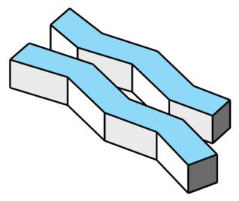
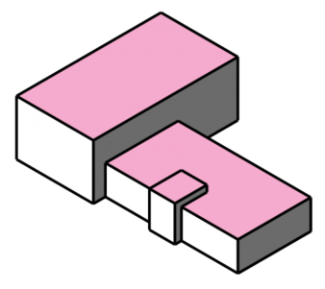
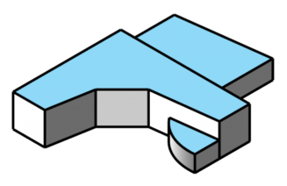

Slide 3
Monitoring

Slide 4
Architecture - monitoring

Slide 5

Architecture - monitoring

Slide 6
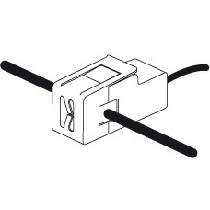

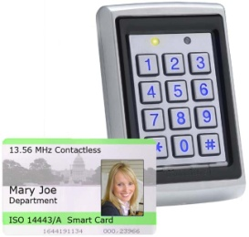
Architecture - monitoring
Mains utility monitors
Individual appliance monitors
Staff movement monitors

Slide 7
Architecture - monitoring
Mains utility monitors
Individual appliance monitors
We must consider a representative range of sources of emissions (different utilities, e.g. electricity, gas, water), and who/what is responsible for those emissions (e.g. number/type of staff, number/type of appliances, current processes)
Staff movement monitors

Slide 8
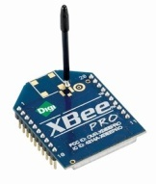
Architecture - monitoring
Each sensor Zigbee
enabled

Slide 9

Architecture - monitoring

Slide 10
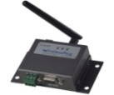
Architecture - monitoring
M2M module
Zigbee wireless data transfer

Slide 11
Architecture - monitoring
M2M module
Zigbee wireless data transfer
When does this occur?
Regularly (e.g. once per minute) and/or triggered by events (e.g. when door is opened)?

Slide 12
Architecture - monitoring
M2M module

Slide 13

Architecture - monitoring
Data store
The M2M module passes the data from the various sensors – via mobile phone network – to an online data store

Slide 14
Architecture - monitoring
Data Store
Company 1
Company 2
Owns
Owns
Owns
Workplace 1
Workplace 2
Workplace 1
Is located in
Employed by
Employed by
Appliance 1
Employee 2
Appliance 2
Operated by
Appliance 1

Slide 15
Architecture - monitoring
Data Store
Company 1
Company 2
Owns
Owns
Owns
Workplace 1
Workplace 2
Workplace 1
Is located in
Employed by
Employed by
Appliance 1
The data store requires a common schema to allow relationships to be expressed clearly and for entities to be compared. What is a reasonable schema for our trial?
Employee 2
Appliance 2
Operated by
Appliance 1

Slide 16
User Interfaces
Presentation and Control

Slide 17
Architecture - presentation
Data store
End-user Interfaces
User interfaces are driven by the data from the data store

Slide 18
Architecture - presentation
User Interfaces
Who are the potential end users?
Staff/tenants of a workplace
Managers of a workplace
Maintenance
Service suppliers (e.g. national grid)
Service retailers

Slide 19
Architecture - presentation
User Interfaces
Who are the potential end users?
Staff/tenants of a workplace
Managers of a workplace
Maintenance
Service suppliers (e.g. national grid)
Service retailers
These are considered in the Desimax project

Slide 20
Architecture - presentation
User Interfaces
Who are the end users?
Staff/tenants of a workplace
Managers of a workplace
Maintenance
Service suppliers (e.g. national grid)
Service retailers
The field-trial in C-Aware focuses on these

Slide 21
Architecture - presentation
User Interfaces
Who are the end users?
Staff/tenants of a workplace
Managers of a workplace
Maintenance
There are 3 interesting interfaces that could be designed for these users, each with different characteristics

Slide 22
Architecture - presentation
User Interfaces
Who are the end users?
Staff/tenants of a workplace – UI 1: Public display
Managers of a workplace – UI2: Private desktop display
Maintenance – UI3: Personal mobile display
There are 3 interesting interfaces that could be designed for these users, each with different characteristics

Slide 23
Architecture - presentation
Data store
End-user Interfaces
User interfaces are accessed by displays with web access

Slide 24
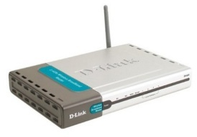
Architecture - presentation
Web access via workplace
UI1
Internal LAN
Web access via mobile network
UI2
UI3

Slide 25
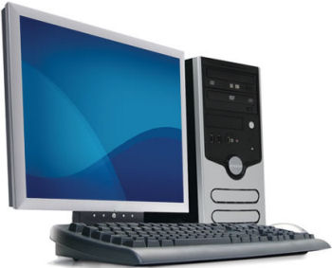
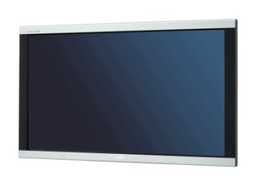
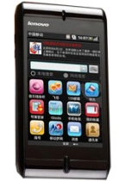
Architecture - presentation
UI1
UI2
UI3

Slide 26
User Interface 1
Public display for presenting data to employees

Slide 27
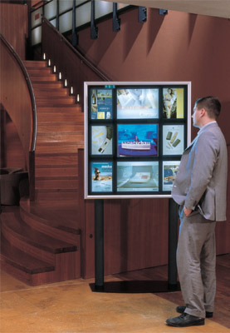
User interfaces
UI1: Public display for employees
Employees at a workplace can be motivated to improve their working habits to reduce the emissions of the workplace
Similar workplaces will compete to reduce emissions; within a workplace, employees will be split into teams to compete to contribute the highest reductions
Each workplace will have a public display (or a number of identical displays?). The public display should show:
Progress of the workplace towards its goal(s)
The contribution of each team to the progress of the workplace
Comparison with progress of a competing workplace
The display also conveys a positive image to visitors

Slide 28
User interfaces
UI1: Public display for employees
E.g. MOCKUP

Slide 29
User interfaces
Issues
Responsibility
These interfaces would require emission data to be reliably linked to the correct employees/teams within a workplace (we should not incorrectly ‘blame’ employees)
Teams, not individuals
Encouraging team competition within a workplace rather than individual competition is usually more effective as this builds relationships between employees and encourages widespread change in habits, rather than individual changes in habits
Progress towards goals by teams should be displayed publicly, but contributions by individual employees should not be shown publicly, so that competition within teams/personal embarrassment does not occur
Clear goals set by management
Within a workplace, teams should compete to contribute to collective goals, not just to beat each other
Goals should be set by the owners/management of a workplace, and advice should be given on methods for improvement
Goals should be set/adjusted regularly to maintain engagement of employees
Rewards
Employees of the winning team should consider enjoyment of the competition as the reward
Rewards for reaching a collective goal may be given to all employees; providing additional rewards to the winning team may discourage competition or encourage over-competition

Slide 30
User Interface 2
Private desktop display for presenting data to managers of a workplace

Slide 31
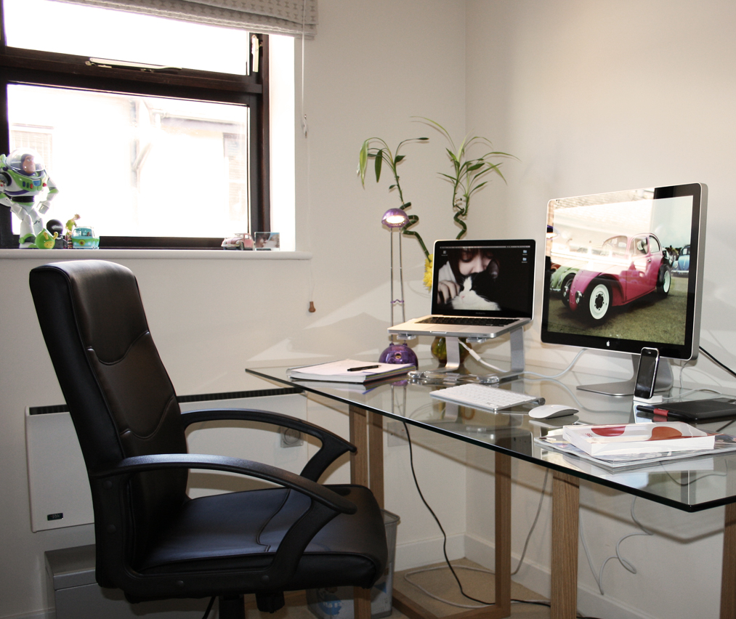
User interfaces
UI2: Private desktop display for managers of a workplace
Managers of the workplace can see which employees/appliances contribute to the emissions of the workplace, and monitor the effects of changes they make to the workplace
UI2 will allow managers to determine what behaviours are causing emissions (discover particular staff, appliances or processes that need to be changed)
UI2 will also allow managers to assess the impact of any changes they make to staff/appliances (compare emissions before and after a change)
UI2 should also allow managers to make comparisons between their workplace and other workplaces so that they can set goals

Slide 32
User interfaces
UI2: Private desktop display for owners of a workplace
E.g. MOCKUP

Slide 33
User interfaces
Issues
Cost vs. emissions
Managers will probably be motivated by the costs of energy use rather than emissions of energy use, therefore UI1 will need to emphasise the link between energy use and both costs and emissions
Responsibility
As with UI1, this interface would require emission data to be reliably linked to the correct employees/appliances within a workplace, particularly if managers are going to make changes based on data presented by the interface; the interface should not suggest a change unless it is highly likely to make a positive impact
Levels of information & privacy
To preserve privacy UI1 only revealed team data; UI2 should allow data to be viewed at different levels of detail, allowing the manager to view the emissions of the entire workplace (and compare to other workplaces), emissions of teams (and compare to other teams), and emissions of individual employees and appliances
The amount of information should correspond to the information already available to a particular manager, e.g. if a manager only has responsibility for one team then they should not be able to view information about employees in other teams. For this reason, the interface must be restricted such that only specific managers can view it (by personal authentication)
Goal setting
UI2 should allow the managers to set the goals that are shown in UI1; UI2 must allow the manager to assess the changes in emissions caused by setting goals – this will allow a manager to determine which changes to make permanent (enforcing changes made by a good team across the whole workplace), and which changes to reverse

Slide 34
User Interface 3
Personal mobile display for presenting data to maintenance staff and providing control

Slide 35
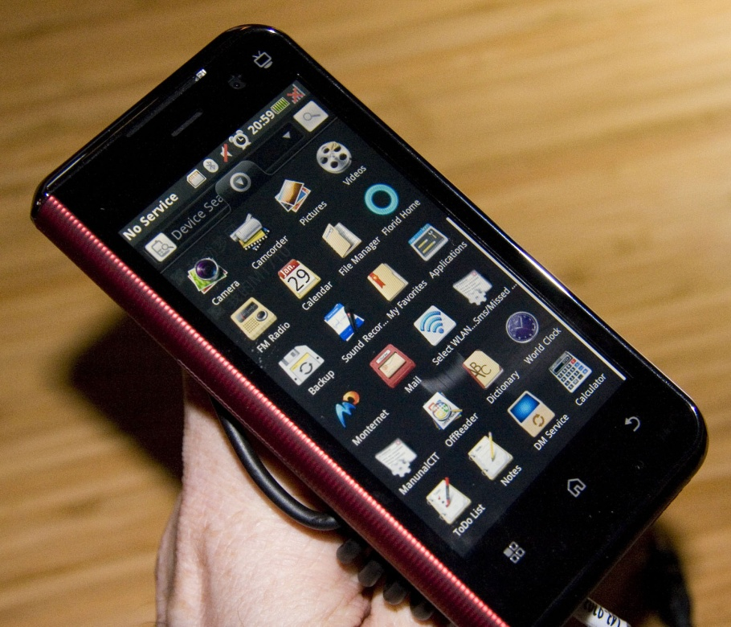
User interfaces
UI3: Personal mobile display for maintenance
UI3 will allow the user to compare the current status of appliances in the workplace to the “expected” status of the appliances, to determine whether an appliance is potentially faulty/requires maintenance
The mobile UI can be accessed inside or outside the workplace
The UI will allow an external maintenance company to monitor many workplaces simultaneously, comparing the effectiveness of appliances in different environments (giving evidence for recommendations to be made to managers for changes to workplaces)

Slide 36
User interfaces
UI3: Personal mobile display for maintenance
MOCKUP

Slide 37
User interfaces
Issues
Authentication
If UI3 can be used to control appliances remotely, we must ensure that only authorised personnel can use the interface
Accountability
If decisions to visit a workplace for maintenance are based on data provided by the interface, this data must be accurate
The effects of controlling appliances via the interface must be made clear to the user, so that the user does not negatively affect the workplace
A history of interactions with the workplace through UI3 must be kept so that the managers of the workplace can see what maintenance has been carried out

Slide 38
Architecture - control
Web access via mobile network
UI3 allows user to request changes to workplace
UI3

Slide 39
Architecture - control
Data store
UI3
Requests require changes to be made to data store

Slide 40
Architecture - control
Data Store
Company 1
Company 2
Owns
Owns
Owns
Workplace 1
Workplace 2
Workplace 1
Is located in
Employed by
Employed by
Entries in the data store for appliances will contain settings for operation (e.g. time to switch on/off) as well as emissions data; UI3 will modify the settings
Appliance 1
Settings
Emission data
Employee 2
Appliance 2
Operated by
Appliance 1

Slide 41
Architecture - control
Data store
The M2M module requests changes to appliance settings

Slide 42
Architecture - control
The M2M module passes settings changes back to the appropriate appliance
Are there any M2M sensors that can control appliances as well as monitor them? Can M2M modules send data back to M2M sensors as well as receiving data?

Slide 43
Field trial plan

Slide 44
Work plan
Phase 1 – Testing monitoring architecture
Consultation with University of Nottingham ETC (http://www.nottingham.ac.uk/etc/) and Estates (http://www.nottingham.ac.uk/estate/) regarding current monitoring capabilities of University of Nottingham and local workplaces
Acquiring suitable sensors and sensor hub (e.g. M2M module) – check compatibility/portability with China
Deploying and testing sensor infrastructure in test site (Horizon Research)

Slide 45
Work plan
Phase 2 – Testing data store for monitoring
Developing schema for data store
Deploying data store on suitable web platform
Linking sensor infrastructure to data store and testing scalability of data store for long-term monitoring

Slide 46
Work plan
Phase 3 – Prototype user interfaces
Develop working prototypes of UI1, UI2 and UI3 (without control functionality)
Rapid iteration of prototypes based on many short test deployments at test sites (student halls of residence at University of Nottingham, Horizon Research, China Mobile Research)
Internationalise interfaces

Slide 47
Work plan
Phase 4 – Test control architecture
Acquire and integrate suitable control hardware with monitoring hardware
Modify data store to support control
Test control functionality (reliability and response speed)

Slide 48
Work plan
Phase 5 – Prototype enhanced UI3
Modify UI3 to enable control functionality
Rapid iteration of UI3 prototype in consultation with various potential end-users

Slide 49
Work plan
Phase 6 – Formal field trials
Determine observation/data capture method + sites
Installation of monitoring/control infrastructure + UI devices on sites
Pre-trial interviews/focus groups with users
Trial
Post-trial interviews/focus groups with users

Slide 50
Work plan
Phase 7 - Analysis
Data sessions/workshop with stakeholders
Dissemination of results
Plan for follow-on proposals

Slide 51
Work plan
Phase | Months
 | 1-3 | 4-6 | 7-9 | 10-12 | 13-15 | 16-18 | 19-21 | 22-24
1
2
3
4
5
6
7

Slide 52
Test/trial sites

Slide 53
Test/trial sites
Interesting workplace comparisons
Similar workplaces in different organisations
China Mobile Research office vs. Horizon Research office
Does this provide motivation?
Similar workplaces within the same organisation
University of Nottingham: Horizon Research office vs. Mixed Reality Lab office
Employees regularly visit the opposite workplace and socialise with employees from the opposite workplace – how does this affect the motivation?

Slide 54
Test/trial sites
Further comparisons (possibly beyond the scope of the trial, but useful for testing)
(Communal) student halls of residence
2 different residences in University of Nottingham UK
1 hall in UoN UK vs. 1 hall in UoN Ningbo
Communal accommodation
2 different shared accommodations in China (difficult to find in the UK?)

