Slide 1
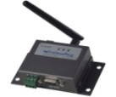
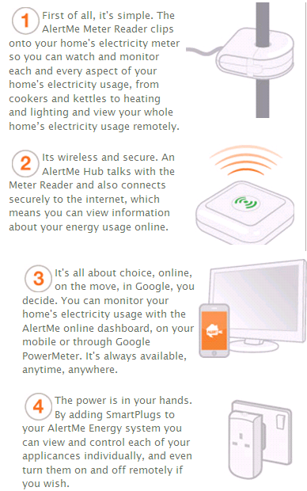
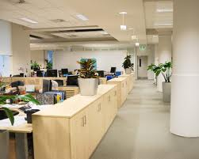



System Overview
The typical scenario is in the commercial office building, which is our initial target market
CMCC M2M Module
Meter Reader
Phase I-Basic energy usage data collection
1
The meter reader clips onto the electricity meter, sending energy usage information to M2M Module periodically, maybe per hour or per day
2
The M2M module is connected to the internet via TD-SCDMA wireless network, making the energy information available through the application in Ophone and a specific webpage
Phase II-Remote control and function extension
Smart Plug
3
View and control all the facilities in office individually using smart plugs, for example, see how much electricity the air condition is using and turn it on/off remotely
PC
CMCC Ophone
4
Group all the facilities in each room and allocate related appliances to each person, so that we could collect user data for developing extended applications

Slide 2

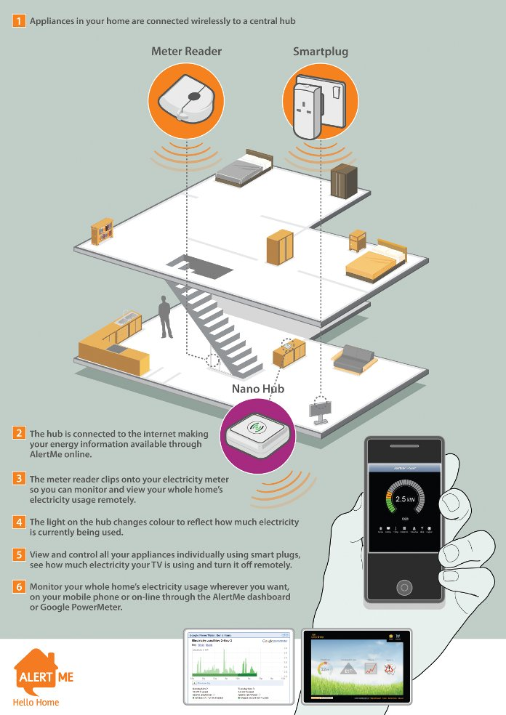

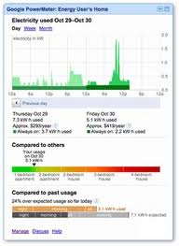

On-Site Deployment
The system will be deployed both in China and UK, comparing the energy usage between the two buildings
vs.
China Mobile Innovation building at Beijing, China
The academic building at the University of Nottingham, UK
Features on mobile phone
Features on PC
1
Real time tracking
1
Real time tracking and historical statistics
2
Remote facilities control
2
Remote facilities control and different usage mode set
3
Top energy saving rooms or groups
4
Energy saving reminder
3
Community sharing and top list
4
Energy cost prediction

Slide 3
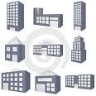


Target Market
The commercial property management companies would be our first target customers, while community property management companies could also be considered in future
Commercial Property
The energy usage of whole building, cost prediction and remote facilities control
Community Property
The energy usage comparison, cost prediction and remote appliances control for all families in the community
The energy usage comparison among individuals or teams in commercial buildings
The energy usage, cost prediction and remote control of public facilities in community

