Slide 1
C-Aware update January 2011
Ben Bedwell

Slide 2
Agenda
Introduction to new researchers at University of Nottingham
Introduction to new researchers at University of Cambridge
Reminder of project plan
Current state of trial infrastructure in Nottingham; plans for Cambridge and China
Plans for paper-prototyping
Current state of business model work
Other business

Slide 3
New researchers

Slide 4
New researchers
University of Nottingham
Alexa Spence (Horizon Transitional Fellow)
Caroline Leygue (Horizon Research Fellow)

Slide 5
New researchers
University of Nottingham
Alexa Spence (Horizon Transitional Fellow)
Caroline Leygue (Horizon Research Fellow)
Psychology research related to Energy
Framing energy use and behaviour change
Online energy experiment
University student survey

Slide 6
New researchers
University of Nottingham
Alexa Spence (Horizon Transitional Fellow)
Caroline Leygue (Horizon Research Fellow)
Psychology research related to Energy
Framing energy use and behaviour change
Online energy experiment
University student survey
James Colley (Computer Science PhD student)
Ian Dent (Computer Science PhD student)
Jianhua Shao (Horizon PhD student)

Slide 7
New researchers
University of Cambridge
Gerard Briscoe (RA)
Sustainable computing (business models/economics)

Slide 8
Project plan

Slide 9
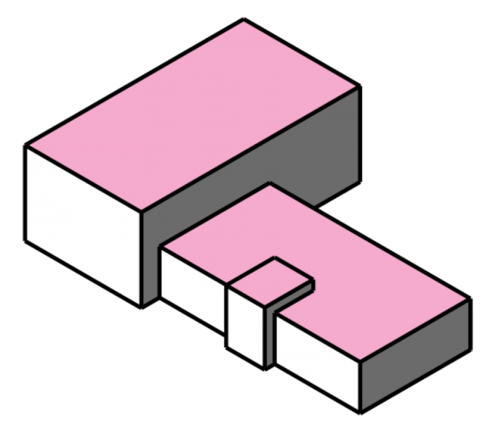
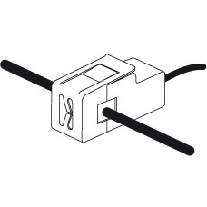

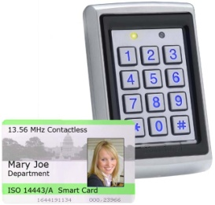
Architecture - monitoring
Mains utility monitors
Individual appliance monitors
Staff movement monitors

Slide 10

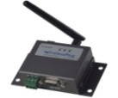
Architecture - monitoring
Hub
Data transfer

Slide 11
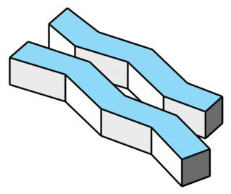



Architecture - monitoring
Data store

Slide 12
Architecture - monitoring
Data store
End-user Interfaces
User interfaces are accessed by displays with web access

Slide 13
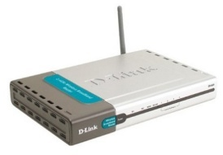
Architecture - presentation
Web access via workplace
UI1
Internal LAN
Web access via mobile network
UI2
UI3

Slide 14

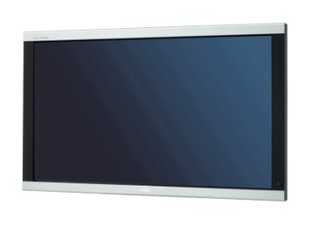
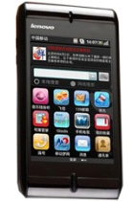
Architecture - presentation
UI1
UI2
UI3

Slide 15
Architecture - presentation
User Interfaces
Who are the end users?
Staff/tenants of a workplace – UI 1: Public display
Managers of a workplace – UI2: Private desktop display
Maintenance – UI3: Personal mobile display
There are 3 interesting interfaces that could be designed for these users, each with different characteristics

Slide 16
Field trials
Eventual deployment of monitoring/presentation infrastructure on sites in UK and in China
University of Nottingham
Horizon (+ Computer Science?)
China Mobile Research
University of Cambridge
Computer Science

Slide 17
Research Qs
Human: what representations of information are most effective for encouraging energy-related behaviour change?
Visual style, metaphor, units of information, etc.
How does context affect this (culture, organisational structure, social relationships, time of day, etc.)?
Infrastructure: what infrastructure is necessary for this to happen?
Business: who pays for this infrastructure/how is value recovered and delivered?

Slide 18
Work plan
Phase | Months
 | 1-3 | 4-6 | 7-9 | 10-12 | 13-15 | 16-18 | 19-21 | 22-24
1 |  |  |  | Develop/test monitoring hardware
2 |  |  |  |  | Develop/test data store
3 |  |  |  |  |  | Prototype UIs
4 |  |  |  |  |  | Develop/test control
5 | Prototype enhanced UIs
6 | Formal field trials
7 | Analysis

Slide 19
Current trial infrastructure

Slide 20
Update: trial infrastructure
Phase 1 – Testing monitoring architecture
Consultation with University of Nottingham regarding current monitoring capabilities – done
Building management system monitors one electricity meter per building (current power reading every few minutes)
Access to current/historical data, although needs work to convert into useful format
Acquiring suitable sensors and sensor hub
Equipment purchased from Green Energy Options; waiting for installation
Deploying and testing sensor infrastructure in test site
Waiting for installation of monitoring equipment

Slide 21
Monitoring equipment
Purchased from Green Energy Options
Domestic energy sensors + displays (>1 million sold)
Commercial + bespoke energy sensors + displays
Equipment for 4 domestic deployments and 1 workplace deployment
Allows 4 members of Horizon staff to monitor their energy use at home, at work and while travelling (via mobile phone)
This is small scale, but allows us to test feasibility (and change design if necessary) before final field trials

Slide 22
Monitoring equipment
Domestic deployments (x4):
1 hub
5-10 individual appliance monitors
Circuit monitors (lighting, etc.)
Workplace deployment (Horizon):
1 hub
20 individual appliance monitors
Circuit monitors
All sensors produce power data every 15 seconds, connect to hub via PowerLine (ethernet over power), hub connects to web via LAN

Slide 23
Update: trial infrastructure
Phase 2 – Testing data store for monitoring
Developing schema for data store
Initial schema developed and updated following TEDDI workshop in December
Deploying data store on suitable web platform
Defined Amazon EC2 + MySQL DB as initial candidate
Linking sensor infrastructure to data store and testing scalability of data store for long-term monitoring
Waiting for installation of monitoring equipment

Slide 24
Monitoring data store
Schema based on data produced by other domestic monitoring products (will be clarified when access is provided to Green Energy Options API)
Discussed at TEDDI workshop (aiming towards a common schema for all TEDDI-funded projects)
Includes:
directory of hubs and sensors
Including connection type, data units, sample frequency, accuracy, etc.
log of hub and sensor events
Including energy data from sensors, switch on/off, commission/decommission, etc.

Slide 25
Monitoring data store
Aim for open APIs to access/insert data
Introduce mechanisms for controlling access, inspired by Dataware (Personal Container) research

Slide 26
Prototyping plans

Slide 27
Update: paper prototyping
Phase 3 – Prototype user interfaces
Paper prototyping workplan defined

Slide 28
Paper prototyping
Activities:
Identify suitable participants (January)
Represent end-users of the system
Preparation exercises (late Jan-early Feb)
3-4 creative exercises over 2 weeks
Short (<15 minutes)
Personal (no need for researchers to help; feedback by email/phone)
20-30 participants
Help designers to find out how end-users understand energy concepts, energy infrastructure and potential system features BEFORE paper-prototyping workshop

Slide 29
Paper prototyping
Activities:
‘Expert’ design session (mid Feb)
Combine energy and user-interface researchers in Horizon
Use existing energy applications and feedback from preparation exercises to generate a set of basic designs for paper-prototyping workshop
Small number of very simple visualisations
Cover a wide range of potential visualisations (to encourage creative thinking)
‘Unfinished’ (to encourage criticism and initiative)

Slide 30
Paper prototyping
Activities:
Paper-prototyping workshop (late Feb-early March)
In China
12-15 participants (from participants of preparation exercises)
Split into 3 groups
Often produces better results when groups are mixtures of different types of user
Use designs from ‘expert’ session as starting-points
Criticise/modify initial designs
Produce new designs
Present designs to other groups for discussion

Slide 31
Paper prototyping
Similar activities will be carried out in UK very soon
Practice
Jian’s Horizon project (cross-cultural design practices)
First major step in prototyping process: provides set of designs to be developed further
Immediate task:
Identify stakeholders in China Mobile & Cambridge
Understand organisational structure (in comparison to Horizon)
Identify contacts for preparation and paper-prototyping activities
Determine suitable dates for exercises

Slide 32
Business model work

Slide 33
Business models
Irene/Gerard … survey, etc.

Slide 34
Other business

Slide 35
Other business
Progress with MoU/other contractual issues
Progress with hiring further staff
Cambridge
Nottingham
Confirm next video-conference/workshop dates
12th January 2011 8 a.m. GMT – videoconference
March – paper-prototyping workshop, Beijing
5th May 2011 – workshop (Nottingham)
15th July 2011 8 a.m. GMT – videoconference
27th-29th September 2011 – trials kick-off

