Slide 1

Fuzzy Interest Forwarding
Kevin Chan (US Army Research Laboratory), Bongjun Ko (IBM T. J. Watson Research Center), Spyridon Mastorakis (UCLA), Alex Afanasyev (Florida International University), Lixia Zhang (UCLA)
Asian Internet Engineering Conference (AINTEC 2017) November 20, 2017 Bangkok, Thailand

Slide 2
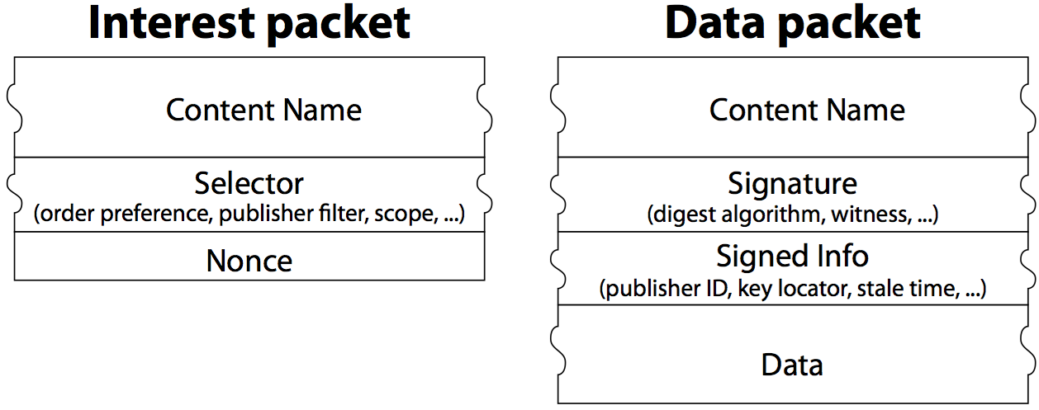
Named Data Networking
application data name
(may carry a few optional parameters)
application data name
a few pieces of metainfo
application
data
crypto signature
Data consumers send Interest packets
Whoever has the matching Data packet can reply
Publisher binds name to content; receivers verify
All data immutable
Notes:
Resembles HTTP’s request/reply, with 2 important differences: data security, data immutability

Slide 3
NDN’s node model
NDN FORWARDING DAEMON
Forwarding Strategy
Multiple ways to fill FIB
Self-learning
Routing protocol
Content
Store
Pending
Interest Table
FIB
name prefix | next hop
/google/search | A, B
/fiu.edu | B,C, D
/fiu.edu/aa | A, B, D,
NFD module resides in every NDN node
PIT breaks Interest looping, enable NDN to freely use multiple paths
Notes:
CS: NDN treat storage and link the same
Forward: show multiple next hop

Slide 4

NDN Interest Forwarding: Three Steps
NDN FORWARDING DAEMON
Forwarding Strategy
1
find matching
name in CS ?
2
find matching name in PIT ?
3
find matching in FIB ?
Interest
Content
Store
Pending
Interest Table
FIB
data
✔
✔ add to PIT entry
May forward an interest packet out through one or more interfaces
For each PIT entry:
Interest
name
incoming
Interface(s)
outgoing interface(s)
sending time
Notes:
CS: talk NDN treat storage and link the same
Forward: show multiple next hop

Slide 5
NDN Data Packet Return
NDN FORWARDING DAEMON
data
Interest
Content
Store
Pending
Interest Table
①find a matching entry in PIT?
Eliminate DDoS by data packets
④ remove the PIT entry
Interest
name
incoming
Interface(s)
outgoing interface(s)
sending time
5
②
Calculate RTT
④save in content store
③
Send to all the interfaces listed here
Built-in feedback loop, enable measurement
caching
Multicast data delivery
Notes:
Data comes back: show potential multicast; NOTE Interests are forwarded, data traverses exactly the same path Interest laid the state, create a feedback loop. Cache freshness controlled by data producer

Slide 6
Forwarding Strategy
NDN FORWARDING DAEMON
Forwarding strategy
Routing
protocol
Content
Store
Pending Interest
Table (PIT)
FIB
Forwarding Strategy makes interest forwarding decisions by taking input from
FIB
measurement from Interest-data exchange (and any other local resource information)
Per-namespace forwarding policies
A hook to control plane
Notes:
Even with a control plane, Best approach is NOT to repalce the routing protocol, let it reflect true connectivity status

Slide 7


Steering Interests Toward Matching Data
Data source, storage, and processing units can all supply requested data
With no prior knowledge: may try broadcast discovery, or even random walk
Building knowledge of directions to reach data: routing announcement
Interest packets are forwarded and matched with data using hierarchical names or prefixes
Origin
data source
Processing
unit
INTEREST
DATA
stable
storage (repo)
opportunistic caching
Notes:
Random walk: NDN can keep the memory of failed paths

Slide 8
How Consumers Discover Data Names or Prefixes
Search engines
Naming conventions
/park/yellowstone/alerts
Retrieves the latest version of known alerts
=> /park/yellowstone/alerts /_v=2017-11-17
=> /park/yellowstone/alerts /_v=2017-04-18
=> /park/yellowstone/alerts /_v=2017-04-19
Metadata
/park/_nodes
{ yellowstone }
/park/yellowstone/_nodes
{ alerts }
Require access to infrastructure and/or multiple Interest/Data exchanges

Slide 9

Efficient Data Discovery in Challenging Environments
/park/yellowstone/lost&found/dog/…
/park/yellowstone/lost&found/canine/…
/park/yellowstone/lost&found/pup/…

Slide 10
Fuzzy Interest Forwarding Extension
NDN FORWARDING DAEMON
/park/yellowstone/lost&found/?pet?
Forwarding Strategy
data
✔
Interest
Content
Store
Pending
Interest Table
FIB
Fuzzy
Lookup
Fuzzy
Lookup
/park/yellowstone/lost&found/
/park/yellowstone/lost&found/
/park/yellowstone/lost&found/
Notes:
CS: talk NDN treat storage and link the same
Forward: show multiple next hop

Slide 11
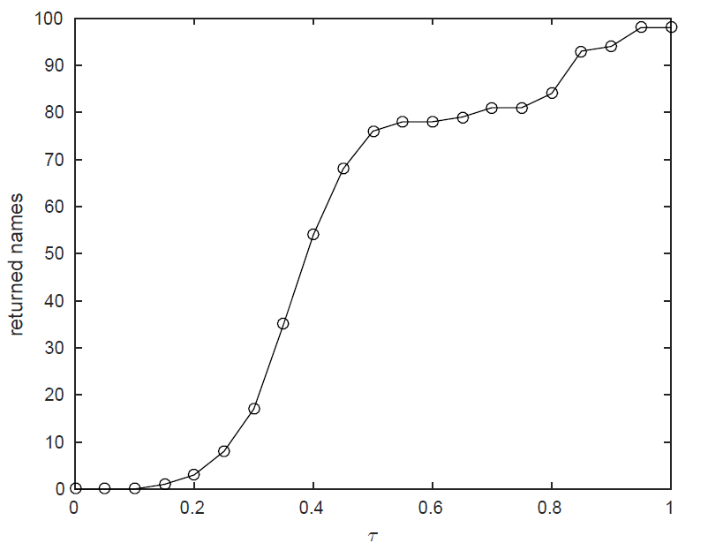
Ontological Matching
Predefined name ontology given by a lexical database
Feasible when matching in resource-rich computing nodes
Source
UCI Zoo dataset, WordNet corpus, WUP Similarity Function
Large database
Expensive lookup
Suitable only for resource-rich nodes

Slide 12
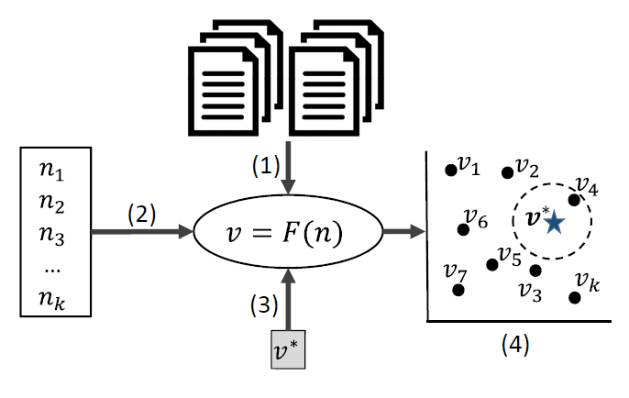
Contextual Matching
Construct a vector space model for contextual similarity distance between words/names
Mapping function learned from a corpus of texts
Names in CS and FIB are mapped to vectors
A (part of) Interest name mapped to a vector
Semantically similar names are found in the vector space
Source
Prefix announcements
Static corpuses of texts
Approximate nearest neighbor search
Locality Sensitive Hashing (LSH): O(1) O(log n) lookup time
Could be feasible for constrained devices

Slide 13
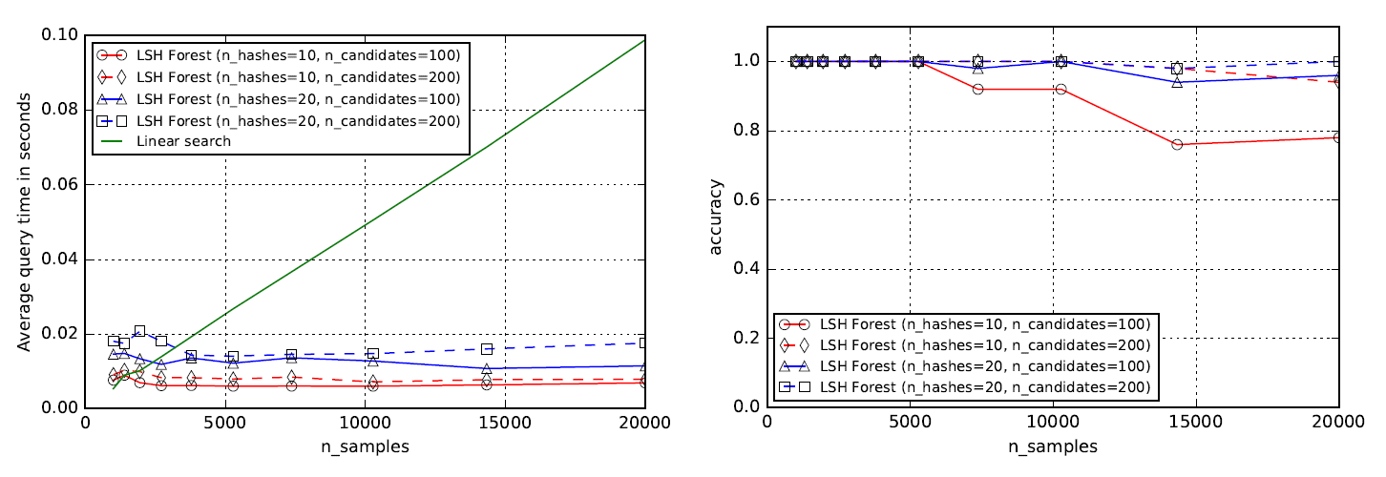
Estimated Performance of Approximate Nearest Neighbor Search

Slide 14
Fuzzy Match of the Hierarchical Name
Exact match on a prefix
Disambiguate context of the requested data
/park/yellowstone/lost&found
/news/cnn
Fuzzy match of a single name component
Fuzzy match on multiple components
Independently on each component
Considering components as a “sentence”
…/animal/dog/…
…/being/mammal/…

Slide 15
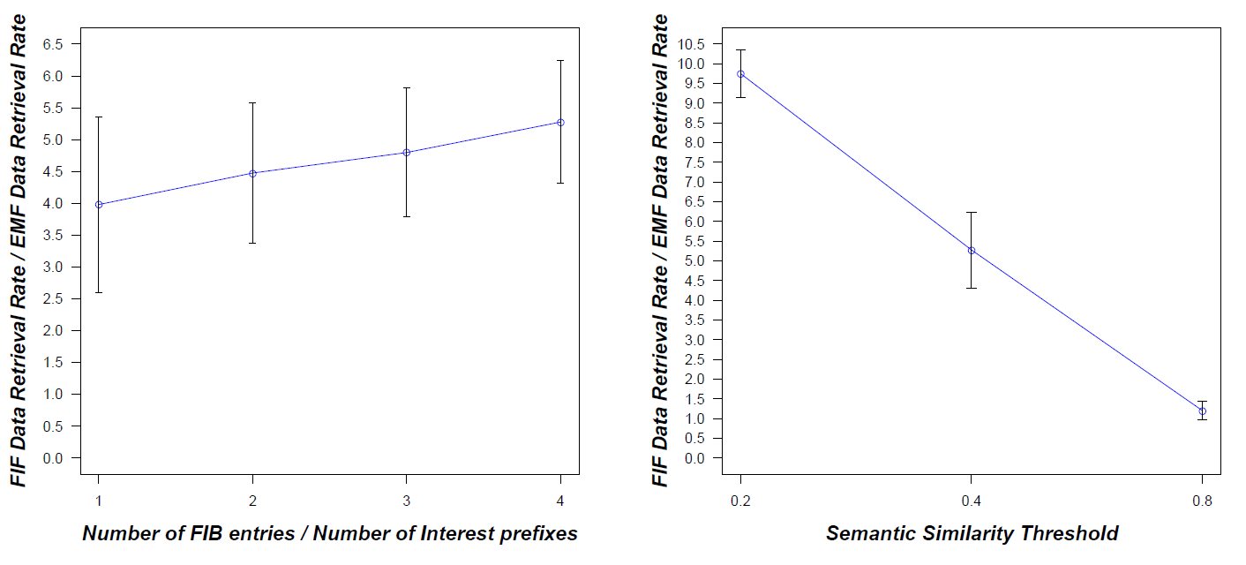
Implementation in ndnSIM
Comparison of FIF with Exact Match Forwarding (EMF)
Word2vec requires 98MB (71K words) -> 1.2 GB (3M) for dictionaries
Data retrieval rate: FIF slower than EMF
4 times slower for small FIB sizes, 5.2 slower for large FIB sizes

Slide 16
Identified Challenges
Resource Constraints
added computation and storage expense for semantic matching
Require feedback of fuzzy matching
NACK and/or relevant names/ name prefixes
Potential attack surface
detection of false data injection

Slide 17
Thanks!

