Slide 1
Named Data Networking
ndnSIM: a modular NDN simulator

Slide 2
Outline
Introduction
Tutorial
getting started
prepare the environment for simulations
writing basic scenario
current status and usage
internal structure

Slide 3
Introduction
Based on NS-3 network simulator
C++, highly module, actively maintained
ndnSIM implements all basic NDN operations
Has modular architecture
Individual abstractions for every NDN component
Can be easily extended
Easy to use
Allows combining different implementations of core NDN components
PIT, CS, Strategies

Slide 4
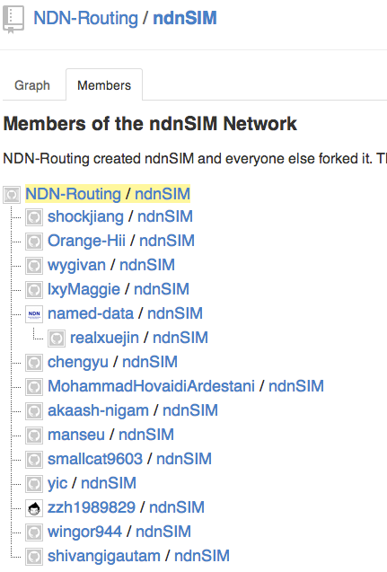
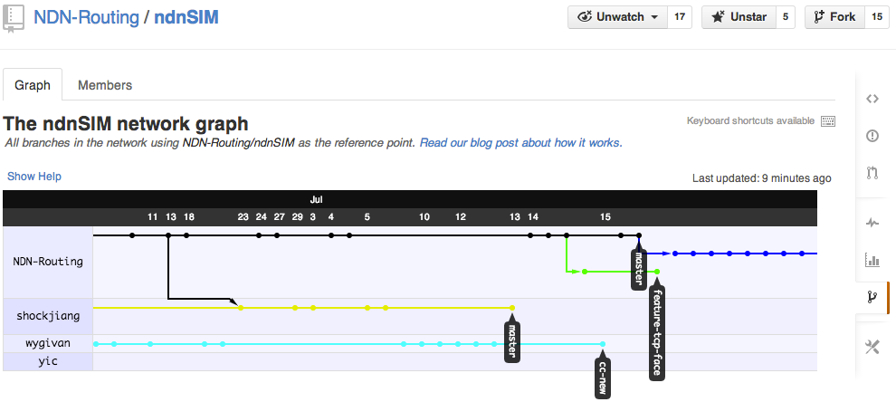
Current status
27 public forks on github
Active development
extended API
usage examples and documentation
Active mailing list

Slide 5
ndnSIM usage scope trends
http://scholar.google.com/scholar?oi=bibs&hl=en&cites=11371705568196953422,10718881312950170080
> 80 published papers from inside and outside NDN team that used ndnSIM
Caching-related evaluation
various caching replacement policies, collaborative caching
Congestion control related
TCP-like transfers (end-to-end, host-by-host)
queueing
Mobile and vehicular environment evaluations
DDoS-related evaluations
interest flooding (us)
content poisoning
Forwarding strategy experimentation
behavior in the presence of link failures, prefix black-holing
Application-level evaluations
exploration of ChronoSync protocol design

Slide 6
Modular ndnSIM structure overview
Applications
NetDevice
(connection to other nodes)
Face (AppFace,
ApiFace)
Face
(NetDeviceFace)
Core NDN Protocol (ndn::L3Protocol)
LRU, LFU, Random, with or without evicting stale data,
others
ContentStore
Pit
Fib
Forwarding
Strategy
BestRoute, Flooding, SmartFlooding, PerOutFaceLimits, PerFibLimits,
others
Unbounded, bounded, “Persistent”, “Random” retention policies for PIT entries
Notes:
* new addition (explained on next slide)

Slide 7
Faces
Abstraction from underlying protocols
callback registration-deregistration
packet encapsulation
Notes:
Callback: functions that are called when an event happens. In ccnx these are called "closures," but callback (my opinion) is much more common and widely used term for that.

Slide 8
General use of ndnSIM
Define topology
Manually
Using various readers (http://ndnsim.net/examples.html#node-grid-example-using-topology-plugin)
Create ndn::StackHelper
Define ContentStore size and policy
ns3::ndn::cs::Lru (default size 100), ... Fifo, ... Random
ns3::ndn::cs::Stats::Lru, ...Fifo, ...Random
ns3::ndn::cs::Freshness::Lru, ...Fifo, ...Random
Define Forwarding Strategy
ns3::ndn::fw::Flooding (default), ...SmartFlooding, ...BestRoute
Set up routes between nodes
manually
semi-automatic
Define and assign applications
Collect metrics

Slide 9
Forwarding strategies
Abstraction control all aspect of Interest and Data packet forwarding
specify where to forward Interest packets
track data plane performance for Data packets
Available strategies
Flooding strategy
Smart flooding strategy
Best-Route strategy
Easy to write your own strategy or redefine aspects of the existing ones
Notes:
Flooding strategy (default)
Interests will be forwarded to all available faces available for a route (FIB entry). If there are no available GREEN or YELLOW faces, interests is dropped.
Smart flooding strategy
If GREEN face is available, Interest will be sent to the highest-ranked GREEN face. If not, Interest will be forwarded to all available faces available for a route (FIB entry)
Best-Route strategy
If GREEN face is available, Interest will be sent to the highest-ranked GREEN face. If not, Interest will be forwarded to the highest-ranked YELLOW face.

Slide 10
An initial set of applications
http://ndnsim.net/applications.html
ndn::ConsumerCbr
generates Interest traffic with predefined frequency
ndn::ConsumerBatches
generates a specified number of Interests at specified points of simulation
ndn::ConsumerWindow
very basic approximation of TCP-like transfer
ndn::ConsumerZipfMandelbrot
(thanks to Xiaoke Jiang) requests contents (names in the requests) following Zipf-Mandelbrot distribution (number of Content frequency Distribution)
ndn::Producer
Interest-sink application, which replies every incoming Interest with Data packet

Slide 11
Metrics
http://ndnsim.net/metric.html
Packet-level trace helpers
L3AggregateTracer
L3RateTracer
L2Tracer
Content store trace helper
ndn::CsTracer
App-level trace helpers
AppDelayTracer
Custom tracing by connecting to available TraceSource’s

Slide 12
Outline
Code from the tutorial can be cloned from github:
https://github.com/cawka/ndnSIM-tutorial
Introduction
Tutorial
getting started
prepare the environment for simulations
writing basic scenario

Slide 13
Getting started
http://ndnsim.net/getting-started.html
Works in OSX, Linux, FreeBSD
requires boost libraries >= 1.46
recommended latest version of boost (e.g., 1.54)
visualizer module need python and various python bindings
Download
mkdir ndnSIM
cd ndnSIM
git clone git://github.com/cawka/ns-3-dev-ndnSIM.git ns-3
git clone git://github.com/cawka/pybindgen.git pybindgen
git clone git://github.com/NDN-Routing/ndnSIM.git ns-3/src/ndnSIM
Build
./waf configure --enable-examples
./waf
Run examples
./waf --run=ndn-grid
./waf --run=ndn-grid --vis
other examples: http://ndnsim.net/examples.html

Slide 14
Prepare the environment
Using scratch folder in NS-3 (not recommended)
one scenario per .cc file
cd ndnSIM/ns-3
create scratch/my-scenario.cc
(./waf)
./waf --run my-scenario
multiple .cc files per scenario
cd ndnSIM/ns-3
mkdir scratch/my-scenario
create scratch/my-scenario/file1.cc
create scratch/my-scenario/file2.cc
...
(./waf)
./waf --run my-scenario
Cons and pros
cons
compilation of the scenario could be very slow
hard to separate simulation code from the simulator code
pros
works out-of-the box

Slide 15
Prepare the environment (cont.)
Using separate repository (recommended)
install ndnSIM and NS-3
cd ndnSIM/ns-3
sudo ./waf install
git clone https://github.com/cawka/ndnSIM-scenario-template my-scenario
cd my-scenario
create extensions (any .cc|.h files) in extensions/
create extensions/my-test-extension.cc
create scenarios in scenarios/
create scenarios/my-test-scenario.cc
./waf configure --debug
or just ./waf configure if ndnSIM/NS-3 was compiled in optimized mode
./waf
./waf --run=my-test-scenario
or directly: ./build/my-test-scenario
or ./waf --run my-test-scenario --vis to run visualizer (if installed)
Cons and pros
cons
may need certain configuration tricks (refer to README.md)
pros
fast compilation
clear separation of the simulator code from the extensions and scenarios
easy to make code available for others to reproduce scenarios

Slide 16
Writing a basic scenario
Simple simulation
filename
scenarios/example1.cc (C++)
scenarios/example1.py (Python)
Topology
3x3 grid topology
10Mbps links / 10ms delays
One consumer, one producer
NDN parameters
Forwarding Strategy for interests: BestRoute
FIB is computed automatically using global routing controller
Cache: LRU with 100 items on each node (default)

Slide 17
NS-3 101: Prepare scenario (C++)
Step 1. Include necessary modules
Step 2. Define main function like in any other
C++ program
Step 3. Set default parameters for the simulator modules.
For example, define that by default all created p2p links will have 10Mbps bandwidth, 10ms delay and DropTailQueue with 20 packets
Step 4. Allow overriding defaults from command line
Step 5. Define what topology will be simulated.
For example, 3x3 grid topology
Step 6. Create and install networking stacks, install and schedule applications, define metric logging, etc.
Step 7. Define when simulation should be stopped
Final step. Run simulation
#include ”ns3/core-module.h"
#include "ns3/network-module.h"
#include "ns3/point-to-point-module.h"
#include "ns3/point-to-point-grid.h"
#include "ns3/ndnSIM-module.h"
using namespace ns3;
int
main (int argc, char *argv[])
{
Config::SetDefault ("ns3::PointToPointNetDevice::DataRate", StringValue ("10Mbps"));
Config::SetDefault ("ns3::PointToPointChannel::Delay", StringValue ("10ms"));
Config::SetDefault ("ns3::DropTailQueue::MaxPackets", StringValue ("20"));
CommandLine cmd; cmd.Parse (argc, argv);
PointToPointHelper p2p;
PointToPointGridHelper grid (3, 3, p2p);
grid.BoundingBox(100,100,200,200);
// scenario meat
Simulator::Stop (Seconds (20.0));
Simulator::Run ();
Simulator::Destroy ();
return 0;
}

Slide 18
The same scenario can be also written in Python
C++
Python
#include "ns3/core-module.h"
#include "ns3/network-module.h"
#include "ns3/point-to-point-module.h"
#include "ns3/point-to-point-grid.h"
#include "ns3/ndnSIM-module.h”
using namespace ns3;
int
main (int argc, char *argv[])
{
Config::SetDefault ("ns3::PointToPointNetDevice::DataRate", StringValue ("10Mbps"));
Config::SetDefault ("ns3::PointToPointChannel::Delay", StringValue ("10ms"));
Config::SetDefault ("ns3::DropTailQueue::MaxPackets", StringValue ("20"));
CommandLine cmd; cmd.Parse (argc, argv);
PointToPointHelper p2p;
PointToPointGridHelper grid (3, 3, p2p);
grid.BoundingBox(100,100,200,200);
// scenario meat
Simulator::Stop (Seconds (20.0));
Simulator::Run ();
Simulator::Destroy ();
return 0;
}
from ns.core import *
from ns.network import *
from ns.point_to_point import *
from ns.point_to_point_layout import *
from ns.ndnSIM import *
Config.SetDefault ("ns3::PointToPointNetDevice::DataRate", StringValue ("10Mbps"))
Config.SetDefault ("ns3::PointToPointChannel::Delay", StringValue ("10ms"))
Config.SetDefault ("ns3::DropTailQueue::MaxPackets", StringValue ("20"))
import sys; cmd = CommandLine (); cmd.Parse (sys.argv);
p2p = PointToPointHelper ()
grid = PointToPointGridHelper (3,3,p2p)
grid.BoundingBox(100,100,200,200)
# scenario meat
Simulator.Stop (Seconds (20.0))
Simulator.Run ()
Simulator.Destroy ()
# or run using the visualizer
# import visualizer
# visualizer.start ()
Defining scenario in Python is easier and don’t require (re)compilation, but not all features of NS-3 and ndnSIM are available in Python interface.

Slide 19
ndnSIM 101: filling scenario meat (C++)
Step 1. Install NDN stack on all nodes (like starting ccnd on a computer)
Step 2. Define which nodes will run applications
Step 3. “Install” applications on nodes
Step 2. Configure FIB
manually
using global routing controller (shown here)
ndn::StackHelper ndnHelper;
ndnHelper.InstallAll ();
// Getting containers for the consumer/producer
Ptr<Node> producer = grid.GetNode (2, 2);
NodeContainer consumerNodes;
consumerNodes.Add (grid.GetNode (0,0));
ndn::AppHelper cHelper ("ns3::ndn::ConsumerCbr");
cHelper .SetPrefix ("/prefix");
cHelper .SetAttribute ("Frequency", StringValue ("10"));
cHelper .Install (consumerNodes);
ndn::AppHelper pHelper ("ns3::ndn::Producer");
pHelper.SetPrefix ("/prefix");
pHelper.SetAttribute ("PayloadSize", StringValue("1024"));
pHelper.Install (producer);
ndn::GlobalRoutingHelper ndnGlobalRoutingHelper;
ndnGlobalRoutingHelper.InstallAll ();
// Add /prefix origins to ndn::GlobalRouter
ndnGlobalRoutingHelper.AddOrigins (“/prefix”, producer);
// Calculate and install FIBs
ndnGlobalRoutingHelper.CalculateRoutes ();

Slide 20
ndnSIM 101: filling scenario meat (Python)
Step 1. Install NDN stack on all nodes (like starting ccnd on a computer)
Step 2. Define which nodes will run applications
Step 3. “Install” applications on nodes
Step 2. Configure FIB
manually
using global routing controller (shown here)
ndnHelper = ndn.StackHelper ()
ndnHelper.InstallAll ();
# Getting containers for the consumer/producer
producer = grid.GetNode (2, 2)
consumerNodes = NodeContainer ()
consumerNodes.Add (grid.GetNode (0,0))
cHelper = ndn.AppHelper ("ns3::ndn::ConsumerCbr”)
cHelper .SetPrefix ("/prefix”)
cHelper .SetAttribute ("Frequency", StringValue ("10"))
cHelper .Install (consumerNodes)
pHelper = ndn.AppHelper ("ns3::ndn::Producer”)
pHelper.SetPrefix ("/prefix”)
pHelper.SetAttribute ("PayloadSize", StringValue("1024"));
pHelper.Install (producer)
ndnGlobalRoutingHelper = ndn.GlobalRoutingHelper ()
ndnGlobalRoutingHelper.InstallAll ()
# Add /prefix origins to ndn::GlobalRouter
ndnGlobalRoutingHelper.AddOrigins (“/prefix”, producer)
# Calculate and install FIBs
ndnGlobalRoutingHelper.CalculateRoutes ()

Slide 21
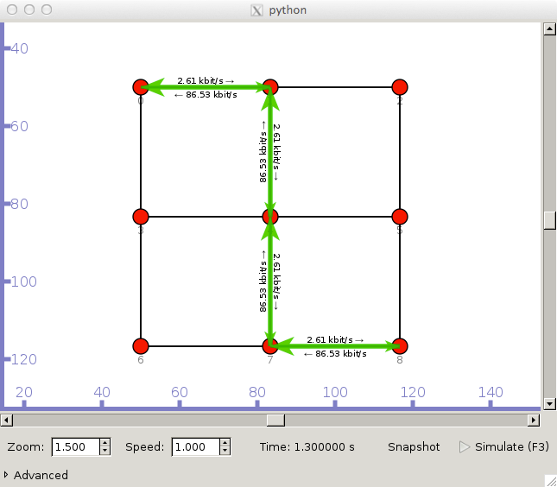
Running the simulation (C++)
Run C++ scenario
./waf --run example1
or ./waf && ./build/example1
or ./waf --run example1 --vis
Run Python scenario
python scenarios/example1.py
If in debug mode
NS_LOG=ndn.fw ./waf --run example1
Result if you followed the steps
Same example is on
http://ndnsim.net
Hint: using right click on a node in visualizer, it is possible to check FIB, PIT, and CS contents on the node during the active simulation

Slide 22
That’s all for now
More tutorial examples in the slide deck
https://dl.dropboxusercontent.com/u/45347685/slides/ndnSIM-tutorial-demo.pptx

Slide 23
Logging in debug mode
Should be used ONLY for developing/debugging purposes
very slow!!!
Actual simulation SHOULD be run in optimized mode
much, much, much faster
all logging is disabled
Available debug loggings in ndnSIM:
ndn.Face, ndn.NetDeviceFace, ndn.AppFace
ndn.App, ndn.Consumer, ndn.Producer, and many others
To discover name for the logging component, look in .cc files:
find src/ndnSIM/ -type f -name '*.cc' -exec grep NS_LOG_COMPONENT_DEFINE {} \;

Slide 24
Logging in debug mode (cont.)
Selecting several several loggings
NS_LOG=ndn.fw:ndn.fw.BestRoute:ndn.Consumer ./waf --run=example1
Select all loggings (including from the NS-3)
NS_LOG=* ./waf --run=example1
DO NOT USE LOGGING TO GET METRICS
use existing tracing helpers or write your own

Slide 25
Getting metrics (supported only in C++)
L3RateTracer
AppDelayTracer
CsTracer

Slide 26
Processing metrics
Resulting .txt files can be processed
R
gnuplot
python graph library and others
Example with R
Same scenario, but with small modifications
Config::SetDefault ("ns3::PointToPointNetDevice::DataRate", StringValue ("20Kbps"));
ndn::AppHelper cHelper ("ns3::ndn::ConsumerZipfMandelbrot");
very basic rate-trace.txt procesing
library (ggplot2)
data = read.table ("results/rate-trace.txt", header=T)
ggplot(data, aes(x=Time, y=Kilobytes, color=Type)) + geom_line () + facet_wrap(~ FaceDescr)

Slide 27
Customizing scenarios
Forwarding strategy
Content Store (type and caching replacement/placement policy)
Pending Interest Table

Slide 28
Forwarding strategy
ndn::StackHelper ndnHelper;
ndnHelper.SetForwardingStrategy (“ns3::ndn::fw::Flooding”);
Available strategies:
(default) ns3::ndn::fw::Flooding
ns3::ndn::fw::BestRoute
ns3::ndn::fw::SmartFloowing
ns3::ndn::fw::Flooding::PerOutFaceLimits
ns3::ndn::fw::Flooding::PerOutFaceLimits::PerFibLimits
ns3::ndn::fw::BestRoute::PerOutFaceLimits
ns3::ndn::fw::BestRoute::PerOutFaceLimits::PerFibLimits
ns3::ndn::fw::SmartFlooding::PerOutFaceLimits
ns3::ndn::fw::SmartFlooding::PerOutFaceLimits::PerFibLimits

Slide 29
Content Store
ndn::StackHelper ndnHelper;
ndnHelper.SetContentStore (“ns3::ndn::cs::Lru”, “MaxSize”, “100”);
Available content stores
(default) ns3::ndn::cs::Lru
ns3::ndn::cs::Random
ns3::ndn::cs::Fifo
ns3::ndn::cs::Lfu
ns3::ndn::cs::Nocache
ns3::ndn::cs::Lru::Freshness
ns3::ndn::cs::Random::Freshness
ns3::ndn::cs::Fifo::Freshness
ns3::ndn::cs::Lfu::Freshness
ns3::ndn::cs::Lru::LifetimeStats
ns3::ndn::cs::Random::LifetimeStats
ns3::ndn::cs::Fifo::LifetimeStats
ns3::ndn::cs::Lfu::LifetimeStats

Slide 30
Pending Interest Table (PIT)
Each PIT entry stores
Interest packet itself
list of incoming faces + associated info
list of outgoing faces + associated info
forwarding strategy tags
e.g., reference to a delayed processing queue
Size of PIT can be limited in simulation scenario
Available policies for new PIT entry creation:
(default) persistent (ns3::ndn::pit::Persistent): a new entry will not be created if limit is reached
LRU (ns3::ndn::pit::LRU): when limit is reached, insertion of a new entry will evict the oldest entry
Random (ns3::ndn::pit::Random): when limit is reached, insertion will evict a random entry
ndn::StackHelper ndnHelper;
ndnHelper.SetPit (“ns3::ndn::pit::Persistent”, “MaxSize”, “100”);

Slide 31
Write your own forwarding strategy
Step 1. Create a standard C++ class and derive it from ndn::ForwardingStrategy, one of the extensions, or one of the existing strategies
Step 2. Extend or re-implement available forwarding strategy events (for the full list refer to http://ndnsim.net/doxygen/):
OnInterest
OnData
WillEraseTimedOutPendingInterest
AddFace
RemoveFace
DidAddFibEntry
WillRemoveFibEntry
DidCreatePitEntry
FailedToCreatePitEntry
DidReceiveDuplicateInterest
DidSuppressSimilarInterest
DidForwardSimilarInterest
DidExhaustForwardingOptions
DetectRetransmittedInterest
WillSatisfyPendingInterest
DidSendOutData
DidReceiveSolicitedData
DidReceiveUnsolicitedData
ShouldSuppressIncomingInterest
CanSendOutInterest
TrySendOutInterest
DidSendOutInterest
PropagateInterest
DoPropagateInterest

Slide 32
Writing a custom forwarding strategy
Basic
http://ndnsim.net/fw.html#writing-your-own-custom-strategy
Processing forwarding strategy events
Example
if we want to perform special logging of all forwarded, timed out, and satisfied Interests
http://ndnsim.net/fw.html#extending-strategy

Slide 33
Write your own cache policy
Option A:
create a class derived from ndn::ContentStore, implementing all interface functions
example
ndn::cs::NoCache
Option B:
use C++ templates of ndnSIM
define “policy traits” (example utils/trie/lru-policy)
defines what to do
on insert (e.g., put in front)
on update (e.g., promote to front)
on delete (e.g., remove)
on lookup (e.g., promote to front)
instantiate cache class with new policy:
template class ContentStoreImpl<lru_policy_traits>;
see examples in model/cs/content-store-impl.cc

Slide 34
Writing a custom cache policy
ExamplePolicy
only every other data packet will be cached
“promote” Data packet if it is accessed more that twice
apply LRU cache replacement strategy
Write “policy traits”
extensions/example-policy.h
use one of the existing policy traits as a base
utils/tries/lru-policy.h
“Instantiate” content store with the policy
create extensions/cs-with-example-policy.cc

Slide 35
Policy (extensions/example-policy.h) 1/3

Slide 36
Policy (extensions/example-policy.h) 2/3

Slide 37
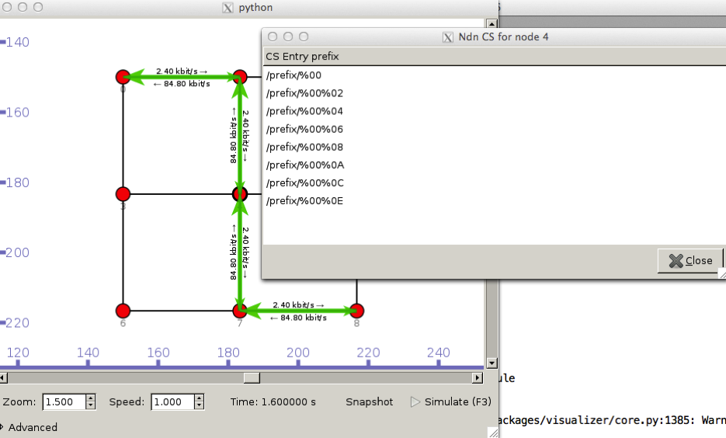
Policy (extensions/example-policy.h) 3/3
See scenarios/example6.cc

Slide 38
Content Store instantiation (extensions/cs-with-example-policy.cc)

Slide 39
Write your own application (requester)
Step 1. Create a normal C++ class and derive it from ndn::App
Step 2. Define GetTypeId () function (use templates!)
Needed for NS-3 object system
Step 3. Define actions upon start and stop of the application
Step 4. Implement OnData method to process requested data:
virtual void
OnData (Ptr<const Data> data);
...
class RequesterApp : public App
{
public:
static TypeId GetTypeId ();
RequesterApp ();
virtual ~RequesterApp ();
protected:
// from App
virtual void
StartApplication ()
{
App::StartApplication ();
// send packet for example
}
virtual void
StopApplication ()
{
// do cleanup
App::StopApplication ();
}
};

Slide 40
RequesterApp (extensions/requester-app.cc)
See scenarios/example3.cc

Slide 41
Write your own application (producer)
Step 0. Do everything as for the requester app
Step 1. Register prefix in FIB (= set Interest filter) in StartApplication
Step 2. Implement OnInterest to process incoming interests
virtual void
OnInterest (Ptr<const Interest> interest);
void StartApplication ()
{
...
Ptr<Fib> fib = GetNode ()->GetObject<Fib> ();
Ptr<fib::Entry> fibEntry = fib->Add (m_prefix, m_face, 0);
fibEntry->UpdateStatus (m_face, fib::FaceMetric::NDN_FIB_GREEN);
}

Slide 42
ProducerApp (extensions/producer-app.cc)
See scenarios/example4.cc

Slide 43
New API to write the same apps (ConsumerApp)
See scenarios/example5.cc

Slide 44
New API to write the same apps (ProducerApp)
See scenarios/example5.cc

Slide 45
Feedback
Try out ndnSIM and let us know your thought/comments/bug reports/new feature requests!
Join our mailing list
http://www.lists.cs.ucla.edu/mailman/listinfo/ndnsim
Contribute
issues on Github
https://github.com/NDN-Routing/ndnSIM/issues?state=open
fork and create pull requests on Github
issues in NDN redmine
http://redmine.named-data.net/projects/ndnsim
http://ndnsim.net

Slide 46
Thanks
Questions?
http://ndnsim.net

