Slide 1

Paper ID: A2-1
Paper title: Interest Flooding Attack and Countermeasures in Named Data Networking
Author: Alexander Afanasyev
Networking 2013: OMM session

Slide 2
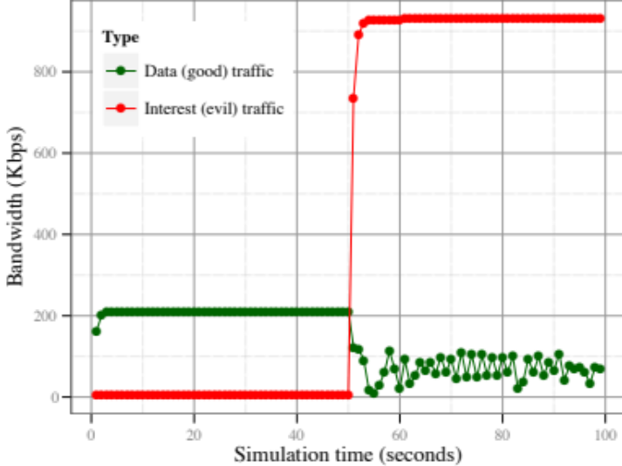
Motivation
(Distributed) denial of service (DoS) attacks are significant threats to the current Internet
NDN architecture prevents conventional (D)DoS attacks
  impossible to spoof IP address or launch a reflector attack
  not as easy to target a specific host
NDN may be exposed to new types of attacks
  interest flooding
    network resource exhaustion
    router’s resource exhaustion
Interest flooding

Slide 3
Solution using architecture’s features
NDN routers have all the information needed to be able to differentiate good interests from bad ones.
  To be effective in DoS, bad interests need to be insuppressible and requesting non-existing content.
  On the other hand, good interests will likely be satisfied with a content
Keep per incoming interface, per prefix (FIB entry) interest satisfaction statistics in routers
Use the statistics to detect and control bad traffic
  “bad” interest can be pushed back to attackers
Notes:
Exponential moving average statistics.

