Slide 1

US Population Shits 2010-2018
Eli Lobato
Brandon Cawthorne
Jason Peters

Slide 2
Motivation & Summary
Hypothesis
People are moving to the south west US.
Questions
1) What are the top cities in the US people are moving to/from?
Summary of Findings
Based on the data collected, we were able to answer all three questions. The data indicates there are a mulatude of factors contributing to the movement.
2) What regions of the US people are moving to/from?
3) What are some of the factors contributing to the population shift?

Slide 3
Questions & Data
What are the top cities in the US people are moving to/from?
What regions of the US people are moving to/from?
What are some of the factors contributing to the population shift?
To answer these questions, we decided to use population data from the census website as our core data. Once we collected the population data, we called the google API to generate the latitude and longitude of the top cities people are moving to/from. From there we were able to start cleaning and exploring the data.

Slide 4
Data Cleanup & Exploration
Decided to use only cities with 100k population and up.
Found the average growth of each city year over year.
Selected the top/bottom 5 cities.
Merged census populations csv files.
Called Google API for lat/lon.

Slide 5
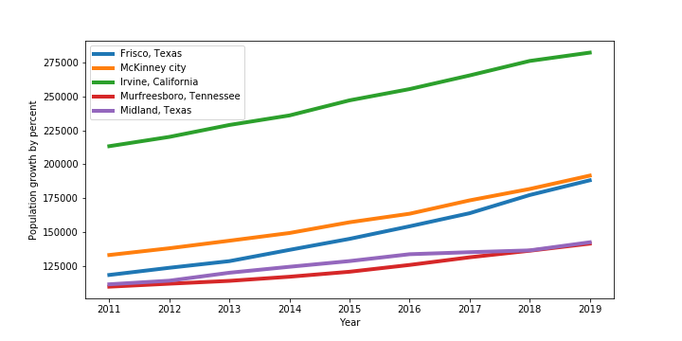
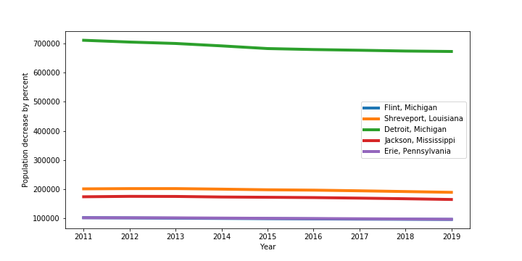
Data Analysis and Discussion Q1

Slide 6
Data Analysis and Discussion Q2

Slide 7
Data Analysis and Discussion Q3

Slide 8
Post Mortem
Additional questions:
What other factors contribute to people moving; weather, job opportunities, housing costs, etc.
From there we would then want to perform the below:
Analysis of variance
Multiple comparison of mean.

