Slide 1
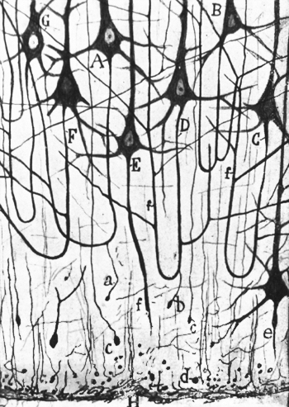
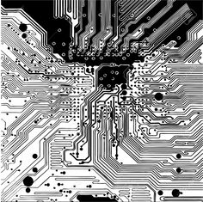
Neurocomputing: From neurons to systems
Basecamp.ai Classes
Dr. Cristian Axenie
Technische Universität München
Neuroscientific System Theory Lab
Vienna, 26-27 Jan 2017

Slide 2
Class overview
Supervised neural computation
  Biological neurons vs. artificial neurons
  Learning in artificial neurons
  From single neurons to neural networks
  Learning in neural networks: Error Backpropagation in Multi-Layer Neural Networks
  Supervised learning: tips and tricks
Unsupervised neural computation
  Introduction to unsupervised learning
  Radial Basis Functions
  Vector Quantization
  Kohonen’s Self-Organizing-Maps
  Hopfield Networks
Neuromorphic engineering
  What is neuromorphic engineering?
  Sample neurobotics applications

Slide 3
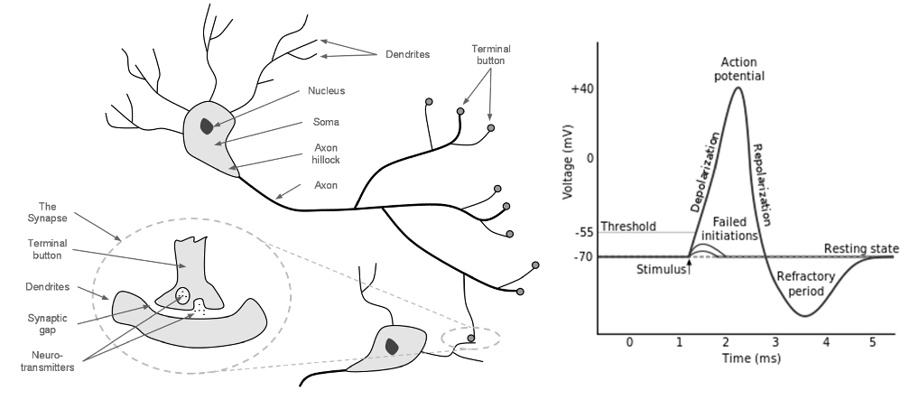
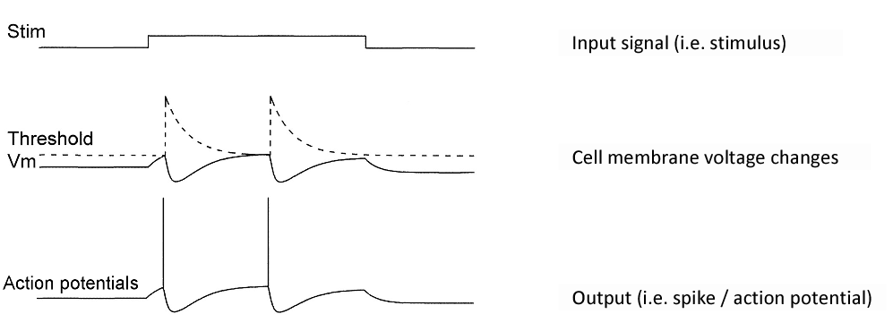
Supervised neural computation
  Biological neurons vs. artificial neurons

Slide 4
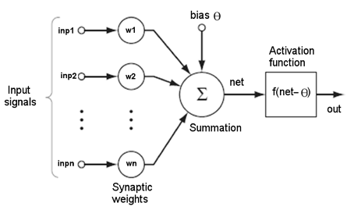


Supervised neural computation
  Biological neurons vs. artificial neurons

Slide 5
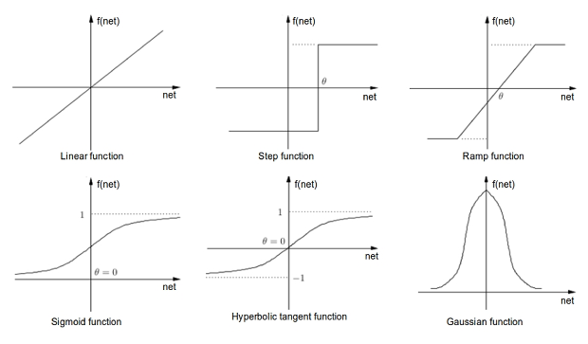
Supervised neural computation
  Biological neurons vs. artificial neurons

Slide 6
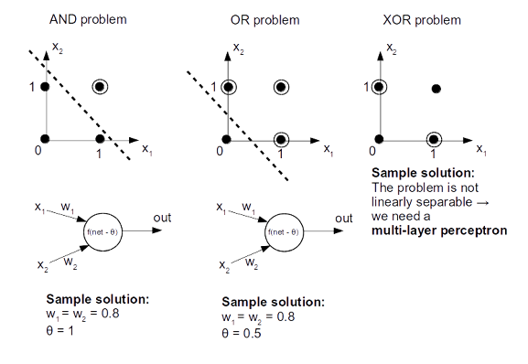
Supervised neural computation
  Biological neurons vs. artificial neurons

Slide 7

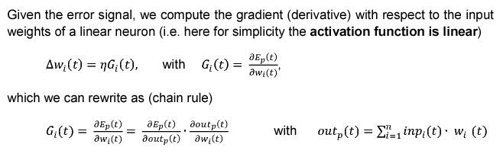
Supervised neural computation
  Learning in artificial neurons

Slide 8
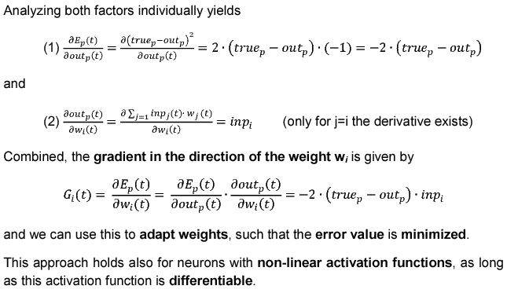
Supervised neural computation
  Learning in artificial neurons

Slide 9
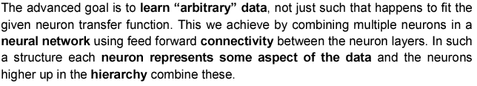
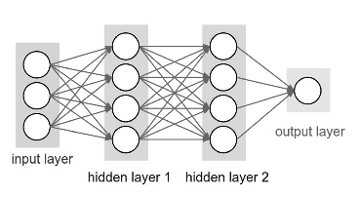
Supervised neural computation
  From single neurons to neural networks

Slide 10
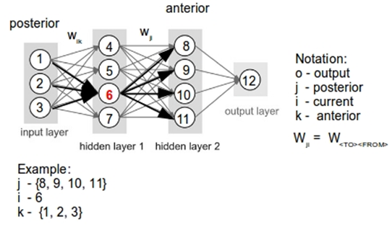
Supervised neural computation
  Error Backpropagation in Multi-Layer Neural Networks
The error backpropagation algorithm was originally introduced in the 1970s, but its importance wasn't fully appreciated until a famous paper published 1986 by David Rumelhart, Geoffrey Hinton, and Ronald Williams. The backpropagation algorithm searches the minimum of the error function in weight space, using gradient descent. The particular combination of weights which minimizes the error function is considered to be the solution for learning a representation of data. In order to introduce the formalism of backpropagation we introduce the following notations:

Slide 11
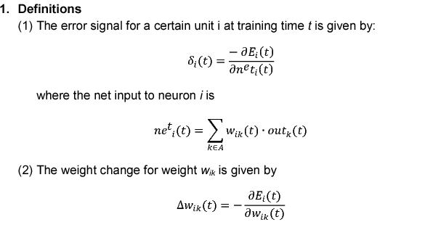
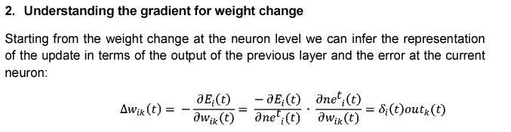
Supervised neural computation
  Error Backpropagation in Multi-Layer Neural Networks

Slide 12
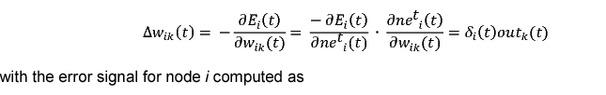
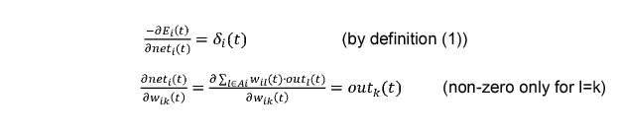
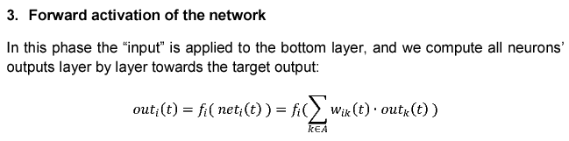
Supervised neural computation
  Error Backpropagation in Multi-Layer Neural Networks

Slide 13
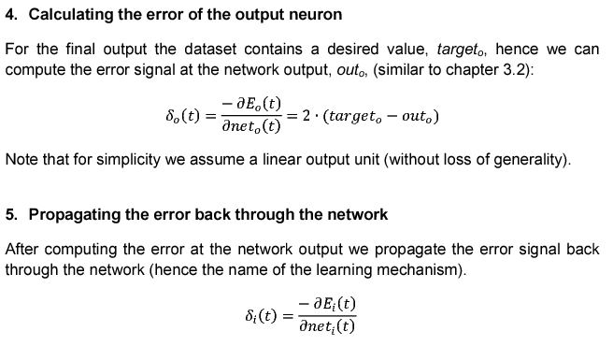
Supervised neural computation
  Error Backpropagation in Multi-Layer Neural Networks

Slide 14
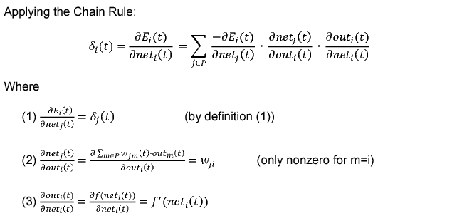
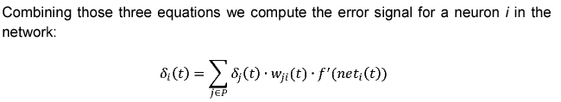
Supervised neural computation
  Error Backpropagation in Multi-Layer Neural Networks

Slide 15
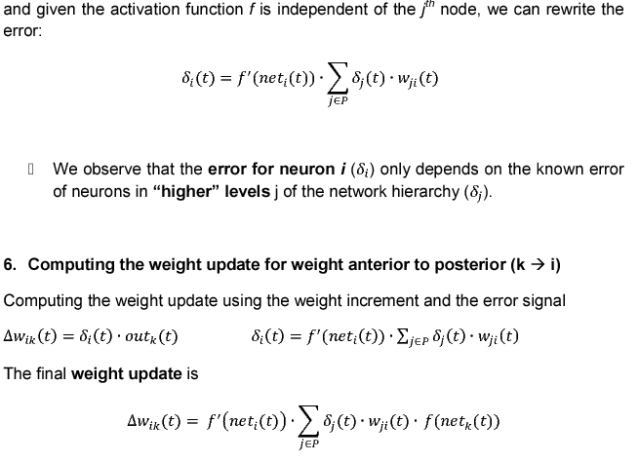
Supervised neural computation
  Error Backpropagation in Multi-Layer Neural Networks

Slide 16
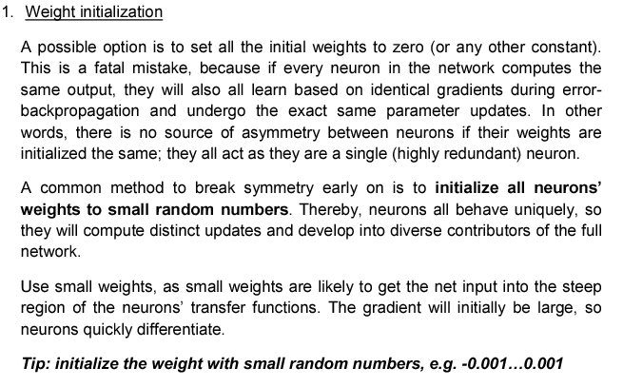
Supervised neural computation
  Supervised learning: tips and tricks

Slide 17
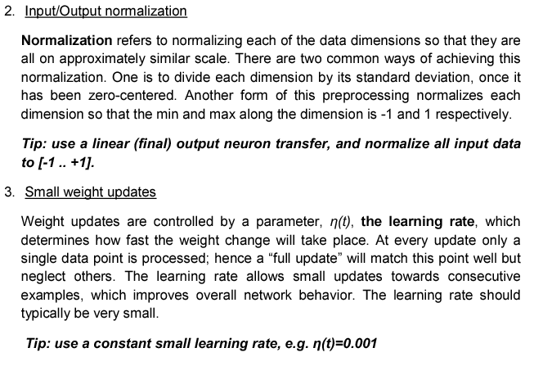
Supervised neural computation
  Supervised learning: tips and tricks

Slide 18
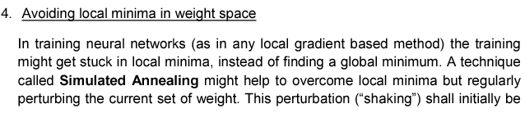
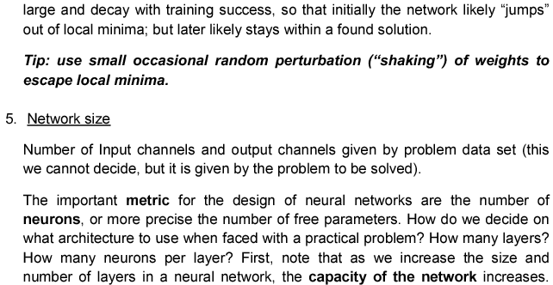
Supervised neural computation
  Supervised learning: tips and tricks

Slide 19
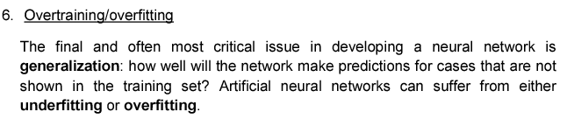
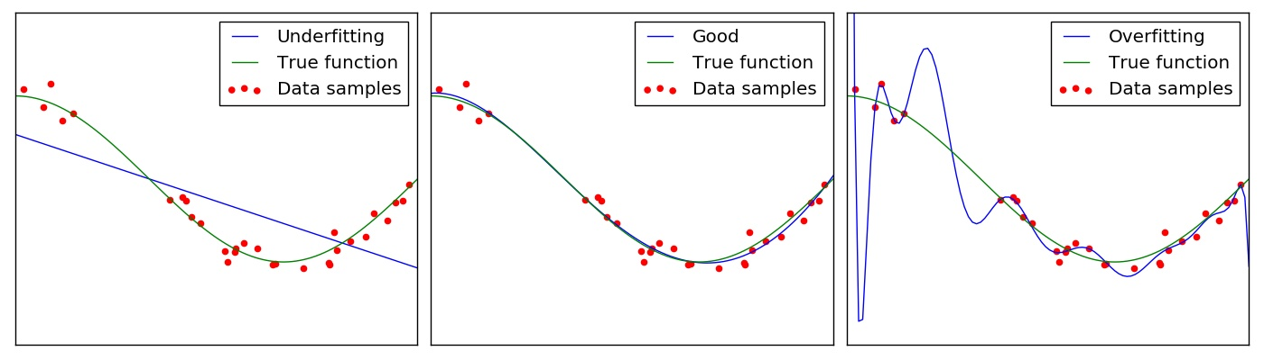
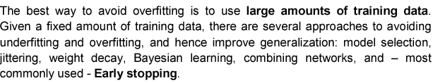
Supervised neural computation
  Supervised learning: tips and tricks

Slide 20
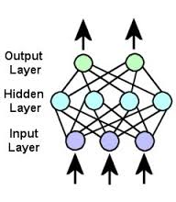
Supervised neural computation
  From connectionst models to spiking neural networks
Biological neurons use short and sudden increases in voltage to send information. These signals are more commonly known as action potentials, spikes or pulses.
Connectionism is a theoretical framework for cognition whose principal tenets are (1) that all cognitive phenomena arise from the propagation of activation among simple neuronlike processing units and (2) that such propagation is mediated by weighted synapselike connections between units.

Slide 21
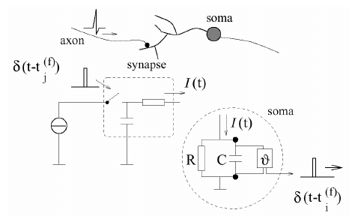
Supervised neural computation
  From connectionst models to spiking neural networks
Neurological research has shown that neurons encode information in the timing of single spikes, and not only just in their average firing frequency.
Networks of spiking neurons are more powerful than their non-spiking predecessors as they can encode temporal information in their signals, but therefore do also need different and biologically more plausible rules for synaptic plasticity.

Slide 22
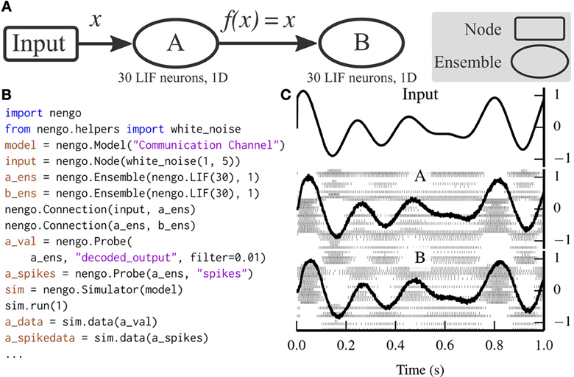
Supervised neural computation
  Spiking neural computation and the Neural Engineering Framework
Spiking Neuron Networks (SNNs) are often referred to as the 3rd generation of neural networks. They derive their strength and interest from an accurate modeling of synaptic interactions between neurons, taking into account the time of spike firing.
Nengo is a Python library for building and simulating large-scale brain models using the methods of the Neural Engineering Framework. The Neural Engineering Framework (NEF) is the set of theoretical methods that are used in Nengo for constructing spiking neural models.
DEMO

Slide 23
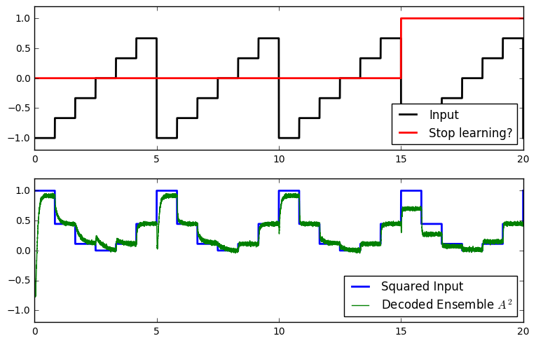
Supervised neural computation
  Spiking neural computation and the Neural Engineering Framework
Nengo is a Python library for building and simulating large-scale brain models using the methods of the Neural Engineering Framework. The Neural Engineering Framework (NEF) is the set of theoretical methods that are used in Nengo for constructing spiking neural models.
Learning to square the input
Prescribed Error Sensitivity (PES) learning rule.
Modifies a connection’s decoders to minimize an error signal provided through a connection to the connection’s learning rule. It uses an adaptive learning rate, a scalar indicating the rate at which weights will be adjusted and a fixed timing constant on activities of neurons in pre population.
DEMO

Slide 24
Supervised neural computation
What we learned:
  Biological neurons vs. artificial neurons
  Learning in artificial neurons
  From single neurons to neural networks
  Learning in neural networks: Error Backpropagation in Multi-Layer Neural Networks
  Supervised learning: tips and tricks
  From connectionist models to spiking neural networks
  Supervised spiking neural computation and the Neural Engineering Framework

Slide 25
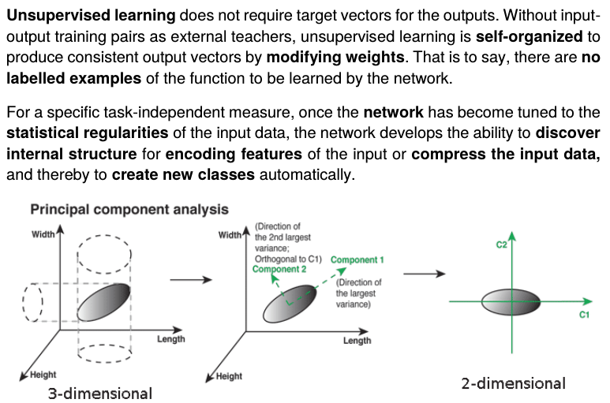
Unsupervised neural computation
  Introduction to unsupervised learning

Slide 26
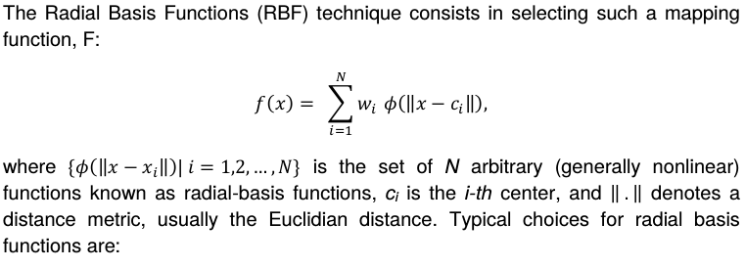


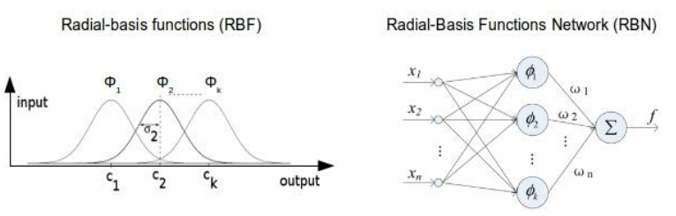
Unsupervised neural computation
  Radial Basis Functions

Slide 27
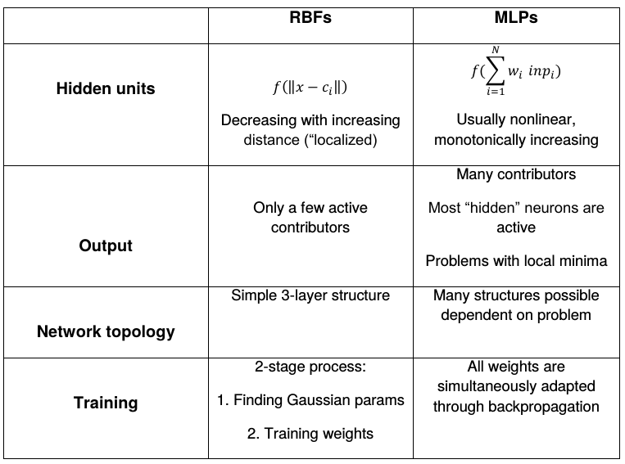
Unsupervised neural computation
  Radial Basis Functions

Slide 28
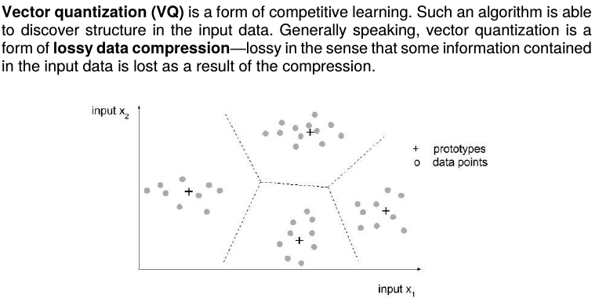

Unsupervised neural computation
  Vector Quantization

Slide 29
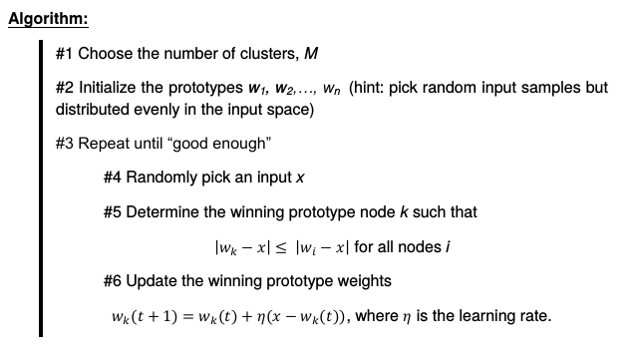
Unsupervised neural computation
  Vector Quantization

Slide 30
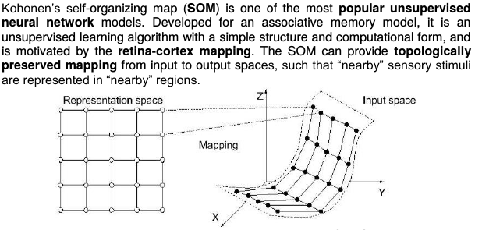
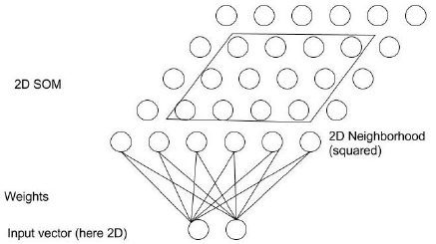
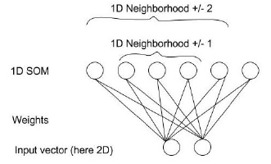
Unsupervised neural computation
  Kohonen’s Self-Organizing-Maps

Slide 31
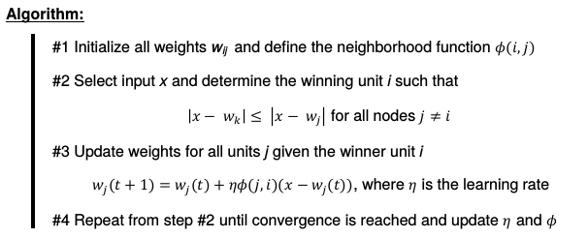
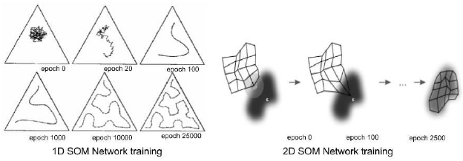
Unsupervised neural computation
  Kohonen’s Self-Organizing-Maps

Slide 32
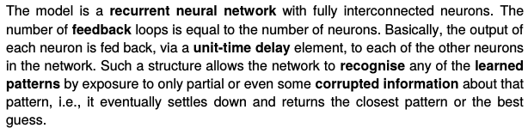

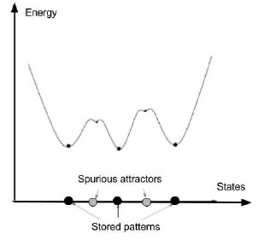
Unsupervised neural computation
  Hopfield Networks

Slide 33
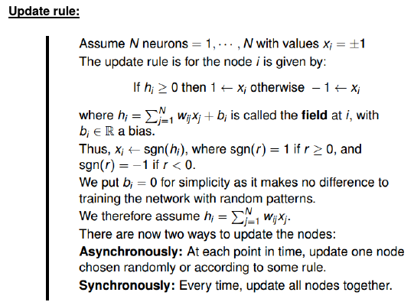
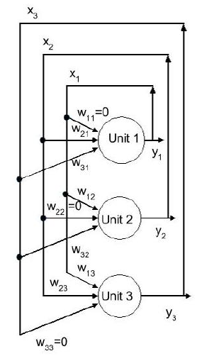
Unsupervised neural computation
  Hopfield Networks

Slide 34
Unsupervised neural computation
  Spiking neural computation and the Neural Engineering Framework
Spiking Neuron Networks (SNNs) are often referred to as the 3rd generation of neural networks. They derive their strength and interest from an accurate modeling of synaptic interactions between neurons, taking into account the time of spike firing.
Nengo is a Python library for building and simulating large-scale brain models using the methods of the Neural Engineering Framework. The Neural Engineering Framework (NEF) is the set of theoretical methods that are used in Nengo for constructing spiking neural models.

Slide 35
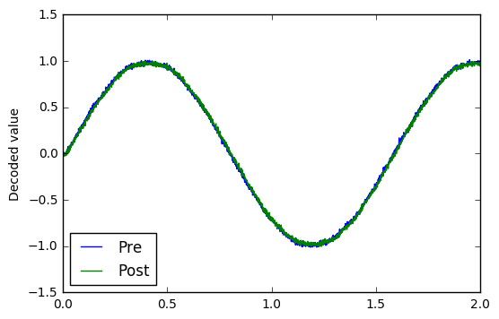
Unsupervised neural computation
  Spiking neural computation and the Neural Engineering Framework
Nengo is a Python library for building and simulating large-scale brain models using the methods of the Neural Engineering Framework. The Neural Engineering Framework (NEF) is the set of theoretical methods that are used in Nengo for constructing spiking neural models.
Bienenstock-Cooper-Munroe (BCM) learning rule.
Modifies connection weights as a function of the presynaptic activity and the difference between the postsynaptic activity and the average postsynaptic activity. As parameters is uses a scalar indicating the time constant for theta integration, a timing constant for filtering activities of neurons in pre and post-synaptic populations and a scalar indicating the rate at which weights will be adjusted.
DEMO

Slide 36
Unsupervised neural computation
What we learned:
  Introduction to unsupervised learning
  Radial Basis Functions
  Vector Quantization
  Kohonen’s Self-Organizing-Maps
  Hopfield Networks
  Unsupervised spiking neural computation and the Neural Engineering Framework

Slide 37
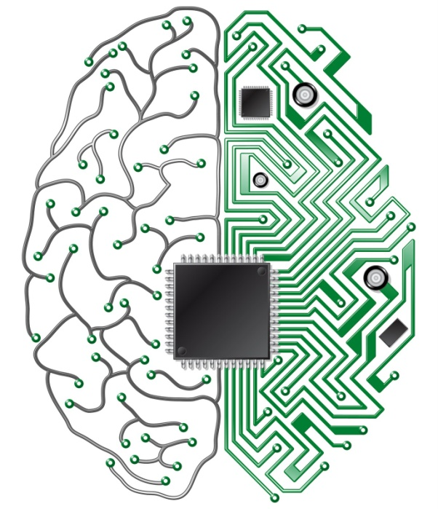
What is neuromorphic engineering ?
Neuro - morphic
“related to neurons”
“structure or form”
Discovering principles by which brains compute efficiently
Implementing them in hardware
that intelligently interacts with the environment
Examples:
Sensors (Silicon Retina/Cochlea)
Massively Parallel Self-Growing Computing Architectures
Distributed Adaptive Control
Neuro-Electronic Implants, Rehabilitation

Slide 38
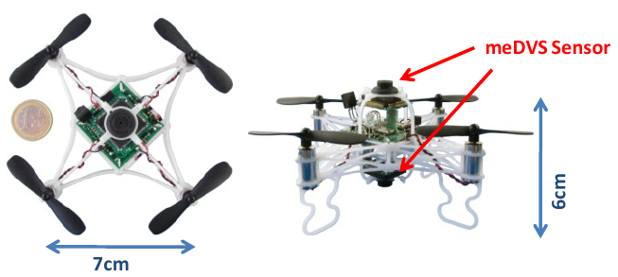








Sample neurobotics applications
Neuronal-style information processing
in closed-loop systems
  Distributed Local Information Processing
  Growing and Adaptive Networks of Computational Units
  Neuromorphic Sensor Fusion and Actuator Networks
  Event-Based Perception – Action – Loops
On-Board Vision-Based Control of Miniature UAVs
Self-Assembling Distributed Neuronal Computation
High-Speed
Event-Based Vision
Cognitive Maps for Spatial Representation

Slide 39




Vision based quadrotor control
Technology: eDVS
Scenario
Algorithm
Local optic flow computation
Drift estimates are computed using optic flow

Slide 40

Vision based quadrotor control
Scenario
Tracking algorithm
y
Pitch
Roll
x
Yaw
z
100 Hz
125 Hz
83 Hz
166 Hz
Ground plane

Slide 41



Neuromorphic vision sensor fusion
Scenario
Algorithm
eDVS estimate
Gyro estimate
Neural model basics

Slide 42
Neuromorphic engineering and neurobotics
What we learned
  What is neuromorphic engineering?
  Sample neurobotics applications
Using principles from brain functionality for building artificial retinas, cochleas, neurons
Intergate them in real-world interactive robotic systems
Use neural learning and adaptation algorithms to address challenges in traditional robotics

Slide 43
Neurocomputing: From neurons to systems
For more info, visit: http://neurorobotics.me/ or http://www.nst.ei.tum.de/

