Slide 1

The future of HR

Slide 2
Who knows somebody in IT
looking for a new job?

Slide 3
46%
of Germans might leave
their job
35%
want to leave their job
$11 billion lost by US business per year to employee turnover

Slide 4
“Career changes and development potential
are key to retain employees”

Slide 5
Our mission:
To support HR in finding the perfect
career path for employees

Slide 6
But what is the “perfect path”?

Slide 7
Talent
??
Project Manager
UX Design
Tech Sales
Tech Support
Developer
Product
People Manager
Network Engineer
Requirements
Engineer
DevOps
IT Specialist
Tester
Architect

Slide 8
Personality Tests Data
+
Machine Learning
=
Employee Profile

Slide 9
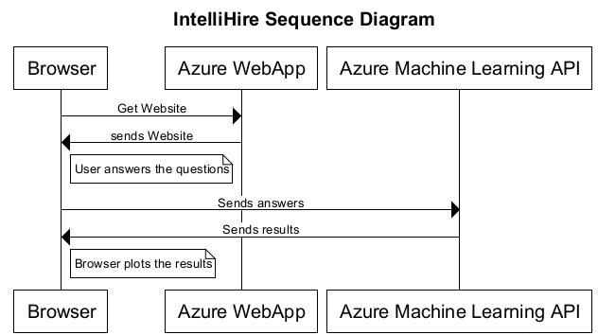
Based on 17,000 Entries

Slide 10
Price based on company size
Compensation if employee leaves
because of misassignment

Slide 11
DEMO USE CASE
http://bit.do/intellihire

Slide 12


Slide 13
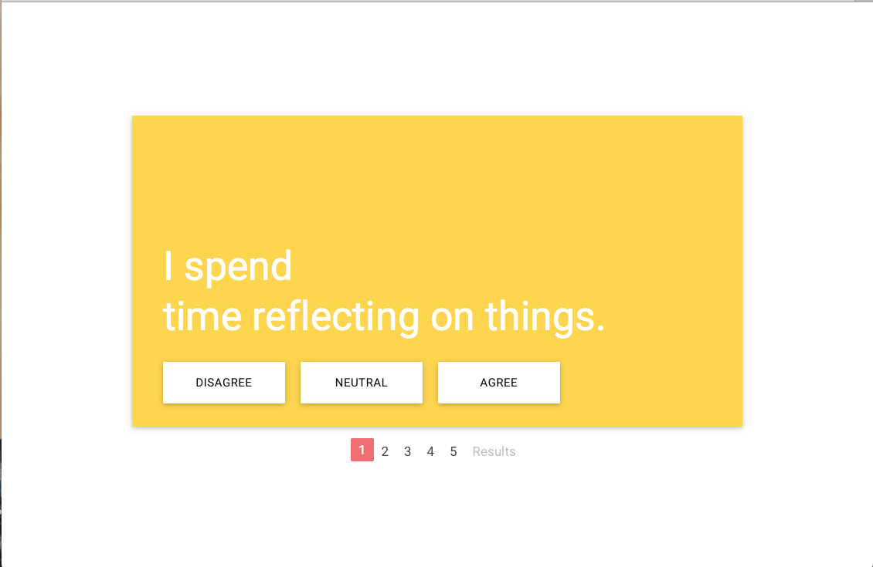

Slide 14


Slide 15
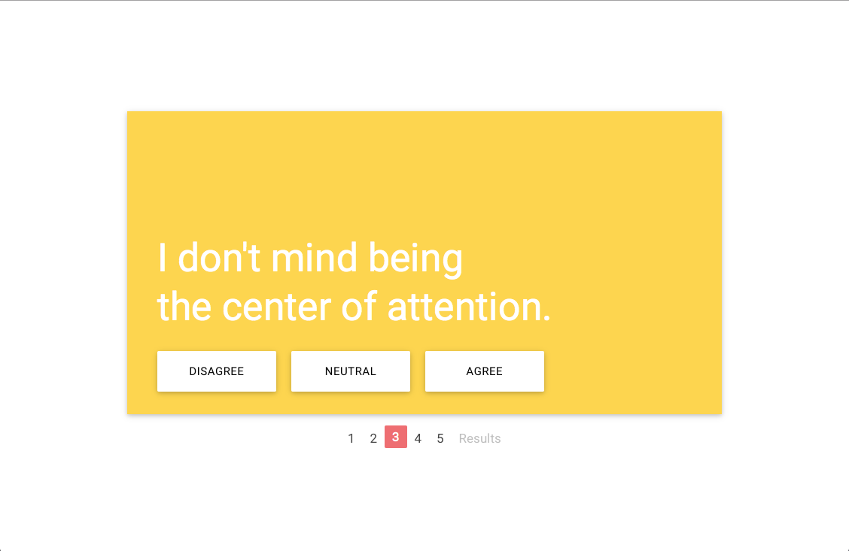

Slide 16


Slide 17


Slide 18


Slide 19
