Slide 1

The future of HR

Slide 2
Who knows somebody in IT
looking for a new job?

Slide 3
46%
of Germans might leave
their job
35%
want to leave their job
$11 billion lost by US business per year to employee turnover

Slide 4
“Career changes and development potential
are key to retain employees”

Slide 5
Our mission:
To support HR in finding the perfect
career path for employees

Slide 6
But what is the “perfect path”?

Slide 7
Talent
??
Project Manager
UX Design
Tech Sales
Tech Support
Developer
Product
People Manager
Network Engineer
Requirements
Engineer
DevOps
IT Specialist
Tester
Architect

Slide 8
Personality Tests Data
+
Machine Learning
=
Employee Profile

Slide 9
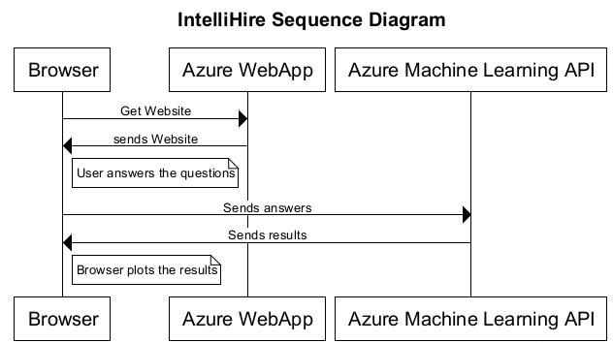
Based on 17,000 Entries

Slide 10
Price based on company size
Compensation if employee leaves
because of misassignment

Slide 11
DEMO USE CASE

Slide 12


Slide 13


Slide 14


Slide 15
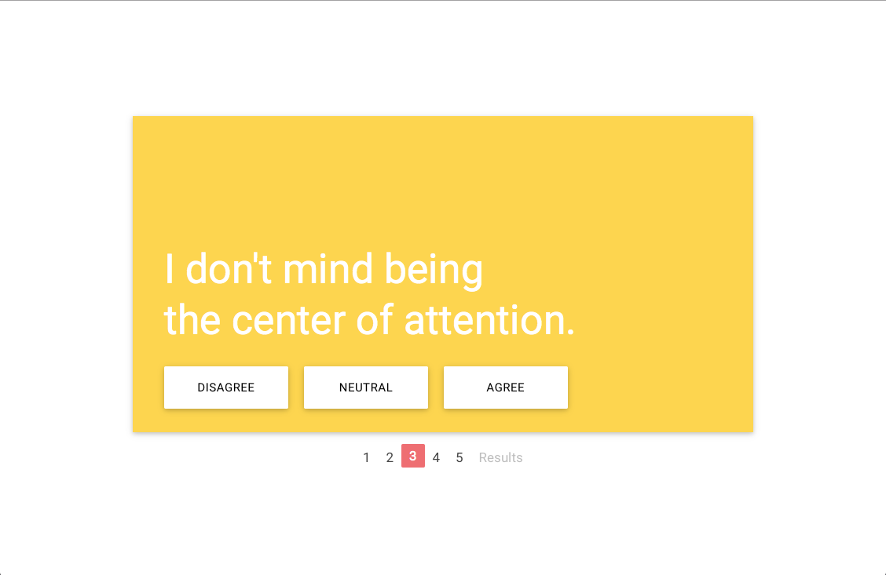

Slide 16


Slide 17


Slide 18


Slide 19
