Slide 1
INGENIERÍA INFORMÁTICA OPERATING SYSTEMS
Introduction and system calls labs.

Slide 2
Goals
Practice with introductory concepts
File system calls programs in C.

Slide 3
1. Statement
What is the difference between a command and a system call?

Slide 4
1. Solution
A command is a program external to the operating system that allows users to interactively dialogue with the system through the shell or command interpreter.
System calls are a set of services that the operating system offers to programs that can be requested when needed. They are called from external programs through system libraries, but the implementation of the system calls is internal to the operating system.
The set of system calls defines the services of the operating system.

Slide 5
2. Statement
How do you request a system call to the operating system?

Slide 6
2. Solution
It is requested through an interrupt mechanism. When requested by a running process, it uses a TRAP instruction that generates an interrupt. As shown in Figure, the TRAP interrupt handling routine uses an internal table of the S.O. to determine which routine to activate depending on which call is requested.
When programmed in a high-level language, the request for services to the operating system is made through a call to a specific function, which is responsible for generating the system call and the corresponding trap.

Slide 7
2. Solution

Slide 8
3. Statement
Give some examples that show the need for the operating system to provide mechanisms for communication and synchronization between processes.

Slide 9
3. Solution
Two processes that write to the same file.
Until one is finished, the other cannot begin: they must do it in an orderly manner. That is, they must communicate with each other so that their writing operations do not overlap.
Two processes that print on the screen.
If they did it at the same time, the information would be mixed. In this way there would be no synchronization between the processes.
Two processes that manage the entry and exit of money from a bank account.
If the process in charge of withdrawing money is running, the process that consults the balance must be synchronized with the first one and wait for it to finish before executing its balance inquiry function.

Slide 10
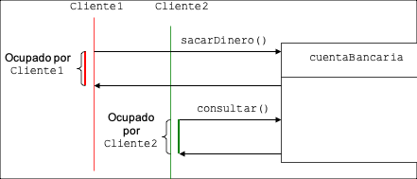
3. Solution

Slide 11
4. Statement
The command interpreter in LINUX in internal or external to the operating system?
Explain you answer.

Slide 12
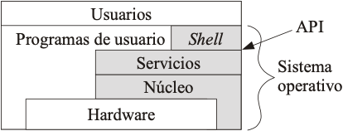
4. Solution
The command interpreter in LINUX is external to the OS. It is call “Shell”
A good example is the case of LINUX, in which you can install as many command interpreters as you want. There are several installed in the system.
Bsh, csh, ksh, …

Slide 13
5. Statement
Write a C program that creates a file, writes something, jumps 100 bytes further from the end of the file, and writes something.
Does it end correctly?

Slide 14
5. Solution
int main(void)
{
int fd;
char buf1[]="abc";
char buf2[]="ABC";
if ( (fd=creat("file_hole",0666))<0)
{
perror("error creating the file");
exit(1);
}
/* write buf1 in the file */
if ( write(fd,buf1,3)< 0) {
perror("write error");
exit(1);
}
/* Jump beyond the end */
if( lseek(fd,100,SEEK_END) < 0) {
perror("seek error");
exit(1);
}

Slide 15
5. Solution
/* write buf2 in the file */
if ( write(fd,buf2,3) <0) {
perror("write error");
exit(1);
}
if (close(fd)<0){
perror("close error");
exit(1);
}
return 0;
}
// See the file with command: “cat file_hole”

Slide 16
6. Statement
Write a C program that receives a directory name and displays the names of files and directories it contains.

Slide 17
6. Solution
#include <stdio.h>
#include <string.h>
#include <time.h>
#include <dirent.h>
#include <fcntl.h>
#include <unistd.h>
#include <sys/stat.h>
#include <sys/types.h>
int main () {
int er;
char nomdir[100], nomfich[100], resp[30];
struct stat atr;
DIR *d;
struct dirent *rd1;
time_t fecha;
printf ("Nombre directorio\n");
fgets (nomdir, sizeof (nomdir), stdin);
/* hay que quitar el \n del nombre del directorio*/
nomdir[strlen(nomdir)-1]='\0’;

Slide 18
6. Solution
if ((d=opendir(nomdir))==NULL) {
printf ("No existe ese directorio \n");
return -1;
}
else {
while (( rd1 =readdir(d)) != NULL) {
if ( (strcmp(rd1->d_name, ".")!=0 )&& (strcmp(rd1->d_name, "..")!=0 )){
strcpy (nomfich, nomdir);
strcat (nomfich, "/");
strcat (nomfich, rd1->d_name);
printf ("fichero :%s:", nomfich);
}
} /* while*/
closedir (d);
}
}/* main*/

Slide 19
7. Statement proposal
With the program from the previous week that created a student file:
Run the program and insert 5 students in the file.
Now, create a program that opens the student file:
Skip to student 3 and display him on the screen.
Insert a student in position 8 of the file, that is, 3 from the end or 8 records from the beginning.
Show student 8 on the screen.

