Slide 1
INGENIERÍA INFORMÁTICA OperaTing Systems
Laboratorio Introducción a Procesos

Slide 2
Goals
Practice with process scheduling concepts

Slide 3
1. Statement
Given the next set of processes:
a) Write a diagram that illustrates the execution of these processes using:
1. FIFO.
2. Scheduling with preemptive (or expulsive) priorities
3. Scheduling with preemptive priorities and with Round Robin (q = 2) for the processes of the same priority.
b) Calculate the waiting time for each scheduling process and algorithm
Process | Arrival | CPU Time | Priority
P1 | 0 | 10 | 3
P2 | 1 | 1 | 1
P3 | 3 | 4 | 3
P4 | 4 | 2 | 4
P5 | 5 | 5 | 2

Slide 4
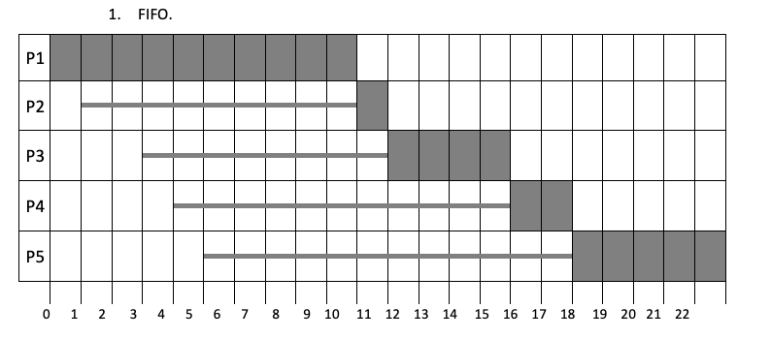
1. Solution. FIFO

Slide 5
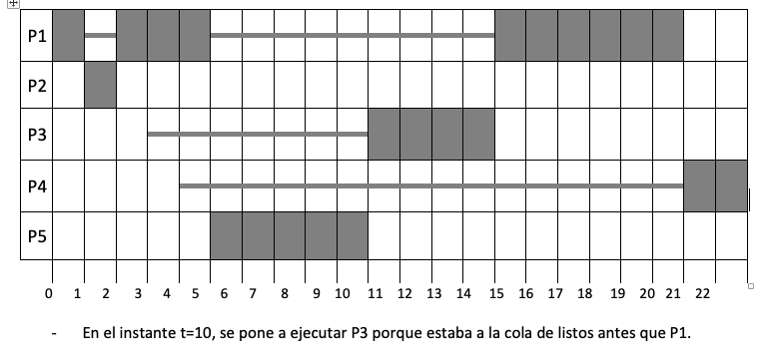
1. Solution. Preemptive

Slide 6
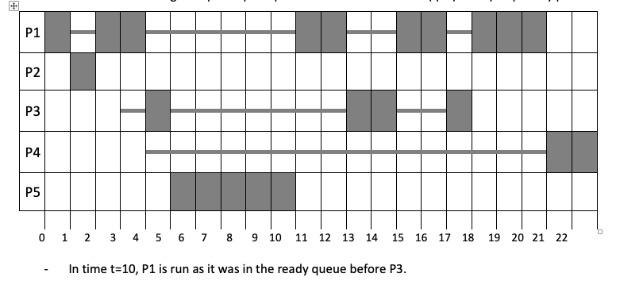
1. Solution. Preemptive and RR(q=2)

Slide 7
1. Solution. Waiting time
 | P1 | P2 | P3 | P4 | P5
Fifo | 0 | 9 | 8 | 11 | 12
Priorities | 10 | 0 | 7 | 16 | 0
Priorities and Round Robin | 10 | 0 | 10 | 16 | 0

Slide 8
2. Statement
Scheduling using priority queues (1 being the highest).
When several processes have the same priority, a round robin scheduling policy is used, with a 100 ms slice.
For the next table of processes:
For scheduling without and with preemption:
1. Make a cronogram of the execution of the processes.
2. Calculate the time that each process is kept on hold from its arrival in the system until it ends.
3. Calculate the return time of each process (time elapsed since the process arrives until the end of its execution).
4. Average waiting time and average return time.
PROCESSES | PRIORITY | ARRIVAL | EXECUTION TIME
P1 | 3 | 0 | 250 CPU + 100 E/S + 200 CPU
P2 | 2 | 200 | 300 CPU
P3 | 1 | 400 | 100 CPU + 250 E/S + 50 CPU
P4 | 1 | 500 | 400 CPU
P5 | 2 | 400 | 100 CPU + 100 E/S + 100 CPU

Slide 9
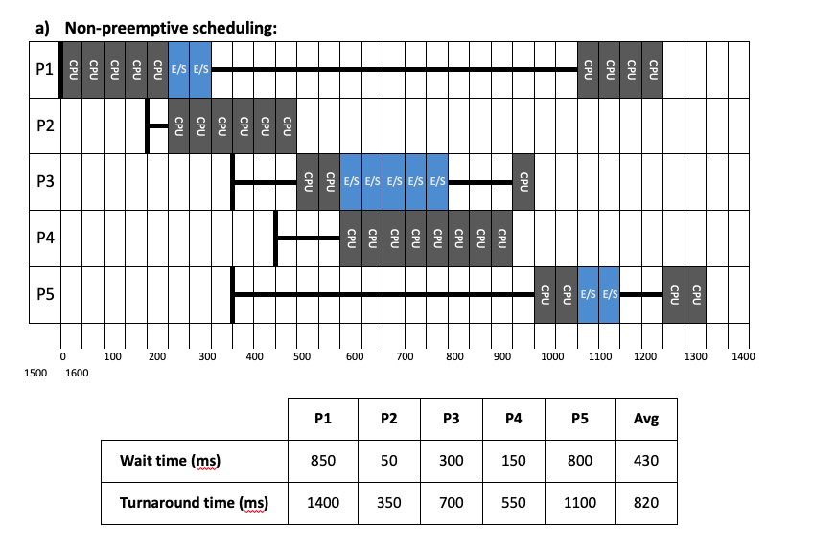
2. Solution. Non preemptive

Slide 10
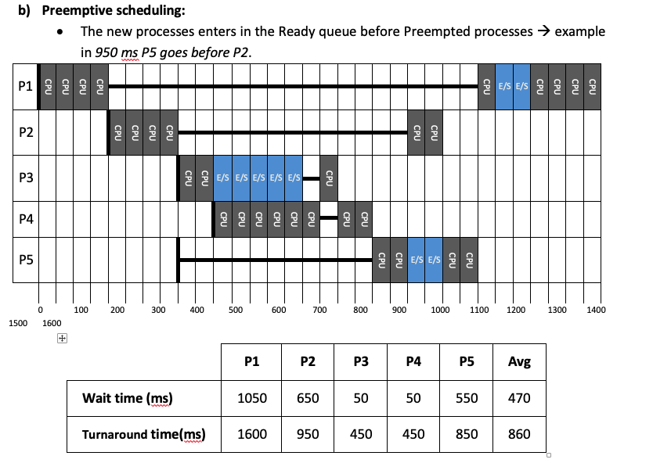
2. Solution. Preemptive

Slide 11
3. Statement proposed
An operating system uses a cyclic (round-robin) scheduler. At a given moment there are no jobs running and you want to run jobs whose arrival times to the system are as follows:
Priorities are inverse of their value. Thus, a process with priority 1 is prioritized over another with priority 2 or 3.
You are asked to fill in the following tables in the following cases:
a) Round-robin scheduling policy with slice of 1
b) Round-robin scheduling policy with slice of 4
c) SJF (Shortest Job First) scheduling Policy (Non-Expulsive)
NOTE: If the execution slice of a process ends at the same instant that a new process arrives on the system, then the new process is placed in the ready-to-run queue before the process that expires the slice.

Slide 12
3. Statement proposed
Draw the cronogram of the following processes.
b) Indicate for each process their time of stay in the system and the penalty time suffered by each one of them.
c) What is the worst treated process?
PROCESSES | ARRIVAL | EXECUTION
P1 | 0 | 1ms CPU + 6ms E/S + 1ms CPU
P2 | 1 | 3 ms CPU
P3 | 3 | 5ms CPU + 3ms E/S + 1ms CPU
P4 | 3 | 3 ms CPU

Slide 13
3. Solution.
A)
B)
c) The worst treated process is process 4 since it takes 10 periods to finish its execution, when it only has 3 execution periods, it suffers 7 penalty periods.
Proces | 1 | 2 | 3 | 4 | 5 | 6 | 7 | 8 | 9 | 10 | 11 | 12 | 13 | 14 | 15 | 16
P1 | CPU | E/S | E/S | E/S | E/S | E/S | E/S | CPU
P2 |  | CPU | CPU |  |  |  |  |  | CPU
P3 |  |  |  | CPU | CPU |  |  |  |  | CPU | CPU | CPU | E/S | E/S | E/S | CPU
P4 |  |  |  |  |  | CPU | CPU |  |  |  |  |  | CPU
Process | Stay | Penalty
P1 | 8 | 0
P2 | 8 | 5
P3 | 13 | 4
P4 | 10 | 7

