Slide 1
INGENIERÍA INFORMÁTICA Operating systems
Laboratory: introduction to memory

Slide 2
Goal
Practice with memory and virtual memory.
Using system calls in C.

Slide 3
1. Statement
We have a virtual memory computer with paging. Virtual addresses are 32 bits and pages are 4 Kbytes. The physical memory of the computer is 16 Mbytes (each position is 1 byte).
How many page frames is physical memory divided into?
How many bits of the virtual address are used to identify the page?
How many bits are needed to address a page frame?
Suppose we have a single-level page table: How many entries does the page table have?

Slide 4

1. Solution. (Exercise 1 notebook)
a) If the page size is 4K, the frame size is too. If there is 16M of physical memory:
b) If a page is 4K, 12 bits are required as an offset (or offset) in the virtual address (since 212 = 4096). Therefore, the bits of the virtual address that are used to identify the page are 32 - 12 = 20 bits.
c) To address a frame, at least 12 bits are needed, considering the installed memory (4096 frames). (since 212 = 4096).
d) With a one-level TP, the number of entries is the number of virtual memory pages: 220 = 1M entries.

Slide 5
2. Statement
A system manages its memory by the method of variable partitions. Assuming that the Partition Description Table (PDT), at a given time, has the following content:
Assuming that the system has 170K of total memory, indicate where a 13K P1 program would be located and then another 5K P2 program using the three possible strategies separately: First-fit, Best-fit, Worst-fit.
PARTITONS | BASE | SIZE | STATUS
0 | 0 | 40 K | ALLOCATED
1 | 56 | 30 K | ALLOCATED
2 | 100 | 12 K | ALLOCATED
3 | 117 | 30 K | ALLOCATED

Slide 6
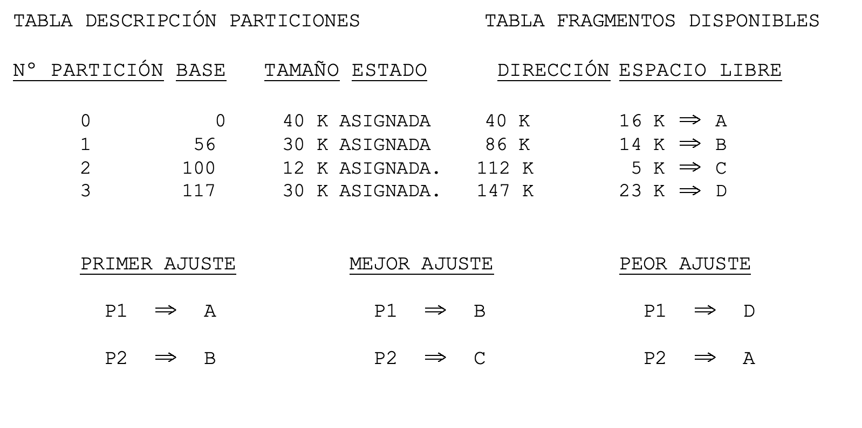
2. Solution. (Exercise 6 notebook)

Slide 7
3. Statement
In an operating system, the memory manager must allow it to be possible to run concurrently 5 processes shown below. For this we have a disk space of 131,072 bytes (128K) and a physical memory of 32768 bytes (32K). We know that our processes when executed have the following parameters:
The data indicates the size in bytes of each of the segments that are part of the process image. Knowing that a page cannot contain parts of two different segments (stack, code or data), we have to determine the page size that our system should use.
proceso | código | pila | datos
A | 4096 | 2000 | 2048
B | 16384 | 8200 | 8192
C | 2048 | 1000 | 1024
D | 16384 | 8200 | 8192
E | 16384 | 8200 | 8192

Slide 8
3. Statement
We have 2 options: 4096 bytes (4K) or 512 bytes (1/2K).
What would be the most appropriate option, 4096 bytes or 512 bytes? Justify your answer.
What is the format of each Page Table entry with the chosen page size? Justify the size of the fields with addresses. How many entries are in the page table (rows)? You can add the bits that you consider necessary for the proper functioning of the system, indicating what they are going to be used for.
How many Page Tables will there be in this system?

Slide 9
3. Solution. (Exercise 10 notebook)
NP = number of pages I need
A) With pages of 4096 bytes we need to be able to execute the 5 processes load in memory:
1 + 4 + 1 + 4 + 4 + 1 + 3 + 1 + 3 + 3 + 1 + 2 + 1 + 2 + 2 = 33 pages
Since the system has an address space of 131072, the number of possible pages would be: 131072/4096 = 217/212 = 25 = 32 pages.
To be able to execute the processes we need 33 pages at least, and we only have capacity for 32.
B) With 512-byte pages we need to be able to execute the 5 processes load in memory:
8 + 32 + 4 + 32 + 32 + 4 + 17 + 2 + 17 + 17 + 4 + 16 + 2 + 16 + 16 = 219 pages
Since the system has an address space of 131072, the number of possible pages would be: 131 072/512 = 217/29 = 28 = 256 pages.
To be able to execute the processes we need 219 pages at least, and we have 256 then if it is possible to execute these processes. We will therefore choose 512-byte pages.
proceso | código | pila | datos
A | 4096 | 2000 | 2048
B | 16384 | 8200 | 8192
C | 2048 | 1000 | 1024
D | 16384 | 8200 | 8192
E | 16384 | 8200 | 8192

Slide 10
3. Solution. (Exercise 10 notebook memoria)
B). El número de marcos de que disponemos en el sistema es:
32768 / 512 = 2¹⁵ / 2⁹ = 2⁶ necesitamos 6 bits para hacer referencia al marco de página.
Cada proceso tiene su propia tabla de páginas, luego el número de entradas en la tabla de páginas dependerá de cual de los procesos (A, B, C, D o E) sea al que nos referimos. Para el proceso A, necesitaremos 16 entradas, tantas como páginas forman parte del proceso.
C) Serían al menos 5 tablas de página, una para cada proceso.
marco de página | P/A | R | M | RO | ...
6 bits | 1 bit | 1 bit | 1 bit | 1 bit | 1 bit

Slide 11
4. Statement
Consider a virtual memory system where the processor has a 15% utilization rate and the paging device is busy 97% of the time:
What do these measurements indicate?
What if with the same percentage of processor use the percentage of use of the paging device was 15%?

Slide 12
4. Solution. (Exercise 4.4 OS problems)
A low processor utilization rate and a very high paging device utilization rate indicates that the system is in a thrashing state. In this state, processes spend most of their time blocked waiting for a page fault to be served from the paging device, which is saturated with requests. This is because there is a very high degree of multiprogramming that prevents the processes from having their working set resident. The Solution consists of reducing the degree of multiprogramming by suspending one or more processes.
In the event that both the paging device and the processor have a low usage rate, this indicates that there is little work on the system. More processes and users could be served to better utilize the capabilities of the equipment.

Slide 13
5. Statement
Given a virtual memory system, it is intended to analyze which read and write operations on the disk requires the treatment of a page fault.
Propose an example of a failure that does not generate operations on the disk, another that requires only 1 read, another that involves only 1 write, and a last that requires 1 read and 1 write.

Slide 14
5. Solution. (Exercise 4.41 OS problems)
Before considering the various examples, it is convenient to highlight that, for a page fault to generate a write operation, the fault handling routine must encounter a situation in which to bring up the page that caused the fault it is necessary to eject a modified page.
Below are the examples that correspond to the different situations raised in the Statement.
No operations. There is a page fault that corresponds to the first access to a certain page from an unsupported region (such as the data region with no initial value) and either there are free frames, or the page chosen for replacement is not modified. There is no reading as it is only necessary to fill the chosen frame with zeros.

Slide 15
5. Solution. (Exercise 4.41 libro problemas)
Only 1 reading. There is a page fault that corresponds to a page to be read from disk, either because it belongs to a supported region (such as the initial value data region) or because it is in swap, and either there are free frames , or the page chosen for replacement is not modified.
Only 1 writing. There is a page fault that corresponds to the first access to a certain page in an unsupported region (such as the data region with no initial value), but there are no free frames and the page selected for replacement is modified. There is only one write to disk of the content of the ejected page.
1 read and 1 write. There is a page fault that corresponds to a page to be read from disk, either because it belongs to a supported region (such as the initial value data region) or because it is in swap, but there are no free frames and the page selected for replacement is modified.

Slide 16
6. Statement proposed (4.54 OS problems)
Be an opderating system with virtual memory and paging on demand, using 32-bit addresses and 1 KB pages. On this system you want to run the following program :
El código del mencionado programa ocupa 21 KB y se utilizan bibliotecas estáticas, ocupando el código de todas las funciones de biblioteca 1 página. Además el tamaño de la pila nunca excede de 1 página. Conteste razonadamente a las siguientes cuestiones:
a) Indique las distintas regiones que configuran la imagen de memoria del proceso así como su tamaño en los siguientes puntos: justo antes de ejecutar la función main, A, B, C, D, E y F.
char vector [15000];
int a = 5; int b = 15; int c = 23;
int x; char d;
main (void)
{
int pid, j, fd;
char *w, *y, *k;
x = a;
A
w = (char *)malloc (18000);
B
pid = fork();
C
if (pid == 0) {
for (j = 0; j < 15000; j ++)
vector[j] = ‘a’;
}
else {
fd = open(”datos.txt”, O_WRONLY);
y = (char *)mmap(0, 15000, PROT_WRITE, MAP_SHARED, fd, 0);
k = y;
D
for (j = 0; j < 15000; j ++){
*k = vector[j];
k++;
}
munmap(y);
}
E
free(w);
F
exit (0);
}

Slide 17
6. Statement proposed
The code of the mentioned program occupies 21 KB and static libraries are used, the code of all the library functions occupying 1 page. Also the stack size never exceeds 1 page.
Answer the following question reasonably: Indicate the different regions that configure the memory image of the process as well as their size in the following points: just before executing the main function, A, B, C, D, E and F.

