Slide 1
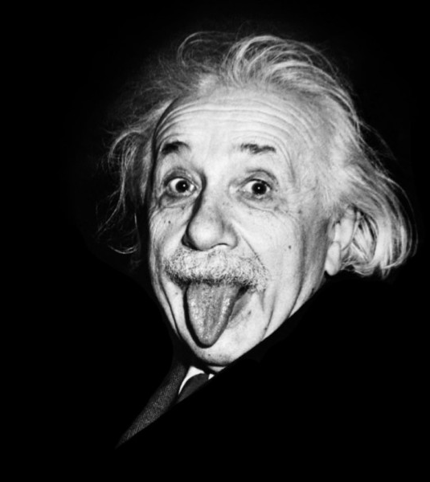
GENERAL RELATIVITY ​
by​
ALBERT EINSTEIN
Why did I need this ?
What is general relativity ?
Experiments
https://www.linkedin.com/pulse/think-like-einstein-paradox-mindset-enza-artino

Slide 2
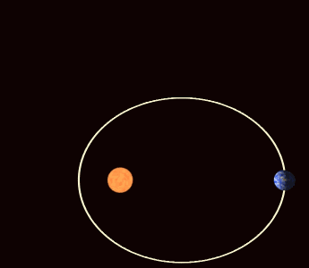
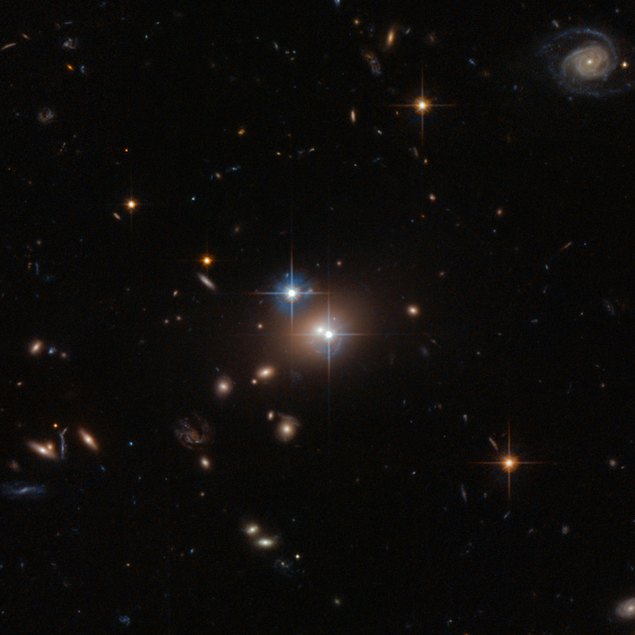
Mercury's orbit deviation
Twin quasar
https://medium.com/@GatotSoedarto/what-causes-mercurys-orbit-is-the-most-eccentric-67bcc1d7e6c
https://www.galactic-hunter.com/post/twin-quasar

Slide 3
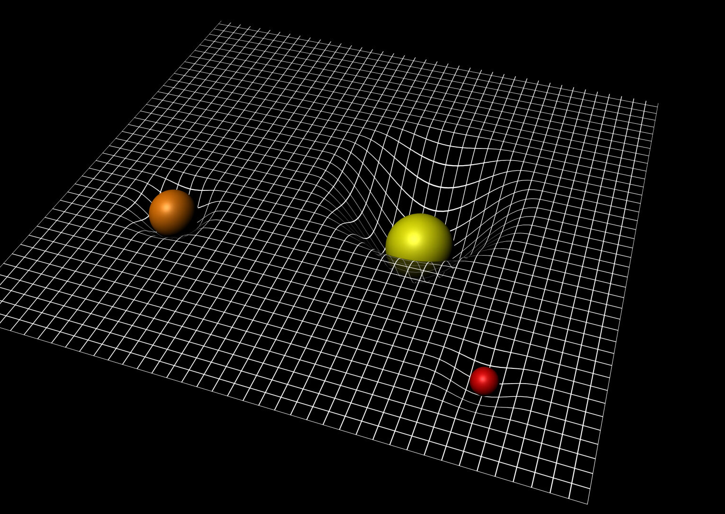
What is General Relativity ?
https://www.esa.int/ESA_Multimedia/Images/2015/09/Spacetime_curvature
A theory which would unify space and time...

Slide 4
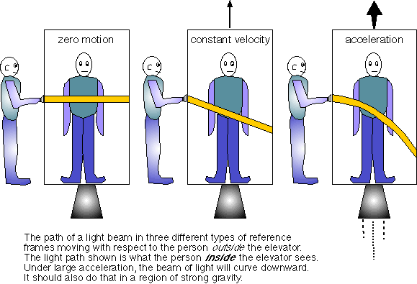
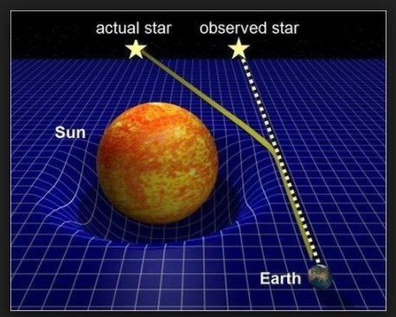
gravity and acceleration are the same thing so, gravity should bend the light.
https://subratachak.wordpress.com/2017/12/22/newtonian-gravity-vs-general-relativity/
https://physics.stackexchange.com/questions/122003/light-and-gravity-bending-of-light-around-a-massive-body

Slide 5
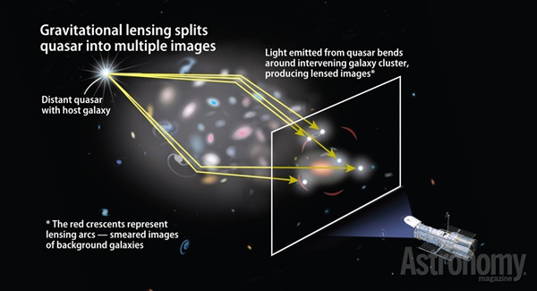
Twin quasar
A twin quasar is a single quasar...
https://astronomy.com/magazine/weirdest-objects/2015/03/40-double-quasar-0957561
is a result of the bending of space-time by the nearby galaxy, as defined by general relativity.

Slide 6
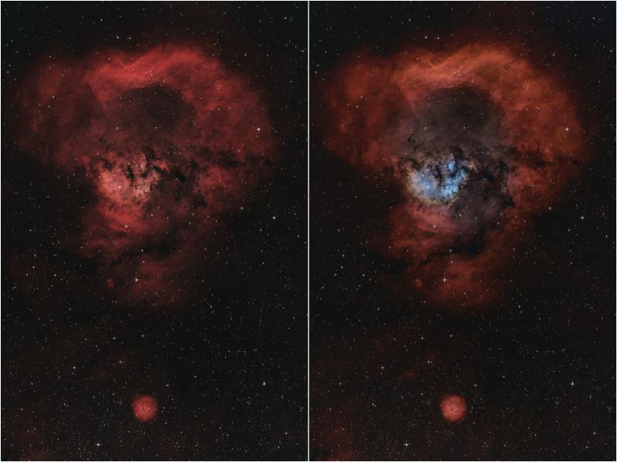
QUESTIONS?
https://www.cloudynights.com/topic/842734-ngc-7822-revisited-the-question-mark-nebula/

Slide 7
TAHNK YOU
REFERANCES
https://openai.com/blog/chatgpt/
https://en.wikipedia.org/wiki/Twin_Quasar#:~:text=The%20Twin%20Quasar%20is%20a,as%20described%20by%20general%20relativity.
ww.youtube.com/watch?v=PKTMprTMYww&list=PLdbeYAM5mGiQ2Uyw7YmK2RPJ5awksXtQF&index=4
https://www.youtube.com/playlist?list=PLdbeYAM5mGiQ2Uyw7YmK2RPJ5awksXtQF
https://www.youtube.com/watch?v=UVs8p1u7BkA

